Slide 1
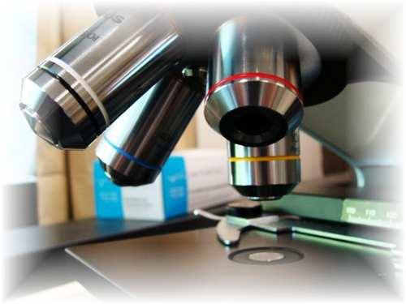
About Science Prof Online
PowerPoint Resources
Science Prof Online (SPO) is a free science education website that provides fully-developed Virtual Science Classrooms, science-related PowerPoints, articles and images. The site is designed to be a helpful resource for students, educators, and anyone interested in learning about science.
The SPO Virtual Classrooms offer many educational resources, including practice test questions, review questions, lecture PowerPoints, video tutorials, sample assignments and course syllabi. New materials are continually being developed, so check back frequently, or follow us on Facebook (Science Prof Online) or Twitter (ScienceProfSPO) for updates.
Many SPO PowerPoints are available in a variety of formats, such as fully editable PowerPoint files, as well as uneditable versions in smaller file sizes, such as PowerPoint Shows and Portable Document Format (.pdf), for ease of printing.
Images used on this resource, and on the SPO website are, wherever possible, credited and linked to their source. Any words underlined and appearing in blue are links that can be clicked on for more information. PowerPoints must be viewed in slide show mode to use the hyperlinks directly.
Several helpful links to fun and interactive learning tools are included throughout the PPT and on the Smart Links slide, near the end of each presentation. You must be in slide show mode to utilize hyperlinks and animations.
This digital resource is licensed under Creative Commons Attribution-ShareAlike 3.0:
http://creativecommons.org/licenses/by-sa/3.0/
Alicia Cepaitis, MS
Chief Creative Nerd
Science Prof Online
Online Education Resources, LLC
alicia@scienceprofonline.com
Tami Port, MS
Creator of Science Prof Online
Chief Executive Nerd
Science Prof Online
Online Education Resources, LLC
info@scienceprofonline.com
From the Virtual Cell Biology Classroom on ScienceProfOnline.com
Image: Compound microscope objectives, T. Port
Notes:
Welcome to Science Prof Online PowerPoint Resources!
This PowerPoint Presentation comes from the Virtual Cell Biology Classroom of Science Prof Online, and, as such, is licensed under Creative Commons Attribution-ShareAlike 3.0.; meaning you can download, share and alter any of this presentation, but you can’t sell it or repackage and sell any part of it. Please credit Science Prof Online as the source of this presentation. Please abide by credited image copyrights. Thank you for using this resource.

Slide 2
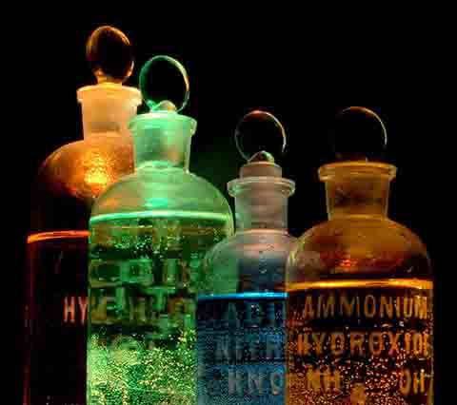
Inorganic Chemistry
For additional resources on this lecture topic, see the Inorganic Chemistry Main Page on SPO.
Image: Chemicals in Flasks, J. Sullivan, Wiki

Slide 3
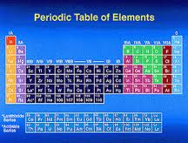
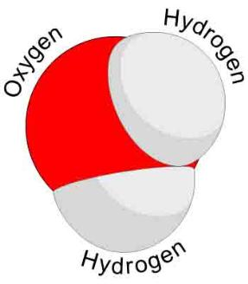
Elements, Atoms, Molecules & Compounds
Elements → Substances that can’t be broken
down any further.
Atom → The smallest unit of an element.
Two or more atoms joined together chemically:
Molecule
Molecule containing at least two different elements:
Compound
Examples of molecules: Carbon dioxide (CO₂) and methane (CH₄) , molecular hydrogen (H₂), molecular oxygen (O₂) and molecular nitrogen (N₂).
Examples of compounds: Only molecules containing two or more elements, such as carbon dioxide (CO₂) and methane (CH₄).
Q: Explain why all compounds are molecules but not all molecules are compounds.
Image: Periodic Table of Elements, NASA; Water Molecule, Wiki
From the Virtual Cell Biology Classroom on ScienceProfOnline.com

Slide 4
Chemical Shorthand
Chemical Symbol
Begins with one or two letters based on
elements name.
Q: What if there is more than one element that
starts with the same letter?
Example: Carbon (C), Calcium (Ca), Chlorine (Cl)
Chemical Formula
“Shorthand” for a compound.
Contains chemical symbols of the elements that make up the molecule.
Numerical subscripts represent number of atoms of each element in molecule.
Example: H₂0 = water; has two hydrogen atoms and one oxygen.
More than one molecule of same type…the group of letters is preceded by number.
Example 2H₂0 = two water molecules.
Follow this link to see Daniel Radcliff (Harry Potter) sing “The Element Song”.
Image: Periodic Table of Elements, NASA
From the Virtual Cell Biology Classroom on ScienceProfOnline.com

Slide 5
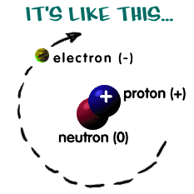
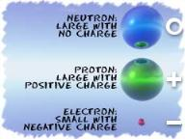

The Structure of an Atom
Here are some examples:
Atoms are the basis for everything in the universe.
Q: What are the three basic parts of an atom?
• ? = "-" negative charge
• ? = "+" positive charge
• ? = neutral (a charge of zero)
The thing that makes each element unique is the number of protons, since the number of neutrons and electrons can vary.
Protons and neutrons always in the center of atom (the nucleus).
Electrons are found whizzing around nucleus in areas called electron shells.
Q: If there is an equal number of electrons and protons in an atom, what is it’s charge?
NERDY SCIENCE JOKE: A neutron walks into a bar and asks “How much for a drink?”
Q: What does the bartender tell him?
Images: Structure of Atom, Chem4Kids Website; Carbon, Universe Today Website
From the Virtual Cell Biology Classroom on ScienceProfOnline.com

Slide 6
Chemical Bonding and Electron Valences
The electrons of an atom can be located in different shells, which are at different energy levels.
Electrons in the highest energy level are called valence electrons.
Number of valence electrons governs an atom’s bonding behavior.
Q: What is the max number of valence electrons for a full valence shell?
Atoms are much more stable, or less reactive, with a full valence shell.
By moving electrons, the two atoms become linked. This is known as chemical bonding.
This stability can be achieved one of two ways:
- Ionic bond
- Covalent bond
Images: Carbon, Universe Today Website
From the Virtual Cell Biology Classroom on ScienceProfOnline.com
Notes:
A: 8

Slide 7
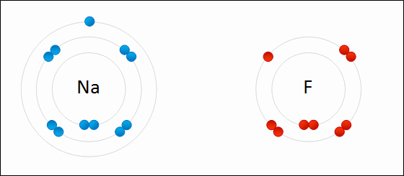
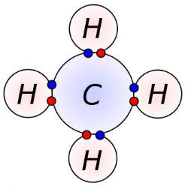
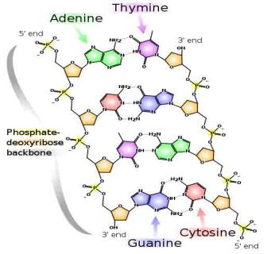
Three Main Types of Chemical Bonds:
1. Ionic
2. Covalent
3. Hydrogen
Image: Formation of ionic sodium fluoride, Wdcf; Methane Covalent Bonds, Dynablast, Wiki; DNA Chemical Structure, Madprime, Wiki
From the Virtual Cell Biology Classroom on ScienceProfOnline.com

Slide 8
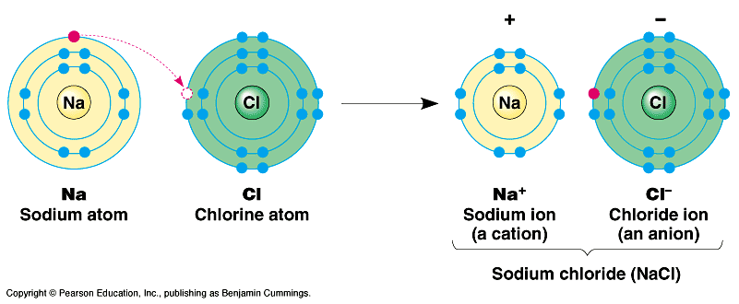
Ionic Bonds
Involves transfer of electrons between two atoms.
Found mainly … inorganic compounds.
Ion = an atom or group of atoms which have lost or gained one or more electrons, making them negatively or positively charged.
Q: What are positively charged ions (+) called?
Q: What are negatively charged ions (-) called?
Images: Sodium Chloride, University of Winnepeg
From the Virtual Cell Biology Classroom on ScienceProfOnline.com

Slide 9
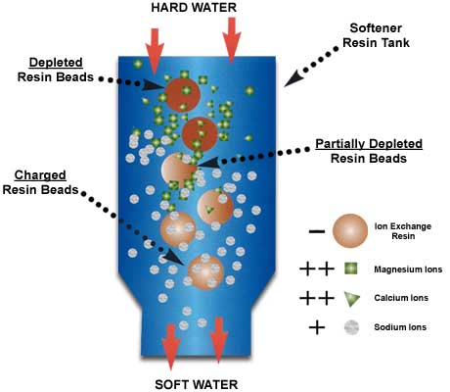
Reactions Involving Ions
Remember… ion = an atom which has lost or gained one or more electrons, so it’s negatively or positively charged.
The Principle of
ion exchange
is a common water softening method.
From the Virtual Cell Biology Classroom on ScienceProfOnline.com

Slide 10




Lets use a Branganalogy to help us Understand the Concept of Ion Exchange…
From the Virtual Cell Biology Classroom on ScienceProfOnline.com
1. Brad Pitt is a negatively charged resin bead
2. Jennifer Anniston is a positively charged Sodium Ion
3. Angelina Jolie is a positively charged Calcium Ion
-
-
Na+
Now lets say that ‘positiveness’ equates with ‘drop-dead gorgeousness’
-
-
-
Ca++
-
-
Na+
-
Ca++
-
-
-
-
-
Negatively charged Brad is attracted to reasonably positive Jennifer.
-
Na+
-
Negatively charged Brad lets go of reasonably positive Jennifer in the presence of insanely positive Angelina.
-

Slide 11
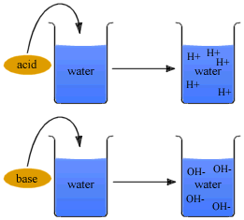
Ions: Acids & Bases
An acid is any ionic compound that releases hydrogen _____ (H⁺) in solution.
A base is any ionic compound that releases hydroxide _____ (⁻OH) in solution.
From the Virtual Cell Biology Classroom on ScienceProfOnline.com
Notes:
cations
anions

Slide 12
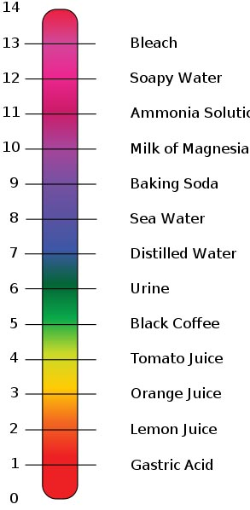
Measurements of Acidity & Alkalinity (pH)
Acidity of a solution > measured by concentration of hydrogen ions (H+).
pH ranges: 0 (very acidic) to 14 (very basic).
Change in just one unit of scale = tenfold change in H+ concentration.
If concentration of H+ = OH - … neutral.
Images: pH scale, Edward Stevens, Wiki
From the Virtual Cell Biology Classroom on ScienceProfOnline.com

Slide 13
Ions & Acids
An acid is any ionic compound that releases hydrogen ions (H+) in solution.
Weak acids have a sour taste.
Strong acids are highly corrosive (So don’t go around taste-testing acids.)
Examples:
Ascorbic acid (C₆H₈O₆, Vitamin C)
Citric acid (C₆H₈O₇, a weak organic acid in citrus fruits)
Phosphoric acid (H₃PO₄, in pop…this stuff is also used to remove rust…hmmm)
Images: pH scale, Edward Stevens, Wiki
From the Virtual Cell Biology Classroom on ScienceProfOnline.com

Slide 14
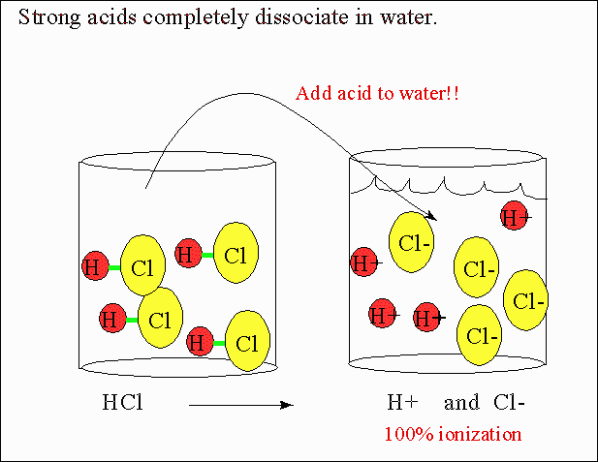
Images: Strong Acids, Department of Chemistry, CSU
From the Virtual Cell Biology Classroom on ScienceProfOnline.com

Slide 15
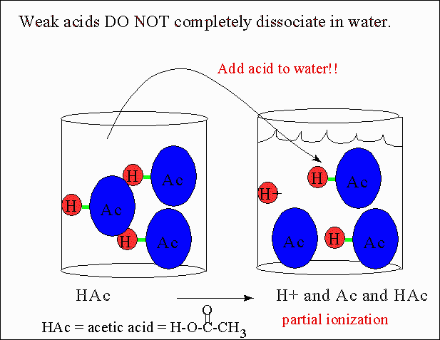
From the Virtual Cell Biology Classroom on ScienceProfOnline.com

Slide 16
Ions & Bases
A base is an ionic compound that releases hydroxyl ions (OH-) in solution.
Bases are also called alkaline substances.
Some general properties of bases include:
Taste: Bitter taste (opposed to sour taste of acids and sweetness of aldehydes and ketones).
Touch: Slimy or soapy feel on fingers.
Reactivity: Strong bases are caustic on organic matter, react violently with acidic substances.
Examples:
Sodium hydroxide, NaOH, of lye or caustic soda used in oven cleaners.
Magnesium hydroxide, Mg(OH)², also known as milk of magnesia, a weak base used in antacids and laxatives.
Images: pH scale, Edward Stevens, Wiki
From the Virtual Cell Biology Classroom on ScienceProfOnline.com

Slide 17
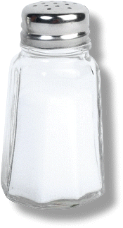
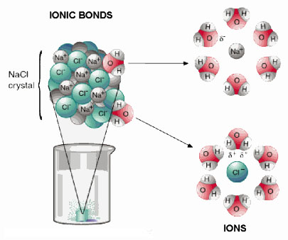
Ions & Salts
Compounds that dissociate in water and produce cations other than H+ and anions other than OH- are called salts.
The most familiar salt is sodium chloride, the principal component of common table salt.
Other examples of salts:
Baking soda (NaHCO3)
Epsom Salts (MgSO4)
From the Virtual Cell Biology Classroom on ScienceProfOnline.com

Slide 18
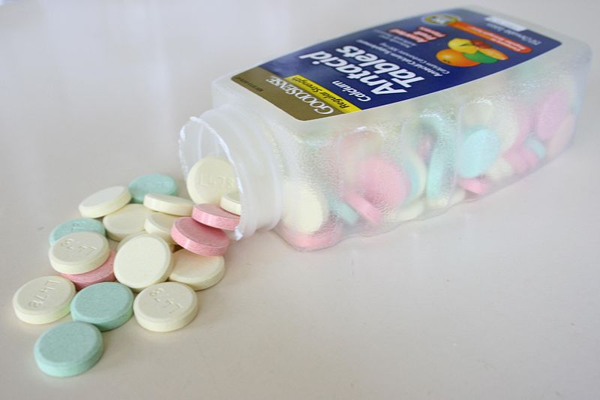
Salts: The Role of Buffers
Certain salts, called
buffers, can
combine with excess
hydrogen (H+) or
hydroxide (OH-) ions.
Produce substances less acidic or alkaline.
Example:
Antacids are buffers made of the salt calcium carbonate (CaCo3).
Images: Antacid Tablets, Wiki
From the Virtual Cell Biology Classroom on ScienceProfOnline.com

Slide 19
REVIEW!
Interactive animated lessons on
pH: Acids & Bases
and
Buffers
Image: Methane Covalent Bonds, Dynablast; Formation of ionic sodium fluoride,
From the Virtual Cell Biology Classroom on ScienceProfOnline.com

Slide 20
Three Main Types of Chemical Bonds:
1. Ionic
2. Covalent
3. Hydrogen
Image: Formation of ionic sodium fluoride, Wdcf; Methane Covalent Bonds, Dynablast, Wiki; DNA Chemical Structure, Madprime, Wiki
From the Virtual Cell Biology Classroom on ScienceProfOnline.com

Slide 21
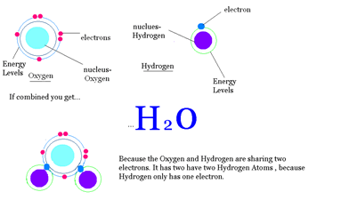
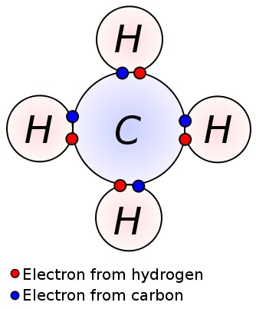
Covalent Bonds
Involves the sharing of a pair of electrons between atoms.
One covalent bond = 1 pair of shared electrons
Covalent Compounds can make single (2 electrons), double (4 electrons) or even triple bonds
(6 electrons) depending on the number of electrons they share.
Found mainly … organic compounds
Image: Methane Covalent Bonds, Dynablast, Wiki
From the Virtual Cell Biology Classroom on ScienceProfOnline.com

Slide 22
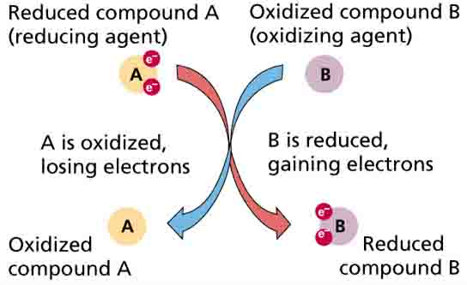
Oxidation - Reduction Reaction
Or Redox reaction = chemical reactions in which electrons are gained, lost (Q: What kind of bond?) or shared (Q: What kind of bond?) in a chemical reaction.
• oxidation: loss of electrons by a molecule, atom or ion.
• reduction: gain of electrons by a molecule, atom or ion.
From the Virtual Cell Biology Classroom on ScienceProfOnline.com

Slide 23
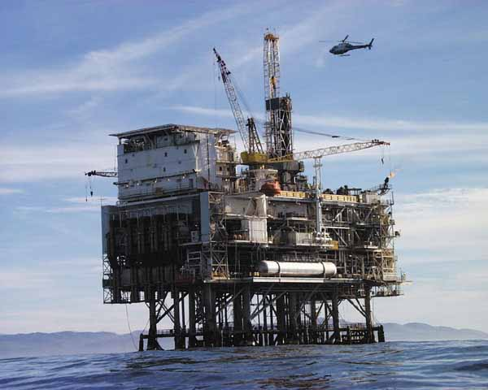
Oil Rig
Image: Oil Rig Platform, Nasa
From the Virtual Cell Biology Classroom on ScienceProfOnline.com
Notes:
Oxidation Is Loss = OIL
Reduction Is Gain = RIG

Slide 24
Three Main Types of Chemical Bonds:
1. Ionic
2. Covalent
3. Hydrogen
Image: Formation of ionic sodium fluoride, Wdcf; Methane Covalent Bonds, Dynablast, Wiki; DNA Chemical Structure, Madprime, Wiki
From the Virtual Cell Biology Classroom on ScienceProfOnline.com

Slide 25
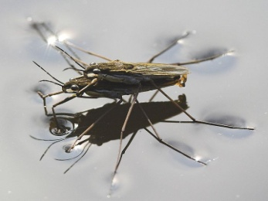
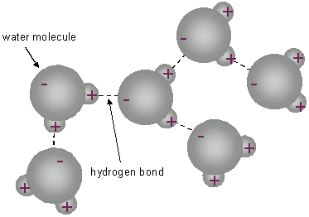
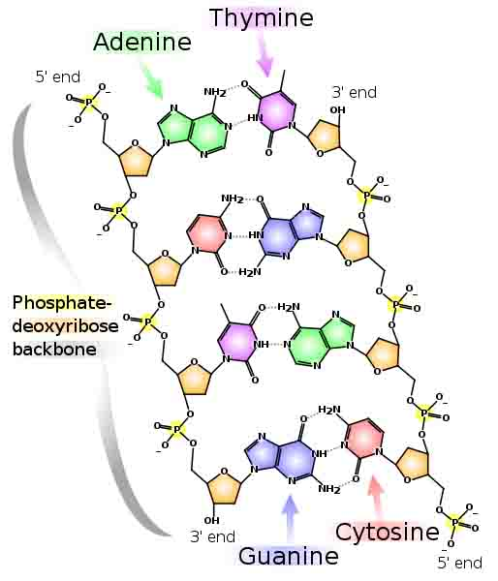
Hydrogen Bonds
Hydrogen Bonds: When an atom of hydrogen is attracted to another electronegative
atom in addition to the one it is covalently bonded to.
In some covalent bonds electrons are shared unequally by the hydrogen and the atom that the hydrogen is bound to. When the electrons in a covalent bond are not equally shared, the molecule is polar.
See the polar, covalent bonds of each individual water molecule below.
See the hydrogen bond attractions between the hydrogens and the oxygens of nearby, but separate water molecule below.
Found in water, proteins & DNA
Image: DNA Chemical Structure, Madprime, Wiki; Water Striders, Markus Gayda, Wiki
From the Virtual Cell Biology Classroom on ScienceProfOnline.com

Slide 26
REVIEW!
Animated lessons on
Chemical Bonding
Image: Methane Covalent Bonds, Dynablast; Formation of ionic sodium fluoride,
From the Virtual Cell Biology Classroom on ScienceProfOnline.com

Slide 27
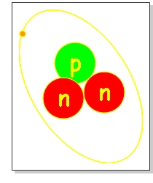
What Is an Isotope?
Normal Atoms
Except for hydrogen (1 proton / no neutrons), every atomic nucleus in normal matter is made of both protons and neutrons.
Typically, the number of protons and neutrons is the same.
Protons in the nucleus are positively charged, and repel each other.
Neutrons are neutral. They separate the protons slightly, making the atom stable.
Isotopes
An isotope is a variant of an element, with a different # of neutrons than is typical.
This makes a nucleus unstable.
Image: Isotope, GRAC
From the Virtual Cell Biology Classroom on ScienceProfOnline.com
Notes:
Neutrons

Slide 28
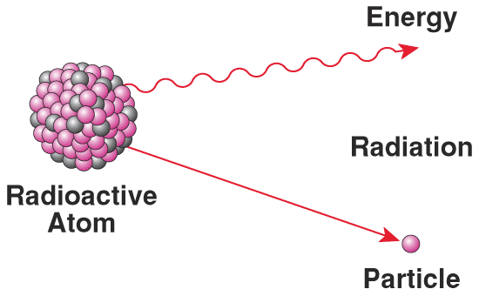
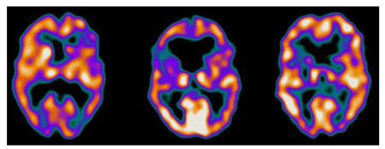
Isotopes & Radioactivity
• Isotope is radioactive if nucleus is unstable.
Most isotopes disintegrate spontaneously with the release
of energy by processes of nuclear or radioactive decay.
When the nucleus changes in structure, energy and/or subatomic particles are given off.
Other than radioactivity, isotopes behaves similarly to the natural variant.
• When controlled, radioactive isotopes can be valuable medical tools. (Ex. Gamma camera can produce images of soft tissue when radiopharmaceuticals are injected into or ingested by patient.)
Schizophrenic female
Female with depression
Healthy female
From the Virtual Cell Biology Classroom on ScienceProfOnline.com

Slide 29
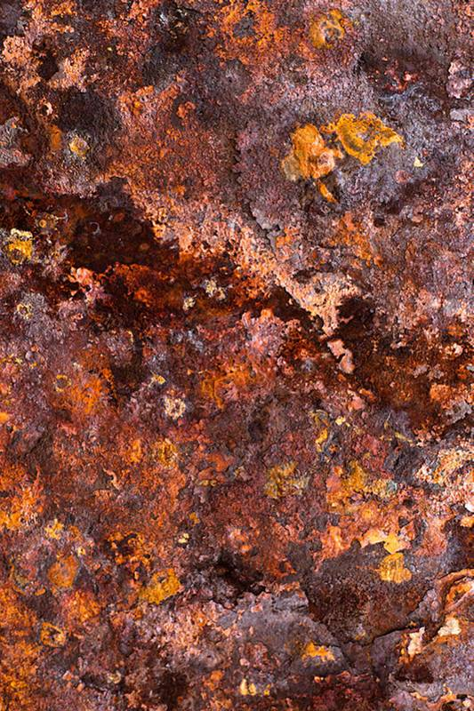

Synthesis, Decomposition & Exchange Reactions
Synthesis Reaction (a.k.a. Combination or Anabolic Reaction)
When two or more substances combine to form a single compound.
Requires energy in order to take place
The general form of a direct combination reaction is:
A + B → AB where A and B are elements or compounds, and AB is a compound consisting of A and B.
Examples of combination reactions include:
2Na + Cl₂ → 2 NaCl (formation of table salt)
4 Fe + 3 O₂ → 2 Fe₂O₃ (iron rusting)
Decomposition Reaction (a.k.a. Catabolic Reaction)
The opposite of a composition reaction. A compound is broken down.
The generalized reaction formula for chemical decomposition is:
AB → A + B
Exchange Reaction (a.k.a. Transfer or Replacement Reaction)
Atoms are moved from one molecule to another.
A + BC → AB + C
Images: Animation decomposition reaction, Armando-Martin; Rust, Later Keiwos
From the Virtual Cell Biology Classroom on ScienceProfOnline.com
Notes:
Synthesis
Decomposition
Exchange

Slide 30
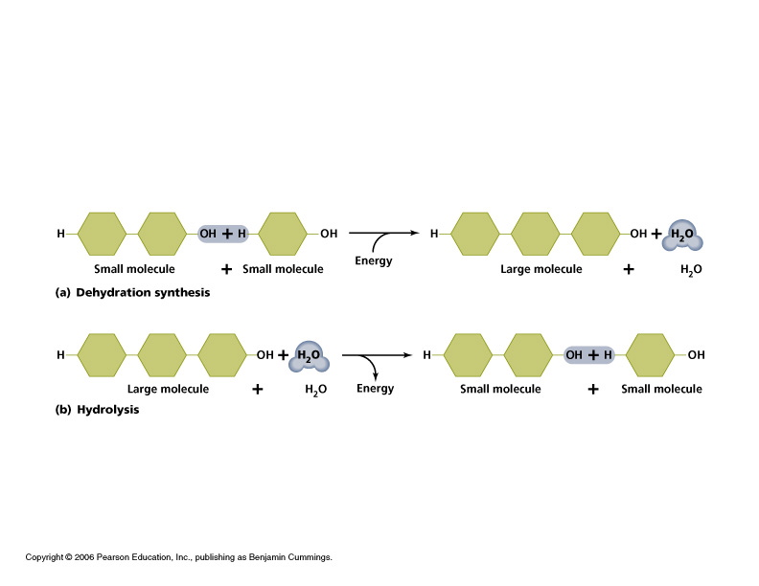
Q: Based on the reaction types we just discussed, how would you categorize the reactions below?
What type is the top reaction?
What type is the bottom reaction?
From the Virtual Cell Biology Classroom on ScienceProfOnline.com
Notes:
Dehydration Synthesis
Hydrolysis Decomposition

Slide 31

Mixtures,
Compounds
&
Solutions
From the Virtual Cell Biology Classroom on ScienceProfOnline.com

Slide 32

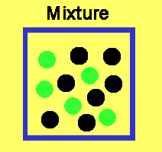

Mixtures & Compounds
mixture = Physical combination of two or more pure substances.
compound = Chemical combination of two or more pure substances in a fixed, definite proportion.
Example:
Mixture - Iron & Sulfur
Iron filings may be mixed with powdered sulfur in any proportion.
The two components are easily separated by means of a magnet,
The magnet will draw out the iron from the mixture.
The components of a mixture usually can be separated by physical means such as distillation, evaporation, etc.
Compound – Iron sulfide (Pyrite or Fools Gold)
However, if:
a. seven parts iron filings or powder are mixed with four parts powdered sulfur
mixture is heated to a red glow
iron and sulfur form a compound - iron sulfide; chemically combined, not readily separated.
Watch Video:
Mixture vs Compound
From the Virtual Cell Biology Classroom on ScienceProfOnline.com
Notes:
Mixture
Compound

Slide 33

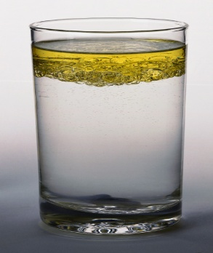
Solutions
Solutions are mixtures in which one substance is dissolved in another.
Solutions have two parts: solute and solvent
Q: Which is the substance that is dissolved?
So the substance that does the dissolving is called the ?.
(Remember water, the ‘universal solvent’?)
Solubility: A measure of how much of a given substance will dissolve in a liquid.
A substance that does not dissolve in water is insoluble.
Example: Oil is insoluble in water.
A substance that does dissolve in water is called soluble.
Example: Sugar is soluble in water.
From the Virtual Cell Biology Classroom on ScienceProfOnline.com
Notes:
A: solute
A: solvent

Slide 34

Confused?
Here are some links to fun resources that further explain Chemistry:
Inorganic Chemistry Main Page on the Virtual Cell Biology Classroom of Science Prof Online.
“What Kind of Bonds Are These?” song and slide show by Mark Rosengarten.
Chemical Bond Formation animated science tutorial.
“Meet the Elements” music video by They Might Be Giants.
Redox Reactions video lecture by Kahnacademy.
Chem4Kids website by Rader.
Neutron Dance …a so-bad-its-good ’80s music video by The Pointer Sisters
Acids & Bases Are Everywhere from Chem4Kids website by Rader.
Acid & Bases, an Introduction by Vision Learning
Acids, Bases & You, and in-depth YouTube video.
Buffer System YouTube video.
Bicarbonate Buffer System & pH imbalances YouTube video.
(You must be in PPT slideshow view to click on links.)
Smart Links
Want to see me sing the Element Song?
Image: Daniel Radcliff by Joella Marano
From the Virtual Cell Biology Classroom on ScienceProfOnline.com

Slide 35
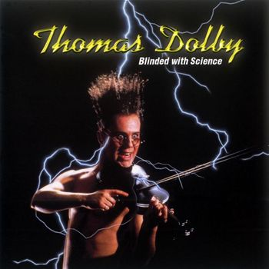
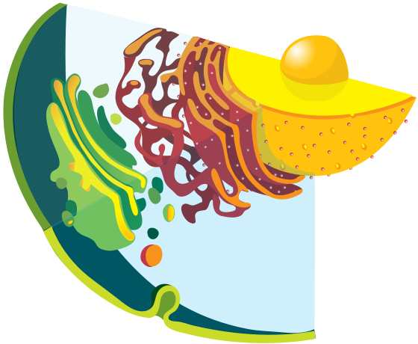
Are you feeling blinded by science?
Do yourself a favor. Use the…
Virtual Cell Biology Classroom (VCBC) !
The VCBC is full of resources to help you succeed, including:
practice test questions
review questions
study guides and learning objectives
PowerPoints on other topics
You can access the VCBC by going to the Science Prof Online website www.ScienceProfOnline.com
Images: Blinded With Science album, Thomas Dolby; Endomembrane system, Mariana Ruiz, Wiki

