Slide 1
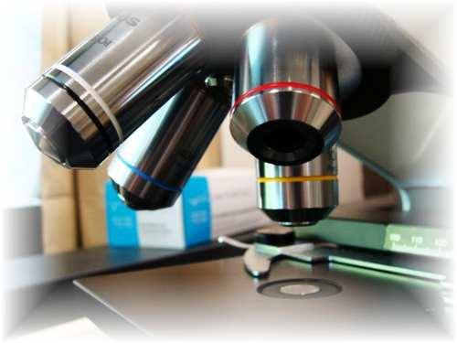
About Science Prof Online
PowerPoint Resources
Science Prof Online (SPO) is a free science education website that provides fully-developed Virtual Science Classrooms, science-related PowerPoints, articles and images. The site is designed to be a helpful resource for students, educators, and anyone interested in learning about science.
The SPO Virtual Classrooms offer many educational resources, including practice test questions, review questions, lecture PowerPoints, video tutorials, sample assignments and course syllabi. New materials are continually being developed, so check back frequently, or follow us on Facebook (Science Prof Online) or Twitter (ScienceProfSPO) for updates.
Many SPO PowerPoints are available in a variety of formats, such as fully editable PowerPoint files, as well as uneditable versions in smaller file sizes, such as PowerPoint Shows and Portable Document Format (.pdf), for ease of printing.
Images used on this resource, and on the SPO website are, wherever possible, credited and linked to their source. Any words underlined and appearing in blue are links that can be clicked on for more information. PowerPoints must be viewed in slide show mode to use the hyperlinks directly.
Several helpful links to fun and interactive learning tools are included throughout the PPT and on the Smart Links slide, near the end of each presentation. You must be in slide show mode to utilize hyperlinks and animations.
This digital resource is licensed under Creative Commons Attribution-ShareAlike 3.0:
http://creativecommons.org/licenses/by-sa/3.0/
Alicia Cepaitis, MS
Chief Creative Nerd
Science Prof Online
Online Education Resources, LLC
alicia@scienceprofonline.com
Tami Port, MS
Creator of Science Prof Online
Chief Executive Nerd
Science Prof Online
Online Education Resources, LLC
info@scienceprofonline.com
From the Virtual Cell Biology Classroom on ScienceProfOnline.com
Image: Compound microscope objectives, T. Port
Notes:
Welcome to Science Prof Online PowerPoint Resources!
This PowerPoint Presentation comes from the Virtual Cell Biology Classroom of Science Prof Online, and, as such, is licensed under Creative Commons Attribution-ShareAlike 3.0.; meaning you can download, share and alter any of this presentation, but you can’t sell it or repackage and sell any part of it. Please credit Science Prof Online as the source of this presentation. Please abide by credited image copyrights. Thank you for using this resource.

Slide 2
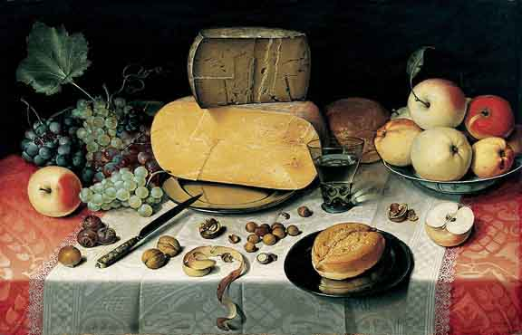
Organic Chemistry,
Macromolecules
&
Nutrition
From the Virtual Cell Biology Classroom on ScienceProfOnline.com
Image: Stilleben, painting dated 1613, oil on canvas, by Floris van Dyck

Slide 3
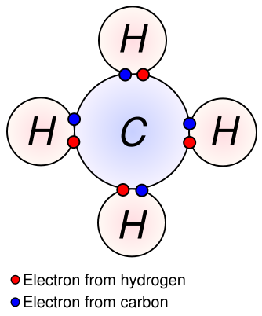
Inorganic vs Organic Molecules
?
?
Inorganic Molecules > Molecules that don’t have Carbon Hydrogen (C-H) bonds.
The major organic macromolecules (big molecules with carbon-hydrogen bonds) found in living things are:
1. carbohydrates
2. proteins
3. nucleic acids
4. lipids
Video:
That’s Why Carbon Is a Tramp
from Crash Course Biology
From the Virtual Cell Biology Classroom on ScienceProfOnline.com
Image: Methane Covalent Bonds, Dynablast, Wiki

Slide 4
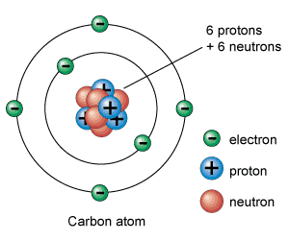
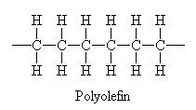
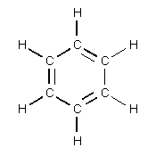
Carbon
Little Atom, Big Deal
The chemical basis of life. Abundant in all known life forms.
Essential to complex organic macromolecules, because each carbon atom can form ___ bonds (usually involving hydrogen , oxygen and/or nitrogen).
Able to form polymers (big organic molecules).
The atoms can bond with each other to form long chains.
Sometimes the ends of these chains join together to form a ring.
Double bonds form when atoms share two pairs electrons (two covalent bonds). Triple bonds = 3 shared pair of electrons.
From the Virtual Cell Biology Classroom on ScienceProfOnline.com
Images: Carbon, Universe Today Website
Notes:
4

Slide 5
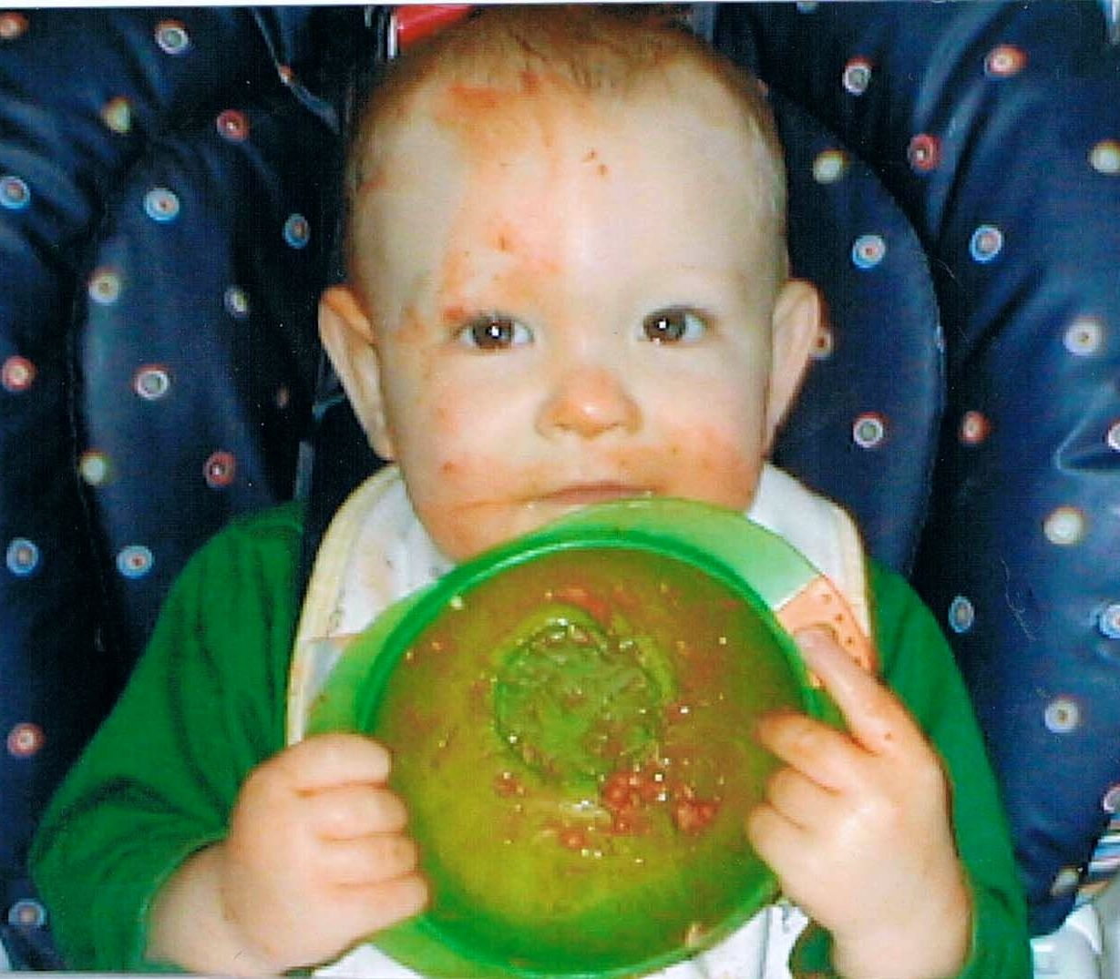
The Chemistry of Food ☺ ^{(yummy!)}
Three of the four types of major macromolecules we recognize as part of our diet: Carbs, protein & lipids (fats).
Provide energy to fuel body’s activities.
And raw materials to build body’s own molecules.
Our diet must also include essential nutrients that our bodies cannot manufacture but are needed for biological function, such as vitamins and minerals.
From the Virtual Cell Biology Classroom on ScienceProfOnline.com
Image: Leo after pouring baby food on his head ☺, T. Port

Slide 6
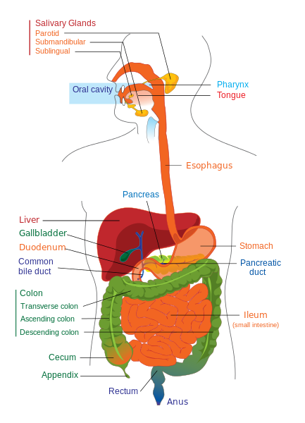
Digestion
Compartmentalized breakdown of foods
  Enzymes
  Stomach acid
Smaller units are absorbed and carried by the bloodstream
Video: Digestion of Molecules Animation
From the Virtual Cell Biology Classroom on ScienceProfOnline.com
Image: Digestive system diagram, Wiki

Slide 7
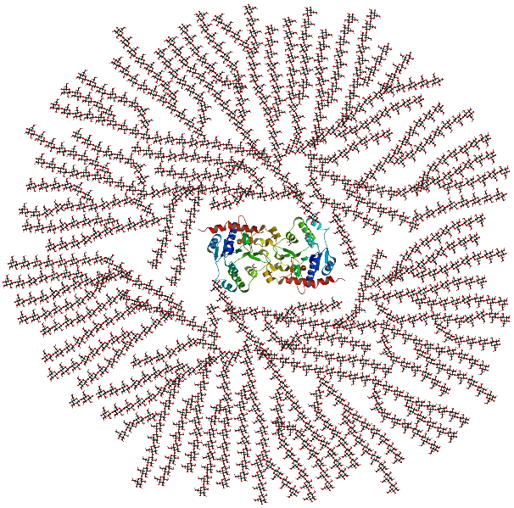
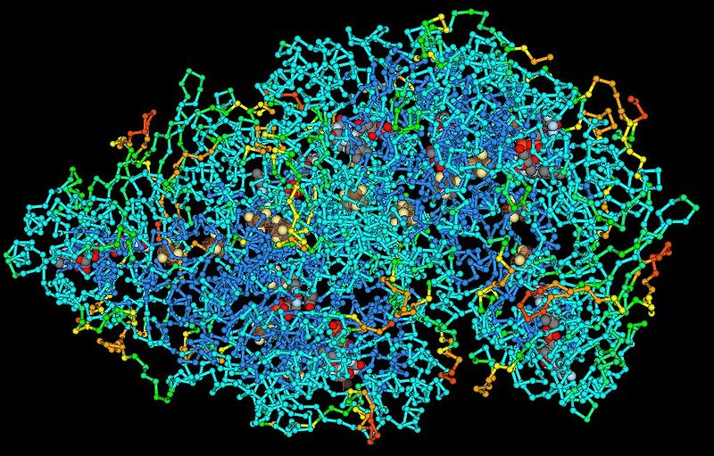
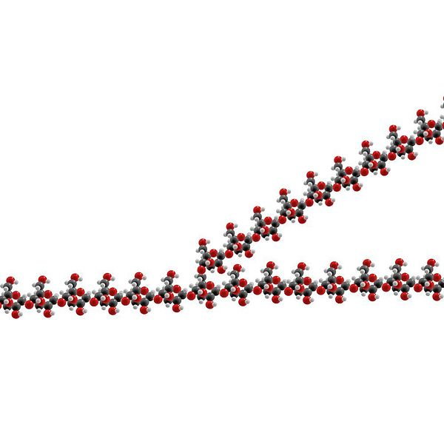
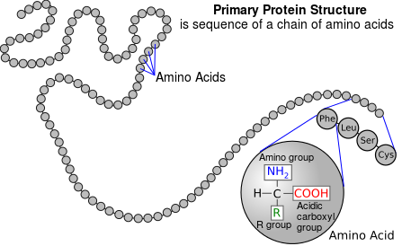
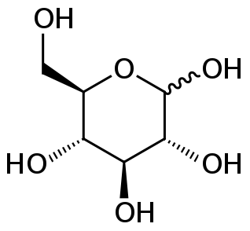
Polymers
Big molecules that are made of many similar units (monomers).
Images: Part of a Glycogen Molecule, Wiki; Glycogen diagram, Wiki; Glucose chemical structure, Wiki; Protein Molecule, Wiki; Primary structure of protein, Wiki
From the Virtual Cell Biology Classroom on ScienceProfOnline.com

Slide 8
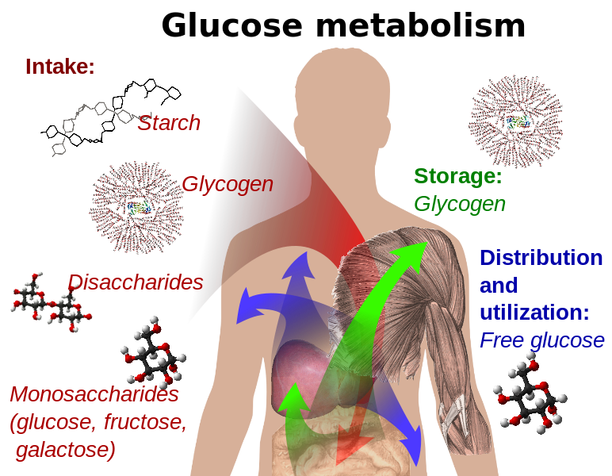
Glycogen
Carbohydrate polymer that we use to store sugar energy.
- Subunits are glucose monosaccharides
- Humans and other vertebrates store glucose as glycogen in the liver and muscles
Images: Part of a Glycogen Molecule, Wiki; Glycogen diagram, Wiki; Glucose chemical structure, Wiki; Glucose metabolism, Wiki
From the Virtual Cell Biology Classroom on ScienceProfOnline.com

Slide 9
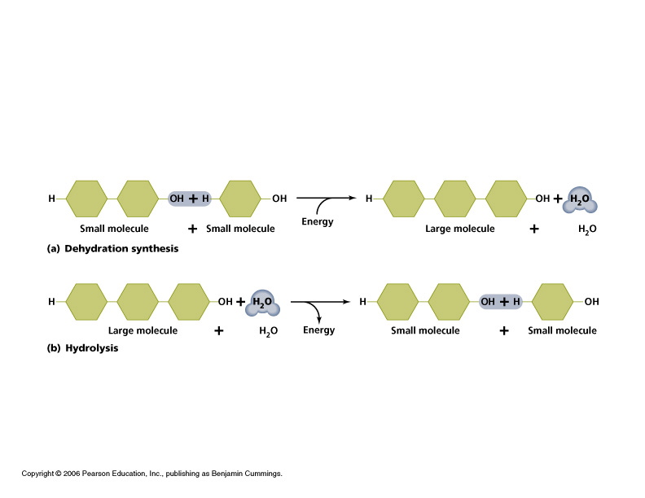
Polymers Can be Built and Broken Down Through
Dehydration and Hydrolysis Reactions
Dehydration reaction: Building the polymer.
- Polymer = long chain of subunits called monomers.
- Reconnect monomers by covalent bonds
- a.k.a. Condensation reaction
- Energy input required.
- Aided by enzymes.
Hydrolysis: Breaking the polymer.
- Covalent bond is broken between subunits. - Releases energy
- Aided by enzymes

Slide 10
Study Table of Organic Macromolecules
(We will fill this in as we go through the rest of the lecture.)
Macromolecule (polymer) | Made of what type of monomer? | Is there another name for this polymer? | What are the main elements in this macromolecule? | Examples
1.
2.
3.
4.
From the Virtual Cell Biology Classroom on ScienceProfOnline.com

Slide 11
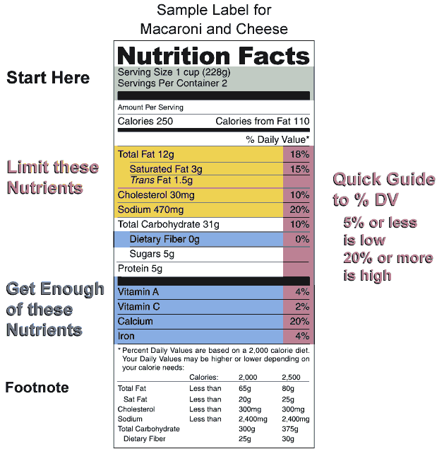
3 of the 4 macromolecules commonly occur on Nutrition Labels, and are the major components in our diet.
Video:
Biological Molecules You Are What You Eat
from Crash Course Biology
Q: Which organic macromolecule is not a common part of our diet?
From the Virtual Cell Biology Classroom on ScienceProfOnline.com
Images: Nutrition Label, Wiki

Slide 12
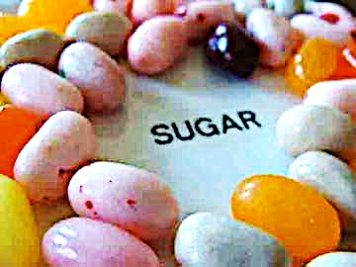

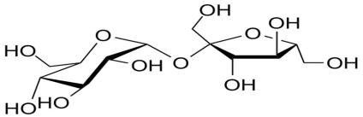
Organic Molecules
Carbohydrates
• “carbon” - hydrates”
• One carbon molecule to one water molecule (CH₂0)n.
• saccharide is a synonym for carbohydrate.
• The prefixes on the word “saccharide” relates to the size of the molecule (mono-, di-, tri- poly-).
BOOGERS!
You probably know that jelly beans are full of refined sugars…carbs. You may not know that boogers contain carbs as well. Boogers are dried-up mucus and dirty nose debris. Mucus is made mostly out of sugars and protein.
Images: Jelly beans, T. Port; Giraffe picking nose with tongue, Sucrose moleculee Wiki
From the Virtual Cell Biology Classroom on ScienceProfOnline.com
Notes:
Saccharide

Slide 13
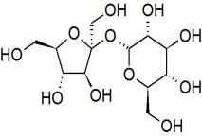
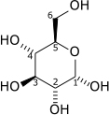
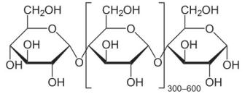
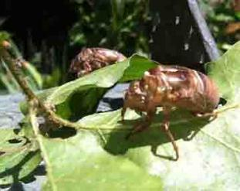
Organic Molecules - Carbohydrates
Monosaccharides
single sugars (one molecule)
simplest
*glucose, fructose
Disaccharides
double sugars
combination of two monosaccharides
* sucrose = glucose + fructose
* lactose = glucose + galactose
Polysaccharides
macromolecules; polymers composed of several sugars
can be same monomer (many of same monosaccharide) or mixture of monomers
food storage carbohydrates: glycogen (animals) starch (plants)
structural carbs: chitin (animals), cellulose (plants)
From the Virtual Cell Biology Classroom on ScienceProfOnline.com
From the Virtual Cell Biology Classroom on ScienceProfOnline.com

Slide 14
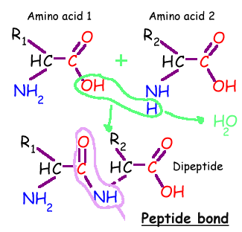
Organic Molecules - Proteins
Proteins are macromolecules, polymers composed of monomers called…
Amino acids contain a:
1. base amino group ( -NH₂)
2. acidic carboxyl group ( -COOH)
3. hydrogen atom
…all attached to same carbon atom (the α –carbon…alpha carbon).
4. Fourth bond attaches α-carbon to a side group (--R) that varies among different amino acids.
Side groups important … affects the way a proteins amino acids interact with one another, and how a protein interacts with other molecules.
Essential amino acids: Cannot be synthesized by the body. They must be ingested in the diet.
Arginine * Histidine * Methionine* Threonine * Valine * Isoleucine * Lysine * Phenylalanine *
Tryptophan * Leucine
From the Virtual Cell Biology Classroom on ScienceProfOnline.com

Slide 15
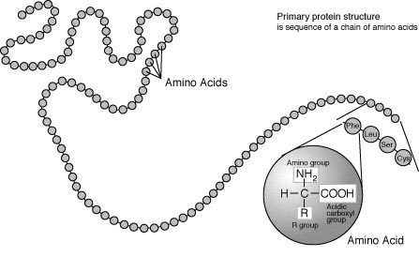
Organic Molecules – Proteins
Peptide Bonds
Link amino acids together in chains, like the beads on a necklace.
A dipeptide is 2 amino acids linked together.
A polypeptide, more than two.
From the Virtual Cell Biology Classroom on ScienceProfOnline.com
Image: Protein Primary Structure, Wiki

Slide 16
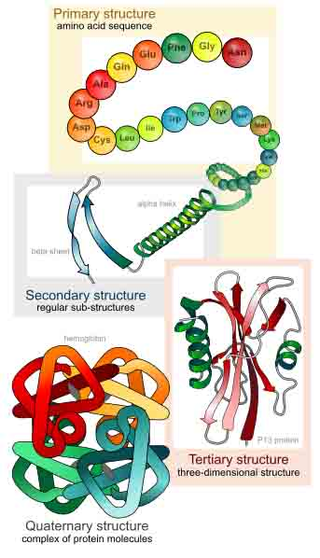

Levels of Protein Structure
From the Virtual Cell Biology Classroom on ScienceProfOnline.com
Image: Levels of protein structure, M Ruiz

Slide 17

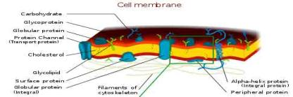
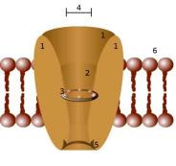
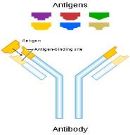
Organic Molecules - Proteins
Complex organic macromolecules fundamental to living cells.
Composed of one or more chains of amino acids.
Proteins perform many functions in cells, including:
1. Structural
• Components in cell walls, membranes,
and within cells themselves.
2. Enzymes
• Chemicals that speed up a chemical reaction.
• The catalysts in cells are called enzymes.
3. Regulation
• Some regulate cell function by stimulating or hindering either the action of other proteins or the expression of genes.
4. Transportation
• Some act as channels and “pumps” that move substances into or out of cells.
5. Defense
• Antibodies = proteins that defend your body against microorganisms
• Some bacteria produce proteins (bacteriocins) that kill other bacteria.
Images : Cell Membrane, Wiki; Channel Protein, Wiki; Antibody, Wiki
From the Virtual Cell Biology Classroom on ScienceProfOnline.com

Slide 18
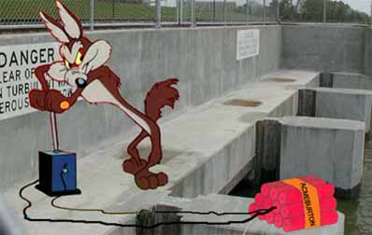

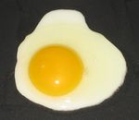
Q: How do you sabotage a protein?
• Alteration of a protein shape through some form of external stress
• Example, by applying heat, acidic or alkaline environment
• Denatured protein can’t carry out its cellular function .
Irreversible egg protein denaturation caused by high temperature (while cooking it).
From the Virtual Cell Biology Classroom on ScienceProfOnline.com

Slide 19
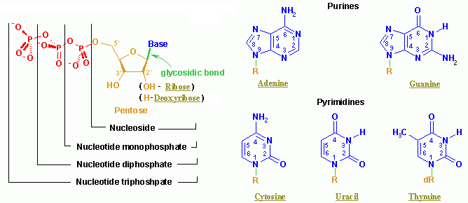
Organic Molecules – Nucleic Acids
Nucleic acids (both RNA and DNA) are macromolecules; polymers made up of monomers called nucleotides.
Nucleic acids deoxyribonucleic acid (DNA) and ribonucleic acid (RNA) = genetic material of cells.
Names derived from type of sugar contained within molecules = ribose
Nucleotides
Each monomer of nucleic acid is a nucleotide and consists of 3 portions:
- a sugar
- one or more phosphate
- one of five cyclic nitrogenous bases
+adenine, guanine (double-ringed purines)
+ cytosine, thiamine or uracil (single-ringed pyrimidines)
From the Virtual Cell Biology Classroom on ScienceProfOnline.com
Image: Nucleotide Structure, Wikipedia

Slide 20
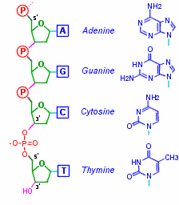
Organic Molecules – Nucleic Acids
Nucleic Acid Structure
Nucleotides linked by covalent bonds between sugar of one nucleotide and phosphate of next (sugar-phosphate backbone).
Nitrogenous bases extend from it like teeth of a comb.
From the Virtual Cell Biology Classroom on ScienceProfOnline.com

Slide 21
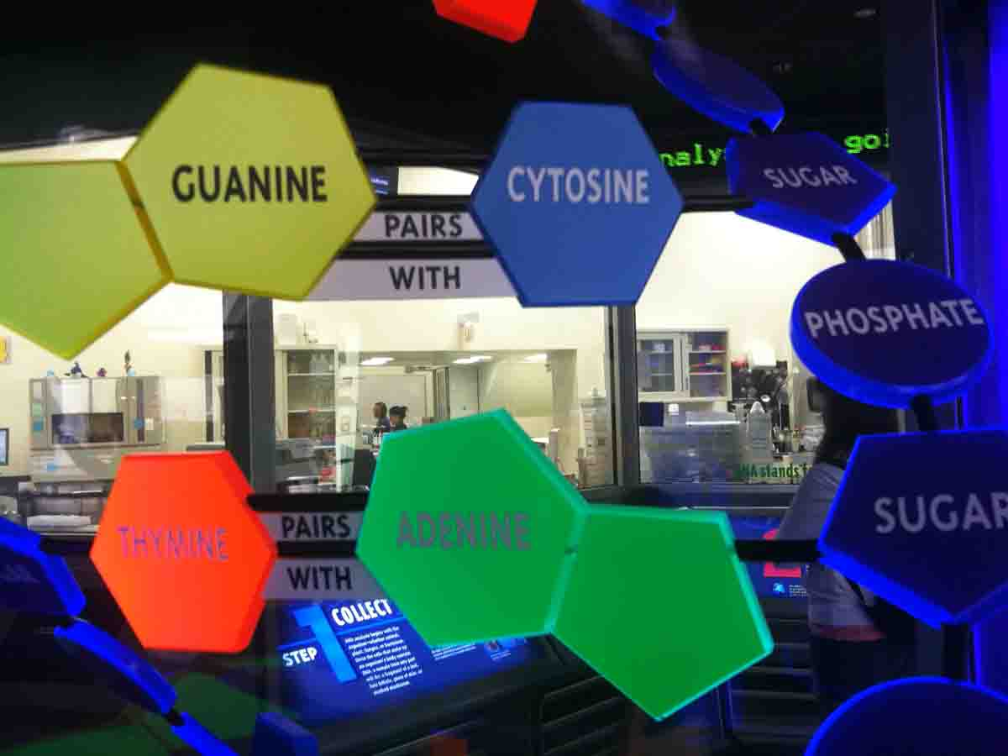
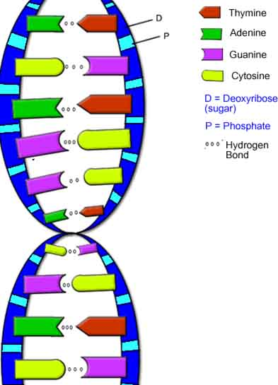
Nucleic Acids - DNA
DNA is a double stranded molecule, analogous to a ladder.
The “ladder” =
• two deoxyribose-phosphate chains form the “side rails”
• base pairs, linked by hydrogen bonds, form the “rungs”.
Purine Bases (double ring)
Adenine & Guanine
Pyrimidine Bases (single ring)
Cytosine & Thymine
Base Pairs (purine always pairs with pyrimidine):
Adenine + Thymine
Cytosine + Guanine
Hydrogen bonds attract the bases from one strand to the bases on the other strand and also twist the phosphate-sugar backbones into a helix.
Q: How do I remember this?
Images: Model of DNA Molecule, Field Museum, Chicago, T. Port DNA, Biology Corner Website
From the Virtual Cell Biology Classroom on ScienceProfOnline.com

Slide 22
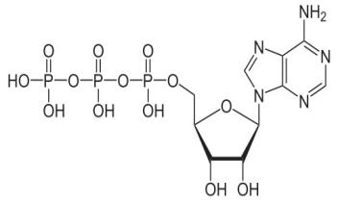
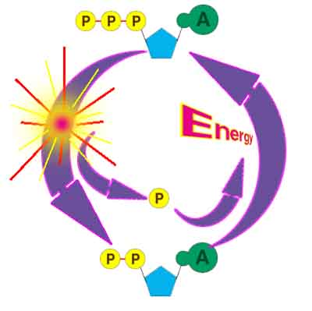
ATP Production and Energy Storage
Q: This molecule has a sugar, a base and three phosphate groups. What kind of monomer is it?
Adenosine 5'-triphosphate
Multifunctional "molecular currency" of intracellular energy transfer.
Organisms release energy from nutrients; can be concentrated and stored in high-energy phosphate bonds of ATP.
Transports chemical energy within cells for metabolism.
Produced as energy source during photosynthesis and cellular respiration.
Consumed by many enzymes and a multitude of cellular processes
From the Virtual Cell Biology Classroom on ScienceProfOnline.com
Image: ATP Molecule, NEUROtiker; ATP-ADP Cycle, CUNY
Notes:
A: Nucleotide

Slide 23
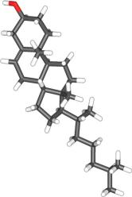
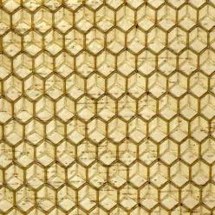
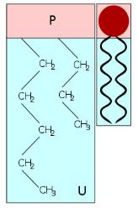
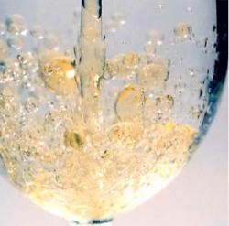
Organic Molecules – Lipids
(Fats, Phospholipids, Waxes & Steroids)
Hydrophobic macromolecules…insoluble in water.
Not attracted to water because …
non-polar covalent bonds linking carbon & hydrogen aren’t attracted to the polar bonds of water.
From the Virtual Cell Biology Classroom on ScienceProfOnline.com
Images: Cholesterol, Wiki; Phospholipid Structure, Bryan Derksen. Wiki Honeycomb, Wikii; Oil & Water, Kidipede

Slide 24
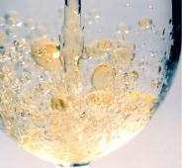
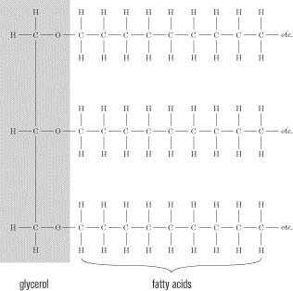
Organic Molecules – Lipids
(Fats, Phospholipids, Waxes & Steroids)
Fats
Fats and oils are made from two kinds of molecules:
• glycerol
(a type of alcohol)
• fatty acids
(triglycerides)
Images: Oil & Water, Kidipede
From the Virtual Cell Biology Classroom on ScienceProfOnline.com

Slide 25
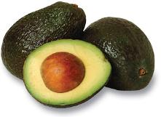
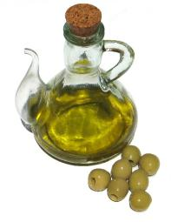
Lipids – Dietary Fats
We typically refer to them all as “Fats”, but remember, fats are only one of several molecules known as lipids.
Phospholipids, steroids and true fats play an important role in human nutrition, should get no more than 30% of calories from fats., and the type of fat consumed is very important!
_____________ fatty acids (EFAs) are fats that the body can’t make, but needs to take in from outside sources.
There are two families of EFAs: omega-3 and omega-6. Fats from each of these families are essential, as the body can convert one omega-3 to another omega-3, for example, but cannot create an omega-3 from scratch.
When the EFAs were discovered in 1923, they were designated Vitamin F. In 1930, further research showed that the two EFAs are better classified with the fats than with the vitamins.
Olive oil has both omega 3 and omega 6 EFAs
From the Virtual Cell Biology Classroom on ScienceProfOnline.com
Notes:
Essential

Slide 26
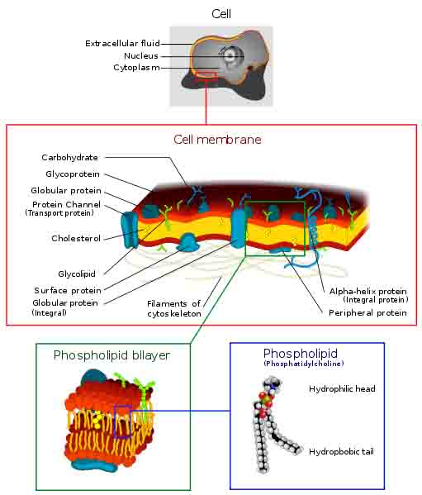
Organic Molecules – Lipids
(Fats, Phospholipids, Waxes & Steroids)
Phospholipids
• Phospholipids are a major component of all cell membranes.
Most phospholipids contain a diglyceride as the tail, and a phosphate group for head.
Hydrocarbon tails are hydrophobic, but phosphate heads are hydrophilic.
• So phospholipids are soluble in both water and oil.
• Tails from both layers facing inward and the heads facing outward = phospholipid bilayer.
From the Virtual Cell Biology Classroom on ScienceProfOnline.com
Image: Cell Membrane, Wiki;

Slide 27
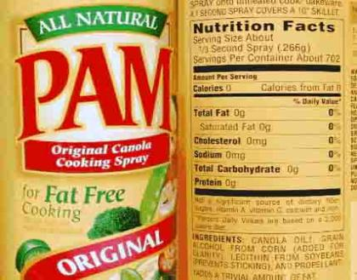
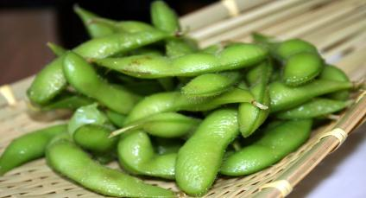
Phospholipids - Dietary
• Because they are polar (hyprophobic and hydrophilic parts) phospholipids can act as an emulsifier in foods, enabling oils to dissolve in water.
_______, which is made of phospoholipid, is used in cooking sprays and as a food emulsifier.
For example, lecithin keeps the cocoa and cocoa butter in a candy bar from separating.
Originally discovered in egg yolk, and today commercially extracted from soybeans, but widely present in animal and plant tissues.
Remember, if we are eating cells, we are eating phospholipids.
Steamed and salted, edamame (soybeans) is yummilicious; as addictive as potato chips, but much healthier! Protein, carbs and healthy fats all in one food item.
From the Virtual Cell Biology Classroom on ScienceProfOnline.com
Image: Edamame, Tammy Green
Notes:
Lecithin (less-a-thin)

Slide 28
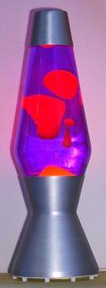

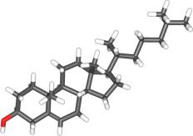
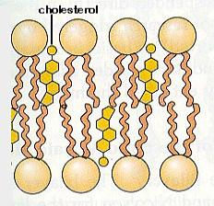
Organic Molecules – Lipids
(Fats, Phospholipids, Waxes & Steroids)
Waxes
• Do not have a hydrophilic head: so completely water insoluble.
Steroids
• The central core of a cholesterol molecule (4 fused rings) is shared by all steroids.
• Cholesterol is precursor to our sex hormones and Vitamin D.
• Our cell membranes contain cholesterol (in between the phospholipids) to help keep membrane “fluid” even when exposed to cooler temperatures.
From the Virtual Cell Biology Classroom on ScienceProfOnline.com
Image: Lava Lamp, Wiki; Cholesterol molecule, Wiki; Phospholipids & Cholesterol, Cytochemistry.net

Slide 29

VITAMINS - Micronurteints
_________ __________ usually not produced by the body, but essential in minute amounts for metabolism.
Do not serve as a source of energy, but some help facilitate many metabolic reactions as _____________.
Example: B vitamins
- Eight water-soluble vitamins that play important roles in cell metabolism.
-Once thought to be a single vitamin, referred to as Vitamin B (much like how people refer to Vitamin C or Vitamin D).
- Later research showed that they are chemically distinct vitamins that often coexist in the same foods.
- Supplements containing all eight B vitamins are generally referred to as a vitamin B complex. Individual B vitamin supplements are referred to by the specific name of each vitamin (e.g. B1, B2, B3).
From the Virtual Cell Biology Classroom on ScienceProfOnline.com
Images: B vitamin caplets, Ragesoss
Notes:
Organic molecules
enzymes

Slide 30

VITAMIN - B₁₂
Largest and most complex of all the vitamins.
Sources of B₁₂: Only bacteria can synthesize. Present in animal products such as meat, poultry, fish (including shellfish), and to a lesser extent, dairy. Vegans need to take supplements.
Involved in many aspects of our health. Required for proper red blood cell formation, neurological function, and DNA synthesis.
10-15% of people are believed to be deficient in this vitamin.
B₁₂ and Depression
Observational studies have found as many as 30% of patients hospitalized for depression to be deficient in vitamin B₁₂.
A recent cross-sectional study of 700 community-living, physically disabled women over the age of 65 found that vitamin B₁₂ deficient women were twice as likely to be severely depressed as non-deficient women.
The reasons for the relationship between vitamin B₁₂ deficiency and depression are not clear.
Learn more about Vitamin B12 from the website of the Office of Dietary Supplements, National Institutes of Health.
From the Virtual Cell Biology Classroom on ScienceProfOnline.com
Image: Molecular structure of Vitamin B12, Wiki

Slide 31

DIETARY MINERALS
All minerals are ________________
found throughout nature.
Cannot be synthesized by the body.
Because they are elements, they cannot be broken down or changed by
metabolism.
Important in many metabolic reactions of the cell.
A balanced diet can normally meet all the body's chemical element requirements.
Supplements may be required when requirements are not adequately met by the diet (for example, vegans should supplement calcium, which is found mainly in dairy products), or when deficiencies arise from pathology or injury.
From the Virtual Cell Biology Classroom on ScienceProfOnline.com
Image: Periodic Table of Elements
Notes:
elements

Slide 32


MINERALS - Magnesium
Mg
12
24.305
Magnesium plays an important role in the production and transport of _________.
It is also important for the contraction and relaxation of muscles.
Magnesium is involved in the synthesis of protein, and it assists certain enzymes in the body.
Over 300 enzymes require magnesium ions for their catalytic action, including all enzymes using or synthesizing ATP, or those that use other nucleotides to synthesize DNA and RNA.
Human magnesium deficiency is common, with only approximately 32% of the United States meeting the RDA.
Low levels of magnesium in the body have been associated with development of illnesses such as asthma, diabetes, and osteoporosis.
Magnesium
From the Virtual Cell Biology Classroom on ScienceProfOnline.com
Images: Magnesium crystals, Warut Roonguthai; Food sources of Magnesium, Peggy Greb
Notes:
energy

Slide 33

WATER
All chemical reactions of living things take place in water.
Many types of metabolic wastes can only be eliminated from body when dissolved in water.
The catalysis of materials requires water.
You may be able to survive weeks without
food, but wouldn’t last more than a few days
without water.
Human body ~ 65% water (even dense tissue
like bone is 33% water).
Food provides ~ 20% of total water intake.
Remaining 80% from water and other beverages.
Institute of Medicine advises men consume
roughly 3.0 liters (~ 13 cups) total beverages
daily & women consume 2.2 liters (~ 9 cups).
Q: What are some reactions that we have
discussed in class that involve water?
From the Virtual Cell Biology Classroom on ScienceProfOnline.com

Slide 34

Calories (really Kilocalories)
Q: What is a calorie?
Carbohydrates have ____ calories per gram.
Fiber, a type of less-digestible carb has ____ calories per gram.
Proteins have _____ calories per gram.
Fats have ___ calories per gram.
From the Virtual Cell Biology Classroom on ScienceProfOnline.com
Notes:
Calorie = the amount of energy needed to raise one kilogram of water one degree Celsius.
4
2
4
9

Slide 35






Confused about what to eat?
Eat more fresh food!
Eat local food when you can!
Complex carbs, balanced
wit protein and healthy fats.
Reduce animal fats and refined sugar.
From the Virtual Cell Biology Classroom on ScienceProfOnline.com
Image: Edamame, Tammy Green

Slide 36

REVIEW!
Animated lessons on
Organic Macromolecules
From the Virtual Cell Biology Classroom on ScienceProfOnline.com
Images: Cholesterol, Wiki; Chilesterol; Amino Acids & Peptide Bonds; DNA Molecule, National Science Foundation

Slide 37
Confused?
Here are some links to fun resources that further explain Chemistry:
Organic Chemistry Main Page on the Virtual Cell Biology Classroom of Science Prof Online.
“What Kind of Bonds Are These?” song and slide show by Mark Rosengarten
Macromolecules interactive science tutorial.
DNA Structure Cell Biology Animation from John Kyrk.
Build a DNA Molecule from University of Utah.
“Chemistry” a song by Kimya Dawson.
Redox Reactions video lecture by Kahnacademy
“Sugar, Sugar” song by The Archies.
Chem4Kids website by Rader.
“Better Living Through Chemistry” a song by Queens of the Stone Age.
“Chemistry” a song by Rush.
(You must be in PPT slideshow view to click on links.)
Smart Links
From the Virtual Cell Biology Classroom on ScienceProfOnline.com

Slide 38


Are you feeling blinded by science?
Do yourself a favor. Use the…
Virtual Cell Biology Classroom (VCBC) !
The VCBC is full of resources to help you succeed, including:
practice test questions
review questions
study guides and learning objectives
PowerPoints on other topics
You can access the VCBC by going to the Science Prof Online website www.ScienceProfOnline.com
Images: Blinded With Science album, Thomas Dolby; Endomembrane system, Mariana Ruiz, Wiki

