Slide 1
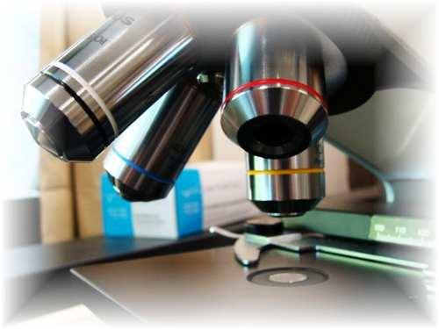
About Science Prof Online
PowerPoint Resources
Science Prof Online (SPO) is a free science education website that provides fully-developed Virtual Science Classrooms, science-related PowerPoints, articles and images. The site is designed to be a helpful resource for students, educators, and anyone interested in learning about science.
The SPO Virtual Classrooms offer many educational resources, including practice test questions, review questions, lecture PowerPoints, video tutorials, sample assignments and course syllabi. New materials are continually being developed, so check back frequently, or follow us on Facebook (Science Prof Online) or Twitter (ScienceProfSPO) for updates.
Many SPO PowerPoints are available in a variety of formats, such as fully editable PowerPoint files (.ppt), as well as uneditable versions in smaller file sizes, such as PowerPoint Shows (.pps) and Portable Document Format (.pdf), for ease of printing. The font “Jokerman” is used frequently in titles. It has a microbiology feel to it. If you do not have this font, some titles may appear odd, oversized and off-center. Find free downloads of Jokerman by Googling “download jokerman font microsoft”.
Images used on this resource, and on the SPO website are, wherever possible, credited and linked to their source. Any words underlined and appearing in blue are links that can be clicked on for more information. PPT files must be viewed in slide show mode to use the hyperlinks directly.
Several helpful links to fun and interactive learning tools are included throughout the PPT and on the Smart Links slide, near the end of each presentation. You must be in slide show mode to utilize hyperlinks and animations.
This digital resource is licensed under Creative Commons Attribution-ShareAlike 3.0:
http://creativecommons.org/licenses/by-sa/3.0/
Alicia Cepaitis, MS
Chief Creative Nerd
Science Prof Online
Online Education Resources, LLC
alicia@scienceprofonline.com
Tami Port, MS
Creator of Science Prof Online
Chief Executive Nerd
Science Prof Online
Online Education Resources, LLC
info@scienceprofonline.com
From the Virtual Microbiology Classroom on ScienceProfOnline.com
Image: Compound microscope objectives, T. Port
Notes:
Welcome to Science Prof Online PowerPoint Resources!
This PowerPoint Presentation comes from the Virtual Cell Biology Classroom of Science Prof Online, and, as such, is licensed under Creative Commons Attribution-ShareAlike 3.0.; meaning you can download, share and alter any of this presentation, but you can’t sell it or repackage and sell any part of it. Please credit Science Prof Online as the source of this presentation. Please abide by credited image copyrights. Thank you for using this resource.

Slide 2
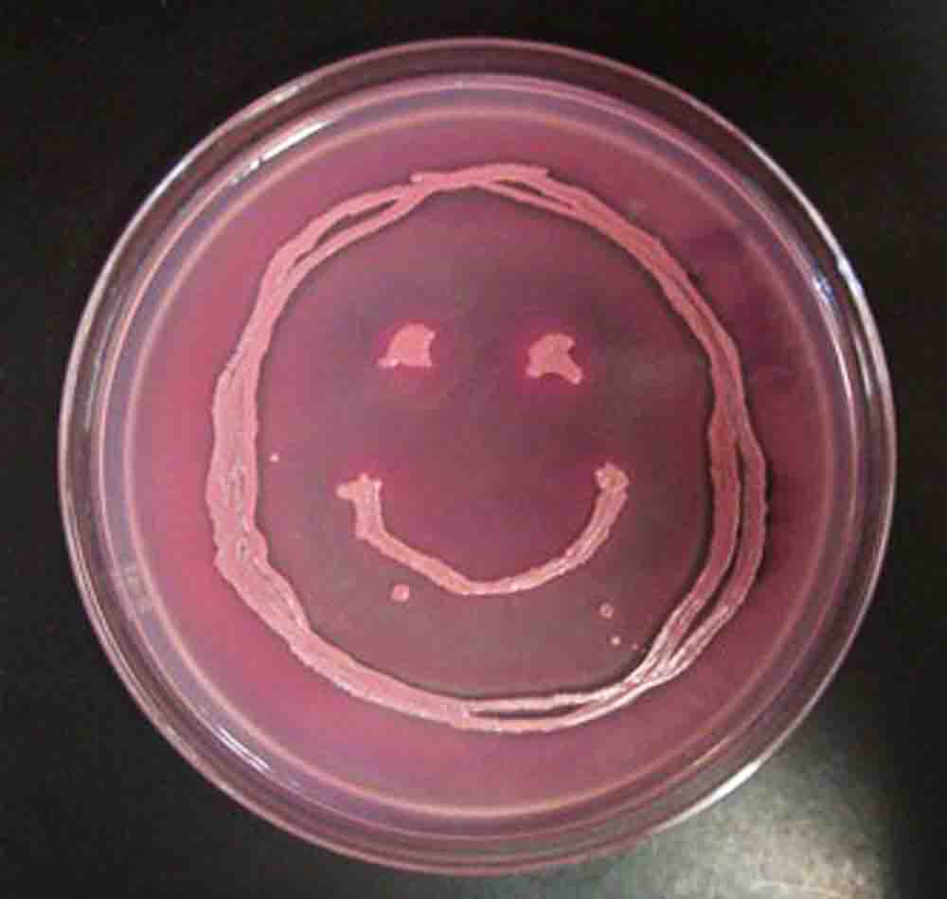
Hi! I’m E. coli ☺
Introduction
to
Microbiology
Image: Ermahgerd Microbiology!, variation by T. Port. Click here for info on the history of the Ermahgerd meme.
From the Virtual Microbiology Classroom on ScienceProfOnline.com

Slide 3
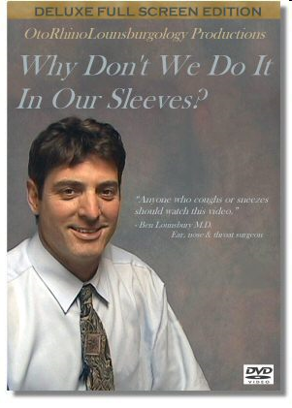
Lets start the semester by learning how to properly cough and sneeze!
DVD 665
From the Virtual Microbiology Classroom on ScienceProfOnline.com

Slide 4
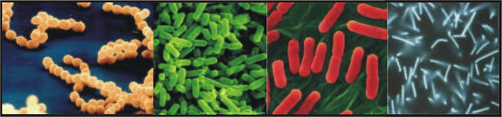
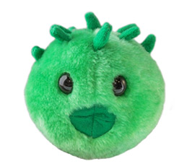
Microbiology
Check your course # (CRN) to make sure that you
are in the current course.
Sign in every time you attend class.
Tami Port…Who’s she?
Microbiology…What is it?
From the Virtual Microbiology Classroom on ScienceProfOnline.com
Image: Chlamydia, Giant Microbes

Slide 5

This should not be your first college biology course.
Nearly every Health Science curriculum at this institution that requires Microbiology, either has:
1. Prerequisite of Cell Biology or
2. 1 year of HS bio, chem & algebra with grade => 2.0. or
3. Completed college level intro biology, chem and algebra with grades => 2.0.
What I might spend 2 slides on, an intro bio course might spend
2-weeks on. See the potential problem here?
From the Virtual Microbiology Classroom on ScienceProfOnline.com

Slide 6



Courtesy
yawn
Be Respectful
Be On Time
(I reserve the right to close and lock the door 10 min after class or lab begins.)
Pay Attention
If you can’t pay attention, at least keep it to yourself … don’t disrupt others.
Cell Phones off/silenced
From the Virtual Microbiology Classroom on ScienceProfOnline.com

Slide 7
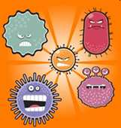
Microbes & You
Normal Flora
  Q: Did you always have them?
  Q: Are they everywhere on your body?
  Q: Are normal flora ever harmful?
Opportunistic Pathogens (part-time bad guys)
Pathogens (full-time bad guys)
Image and great micro info in Todar’s Textbook of Bacteriology.
From the Virtual Microbiology Classroom on ScienceProfOnline.com
Notes:
Main locations of normal flora:
Skin (epidermis and mucous membranes), especially the moist areas, such as the groin and between the toes.
Respiratory tract, particularly the nose.
Urinary tract.
The digestive tract, i.e. the mouth, the terminal ileum and the colon.

Slide 8
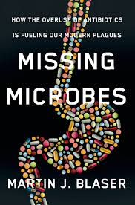
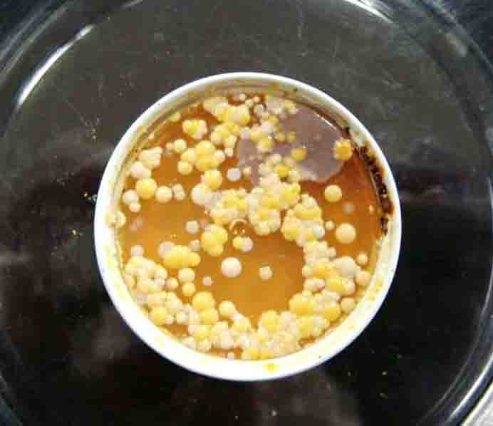
Types of symbiotic microbe-host relationships
Mutualism * Commensalism * Parasitism
What are the benefits of normal flora?
Benefit to the bacteria = They have a place to eat, survive and multiply.
Benefits to the human =
Bacteria may produce vitamins (such as B and K), and break down food that host cant normally digest.
Normal flora protect host against infection by pathogenic organisms:
- take up space, so pathogen has nowhere to set up shop
- may out-compete the invader for available nutrients
- may produce anti-bacterial chemicals (bacteriocins)
- long-term relationship with the human immune system
Q: What is the “human microbiome”?
Image: Arm plate of normal flora, T. Port.
From the Virtual Microbiology Classroom on ScienceProfOnline.com
Notes:
Simbiotic describes an intimate relationship between two organisms. There are three types of symbiotic relationships:
mutualism: both benefit
e.g. some normal flora
Commensalism: one benefits and the other receives no benefit, but is not harmed
Some normal flora
Parasitism: one benefits and the other is harmed

Slide 9
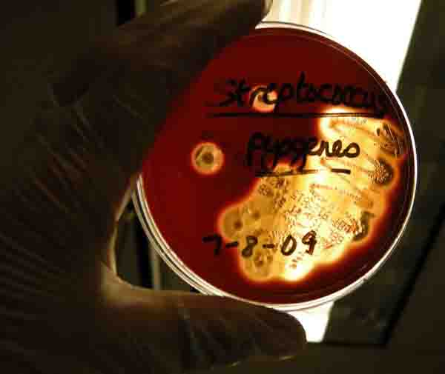
Types of symbiotic microbe-host relationships
Mutualism * Commensalism * Parasitism
- One partner in the relationship
benefits. The other neither
benefits nor is harmed.
  Pathogens that harm their host.
  Cost to the host can vary from slight to fatal.
  External parasites (ectoparasite) cause infestation.
  Internal parasites (endoparasite) cause infection.
Streptococcus pyogenes, a pathogen that can cause Strep throat, post-partum fever, pneumonia and necrotizing fasciitis.
Image: Blood Agar showing Beta hemolysis from pathogen Streptococcus pyogenes, T. Port.
From the Virtual Microbiology Classroom on ScienceProfOnline.com

Slide 10
Q: Why are you in this class?
“Because it is a requirement to get into my program of study.”
Why else?
From the Virtual Microbiology Classroom on ScienceProfOnline.com

Slide 11
Impact of Infectious Disease
Average life span:
- Bronze age 26 yrs
- Medieval Europe (400 – 1500 ad) 30 yrs
- Early 20th century 50 – 64 yrs
- Now world average 71 years (USA., 78.7)
Q: Why?
From the Virtual Microbiology Classroom on ScienceProfOnline.com

Slide 12
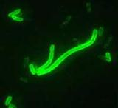
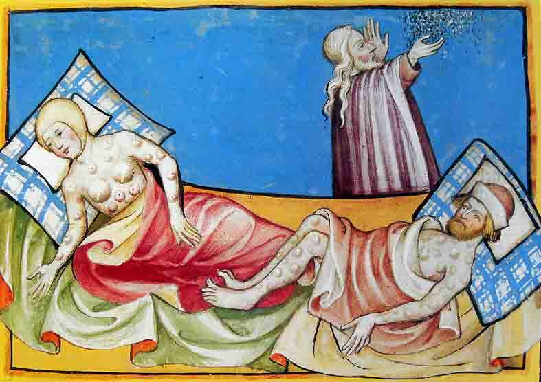
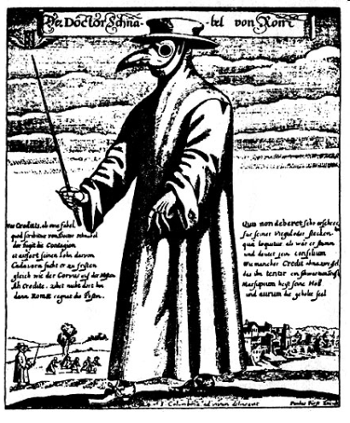
Impact of Infectious Disease
Bubonic Plague
a.k.a. Black Plague & Black Death
Caused by bacteria Yersenia pestis.
Several pandemics of plague have occurred throughout history.
50 million deaths between years 1346 – 50.
Nearly 1/2 of Europe perished in this plague
Doctor beak from Roman engraving, 1656 Physician attire for protection from the Bubonic plague (a.k.a Black death).
Images: Yersenia pestis, CDC; Black Death illustration, Toggenburg Bible (1411); Black Plague Physician Attire, History of Medicine, Paul Furst
From the Virtual Microbiology Classroom on ScienceProfOnline.com

Slide 13
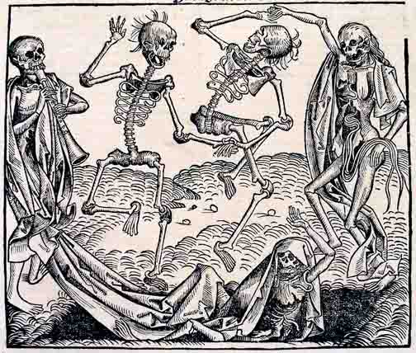
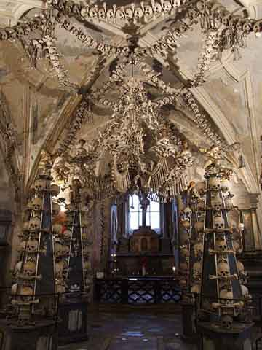
Impact of
Infectious Disease
• The Sedlec Ossuary, small Roman Catholic chapel, located in the Czech Republic.
• Contains ~ 40,000-70,000 human skeletons which have been artistically arranged to form decorations and furnishings for the chapel.
• Many of these bones were from bubonic plague victims.
• “Bring out your dead!” plague scene from Monty Python & Holy Grail.
Images: From the Dance of Death by Michael Wolgemut (1493) Sedlec Ossuary, Czech Republic by Marcin Szala)
From the Virtual Microbiology Classroom on ScienceProfOnline.com

Slide 14
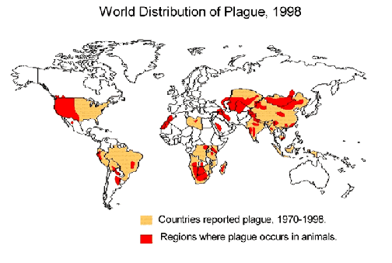
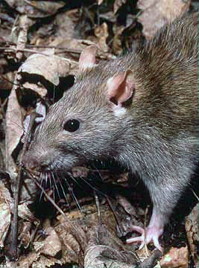
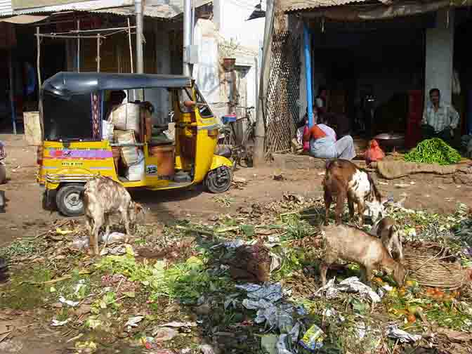
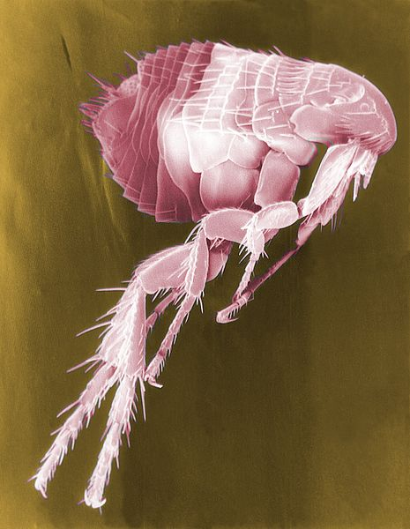
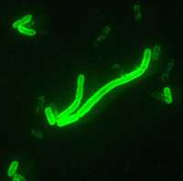
Impact of
Infectious Disease
Bubonic Plague
Images: Worldwide distribution of plague 1998, CDC; Waste in open market, frabood; Brown rat, National Park Service; Scanning electron micrograph of flea, CDC; Yersenia pestis, CDC
From the Virtual Microbiology Classroom on ScienceProfOnline.com

Slide 15
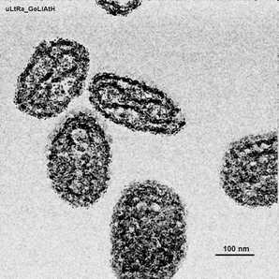
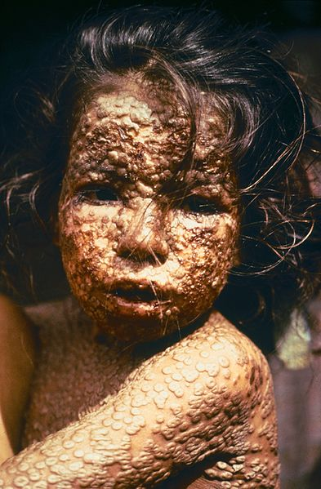
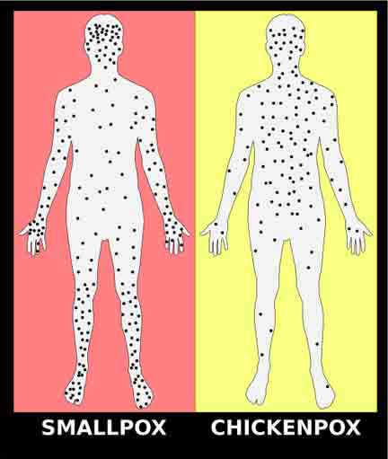
Impact of Infectious Disease
Smallpox
  Caused two airborne virus variants, Variola major and Variola minor.
  Deadly disease that, in survivors, can cause disfigurement and blindness.
  Killed Queen Mary II of England, Emperor Joseph I of Austria, King Luis I of Spain, Tsar Peter II and King Louis XV of France.
  Approx 300 million deaths worldwide just in the 20th century.
  Eradicated in 1980 though widespread vaccination.
  Now still possible weapon of bioterrorism.
  Watch this short National
  Geographic video on Smallpox.
Images: Girl with smallpox, James Hicks, CDC; Electron micrograph of smallpox virus, Magnus Manske; Smallpox vs. Chickenpox
From the Virtual Microbiology Classroom on ScienceProfOnline.com

Slide 16
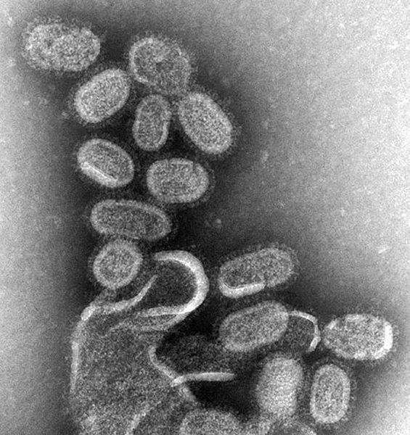
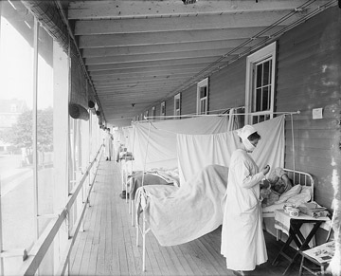
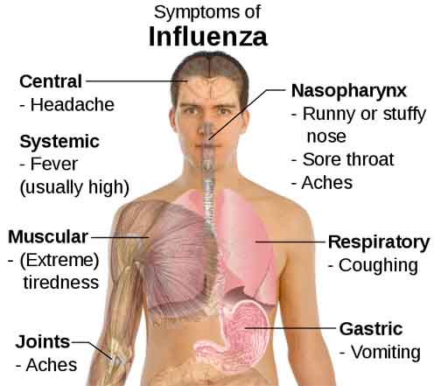
Impact of Infectious Disease
Influenza
  Infectious disease caused by RNA viruses in the family Orthomyxoviridae.
  Spanish flu pandemic 1918; more than 50 million deaths.
  In the U.S. seasonal flu kills thousands of people every year (mainly very young and old).
  Q: How is pandemic influenza different from seasonal flu?
  Watch this short National Geographic video “How Flu Viruses Attack”.
Images: Influenza virus, Cynthia Goldsmith; Walter Reed Hospital Spanish Flu Ward, by Harris & Ewing via Library of Congress; Symptoms of influenza, Mikael Häggström
From the Virtual Microbiology Classroom on ScienceProfOnline.com

Slide 17
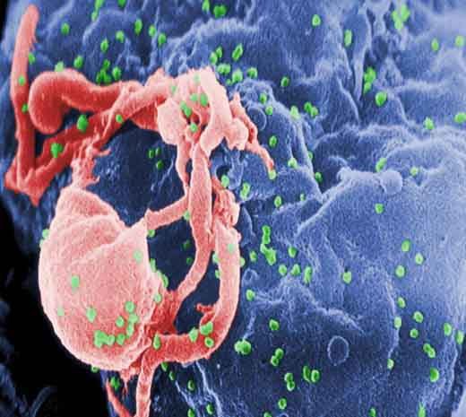
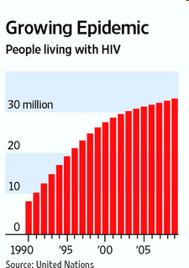

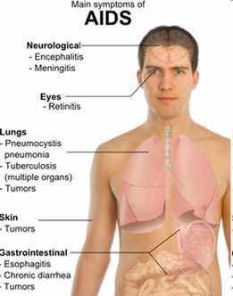
Impact of Infectious Disease
AIDS
  - Acquired immune deficiency syndrome (AIDS).
  - Caused by HIV (human immunodeficiency) virus, a retrovirus that infects T-cells of the immune system.
  - AIDS fatalities typically die of opportunistic infections and tumors.
  - More than 39 million people have died from HIV since it was recognized in 1981.
  - With anti-retroviral drug therapy, more, and more people are living with aids.
  - New breakthroughs in anti-retroviral drugs can reduce contagiousness and transmission of HIV.
  Recent HIV News:“New Insights into HIV Vaccines Will Improve Drug Development”, Science News 2013
Everything comes from somewhere…
Where did HIV come from?
This semester we will listen to the
RADIOLAB podcast
“Patient 0” to find out.
Images: Aids viruses budding off a lymphocyte, C. Goldsmith, CDC; Main symptoms of Aids, Mikael Haggstrom
From the Virtual Microbiology Classroom on ScienceProfOnline.com

Slide 18
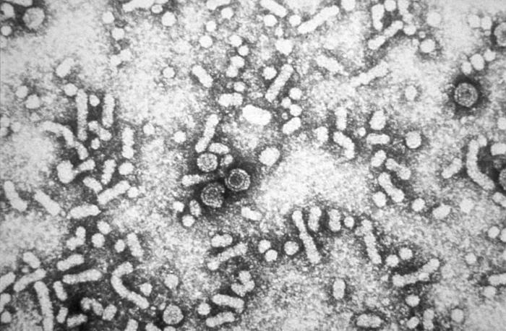
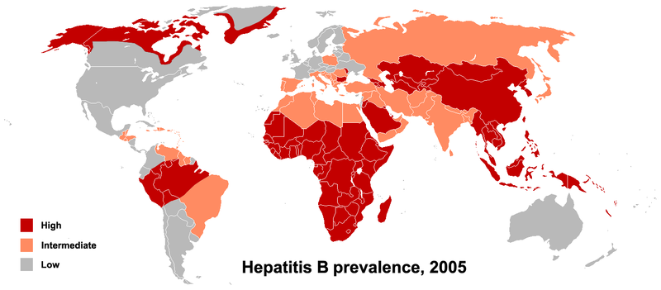
Impact of Infectious Disease
HBV
  Hepatitis B = infectious inflammatory illness of the liver caused by hepatitis B virus (HBV).
  Virus transmitted by exposure to infectious blood or body fluids.
  Risk of HBV transmission from carrier 10 – 35%. Health care workers high risk group.
  The hepatitis B virus is 50 to 100 times more infectious than HIV.
  HBV infection may be either acute (self-limiting) or chronic (long-standing). Persons with self-limiting infection clear the infection spontaneously within weeks to months.
  Watch this video on Hepatitis A & B and how they can damage the liver.
  Get vaccinated!
Images HBV virions, PHIL #5631; HBV prevalence 2005,
From the Virtual Microbiology Classroom on ScienceProfOnline.com

Slide 19
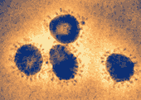
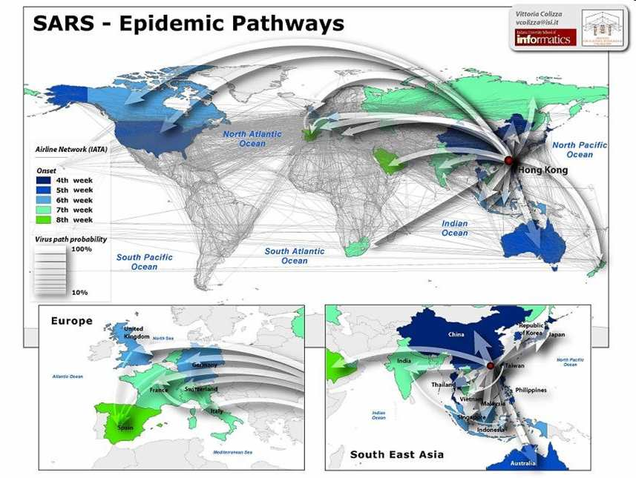
Impact of Infectious Disease
SARS
  Severe acute respiratory syndrome caused by the SARS coronavirus, an enveloped RNA virus.
  One near pandemic to date, with 8,096 known infected cases and 774 deaths (fatality rate of 9.6%).
  Within a matter of weeks in early 2003, SARS spread from a province of China to infect individuals in 37 countries.
  Majority of those who became sick were household contacts and health care workers.
Images: Sars coronavirus, CDC
From the Virtual Microbiology Classroom on ScienceProfOnline.com

Slide 20
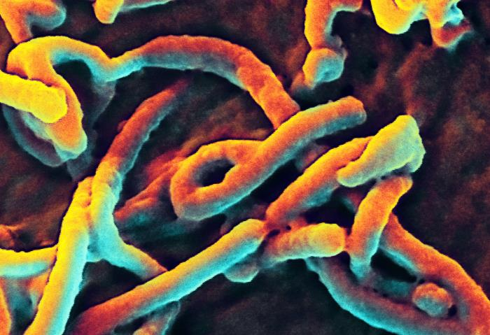
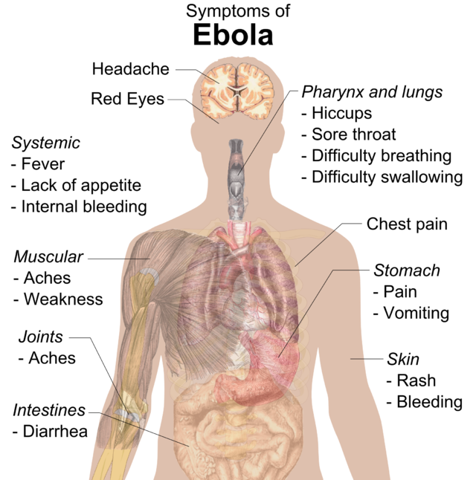
Disease Please:
Ebola Virus Disease
(a.k.a. Ebola Hemorrhagic Fever)
Caused by ssRNA animal viruses, a filovirus
Where does the Ebola virus hide?
May be present in more animals than previously thought, including chimpanzees, gorillas, fruit bats, monkeys, antelopes, porcupines, rodents, dogs, pigs and humans.
Ebola viruses, and their relative Marbug viruses cause severe and often fatal hemorrhagic fever in humans and other mammals.
EVD first appeared in 1976 in 2 simultaneous African outbreaks, one in Sudan, and the other in Democratic Republic of Congo.
The 2014 Ebola epidemic is the largest in history, affecting multiple countries in West Africa, causing more than 8,000 deaths.
Transmission
Transmitted from wild animals and spreads in the human population through human-to-human transmission.
Spreads through direct contact with bodily fluids of infected people and animals, as well as from contaminated surfaces.
Health-care workers frequently infected when infection control precautions not strictly practiced.
Burial ceremonies where mourners have direct contact with body of deceased Ebola victim can also play a role in transmission.
People remain infectious as long as their body fluids contain the virus. Recovered males can transmit through semen for up to 7 weeks after recovery.
Images: Ebola symptoms, Wiki.
From the Virtual Microbiology Classroom on ScienceProfOnline.com

Slide 21
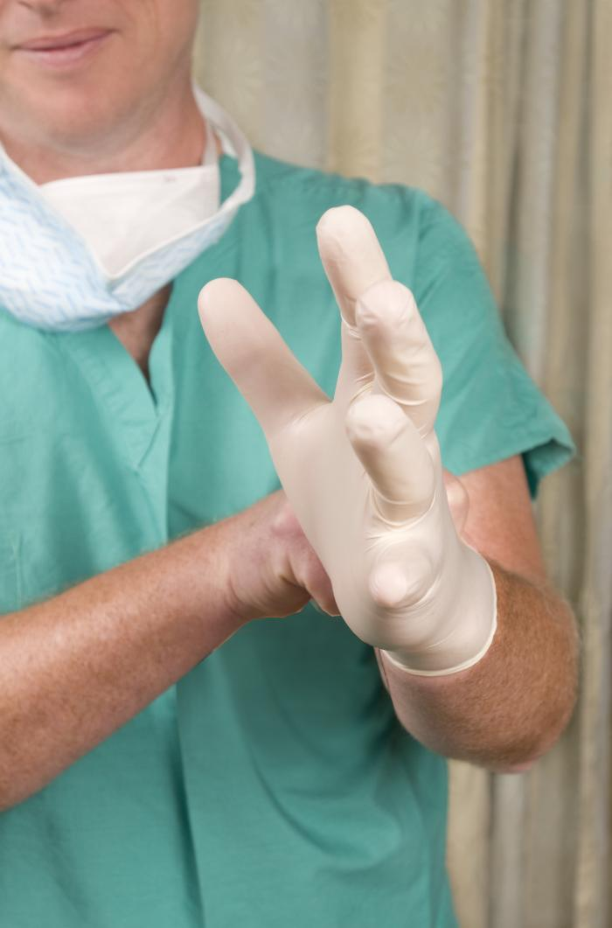
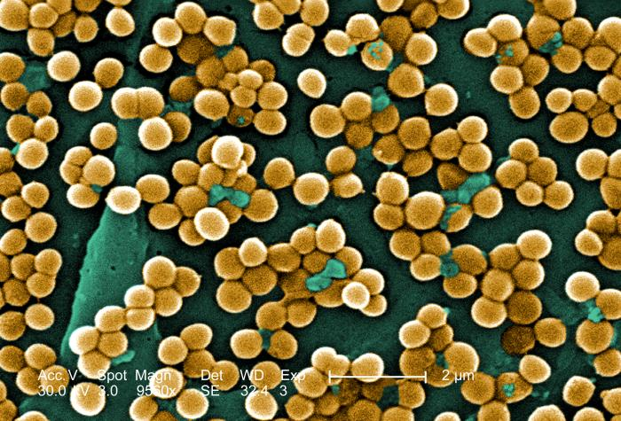
What is a nosocomial infection?
There are many different types of microbes that cause HAIs. Many are bacteria resistant to antibiotics.
A majority of HAIs include:
Urinary tract infections
Surgical site infections
Bloodstream infections
Pneumonia
2011 HAI Prevalence Survey found that on any given day, about 1 in 25 hospital patients has at least one healthcare-associated infection.
There were an estimated 722,000 HAIs in U.S acute care hospitals in 2011.
About 75,000 hospital patients with HAIs died during their hospitalizations.
Most of these HAI infections are preventable.
.
Images: Surgeon PHIL #13551, S. aureus, PHIL #10046
From the Virtual Microbiology Classroom on ScienceProfOnline.com
Notes:
Hospital acquired infection.
While rates have stayed the same for the last 20 years because of shorter inpatient stays the rate of infections per 1,000 patient days has increased 36%.

Slide 22

Q: What is the single most important thing that you can do to prevent the spread of infectious disease?
Find out by watching this CDC (Centers for Disease Control) video:
Put Your Hands Together.
From the Virtual Microbiology Classroom on ScienceProfOnline.com

Slide 23

What does it take to be a butt-kicking, badass infectious disease?
One of the best ways to begin learning about infectious disease is to see the world from the perspective of a pathogen!
Plague Inc. is a FREE game app where you get to be an infectious disease and figure out what it takes to succeed.

Slide 24
Confused?
Here are links to fun resources that further explain
what we discussed in this lecture:
Intro to Microbiology Main Page on the Virtual Microbiology Classroom of Science Prof Online.
Play Pandemic 2 a video game of strategy, where you try to become a successful pandemic microbe and infect the world. My 14-year old, daughter and I recommend this one to you.
“Quarantine” a scary movie about a new infectious disease.
“Contagion” great dramatic movie that realistically depicts what could happen in outbreak of a novel, virulent infectious disease.
Play Disease Defenders educational video game, Rice University.
Normal Flora webpage, by Douglas F. Fix. Interactive page where you can select an area of the body and learn which normal flora typically colonize that location.
“Catch My Disease” song by Ben Lee.
Bacterial Pathogen Pronunciation Station, a webpage with links to audio files containing the pronunciation of the bacterial names, created by Neal R. Chamberlain, Ph.D.
Giant Microbes, a company that sells adorable stuffed microbes.
(You must be in PPT slideshow view to click on links.)
Smart Links
From the Virtual Microbiology Classroom on ScienceProfOnline.com

Slide 25
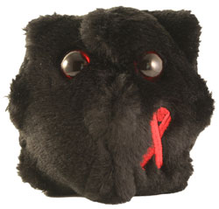
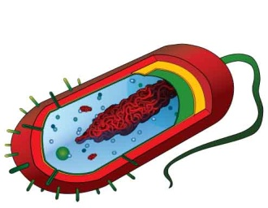
Are microbes intimidating you?
Do yourself a favor. Use the…
Virtual Microbiology Classroom (VMC) !
The VMC is full of resources to help you succeed, including:
practice test questions
review questions
study guides and learning objectives
You can access the VMC by going to the Science Prof Online website www.ScienceProfOnline.com
Images: HIV, Giant Microbes; Prokaryotic cell, Mariana Ruiz

