Slide 1
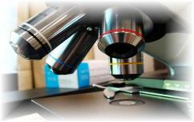
About Science Prof Online
PowerPoint Resources
Science Prof Online (SPO) is a free science education website that provides fully-developed Virtual Science Classrooms, science-related PowerPoints, articles and images. The site is designed to be a helpful resource for students, educators, and anyone interested in learning about science.
The SPO Virtual Classrooms offer many educational resources, including practice test questions, review questions, lecture PowerPoints, video tutorials, sample assignments and course syllabi. New materials are continually being developed, so check back frequently, or follow us on Facebook (Science Prof Online) or Twitter (ScienceProfSPO) for updates.
Many SPO PowerPoints are available in a variety of formats, such as fully editable PowerPoint files, as well as uneditable versions in smaller file sizes, such as PowerPoint Shows and Portable Document Format (.pdf), for ease of printing.
Images used on this resource, and on the SPO website are, wherever possible, credited and linked to their source. Any words underlined and appearing in blue are links that can be clicked on for more information. PowerPoints must be viewed in slide show mode to use the hyperlinks directly.
Several helpful links to fun and interactive learning tools are included throughout the PPT and on the Smart Links slide, near the end of each presentation. You must be in slide show mode to utilize hyperlinks and animations.
This digital resource is licensed under Creative Commons Attribution-ShareAlike 3.0:
http://creativecommons.org/licenses/by-sa/3.0/
Alicia Cepaitis, MS
Chief Creative Nerd
Science Prof Online
Online Education Resources, LLC
alicia@scienceprofonline.com
Tami Port, MS
Creator of Science Prof Online
Chief Executive Nerd
Science Prof Online
Online Education Resources, LLC
info@scienceprofonline.com
From the Virtual Cell Biology Classroom on ScienceProfOnline.com
Image: Compound microscope objectives, T. Port
Notes:
Welcome to Science Prof Online PowerPoint Resources!
This PowerPoint Presentation comes from the Virtual Cell Biology Classroom of Science Prof Online, and, as such, is licensed under Creative Commons Attribution-ShareAlike 3.0.; meaning you can download, share and alter any of this presentation, but you can’t sell it or repackage and sell any part of it. Please credit Science Prof Online as the source of this presentation. Please abide by credited image copyrights. Thank you for using this resource.

Slide 2
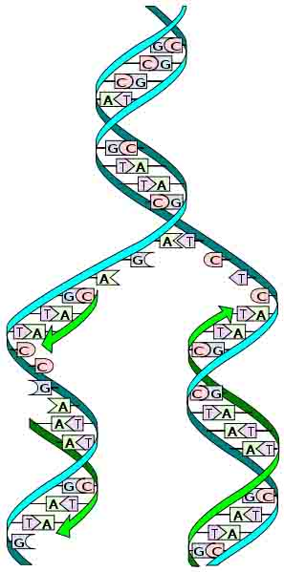
Molecular Genetics
DNA
Replication
From the Virtual Cell Biology Classroom on ScienceProfOnline.com
Image: Replication Diagram: Madprime

Slide 3
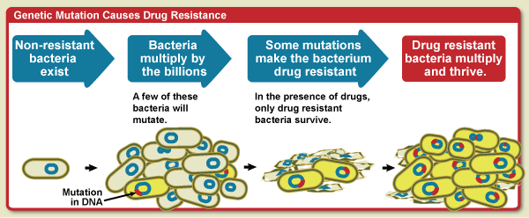
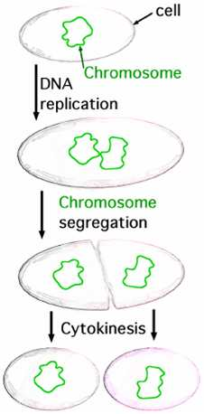
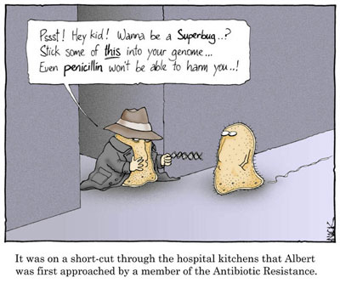
Everyday Biology
How do bacteria
become resistant
to antibiotics?
Genes for antibiotic resistance arise through DNA mutations (mistakes when copying DNA).
These resistance genes spread as resistant bacteria multiply and through horizontal gene transfer.
Q: How would overuse and incorrect use of antibiotics contribute to
antibiotic resistance in bacteria?
From the Virtual Cell Biology Classroom on ScienceProfOnline.com
Images: Drug resistance, NIAID; Binary Fission, JW Schmidt; Bacterial conjugation by Adenosine

Slide 4
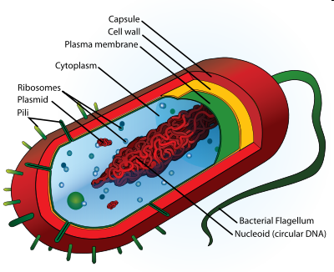
Prokaryotic Genomes
Made of DNA
Chromosomes can be circular or linear
Genome floats freely within cytoplasm
Q: Where is DNA found in prokaryotes?
  ______________
  ______________
From the Virtual Cell Biology Classroom on ScienceProfOnline.com
Image: Prokaryotic Cell Diagram: Mariana Ruiz
Notes:
Nucleoid
Plasmids

Slide 5
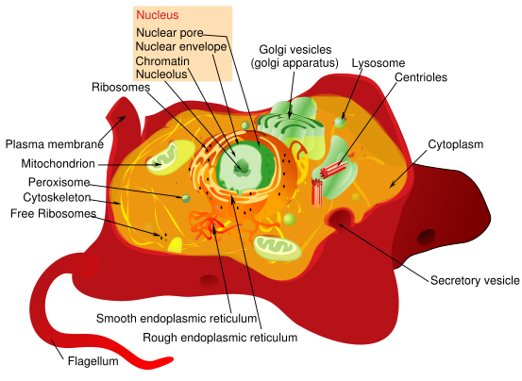
Eukaryotic Genomes
Genomes of eukaryotic organisms made of DNA.
Eukaryotic genomes frequently include many linear chromosomes within a membrane-bound nucleus
(Q: How many do we have?).
Where is DNA found in eukaryotes?
  Nuclear DNA
  Extranuclear DNA
  (Q: What is extranuclear DNA?)
From the Virtual Cell Biology Classroom on ScienceProfOnline.com
Image: Eukaryotic Cell Diagram, Mariana Ruiz
Notes:
Eukaryotic

Slide 6
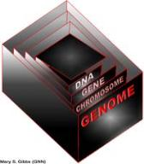
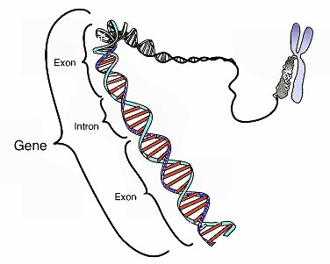
Chromosomes & Genes
Genome - Complete complement of an organism’s DNA.
Cellular DNA is organized in chromosomes.
Genes have specific places on chromosomes.
Image: Chromosome & gene, Graham Colm, National Human Genome Research Institute
From the Virtual Cell Biology Classroom on ScienceProfOnline.com

Slide 7
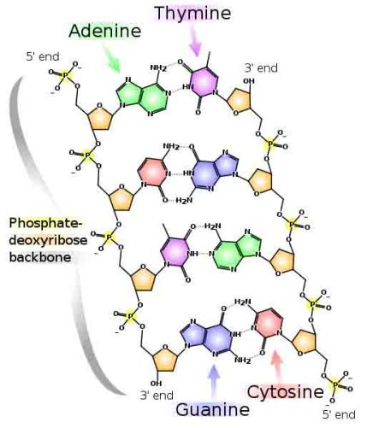
Nucleotides
and
Nucleic Acids
From the Virtual Cell Biology Classroom on ScienceProfOnline.com
Image: DNA Detail Diagram: Madprime

Slide 8
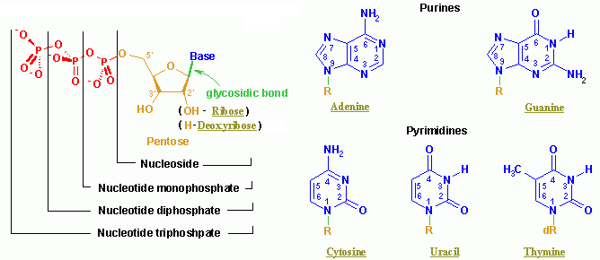
Nucleic Acids
Q: What type of monomer are nucleic acids made of?
From the Virtual Cell Biology Classroom on ScienceProfOnline.com
Image: Nucleotide Structure, Wikipedia

Slide 9
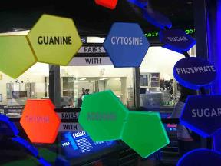
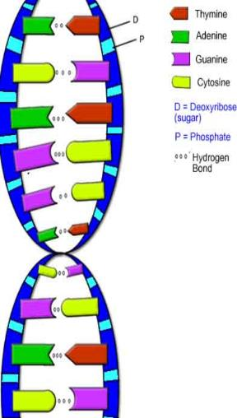

DNA Structure
Double stranded molecule, analogous to a spiral staircase:
- two deoxyribose-phosphate chains as the “side rails”
- base pairs, linked by hydrogen bonds, are the “steps”
Purine Bases
(double ring)
Adenine & Guanine
Pyrimidine Bases
(single ring)
Cytosine & Thymine
Images: Model of DNA Molecule, Field Museum, Chicago, T. Port; DNA Detail Diagram: Madprime; DNA Molecule, Biology Corner
From the Virtual Cell Biology Classroom on ScienceProfOnline.com

Slide 10
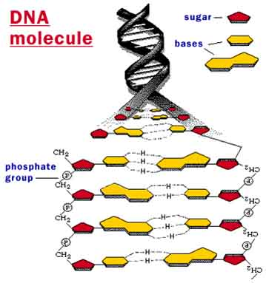
From the Virtual Cell Biology Classroom on ScienceProfOnline.com
Image: DNA molecule, Why Files, NSF

Slide 11
DNA Replication
Copying of a double-stranded
DNA molecule.
Each DNA strand holds the same genetic information, so each strand can serve as a template for the new, opposite strand.
The parent (a.k.a. __________ )
strand is preserved and the daughter (a.k.a. ___________) strand is assembled from nucleotides.
This is called semi-conservative replication.
Resulting double-stranded DNA molecules are identical.
Q: Why would a cell need to copy its DNA?
From the Virtual Cell Biology Classroom on ScienceProfOnline.com
Image: Replication Diagram: Madprime, Wiki
Notes:
template
new
semi-conservative

Slide 12

DNA Replication
In a cell, DNA replication must happen before cell division.
Prokaryotes replicate their DNA throughout the interval between cell divisions.
In eukaryotes, timing of replication is highly regulated.
From the Virtual Cell Biology Classroom on ScienceProfOnline.com
Image: Prokaryotic Cell Diagram & Eukaryotic Cell Diagram, Mariana Ruiz

Slide 13
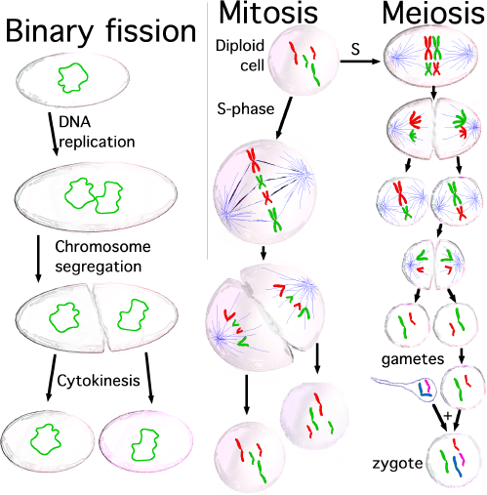
DNA Replication
From the Virtual Cell Biology Classroom on ScienceProfOnline.com
Image: Types of Cell Division, Saperaud Wiki

Slide 14

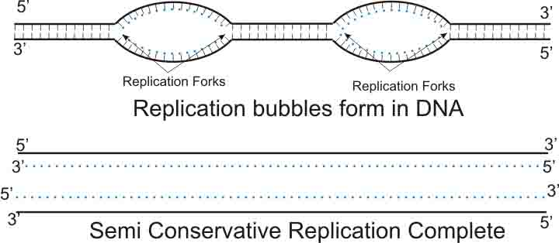
EUKARYOTIC DNA Replication: Replication “Bubbles”
Multiple origins of replication > These “bubbles” are the start points of replication.
Replication fork: ‘Y’-shaped region where new strands of DNA are elongating.
Image: Eukaryotic Cell Diagram, Mariana Ruiz; Replication Bubbles Boumphreyfr, Wiki
From the Virtual Cell Biology Classroom on ScienceProfOnline.com

Slide 15

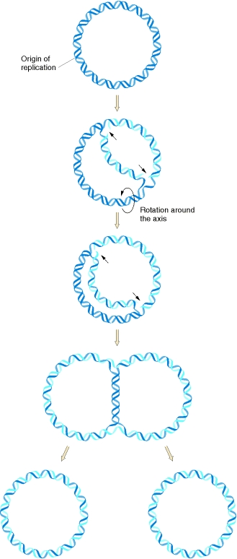
PROKARYOTIC DNA Replication
One Origin
Prokaryotic DNA is arranged in a circular shape, and there is only one replication origin.
Despite these differences, the underlying process of replication is the same for both prokaryotic and eukaryotic DNA.
From the Virtual Cell Biology Classroom on ScienceProfOnline.com
Image: Prokaryotic Replication, U.S. National Library of Medicine

Slide 16
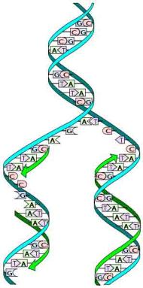
How Do Nucleotides Put Themselves Together Into Nucleic Acids?
An anabolic polymerization process.
Q: Anabolic or Anabolism is….? _______________________
Q: Polymerization is …? ____________________________
Polymerization requires monomers (building blocks) and energy.
- Triphosphate deoxyribonucleotides provide both.
- These building blocks of DNA bring their own energy for polymerization.
From the Virtual Cell Biology Classroom on ScienceProfOnline.com
Image: Replication Diagram: Madprime, Wiki

Slide 17

DNA Replication: Anti-parallel Nature of DNA
• Sugar/phosphate backbone runs in opposite directions.
• One strand runs 5’ to 3’, while the other runs 3’ to 5’.
• DNA polymerase: enzyme that facilitates addition of nucleotides in building the new DNA strand.
• Can only adds nucleotides at the free 3’ end.
Q: Why is this important?
Image: DNA Detail Diagram: Madprime
From the Virtual Cell Biology Classroom on ScienceProfOnline.com

Slide 18
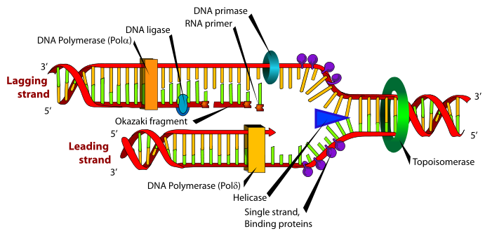
DNA Replication: Leading & Lagging Strand
Leading Strand
Synthesis proceeds smoothly as the replication fork unzips.
Lagging Strand
Synthesis away from the replication fork (Okazaki fragments); joined by DNA ligase.
REVIEW
DNA Replication Animations
from McGraw-Hill
This link will take you to a page with 4 links on it. Please view the first, “How Nucleotides are Added in DNA Replication” and the fourth “DNA Replication Fork”.
Replication Fork Diagram: Mariana Ruiz
From the Virtual Cell Biology Classroom on ScienceProfOnline.com

Slide 19
Let’s Practice How Leading & Lagging Daughter Strands Are Built Within the Replication Bubble
?’
?’
5’
?’
RNA Primers
?’
?’
?’
?’
Replication Fork
Replication Fork
Now lets look at how replication of the leading and lagging strands occurs at each of the two replication forks within the replication bubble:
1. Label each end of the parent strands as either 5’ or 3’.
2. Start a RNA primer for each daughter strand and label its 5’ and 3’ ends.
3. Show how new strands are built (continuously or discontinuously).
From the Virtual Cell Biology Classroom on ScienceProfOnline.com

Slide 20
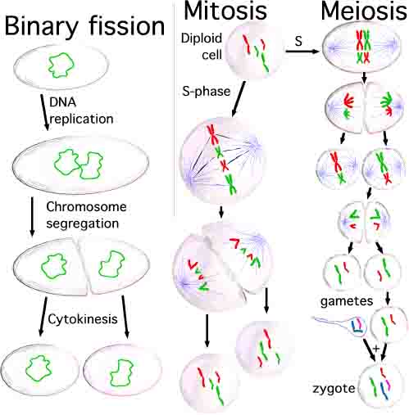
Reminder…Why is the DNA copied?
  Replication occurs prior to cell division, because the new, daughter cell will also need a complete copy of cellular DNA.
From the Virtual Cell Biology Classroom on ScienceProfOnline.com
Image: Types of Cell Division, Saperaud Wiki

Slide 21
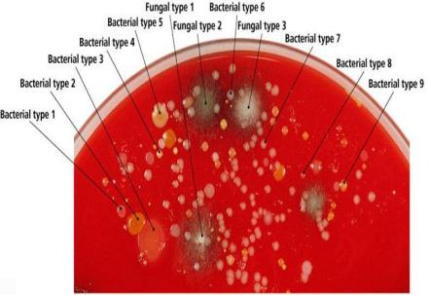
If binary fission creates clones…
Genetic Diversity in Prokaryotes
…then:
Why isn’t there just one type of bacteria?
How do bacteria change (for example develop resistance to antibiotics)?
From the Virtual Cell Biology Classroom on ScienceProfOnline.com
Images: Binary Fission, JW Schmidt

Slide 22
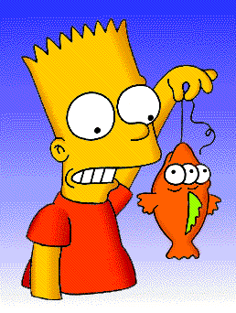
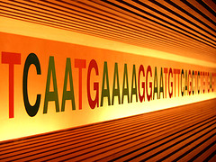
Replication Mistakes: Mutations of Genes
Change in the nucleotide base sequence of a genome; rare.
Almost always bad news, but...
Rarely leads to a protein having a novel property that improves ability of organism and its descendants to survive and reproduce.
From the Virtual Cell Biology Classroom on ScienceProfOnline.com
Images: Blinky & Bart, Matt Groening

Slide 23
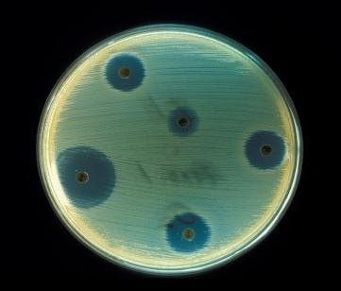
Mutation and Bacterial Change
_________ __________= When a microorganism is able to survive exposure to an antibiotic.
Genetic mutation in bacteria can produce resistance to antimicrobial drugs (example: beta-lactamase).
If those genes are on a plasmid, they can be transferred between bacteria by conjugation and other forms of horizontal gene transfer.
If a bacterium carries several resistance genes, it is called multidrug resistant (MDR) or, informally, a superbug or super bacterium.
Any use of antibiotics can increase selective pressure in a population of bacteria to allow the resistant bacteria to thrive and the susceptible bacteria to die off.
REVIEW!
Antibiotic Resistance Animation
from Sumanas
From the Virtual Cell Biology Classroom on ScienceProfOnline.com
Image: Staphylococcus aureus on antibiotic test plate, PHIL #2641
Notes:
Antibiotic resistance

Slide 24
Confused?
Here are links to fun resources that further explain genetic replication:
Molecular Genetics: Replication Main Page on the Virtual Cell Biology Classroom of Science Prof Online.
“That Spells DNA” song by Jonathan Coulton.
DNA Structure Cell Biology Animation from John Kyrk.
Build a DNA Molecule from University of Utah.
DNA Replication animation and review questions.
“Bio Rad GTCA Song” musical advertisement for SsoFast™.
animation by John Kyrk.
“She Blinded Me With Science” music video Thomas Dolby.
(You must be in PPT slideshow view to click on links.)
Smart Links
From the Virtual Cell Biology Classroom on ScienceProfOnline.com

Slide 25
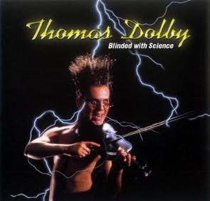
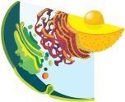
Are you feeling blinded by science?
Do yourself a favor. Use the…
Virtual Cell Biology Classroom (VCBC) !
The VCBC is full of resources to help you succeed, including:
practice test questions
review questions
study guides and learning objectives
PowerPoints on other topics
You can access the Virtual Cell Biology Classroom by going to the Science Prof Online website www.ScienceProfOnline.com
Images: Blinded With Science album, Thomas Dolby; Endomembrane system, Mariana Ruiz, Wiki

