Slide 1

About Science Prof Online
PowerPoint Resources
Science Prof Online (SPO) is a free science education website that provides fully-developed Virtual Science Classrooms, science-related PowerPoints, articles and images. The site is designed to be a helpful resource for students, educators, and anyone interested in learning about science.
The SPO Virtual Classrooms offer many educational resources, including practice test questions, review questions, lecture PowerPoints, video tutorials, sample assignments and course syllabi. New materials are continually being developed, so check back frequently, or follow us on Facebook (Science Prof Online) or Twitter (ScienceProfSPO) for updates.
Many SPO PowerPoints are available in a variety of formats, such as fully editable PowerPoint files, as well as uneditable versions in smaller file sizes, such as PowerPoint Shows and Portable Document Format (.pdf), for ease of printing.
Images used on this resource, and on the SPO website are, wherever possible, credited and linked to their source. Any words underlined and appearing in blue are links that can be clicked on for more information. PowerPoints must be viewed in slide show mode to use the hyperlinks directly.
Several helpful links to fun and interactive learning tools are included throughout the PPT and on the Smart Links slide, near the end of each presentation. You must be in slide show mode to utilize hyperlinks and animations.
This digital resource is licensed under Creative Commons Attribution-ShareAlike 3.0:
http://creativecommons.org/licenses/by-sa/3.0/
Tami Port, MS
Creator of Science Prof Online
Chief Executive Nerd
Science Prof Online
Online Education Resources, LLC
info@scienceprofonline.com
Alicia Cepaitis, MS
Chief Creative Nerd
Science Prof Online
Online Education Resources, LLC
alicia@scienceprofonline.com
From the Virtual Microbiology Classroom on ScienceProfOnline.com
Image: Compound microscope objectives, T. Port
Notes:
Welcome to Science Prof Online PowerPoint Resources!
This PowerPoint Presentation comes from the Virtual Cell Biology Classroom of Science Prof Online, and, as such, is licensed under Creative Commons Attribution-ShareAlike 3.0.; meaning you can download, share and alter any of this presentation, but you can’t sell it or repackage and sell any part of it. Please credit Science Prof Online as the source of this presentation. Please abide by credited image copyrights. Thank you for using this resource.

Slide 2
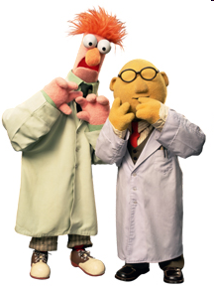
Laboratory
LAB MEETS 1x WEEKLY
Be on time. 10 minutes after the start of lab, the doors may be locked.
LAB REQUIREMENTS:
• You must have the following to participate in lab:
- Goggles (We have those in lab for you)
- Lab coat (We have those in lab for you)
- Shoes that completely cover feet, long pants (No shorts or capris),
& long hair up.
LAB QUIZ & REPORT:
• Each week there will be an open-book lab quiz available on Moodle. It must be completed before lab. The quiz will cover information from that week’s lab (i.e. the upcoming lab). This is how I assess whether or not you are prepared to safely participate in lab.
• Each Lab Project has an associated Lab Report. See Moodle syllabus for schedule of due dates for homework.
WHERE IS THE LAB MANUAL?
• The links to the Laboratory material are on Moodle.
IT IS NOT ALWAYS POSSIBLE TO MAKE UP LABORATORY SESSIONS:
From the Virtual Microbiology Classroom on ScienceProfOnline.com
Image: : The Muppets Beaker & Dr. Bunsen Honeydew

Slide 3
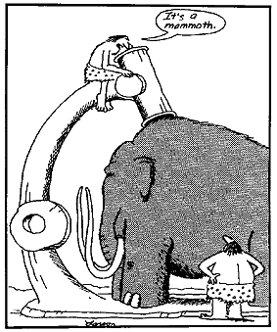
Laboratory
Exercise 1
How to Use a Compound Microscope
Basic Microscopy
From the Virtual Microbiology Classroom on ScienceProfOnline.com
Image: The Far Side by Gary Larson

Slide 4
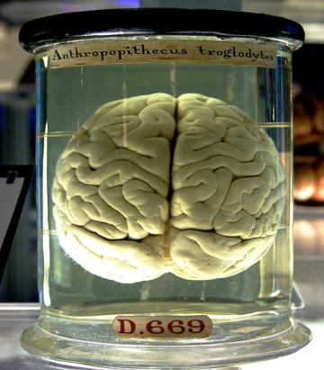
What am I going to learn from Lab Topic #1?
How to make a wet mount slide (Sweeeet)!
How to microscopically view wet mounted plant cells & animal cells.
How to use and maintain a compound light microscope.
How to protect yourself from other people’s bodily fluids ☺.
From the Virtual Microbiology Classroom on ScienceProfOnline.com
Image: Chimp brain in a jar, Gaetan Lee

Slide 5
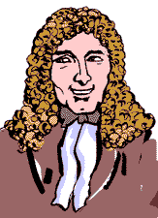
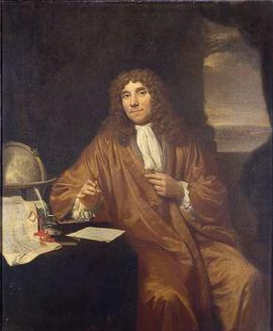
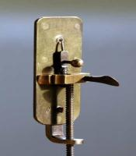
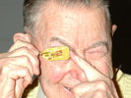
Anton van Leeuwenhoek’s “Animalcules”
(Pronounced Lay-ven-hook)
As a draper (merchant who sells cloth and dry goods), he used lenses to examine cloth. This probably led to his interest in lens making.
He assembled hundreds of microscopes, some of which magnified objects 270 times.
As he looked at things with his microscopes, he discovered “micro” organisms - organisms so tiny that they were invisible to the naked eye.
He called these tiny living organisms “animalcules”. He first described bacteria, protozoans and many cells of the human body.
1632 - 1723
Images: Leeuwenhoek portrait 1680, Jan Verkolje (I);. Replica of Leeuwenhoek microscope, Jacopo Werther; Man with scope, source unknown
From the Virtual Biology Classroom on ScienceProfOnline.com

Slide 6
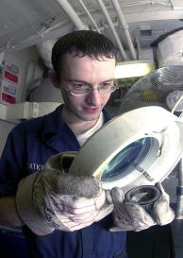
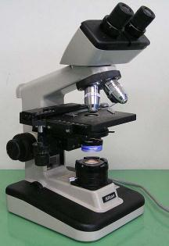
Compound Light Microscope
The “Compound” Part
Simple microscopes have single magnifying lens (like a magnifying glass).
Compound microscopes have two sets of lenses for magnification.
Lens closer to the eye = ocular lens (magnifying power of 10x).
Lenses closer to the object being viewed = objective lens. (Most light microscopes used in biology have three or four objective lenses).
The “Light” Part
Bright-field light microscopes produce a dark image against brighter, backlit background.
Provide a 2-D image.
Commonly used to view stained cells.
Image: Magnifying lamp use to look for part defects, US Navy; Compound light microscope, Moisey
From the Virtual Microbiology Classroom on ScienceProfOnline.com

Slide 7
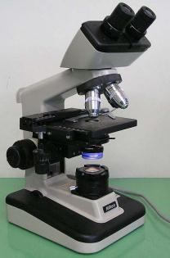
Your Microscope
Take Care of Your Scope:
  It is your responsibility to take care of your scope and learn to use it properly.
  I randomly check scopes to see if they are put away correctly. If yours is not, I may subtract points from your lab grade.
Microscope Log:
  If you get your scope out and find that it has not been put away properly, make an entry in the microscope log.
Getting Scope Out:
  The scope that you use is numbered to correspond to your seat number, on edge of lab bench in front of you.
  When transporting your scope, always hold it with one hand under the base, and one hand around the arm.
Putting Scope Away:
  Clean stage if it is oily, and use lens paper to clean lenses.
  Shortest objective lens (the one with the red band) should be pointing down toward stage.
  Use course focus to position stage as low as it can go.
  Always put scope back in numbered parking spot in scope cabinet.
  ** Now everyone get out their scope **
ARM
BASE
From the Virtual Microbiology Classroom on ScienceProfOnline.com
Image: Compound light microscope, Moisey

Slide 8

Parts of a Compound Light Microscope
From the Virtual Microbiology Classroom on ScienceProfOnline.com
Image: Compound light microscope, Moisey

Slide 9
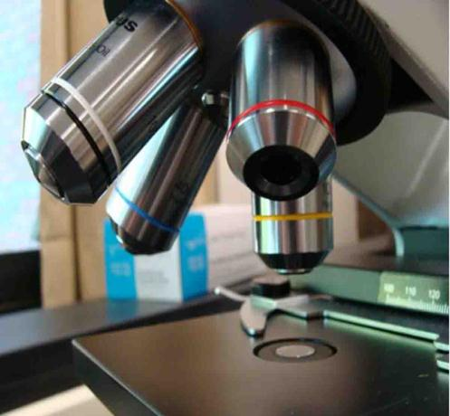
Magnification & The Objective Lenses
Ocular lens magnifies the specimen 10x.
You will always be looking through the ocular and objective lens simultaneously, so multiply ocular magnification x objective power to calculate the Total Magnification (xTM).
Rotary nosepiece of your microscope has four objective lenses attached.
Shortest lens (red band) should have been pointing down when your scopes were last put away.
From the Virtual Microbiology Classroom on ScienceProfOnline.com
Image: Microscope objective lenses, T. Port

Slide 10
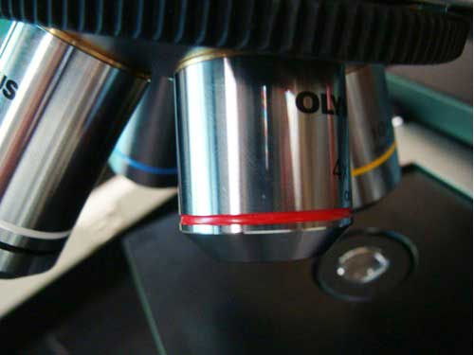
Scanning Power Objective Lens
Red band around it.
Magnifies objects 4x.
Q: What is the Total Magnification? ____ TM
We will only use this lens in today’s lab. It is not useful for looking at bacteria.
From the Virtual Microbiology Classroom on ScienceProfOnline.com
Image: Microscope objective lenses, T. Port

Slide 11
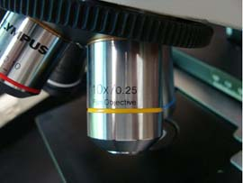
Low Power Objective Lens
Has yellow band around it.
Magnifies objects 10x.
Q: What is the Total Magnification? ____ TM
Start with this lens when looking at a bacterial smear.
Q: What does the term parfocal mean?
From the Virtual Microbiology Classroom on ScienceProfOnline.com
Image: Microscope objective lenses, T. Port

Slide 12
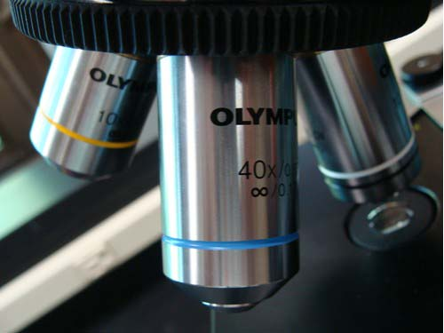
High Dry Objective Lens
Has blue band around it.
Magnifies objects 40x.
Q: What is the Total Magnification? ____ TM
Switch to this lens after getting your specimen in focus at 100xTM.
From the Virtual Microbiology Classroom on ScienceProfOnline.com
Image: Microscope objective lenses, T. Port

Slide 13
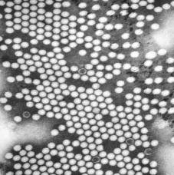
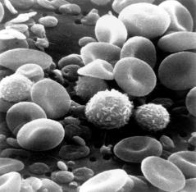
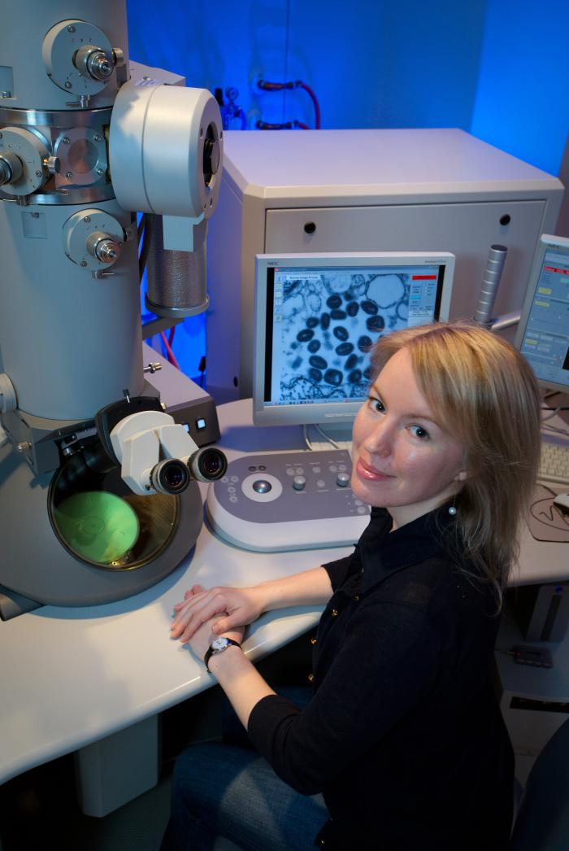
Microscopy: Electron Microscopes
Many microscopic images in your textbook were obtained using electron microscopes.
Electron beam wavelengths are shorter than light wavelengths, so better resolving power.
Q: What is resolution, in the context of microscopy?
Transmission Electron Microscope (TEM): 2-D image
Scanning Electron Microscope (SEM): 3-D image
Images: Poliovirus, taken with TEM, PHIL #1875, Blood cells, taken with SEM, National Cancer Institute; Transmission electron microscope, Public Health Image Library, image #14236.
From the Virtual Microbiology Classroom on ScienceProfOnline.com

Slide 14
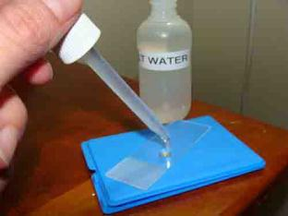
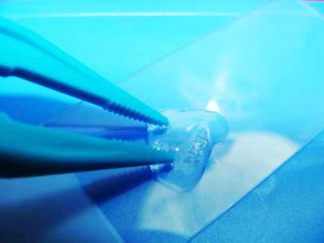
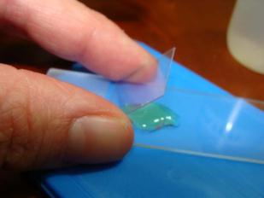
How to make a wet mount
From the Virtual Microbiology Classroom on ScienceProfOnline.com
Image: Wet mount procedure, T. Port

Slide 15
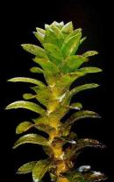
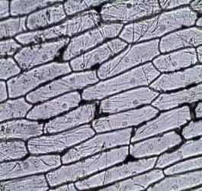
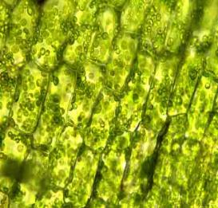
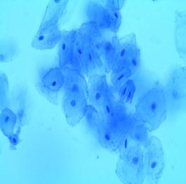
Procedure
1. How to make a wet mount
2. Letter “e”
What happens to the “e” when you look at it through the lens?
What happens to your view of the “e” when your increase magnification?
3. Onion
Wet mount, use stain
Note nucleus and cell wall
View video tutorial
4. Elodea
- Wet mount NO stain
- Depth of field
2 layers of cells
Note cell wall, chloroplasts streaming
View video tutorial
5. Cheek cell
Wet mount using NaCl & Methylene blue.
Contrast!
View video tutorial
Images: Onion cells, Elodea cells & Cheek cells, SPO General Microbiology Microscopic Images; Elodea plant, Frank Vincentz
From the Virtual Microbiology Classroom on ScienceProfOnline.com

Slide 16
Confused?
Here are links to fun resources that further explain use of the microscope:
Microscopy Laboratory Main Page on the Virtual Microbiology Classroom of Science Prof Online.
Compound Microscope Parts and Use video from Science ProfOnline.
How to Make a Wet Mount of an Elodea Plant Cell video from ScienceProfOnline.
How to Make a Wet Mount of an Onion Epithelial Cell video from ScienceProfOnline.
How to Make a Wet Mount of a Cheek Cell video from ScienceProfOnline.
Play Amoeba, a video game where you are an amoeba that eats and grows.
Microscope Mania crossword puzzle.
Microscopic Pond Life, an extremely cool collection of videos of a variety of microscopic pond life to the tune of Radiohead’s “Kid A”.
Smart Links
(You must be in PPT slideshow view to click on links.)
From the Virtual Microbiology Classroom on ScienceProfOnline.com

Slide 17
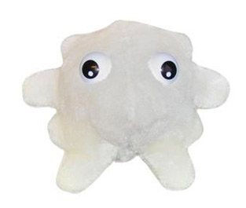
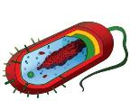
Are microbes intimidating you?
Do yourself a favor. Use the…
Virtual Microbiology Classroom (VMC) !
The VMC is full of resources to help you succeed, including:
practice test questions
review questions
study guides and learning objectives
You can access the VMC by going to the Science Prof Online website www.ScienceProfOnline.com
Images: White blood cell, Giant Microbes; Prokaryotic cell, Mariana Ruiz

