Slide 1

About Science Prof Online
PowerPoint Resources
Science Prof Online (SPO) is a free science education website that provides fully-developed Virtual Science Classrooms, science-related PowerPoints, articles and images. The site is designed to be a helpful resource for students, educators, and anyone interested in learning about science.
The SPO Virtual Classrooms offer many educational resources, including practice test questions, review questions, lecture PowerPoints, video tutorials, sample assignments and course syllabi. New materials are continually being developed, so check back frequently, or follow us on Facebook (Science Prof Online) or Twitter (ScienceProfSPO) for updates.
Many SPO PowerPoints are available in a variety of formats, such as fully editable PowerPoint files, as well as uneditable versions in smaller file sizes, such as PowerPoint Shows and Portable Document Format (.pdf), for ease of printing.
Images used on this resource, and on the SPO website are, wherever possible, credited and linked to their source. Any words underlined and appearing in blue are links that can be clicked on for more information. PowerPoints must be viewed in slide show mode to use the hyperlinks directly.
Several helpful links to fun and interactive learning tools are included throughout the PPT and on the Smart Links slide, near the end of each presentation. You must be in slide show mode to utilize hyperlinks and animations.
This digital resource is licensed under Creative Commons Attribution-ShareAlike 3.0:
http://creativecommons.org/licenses/by-sa/3.0/
Tami Port, MS
Creator of Science Prof Online
Chief Executive Nerd
Science Prof Online
Online Education Resources, LLC
info@scienceprofonline.com
Alicia Cepaitis, MS
Chief Creative Nerd
Science Prof Online
Online Education Resources, LLC
alicia@scienceprofonline.com
From the Virtual Microbiology Classroom on ScienceProfOnline.com
Image: Compound microscope objectives, T. Port
Notes:
Welcome to Science Prof Online PowerPoint Resources!
This PowerPoint Presentation comes from the Virtual Cell Biology Classroom of Science Prof Online, and, as such, is licensed under Creative Commons Attribution-ShareAlike 3.0.; meaning you can download, share and alter any of this presentation, but you can’t sell it or repackage and sell any part of it. Please credit Science Prof Online as the source of this presentation. Please abide by credited image copyrights. Thank you for using this resource.

Slide 2
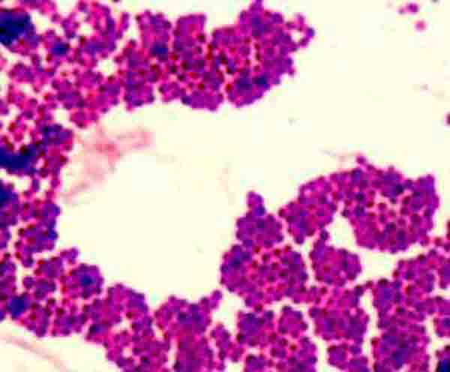
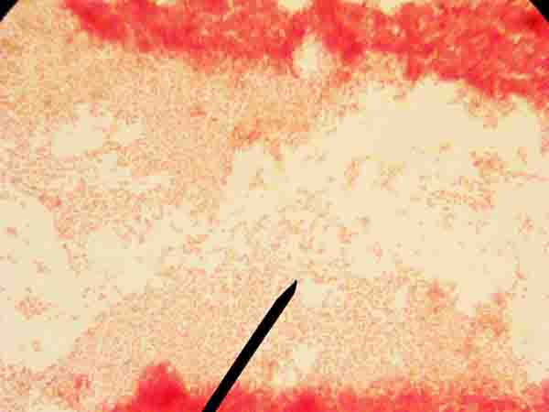
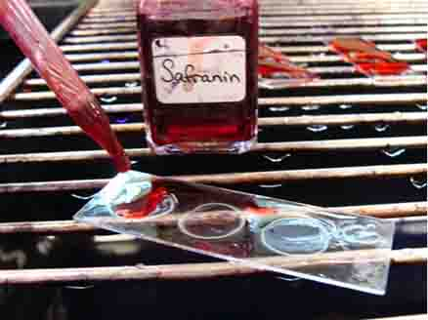
Laboratory Exercise 2
Gram Stain
Prepare Bacterial Smear for Gram Staining
Gram Stain Procedure
Identification of Unknown Bacteria
G
+
?
-
From the Virtual Microbiology Classroom on ScienceProfOnline.com
Images: Acid fast stain & mordant step of Gram stain, both by T. Port

Slide 3
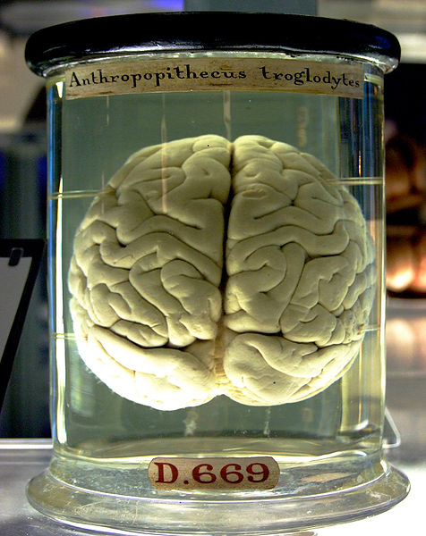
What am I going to learn from Lab Topic #2?
Gram Staining
Provide student with opportunity to perform a Gram stain with controls and an unknown.
Practice evaluating Gram stain results.
Practice viewing bacteria under oil immersion and taking photo micrographs of bacterial samples.
Please plug in your microincinerators.
From the Virtual Microbiology Classroom on ScienceProfOnline.com
Image: Chimp brain in a jar, Gaetan Lee

Slide 4
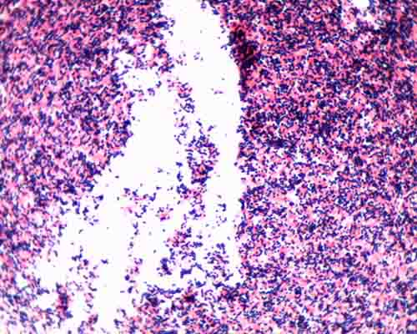
Differential Stains
Most stains used in microbiology are differential.
Differential stains involve use of more than one dye, so that certain differences between cell type or structures can be distinguished.
Image: Acid fast stain, T. Port
From the Virtual Microbiology Classroom on ScienceProfOnline.com

Slide 5
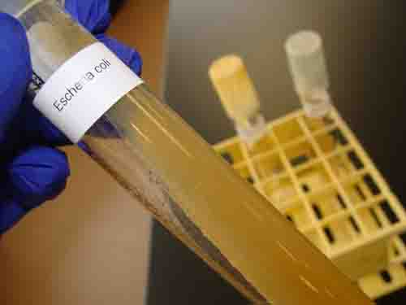
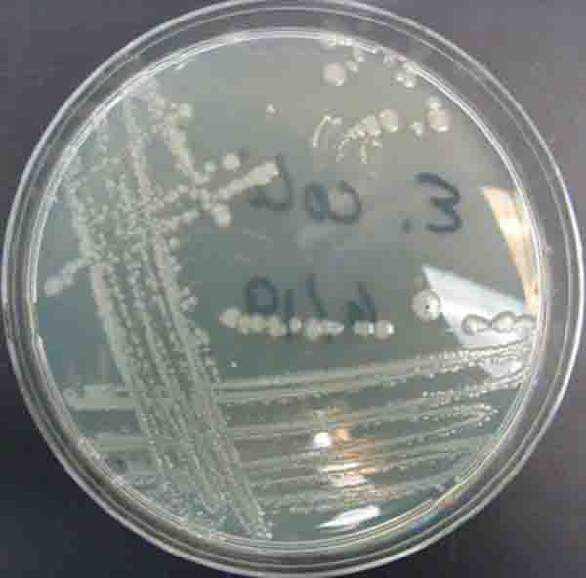
When obtaining a bacterial sample from a tube or plate of media do so gently! The bacteria is growing as a thin film on top of the media! Don’t scrape so hard that you have pieces of agar in your sample!
If obtaining bacterial sample from slant tubes:
never pick up test tube by the cap.
do NOT set cap down on lab bench
flame neck of the test tube before & after
obtaining sample.
Image: E. coli growing on TSY agar in slant tube and in Petri dish, T. Port
From the Virtual Microbiology Classroom on ScienceProfOnline.com

Slide 6
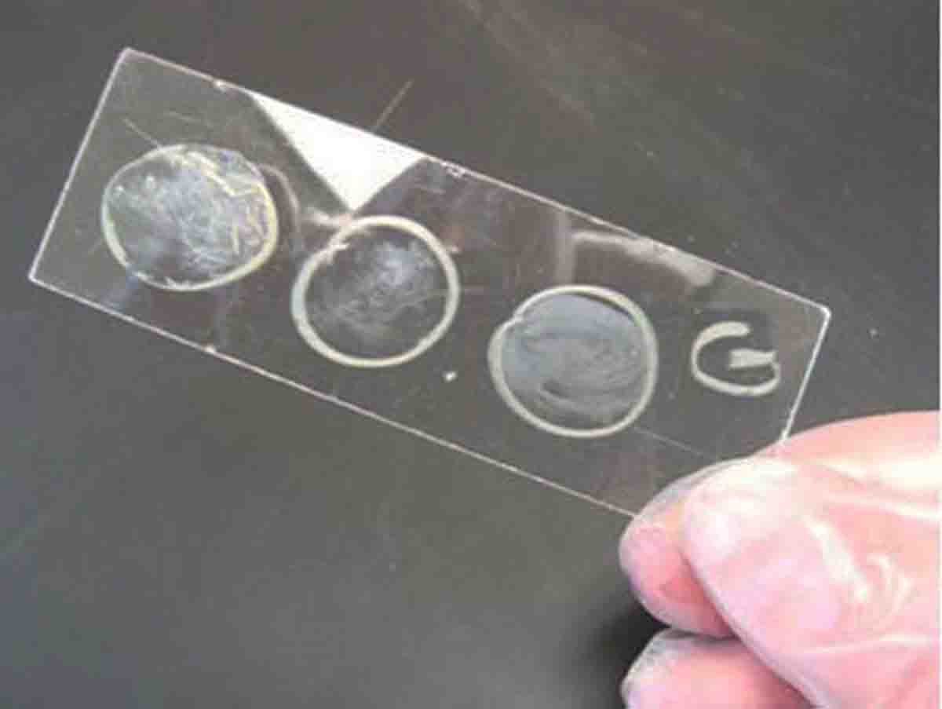
Gram Stain
Distinguishes between two large groups of
microorganisms:
- purple staining, Gram-positive cells
- pink staining, Gram-negative cells
Q: What is the difference between Gram+ and Gram- cell wall structure?
Q: Why do we draw three circles on the slide?
How to prepare bacterial smear for Gram staining:
Draw three circles on slide using wax pen
Also include a “G” to identify that slide will be Gram stained.
Flip slide over.
Use DI water dropper to place very small drop of water inside each circle.
Using a sterilized inoculation loop, take a small sample of your unknown. Be gentle! The bacteria is on the surface of the medium.
Swirl into the water in the center circle of your slide.
Q: Why are there two additional circles on our slide?
Use same method to add controls to circle on left and right.
Heat fix the slide on top of your microincinerator. Allow it to stay in the platform for 5 minutes after water has completely evaporated.
G
+
?
-
Watch video on
How to Prepare a Bacterial Smear for Gram Staining
From the Virtual Microbiology Classroom on ScienceProfOnline.com

Slide 7
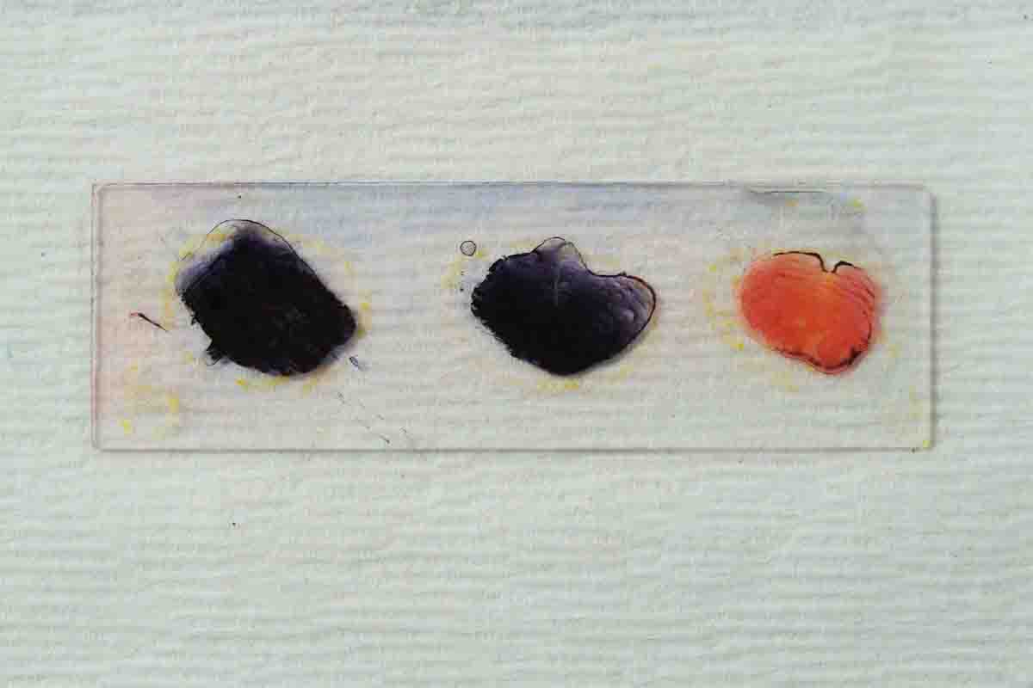
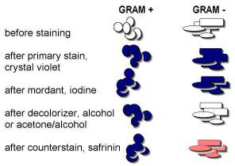
Gram Stain
GRAM STAINING
PROCEDURE
Crystal violet (1 min) > rinse
Iodine (1 min) > rinse
Acetone Alcohol (10–15 sec) > rinse
Safrinin (1 min) > rinse & blot dry
Watch video of
How to Do a
Gram Stain
From the Virtual Microbiology Classroom on ScienceProfOnline.com

Slide 8
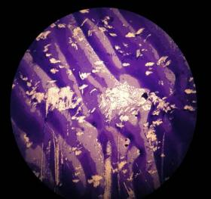
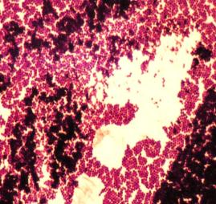
Although you will be using 100xTM to get your specimen in focus, you will not be able to see individual bacteria until you use the 1000xTM oil immersion lens.
Bacterial smear at 100xTM
Bacterial smear at 1000xTM
(oil immersion)
FYI: The example above is Staph.
Remember, you want to use the microscope with a built in camera so that you can take pictures of the bacteria you see at 1000xTM.
From the Virtual Microbiology Classroom on ScienceProfOnline.com
Images: Both images Staphylococcus, by T. Port

Slide 9

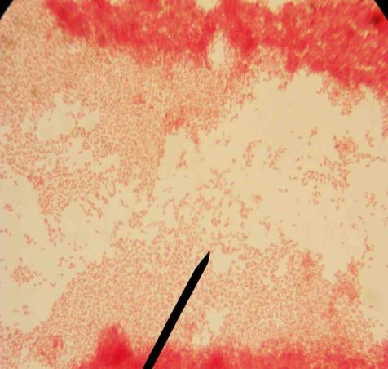
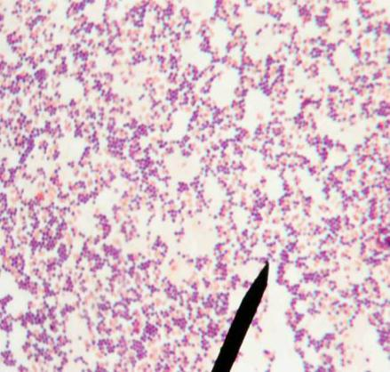
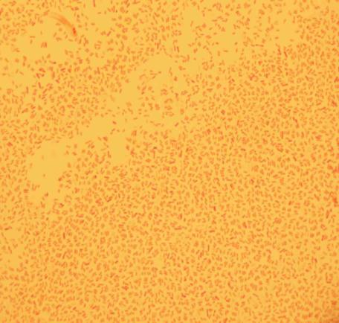
Gram Stain
Examples
@ 1000xTM
Staphylococcus epidermidis
Escherichia coli
Mixed Sample of S. epidermidis & E. coli
From the Virtual Microbiology Classroom on ScienceProfOnline.com
Images: All Gram stain images by T. Port

Slide 10
Confused?
Here are links to fun resources that further explain Gram Staining:
Gram Stain Lab Main Page on the Virtual Microbiology Classroom of Science Prof Online.
Gram Stain Interactive Tutorial.
This is an extremely useful tutorial that shows, step-by-
step, what happens in Gram-positive and Gram-negative
cells during Gram staining.
Video on How to Prepare a Bacterial Smear for Gram Staining
Video of Gram Stain Procedure
Smart Links
(You must be in PPT slideshow view to click on links.)
From the Virtual Microbiology Classroom on ScienceProfOnline.com

Slide 11
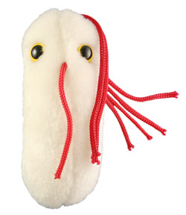
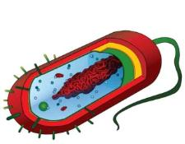
Are microbes intimidating you?
Do yourself a favor. Use the…
Virtual Microbiology Classroom (VMC) !
The VMC is full of resources to help you succeed, including:
practice test questions
review questions
study guides and learning objectives
You can access the VMC by going to the Science Prof Online website www.ScienceProfOnline.com
Images: Salmonella, Giant Microbes; Prokaryotic cell, Mariana Ruiz

