Slide 1

About Science Prof Online
PowerPoint Resources
Science Prof Online (SPO) is a free science education website that provides fully-developed Virtual Science Classrooms, science-related PowerPoints, articles and images. The site is designed to be a helpful resource for students, educators, and anyone interested in learning about science.
The SPO Virtual Classrooms offer many educational resources, including practice test questions, review questions, lecture PowerPoints, video tutorials, sample assignments and course syllabi. New materials are continually being developed, so check back frequently, or follow us on Facebook (Science Prof Online) or Twitter (ScienceProfSPO) for updates.
Many SPO PowerPoints are available in a variety of formats, such as fully editable PowerPoint files, as well as uneditable versions in smaller file sizes, such as PowerPoint Shows and Portable Document Format (.pdf), for ease of printing.
Images used on this resource, and on the SPO website are, wherever possible, credited and linked to their source. Any words underlined and appearing in blue are links that can be clicked on for more information. PowerPoints must be viewed in slide show mode to use the hyperlinks directly.
Several helpful links to fun and interactive learning tools are included throughout the PPT and on the Smart Links slide, near the end of each presentation. You must be in slide show mode to utilize hyperlinks and animations.
This digital resource is licensed under Creative Commons Attribution-ShareAlike 3.0:
http://creativecommons.org/licenses/by-sa/3.0/
Tami Port, MS
Creator of Science Prof Online
Chief Executive Nerd
Science Prof Online
Online Education Resources, LLC
info@scienceprofonline.com
Alicia Cepaitis, MS
Chief Creative Nerd
Science Prof Online
Online Education Resources, LLC
alicia@scienceprofonline.com
From the Virtual Microbiology Classroom on ScienceProfOnline.com
Image: Compound microscope objectives, T. Port
Notes:
Welcome to Science Prof Online PowerPoint Resources!
This PowerPoint Presentation comes from the Virtual Cell Biology Classroom of Science Prof Online, and, as such, is licensed under Creative Commons Attribution-ShareAlike 3.0.; meaning you can download, share and alter any of this presentation, but you can’t sell it or repackage and sell any part of it. Please credit Science Prof Online as the source of this presentation. Please abide by credited image copyrights. Thank you for using this resource.

Slide 2
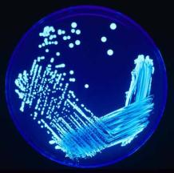
Laboratory Exercise 2
How to Aseptically Pour
Bacterial Growth
Media & Prepare
an Isolation
Streak Plate
Plug in and turn on microincinerator now!
From the Virtual Microbiology Classroom on ScienceProfOnline.com
Images: Isolation streak plate of Legionella, PHIL #7925; Bacterial smear, T. Port

Slide 3
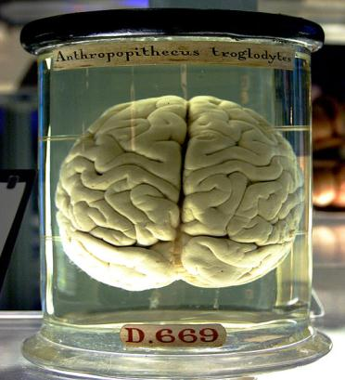
What am I going to learn from Lab Topic #2?
Isolation Streak Plate Method
You will learn how to aseptically pour bacterial growth media.
You will practice performing isolation streak plates using aseptic technique.
Please plug in your microincinerators.
From the Virtual Microbiology Classroom on ScienceProfOnline.com
Image: Chimp brain in a jar, Gaetan Lee

Slide 4
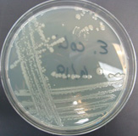
Growth Media
Bacteria and other microbes have
particular requirements for growth.
In order to successfully grow bacteria
in lab, we must provide an environment
suitable for growth.
Growth media (singular = medium) are used to
cultivate microbial growth.
Media = mixtures of nutrients that the microbes need to live.
Also provides a surface and the necessary moisture and pH to support microbial growth.
Tryptic Soy Agar (TSY) is the medium that we most often use. Complex nutrient media which supports the growth of a wide variety of microbes.
From the Virtual Microbiology Classroom on ScienceProfOnline.com
Image: Streak plate of E. coli, T. Port

Slide 5
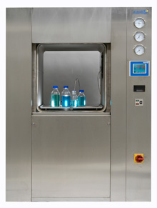
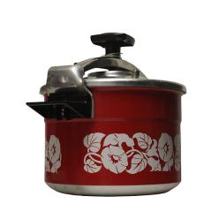
How is media made?
When lab personnel make media they measure out a quantity of dry powdered nutrient media, add water and check the pH.
They pour the media into bottles, cap it and autoclave.
This is a process similar to home canning techniques in food preservation.
The autoclave exposes the media to high temperature (121°C) and pressure (15 psi) for 20 minutes.
Once the media is autoclaved it is considered sterile (all life forms killed).
From the Virtual Microbiology Classroom on ScienceProfOnline.com
Image: Autoclave, Astell Scientific; Pressure cooker, Rama

Slide 6
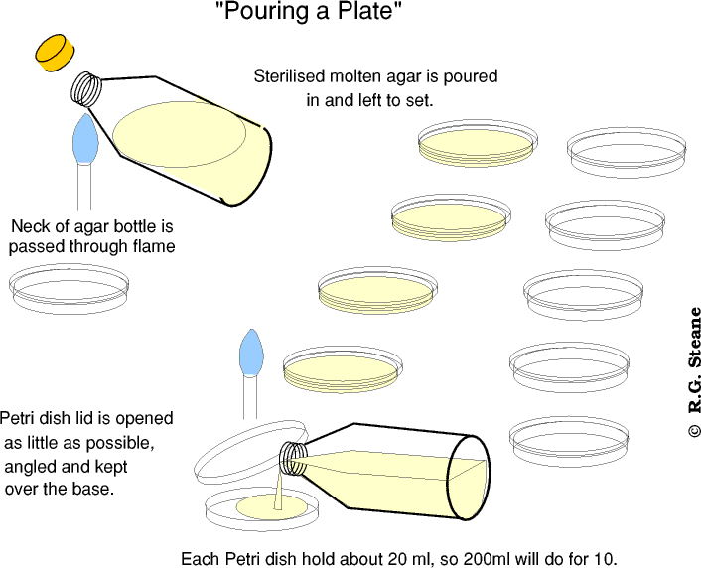
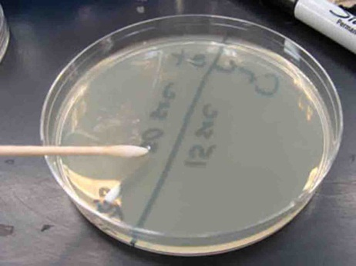
Watch
VIDEO:
How to Aseptically Pour
Bacterial Growth Media
TSY

Slide 7
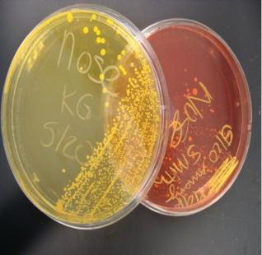
Labeling Plates
All Petri plates for this and future lab exercises should be labeled and stored in the following manner:
1. Make certain that all plates are labeled on the bottom half (i.e. the portion of the Petri plate that contains the media).
2. You can label plastic with a sharpie; glass with a wax pencil.
3. Include the following:
a. Your initials or identifying mark
b. Date
c. Type of specimen
4. All plates are incubated in the green storage bin
(which is identified as "SAVE") in the "upside down"
position.
“Upside down” means that the ½ of the Petri plate with
media faces up. The empty ½ of the Petri plate is down.
We do not use rubber bands to hold lids in place.
(Except for the plates that you may transport home)
Plates will be incubated at 37° C for 24 hrs,
then stored at room temperature until next
week, when you will observe for results.
Images: Positive & negative differential reaction on Mannitol Salt Agar, T. Port
From the Virtual Microbiology Classroom on ScienceProfOnline.com

Slide 8
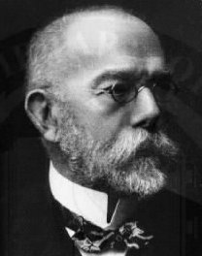
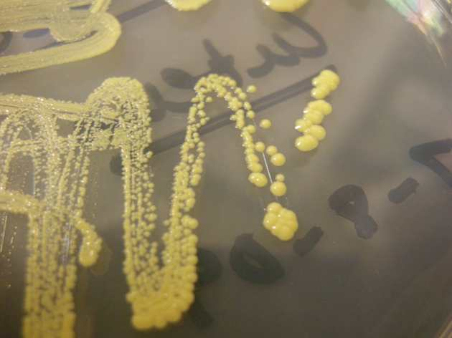
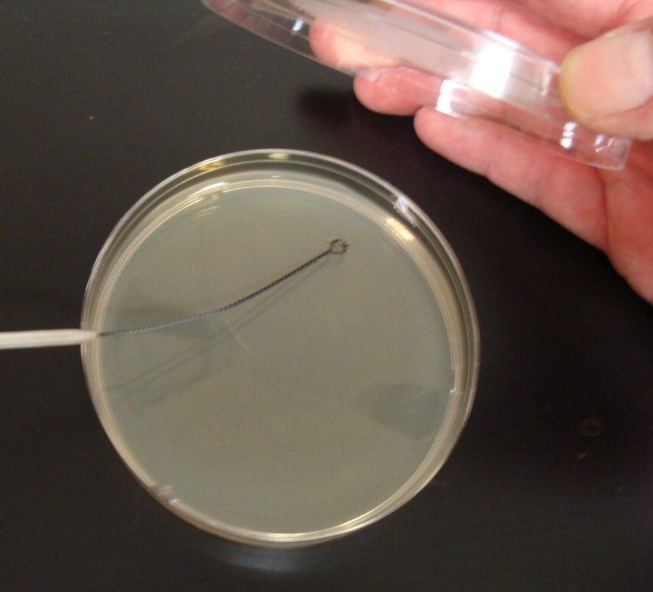
Germ Theory of Disease
Robert Koch
1843 - 1910
Experimented with medium to grow bacteria on.
He tried gelatin, but it did not work.
Wife of colleague recommended agar (a gelatin-like product derived from seaweed).
Didn’t melt, and bacteria couldn’t digest it.
He could also add various nutrients necessary to grow certain organisms.
Koch (pronounced Coke) originated use of a two part dish for growing bacteria (Petri dish named after Julius Petri, a German bacteriologist), and a technique for isolating pure bacterial colonies.
From the Virtual Microbiology Classroom on ScienceProfOnline.com
Images. Micrococcus luteus colonies, T. Port; Robert Koch portrait, 1843-1910, NIH; MAC differential media, T. Port

Slide 9
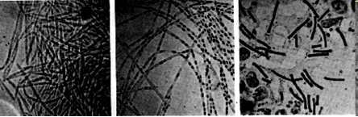
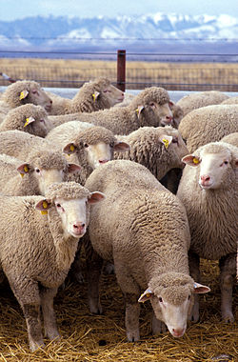
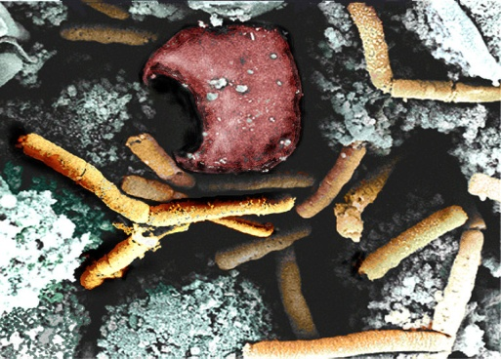
Disease, Please!
Anthrax
Gram + bacteria
Bacillus anthracis
Endospore-producing bacterium.
(Genera Bacillus & Clostridium examples
of endospore producing bacteria.)
Bacillus anthracis first bacterium proven to be the cause of a disease.
Anthrax was killing European livestock Farm animals, apparently healthy in the morning, might die by the end of the day, blood turned black. Human working closely with livestock could catch anthrax (a.k.a.wool-sorter’s disease).
In 1877, Robert Koch grew Bacillus anthracis in pure culture (meaning that he had to do may isolation streak plates to isolate the different types of bacteria sampled from the dead animals).
He then produced experimental anthrax by injecting one of the isolates into animals.
These experiments resulted in Koch formulating guidelines, called Koch’s Postulates, for linking specific organisms with specific diseases.
Robert Koch's original micrographs of the anthrax bacillus.
From the Virtual Microbiology Classroom on ScienceProfOnline.com
Images: Sheep, Wiki; Inhilation Anthrax in monkey spleen tissue, NIH.

Slide 10

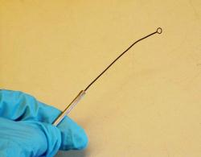
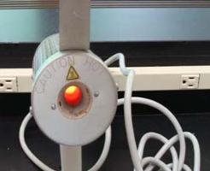
Isolation Streak Plates & Aseptic Technique
You’ll be using an unknown bacteria that you will be identifying in the next lab.
To help identify our unknown we will culture it onto MacConkey’s & Mannitol Salt using streak plate method.
To do a streak plate technique, we will use an inoculation loop (aka smear loop, inoculation wand or microstreaker).
Simple tool used to retrieve an inoculum from a culture of microorganisms.
Always sterilize in microincinerator until loop becomes red hot before and after each use.
By doing this, the same tool can be reused in different experiments without fear of cross-contamination.
Be sure that your inoculation loop has cooled before using it to retrieve inoculum or to streak a plate!
If you hear medium sizzle when you touch it with loop, the loop is too hot!
Images:; Isolation streak plate of Legionella, PHIL #7925 Inoculation loop, Jeffrey M. Vinocur; Microincinerator, T. Port
From the Virtual Microbiology Classroom on ScienceProfOnline.com

Slide 11
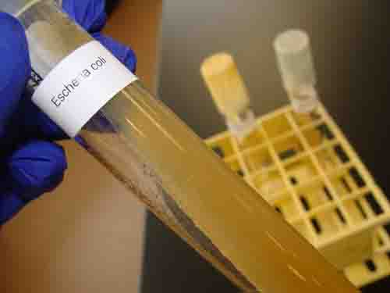
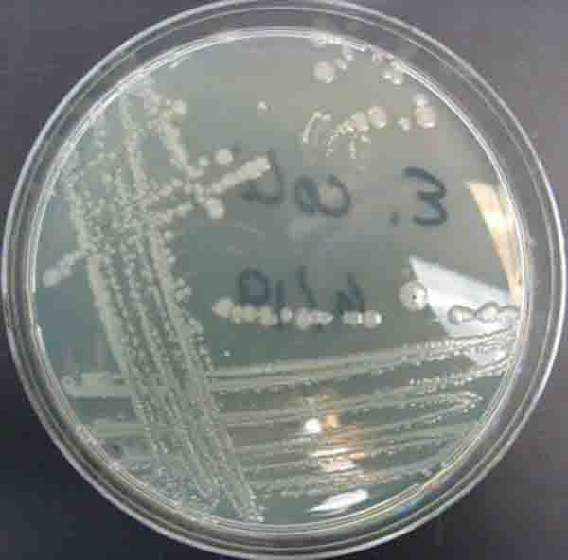
When obtaining a bacterial sample from a tube or plate of media do so gently! The bacteria is growing as a thin film on top of the media! Don’t scrape so hard that you have pieces of agar in your sample!
If obtaining bacterial sample from slant tubes:
never pick up test tube by the cap.
do NOT set cap down on lab bench
flame neck of the test tube before & after
obtaining sample.
Image: E. coli growing on TSY agar in slant tube and in Petri dish, T. Port
From the Virtual Microbiology Classroom on ScienceProfOnline.com

Slide 12
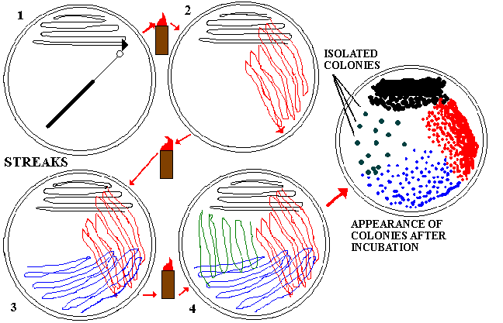
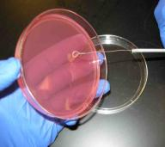
Isolation Streak Plates & Aseptic Technique
Streak plating is used to isolate a single type of bacteria.
This technique spreads out original “parent bacteria” in a sparse pattern that ,after growth, results in individual colonies.
After incubation, the 4th quadrant of your plate should have dots.
These small “dots” are individual colonies, and represent millions of bacteria of the same type.
* IMPORTANT!!!: Be very gentle when streaking the sample onto the plate. Try not to gouge the surface of the medium with your inoculation loop.
From the Virtual Microbiology Classroom on ScienceProfOnline.com

Slide 13
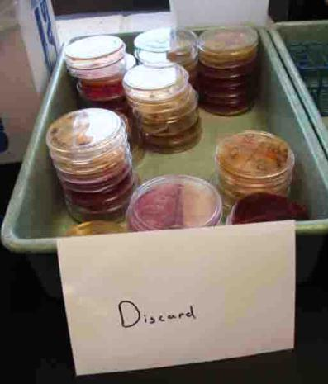
Discard Bin at Back of Lab
From the Virtual Microbiology Classroom on ScienceProfOnline.com

Slide 14
Confused?
Here are links to fun resources that further explain streak plate technique and differential staining:
Gram Stain & Isolation Streak Plate Technique Lab Main Page on the Virtual Microbiology Classroom of Science Prof Online.
Streak Plate Procedure Animation with narration from Sinauer Associates.
Streak Plate Interactive Animation from MSU. Test your skill to see if you can do a virtual streak plate procedure that produces isolated colonies.
Smart Links
(You must be in PPT slideshow view to click on links.)
From the Virtual Microbiology Classroom on ScienceProfOnline.com

Slide 15
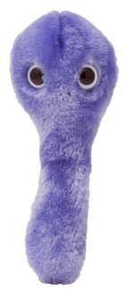
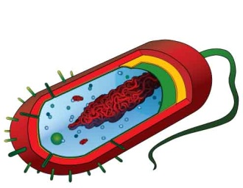
Are microbes intimidating you?
Do yourself a favor. Use the…
Virtual Microbiology Classroom (VMC) !
The VMC is full of resources to help you succeed, including:
practice test questions
review questions
study guides and learning objectives
You can access the VMC by going to the Science Prof Online website www.ScienceProfOnline.com
Images: C. diff., Giant Microbes; Prokaryotic cell, Mariana Ruiz

