Slide 1

About Science Prof Online
PowerPoint Resources
Science Prof Online (SPO) is a free science education website that provides fully-developed Virtual Science Classrooms, science-related PowerPoints, articles and images. The site is designed to be a helpful resource for students, educators, and anyone interested in learning about science.
The SPO Virtual Classrooms offer many educational resources, including practice test questions, review questions, lecture PowerPoints, video tutorials, sample assignments and course syllabi. New materials are continually being developed, so check back frequently, or follow us on Facebook (Science Prof Online) or Twitter (ScienceProfSPO) for updates.
Many SPO PowerPoints are available in a variety of formats, such as fully editable PowerPoint files, as well as uneditable versions in smaller file sizes, such as PowerPoint Shows and Portable Document Format (.pdf), for ease of printing.
Images used on this resource, and on the SPO website are, wherever possible, credited and linked to their source. Any words underlined and appearing in blue are links that can be clicked on for more information. PowerPoints must be viewed in slide show mode to use the hyperlinks directly.
Several helpful links to fun and interactive learning tools are included throughout the PPT and on the Smart Links slide, near the end of each presentation. You must be in slide show mode to utilize hyperlinks and animations.
This digital resource is licensed under Creative Commons Attribution-ShareAlike 3.0:
http://creativecommons.org/licenses/by-sa/3.0/
Tami Port, MS
Creator of Science Prof Online
Chief Executive Nerd
Science Prof Online
Online Education Resources, LLC
info@scienceprofonline.com
Alicia Cepaitis, MS
Chief Creative Nerd
Science Prof Online
Online Education Resources, LLC
alicia@scienceprofonline.com
From the Virtual Microbiology Classroom on ScienceProfOnline.com
Image: Compound microscope objectives, T. Port
Notes:
Welcome to Science Prof Online PowerPoint Resources!
This PowerPoint Presentation comes from the Virtual Cell Biology Classroom of Science Prof Online, and, as such, is licensed under Creative Commons Attribution-ShareAlike 3.0.; meaning you can download, share and alter any of this presentation, but you can’t sell it or repackage and sell any part of it. Please credit Science Prof Online as the source of this presentation. Please abide by credited image copyrights. Thank you for using this resource.

Slide 2
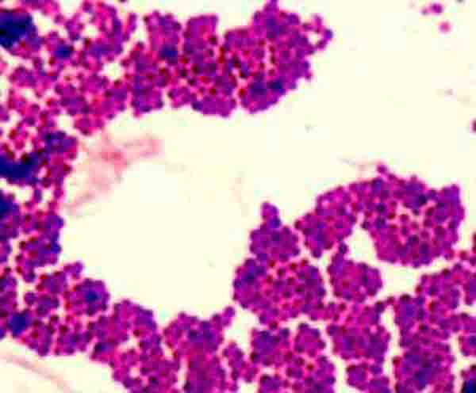
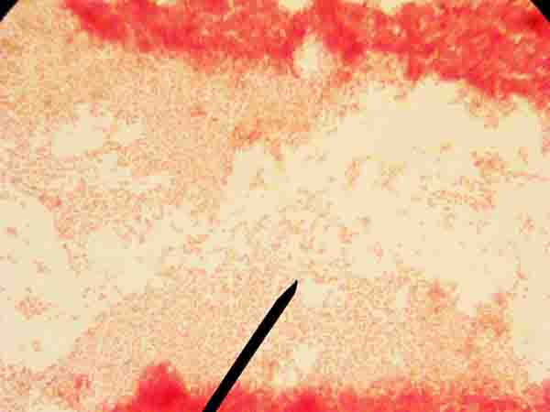
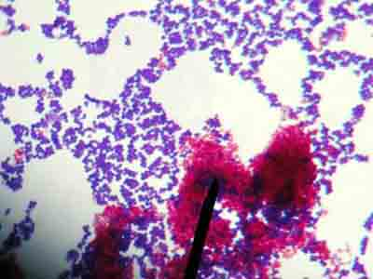
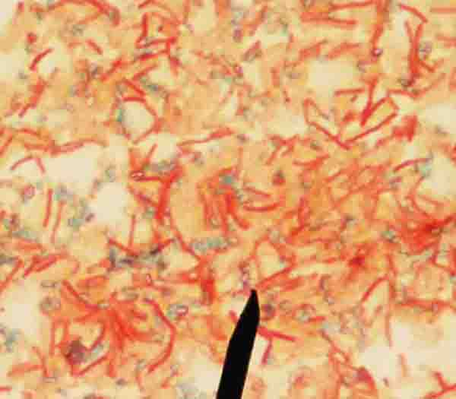
IDENTIFICATION OF UNKNOWN BACTERIA
Laboratory Exercise 3
Differential Staining
Gram Stain
Acid-fast Stain
Endospore Stain
Gram
Acid-fast
Endospore
+
u
-
From the Virtual Microbiology Classroom on ScienceProfOnline.com
Images: Acid fast stain & mordant step of Gram stain, both by T. Port

Slide 3
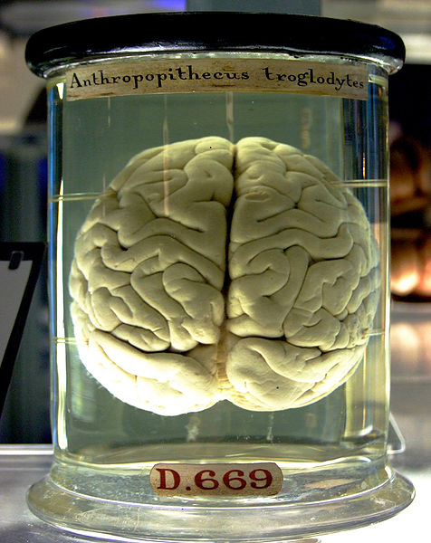
What am I going to learn from Lab Topic #3?
Differential Staining
Perform Gram, Acid fast and Endospore stains.
Compare and contrast differential staining procedures and the clinical information obtained from performing them.
Practice viewing bacteria under oil immersion and taking photo micrographs of bacterial samples.
Please plug in your microincinerators.
From the Virtual Microbiology Classroom on ScienceProfOnline.com
Image: Chimp brain in a jar, Gaetan Lee

Slide 4
Differential Stains
Most stains used in microbiology are differential.
Differential stains involve use of more than one dye, so that certain differences between cell type or structures can be distinguished.
Image: Acid fast stain, T. Port
From the Virtual Microbiology Classroom on ScienceProfOnline.com

Slide 5
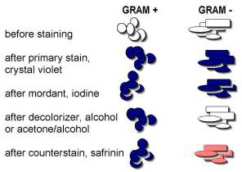
Gram Stain
GRAM STAINING PROCEDURE
Crystal violet (1 min) > rinse
Iodine (1 min) > rinse
Acetone Alcohol (10–15 sec) > rinse
Safrinin (1 min) > rinse & blot dry
Distinguishes between two large groups
of microorganisms:
- purple staining, Gram-positive cells
- pink staining, Gram-negative cells
Q: What is the difference between Gram+ and Gram- cell wall structure?
G
+
?
-
Watch video of
How to Do a
Gram Stain
From the Virtual Microbiology Classroom on ScienceProfOnline.com

Slide 6
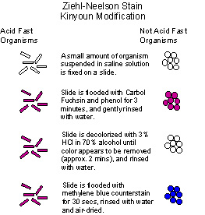
Acid-fast Stain
ACID-FAST STAINING PROCEDURE
Blotting paper
Ziehls carbol fuchsin (3 – 5 min heat) > rinse Acid Alcohol (10 – 15 sec) > rinse
Crystal violet (1 min) > rinse & blot dry
Q: What does an acid-fast cell have
that a non acid fast cell does not?
- purple staining, Non acid-fast cells (NAF)
- bright pink staining, Acid-fast cells (AF)
A
Create a smear of organism you are testing. Cover smear with a blotting paper.
+
?
-
Saturate paper with Ziehl’s carbol fuchsin (say fyook-sin). Heat 3 – 5 minutes. Remove blotting paper.
Watch video of
How to Do an
Acid Fast Stain
Rinse slide with tap water, then decolorize the smear for 10 - 15 seconds with acid alcohol. Rinse.
Apply crystal violet for 1 minute, wash, blot dry.
From the Virtual Microbiology Classroom on ScienceProfOnline.com
Notes:
Mycobacteria
Nocardia

Slide 7
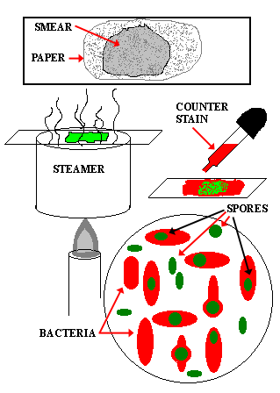
Endospore Stain
ENDOSPORE STAINING PROCEDURE
Malachite Green (5 min heat) > rinse
Safrinin (1 min) > rinse & blot dry
Distinguishes between two things:
- endospores, which stain green
- vegetative cells, which stain pink
Some bacteria produce endospores, dormant, highly-resistant
structures that can survive environmental extremes
(desiccation, heat, harmful chemicals).
Most notable genera: Bacillus and Clostridium
Endospores cannot be stained by normal staining
procedures because their walls are practically impermeable.
Endospore stain uses heat to drive the primary stain,
(malachite green) into the endospore.
Q: What color(s) will I see if sample is negative?
Q: What color(s) will you see if sample is positive?
E
Watch video of
How to Do an Endospore Stain
+
u
-
From the Virtual Microbiology Classroom on ScienceProfOnline.com

Slide 8

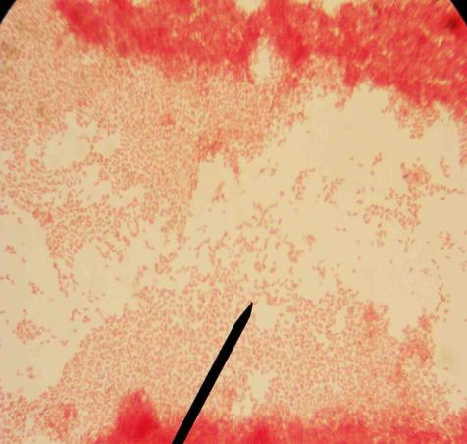
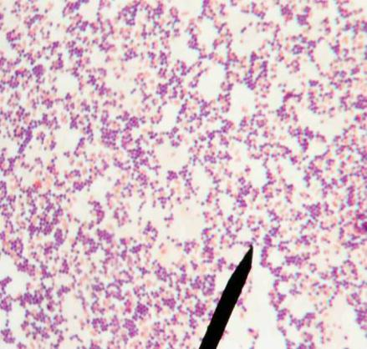
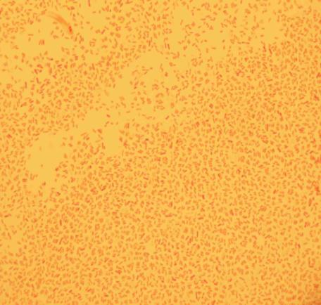
Gram Stain
Examples
Staphylococcus epidermidis
Escherichia coli
Mixed Sample of S. epidermidis & E. coli
From the Virtual Microbiology Classroom on ScienceProfOnline.com
Images: All Gram stain images by T. Port

Slide 9
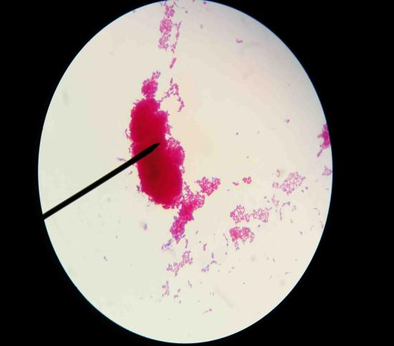
Acid Fast Stain
Examples
Mixed sample of Mycobacterium smegmatis & Micrococcus luteus
Mycobacterium smegmatis
From the Virtual Microbiology Classroom on ScienceProfOnline.com
Images: All acid fast stain images by T. Port

Slide 10
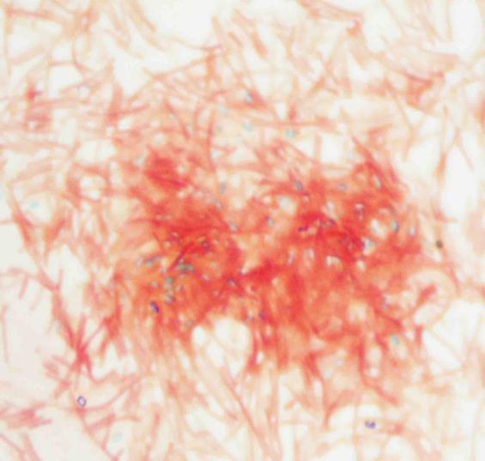
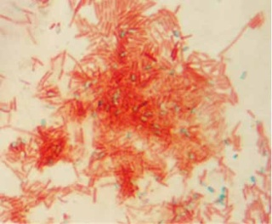
Endospore Stain
Examples
Bacillus cereus
From the Virtual Microbiology Classroom on ScienceProfOnline.com
Images: All endospore stain images by T. Port

Slide 11
Dichotomous Key
Q: Why are we doing Differential Stains of our bacterial unknown?
Intense pink
From the Virtual Microbiology Classroom on ScienceProfOnline.com
Light, uneven pink

Slide 12
Confused?
Here are links to fun resources that further explain
bacterial identification:
Differential Stain Main Page on the Virtual Microbiology Classroom of Science Prof Online.
Gram Stain Interactive Tutorial. This is an extremely useful tutorial that shows, step-by-step, what happens in Gram-positive and Gram-negative cells during Gram staining.
Acid-fast Stain Animated Tutorial. The staining procedure depicted in this tutorial differs a bit from how we do it in lab, but this tutorial is still very useful. Shows the steps of the staining procedure and the resulting color of Acid-fast and Nonacid-fast cells.
Endospore Stain PowerPoint. Although this is just a PPT, it does have useful information and images for students learning about the endospore stain.
Videos of differential staining procedures: Gram, Acid-fast, Endospore
Smart Links
(You must be in PPT slideshow view to click on links.)
From the Virtual Microbiology Classroom on ScienceProfOnline.com

Slide 13
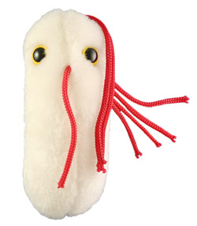
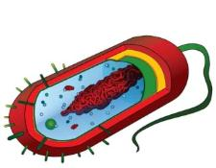
Are microbes intimidating you?
Do yourself a favor. Use the…
Virtual Microbiology Classroom (VMC) !
The VMC is full of resources to help you succeed, including:
practice test questions
review questions
study guides and learning objectives
You can access the VMC by going to the Science Prof Online website www.ScienceProfOnline.com
Images: Salmonella, Giant Microbes; Prokaryotic cell, Mariana Ruiz

