Slide 1
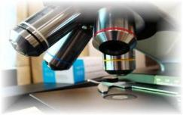
About Science Prof Online
PowerPoint Resources
Science Prof Online (SPO) is a free science education website that provides fully-developed Virtual Science Classrooms, science-related PowerPoints, articles and images. The site is designed to be a helpful resource for students, educators, and anyone interested in learning about science.
The SPO Virtual Classrooms offer many educational resources, including practice test questions, review questions, lecture PowerPoints, video tutorials, sample assignments and course syllabi. New materials are continually being developed, so check back frequently, or follow us on Facebook (Science Prof Online) or Twitter (ScienceProfSPO) for updates.
Many SPO PowerPoints are available in a variety of formats, such as fully editable PowerPoint files, as well as uneditable versions in smaller file sizes, such as PowerPoint Shows and Portable Document Format (.pdf), for ease of printing.
Images used on this resource, and on the SPO website are, wherever possible, credited and linked to their source. Any words underlined and appearing in blue are links that can be clicked on for more information. PowerPoints must be viewed in slide show mode to use the hyperlinks directly.
Several helpful links to fun and interactive learning tools are included throughout the PPT and on the Smart Links slide, near the end of each presentation. You must be in slide show mode to utilize hyperlinks and animations.
This digital resource is licensed under Creative Commons Attribution-ShareAlike 3.0:
http://creativecommons.org/licenses/by-sa/3.0/
Tami Port, MS
Creator of Science Prof Online
Chief Executive Nerd
Science Prof Online
Online Education Resources, LLC
info@scienceprofonline.com
Alicia Cepaitis, MS
Chief Creative Nerd
Science Prof Online
Online Education Resources, LLC
alicia@scienceprofonline.com
From the Virtual Microbiology Classroom on ScienceProfOnline.com
Image: Compound microscope objectives, T. Port
Notes:
Welcome to Science Prof Online PowerPoint Resources!
This PowerPoint Presentation comes from the Virtual Cell Biology Classroom of Science Prof Online, and, as such, is licensed under Creative Commons Attribution-ShareAlike 3.0.; meaning you can download, share and alter any of this presentation, but you can’t sell it or repackage and sell any part of it. Please credit Science Prof Online as the source of this presentation. Please abide by credited image copyrights. Thank you for using this resource.

Slide 2
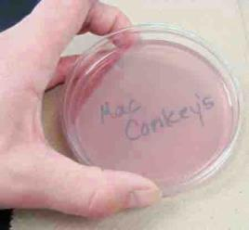
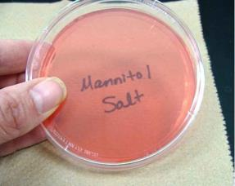
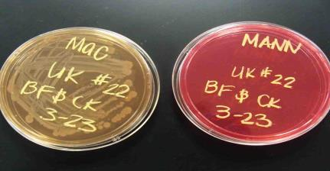
IDENTIFICATION OF UNKNOWN BACTERIA
Laboratory Exercise 3
Specialized Bacterial Growth Media
MacConkey’s Agar
Mannitol Salt Agar
Images: Liquid TSY; Clinical sample being applied to TSY agar; Arm plate; all by T. Port
From the Virtual Microbiology Classroom on ScienceProfOnline.com

Slide 3
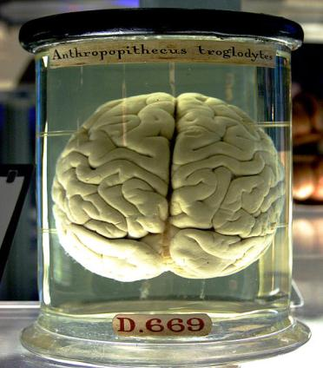
What am I going to learn from Lab Topic #3?
MacConkeys & Mannitol Salt Agars
You will practice microbial collection techniques.
Define and use aseptic technique in microbial culture and media preparation.
Use selective & differential media to culture and identify microbes.
Describe colony morphology and its relationship to microbial identification.
Interpret results of microbial growth on various culture media.
Please plug in your microincinerators.
From the Virtual Microbiology Classroom on ScienceProfOnline.com
Image: Chimp brain in a jar, Gaetan Lee

Slide 4
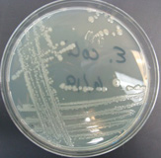
Growth Media
Bacteria and other microbes have
particular requirements for growth.
In order to successfully grow bacteria
in lab, we must provide an environment
suitable for growth.
Growth media (singular = medium) are used to
cultivate microbial growth.
Media = mixtures of nutrients that the microbes need to live.
Also provides a surface and the necessary moisture and pH to support microbial growth.
Tryptic Soy Agar (TSY) is the medium that we most often use. Complex nutrient media which supports the growth of a wide variety of microbes.
From the Virtual Microbiology Classroom on ScienceProfOnline.com
Image: Streak plate of E. coli, T. Port

Slide 5
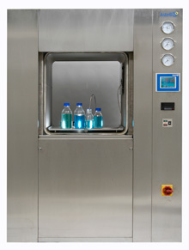
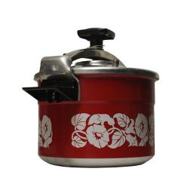
How is media made?
When lab personnel make media they measure out a quantity of dry powdered nutrient media, add water and check the pH.
They pour the media into bottles, cap it and autoclave.
This is a process similar to home canning techniques in food preservation.
The autoclave exposes the media to high temperature (121°C) and pressure (15 psi) for 20 minutes.
Once the media is autoclaved it is considered sterile (all life forms killed).
From the Virtual Microbiology Classroom on ScienceProfOnline.com
Image: Autoclave, Astell Scientific; Pressure cooker, Rama

Slide 6
Specialized Media:
- McConkey’s Agar
- Mannitol Salt Agar
Look at the plates on your lab bench that are red/pink in color.
McConkey’s = lighter, purplish-pink
Mannitol Salt = orangish-pink
Unlike TSY media, these specialized
selective & differential media plates
are already prepared for you.
Image: McConkey’s, Mannitol Salt & Blood Agar specialized media, T. Port
From the Virtual Microbiology Classroom on ScienceProfOnline.com

Slide 7
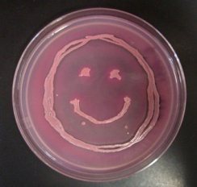
Differential
&
Selective
Media
Q: What does selective mean?
Q: What does differential mean?
Image: McConkey’s media growing E. coli, T. Port
From the Virtual Microbiology Classroom on ScienceProfOnline.com

Slide 8
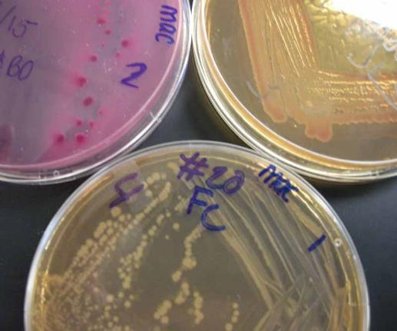
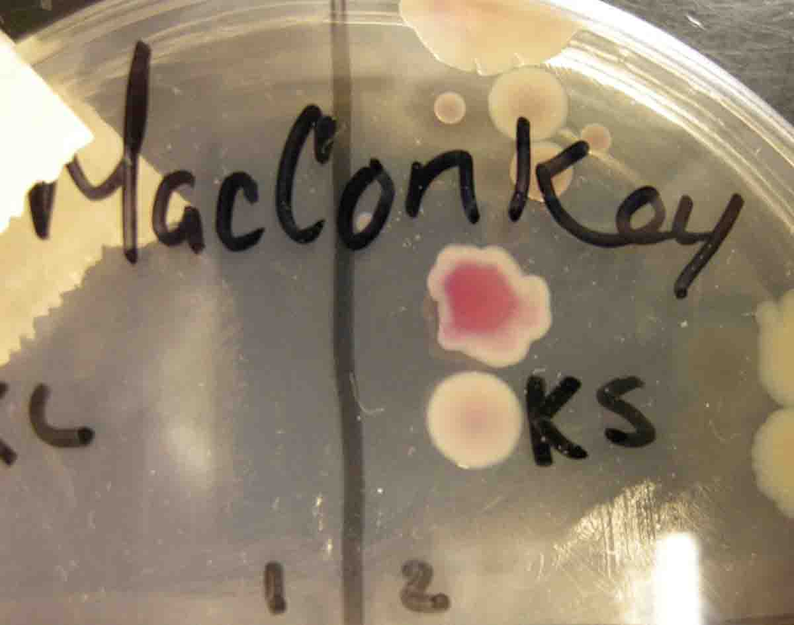
MacConkey's (MAC)
MacConkey’s agaris both selective & differential.
Selective because it only grows Gram-negative
bacteria. Inhibits the growth of Gram-positive
bacteria.
Differential because neutral red (pH-sensitive
dye) and lactose (type of sugar) have been added
to media.
- Bacteria that use lactose for food (lactose fermenters), produce acidic
metabolites that trigger the pH sensitive dye to turn pink.
- So lactose fermenting bacteria will grow in bright pink colonies while
non-lactose fermenters will be colorless and clear.
Q: Regardless of the color of the plate, what do know about bacteria found growing on MacConkey’s?
Q: If there is growth, what additional information is provided when the color of the bacteria is examined?
Enteric bacteria are the most frequently encountered bacteria isolated from many types of clinical specimens. They are most commonly lactose fermenters.
Watch
VIDEO:
How to Interpret MacConkey’s Agar (MAC)
Images: McConkey’s growing E. coli, Enterobacter &Salmonella on plates clockwise from top left; MAC with lactose fermenting colony above a non-lactose fermenting colony. All photos by T. Port
From the Virtual Microbiology Classroom on ScienceProfOnline.com

Slide 9
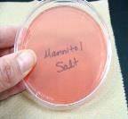
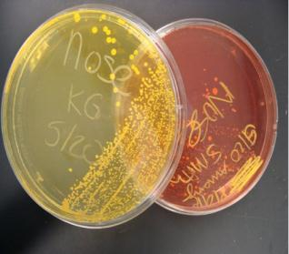
Mannitol Salt (MSA)
Mannitol Salt agar is both selective & differential.
Selective because it has a high NaCl (7.5%) concentration, and few types of bacteria can grow on this hypertonic medium.
Members of genus Staphylococcus are
halophilic, and grow well on this media.
2. Differential because this medium contains a pH-sensitive dye to identify organisms that ferment mannitol. Organic acids wastes mannitol fermenters produce change the medium from red to yellow.
MSA works well for identifying pathogenic staphylococci, such as Staphylococcus aureus, which will ferment mannitol.
Most non-pathogenic staphylococci (Staphylococcus epidermidis) will not ferment mannitol.
Q: Regardless of the color of the plate, what do know about bacteria found growing on Mannitol Salt?
Q: If there is growth, additional information can then be obtained about bacteria growing based on color of the medium.
Watch
VIDEO:
How to Interpret
Mannitol Salt Agar (MSA)
Images: Sterile Mannitol Salt Agar & Positive & negative differential reaction on Mannitol Salt Agar, T. Port
From the Virtual Microbiology Classroom on ScienceProfOnline.com

Slide 10
Labeling Plates
All Petri plates for this and future lab exercises should be labeled and stored in the following manner:
1. Make certain that all plates are labeled on the bottom half (i.e. the portion of the Petri plate that contains the media).
2. You can label plastic with a sharpie; glass with a wax pencil.
3. Include the following:
a. Your initials or identifying mark
b. Date
c. Type of specimen
4. All plates are incubated in the green storage bin
(which is identified as "SAVE") in the "upside down"
position.
“Upside down” means that the ½ of the Petri plate with
media faces up. The empty ½ of the Petri plate is down.
We do not use rubber bands to hold lids in place.
(Except for the plates that you may transport home)
Plates will be incubated at 37° C for 24 hrs,
then stored at room temperature until next
week, when you will observe for results.
Images: Positive & negative differential reaction on Mannitol Salt Agar, T. Port
From the Virtual Microbiology Classroom on ScienceProfOnline.com

Slide 11
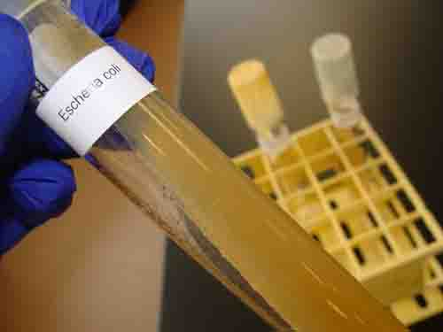
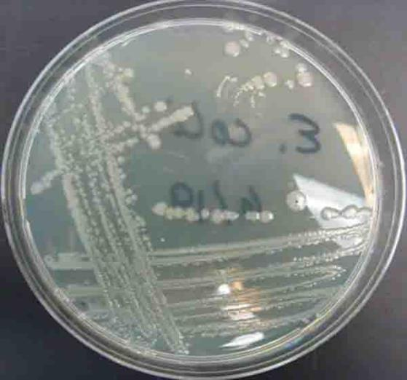
When obtaining a bacterial sample from a tube or plate of media do so gently! The bacteria is growing as a thin film on top of the media! Don’t scrape so hard that you have pieces of agar in your sample!
If obtaining bacterial sample from slant tubes:
never pick up test tube by the cap.
do NOT set cap down on lab bench
flame neck of the test tube before & after
obtaining sample.
Image: E. coli growing on TSY agar in slant tube and in Petri dish, T. Port
From the Virtual Microbiology Classroom on ScienceProfOnline.com

Slide 12
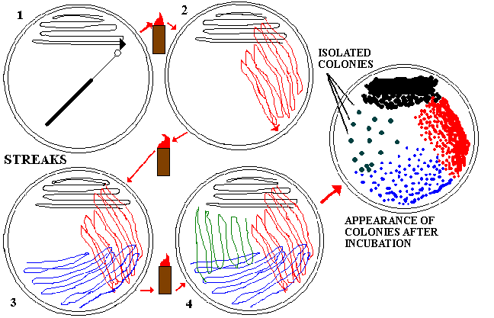
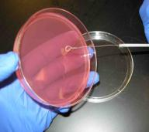
Isolation Streak Plates & Aseptic Technique
Streak plating is used to isolate a single type of bacteria.
This technique spreads out original “parent bacteria” in a sparse pattern that ,after growth, results in individual colonies.
After incubation, the 4th quadrant of your plate should have dots.
These small “dots” are individual colonies, and represent millions of bacteria of the same type.
* IMPORTANT!!!: Be very gentle when streaking the sample onto the plate. Try not to gouge the surface of the medium with your inoculation loop.
From the Virtual Microbiology Classroom on ScienceProfOnline.com

Slide 13
Dichotomous Key
Q: Why are we plating our bacterial unknown onto MacConkey’s & Mannitol Salt Agar?
Intense pink
From the Virtual Microbiology Classroom on ScienceProfOnline.com
Light, uneven pink

Slide 14
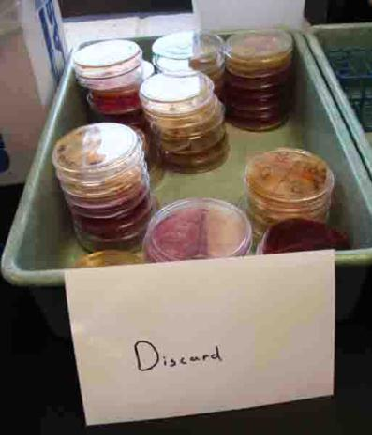
Discard Bin at Back of Lab
From the Virtual Microbiology Classroom on ScienceProfOnline.com

Slide 15
Confused?
Here are links to fun resources that further explain microbiology media & culture:
Media & Culture Laboratory Main Page on the Virtual Microbiology Classroom of Science Prof Online.
“Germs”, music by Weird Al Yankovic. Video by RevLucio.
Normal Flora webpage, by Douglas F. Fix. Interactive page where you can select an area of the body and learn which normal flora typically colonize that location.
How to Interpret: MacConkey’s (MAC), & Mannitol Salt (MSA) videos from Science Prof Online.
Bacterial growth video and narration, YouTube, Dizzo95..
Microbial Growth & Metabolism Main Page on the Virtual Microbiology Classroom of Science Prof Online.
E. coli population growth time lapse video.
Smart Links
(You must be in PPT slideshow view to click on links.)
From the Virtual Microbiology Classroom on ScienceProfOnline.com

Slide 16
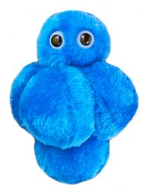
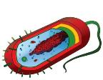
Are microbes intimidating you?
Do yourself a favor. Use the…
Virtual Microbiology Classroom (VMC) !
The VMC is full of resources to help you succeed, including:
practice test questions
review questions
study guides and learning objectives
You can access the VMC by going to the Science Prof Online website www.ScienceProfOnline.com
Images: Staph, Giant Microbes; Prokaryotic cell, Mariana Ruiz

