Slide 1

About Science Prof Online
PowerPoint Resources
Science Prof Online (SPO) is a free science education website that provides fully-developed Virtual Science Classrooms, science-related PowerPoints, articles and images. The site is designed to be a helpful resource for students, educators, and anyone interested in learning about science.
The SPO Virtual Classrooms offer many educational resources, including practice test questions, review questions, lecture PowerPoints, video tutorials, sample assignments and course syllabi. New materials are continually being developed, so check back frequently, or follow us on Facebook (Science Prof Online) or Twitter (ScienceProfSPO) for updates.
Many SPO PowerPoints are available in a variety of formats, such as fully editable PowerPoint files, as well as uneditable versions in smaller file sizes, such as PowerPoint Shows and Portable Document Format (.pdf), for ease of printing.
Images used on this resource, and on the SPO website are, wherever possible, credited and linked to their source. Any words underlined and appearing in blue are links that can be clicked on for more information. PowerPoints must be viewed in slide show mode to use the hyperlinks directly.
Several helpful links to fun and interactive learning tools are included throughout the PPT and on the Smart Links slide, near the end of each presentation. You must be in slide show mode to utilize hyperlinks and animations.
This digital resource is licensed under Creative Commons Attribution-ShareAlike 3.0:
http://creativecommons.org/licenses/by-sa/3.0/
Tami Port, MS
Creator of Science Prof Online
Chief Executive Nerd
Science Prof Online
Online Education Resources, LLC
info@scienceprofonline.com
Alicia Cepaitis, MS
Chief Creative Nerd
Science Prof Online
Online Education Resources, LLC
alicia@scienceprofonline.com
From the Virtual Microbiology Classroom on ScienceProfOnline.com
Image: Compound microscope objectives, T. Port
Notes:
Welcome to Science Prof Online PowerPoint Resources!
This PowerPoint Presentation comes from the Virtual Cell Biology Classroom of Science Prof Online, and, as such, is licensed under Creative Commons Attribution-ShareAlike 3.0.; meaning you can download, share and alter any of this presentation, but you can’t sell it or repackage and sell any part of it. Please credit Science Prof Online as the source of this presentation. Please abide by credited image copyrights. Thank you for using this resource.

Slide 2
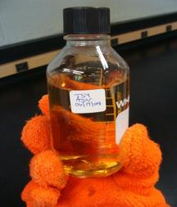
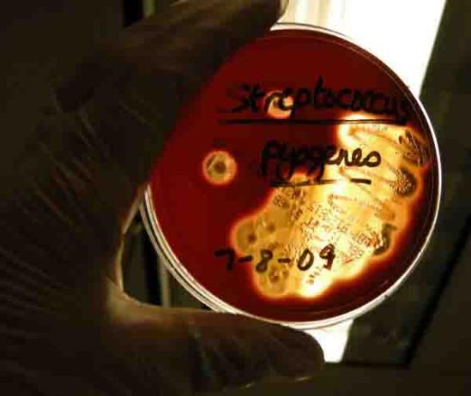
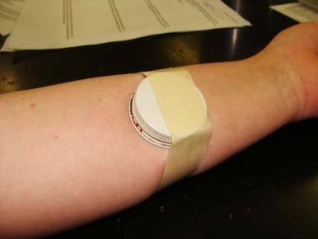
Laboratory Exercise 4
Bacterial Media & Culture
Collecting, Culturing & Interpreting
Bacterial Samples
Images: Liquid TSY; Clinical sample being applied to TSY agar; Arm plate; all by T. Port
From the Virtual Microbiology Classroom on ScienceProfOnline.com

Slide 3
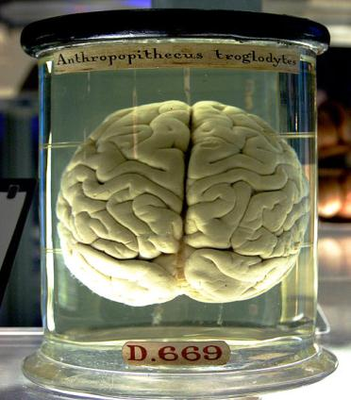
What am I going to learn from Lab Topic #4? Bacterial Media & Culture
You will practice microbial collection techniques.
Define and use aseptic technique in microbial culture and media preparation.
Use enriched, complex, selective & differential media to culture microbes.
Describe colony morphology and its relationship to microbial identification.
Interpret results of microbial growth on various culture media based on prepared controls.
Understand the ubiquitous nature of microbes.
From the Virtual Microbiology Classroom on ScienceProfOnline.com
Image: Chimp brain in a jar, Gaetan Lee

Slide 4
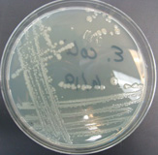
Growth Media
Bacteria and other microbes have
particular requirements for growth.
In order to successfully grow bacteria
in lab, we must provide an environment
suitable for growth.
Growth media (singular = medium) are used to
cultivate microbial growth.
Media = mixtures of nutrients that the microbes need to live.
Also provides a surface and the necessary moisture and pH to support microbial growth.
Before being used, media must be autoclaved, so that it is sterile (all life forms killed.)
Tryptic Soy Agar (TSY) is the medium that we most often use. Complex nutrient media which supports the growth of a wide variety of microbes.
From the Virtual Microbiology Classroom on ScienceProfOnline.com
Image: Streak plate of E. coli, T. Port

Slide 5
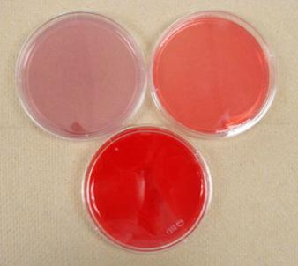
Specialized Media:
McConkey’s, Mannitol Salt & Blood Agar
Look at the plates on your lab bench that are red/pink in color.
McConkey’s = lighter, purplish-pink
Mannitol Salt = orangish-pink
Blood Agar = very dark red
Unlike TSY media, these specialized selective & differential media plates are already prepared for you.
Image: McConkey’s, Mannitol Salt & Blood Agar specialized media, T. Port
From the Virtual Microbiology Classroom on ScienceProfOnline.com

Slide 6
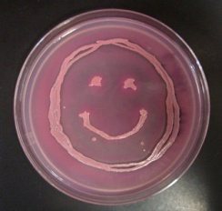
Differential
&
Selective Specialized Media
Q: What does selective mean?
Q: What does differential mean?
Image: McConkey’s media growing E. coli, T. Port
From the Virtual Microbiology Classroom on ScienceProfOnline.com

Slide 7
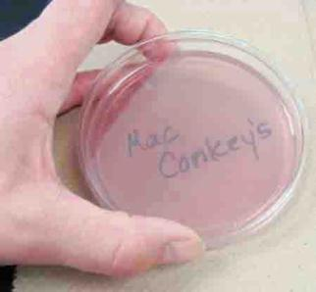
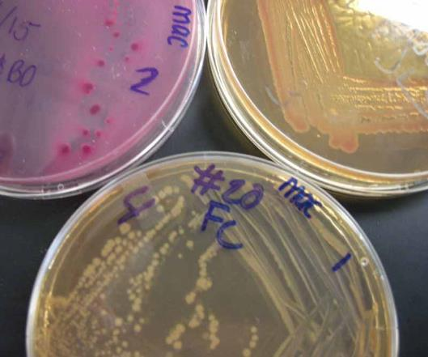
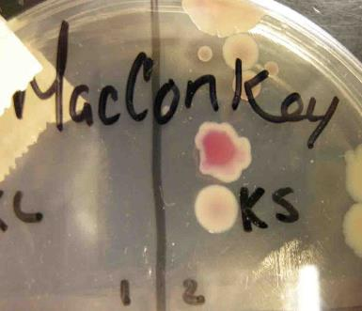
MacConkey's (MAC)
Q: Is MacConkey’s selective? Explain.
Q: Is MacConkey’s differential? Explain.
Watch
VIDEO:
How to Interpret MacConkey’s Agar (MAC)
Images clockwise from top: McConkey’s agar sterile; growing E. coli, Enterobacter & Salmonella (plates clockwise from top left); Lactose fermenting and non-lactose fermenting Gram – colonies on MAC. All by T. Port
From the Virtual Microbiology Classroom on ScienceProfOnline.com

Slide 8
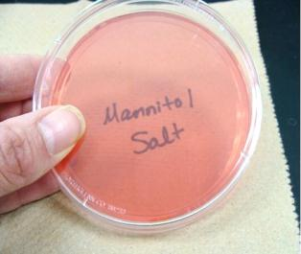
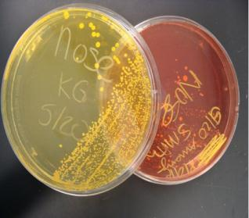
Mannitol Salt (MSA)
Q: Is Mannitol Salt selective? Explain.
Q: Is Mannitol Salt differential? Explain.
Watch
VIDEO:
How to Interpret
Mannitol Salt Agar (MSA)
Images: Sterile Mannitol Salt Agar, Positive & negative differential reaction on Mannitol Salt Agar, T. Port
From the Virtual Microbiology Classroom on ScienceProfOnline.com

Slide 9
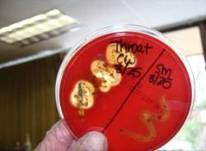
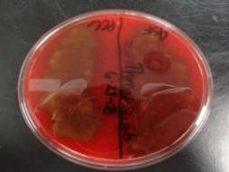
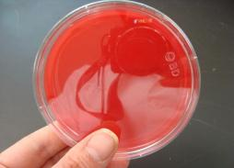
Blood agar (BAP)
Most specimens received in a clinical microbiology lab are plated onto Blood Agar. It is an enriched medium that will grow even fastidious bacteria.
Also contains 5% sheep blood.
This media is not selective. It is enriched and differential:
Certain bacteria produce enzymes (hemolysins…say hemo-lice-ins) that act on red cells to produce either:
* Beta hemolysis: Enzymes lyse the blood cells completely, producing a clear area around the colony.
* Alpha hemolysis: Incomplete hemolysis produces a greenish discoloration around the colony.
* Gamma hemolysis: No effect on the red cells.
Blood agar is usually inoculated from a patient’s throat swab.
Microbiologist are trying to detect Group A beta hemolytic Streptococcus pyogenes (a Gram-positive cocci-shaped bacteria that causes Beta hemolysis on blood agar.)
Normal flora of the throat will exhibit alpha or gamma hemolysis.
Watch
VIDEO:
How to Interpret Blood Agar (BAP)
Images: Beta-hemolysis, Alpha-hemolysis and a sterile plate of Blood Agar, T. Port
From the Virtual Microbiology Classroom on ScienceProfOnline.com

Slide 10
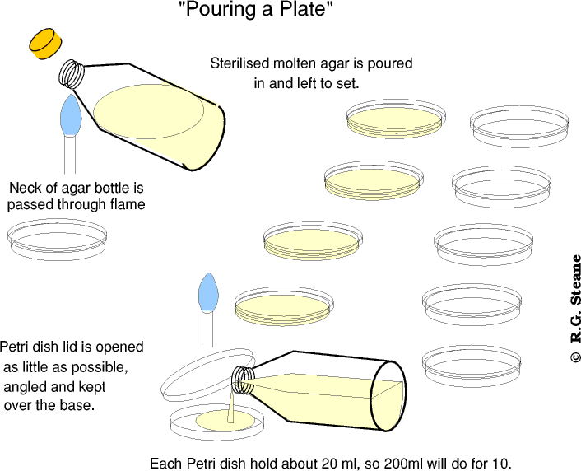
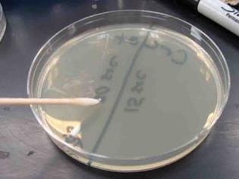
Watch
VIDEO:
How to Aseptically Pour Bacterial Growth Media
TSY

Slide 11
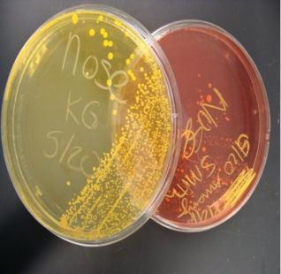
Labeling Plates
All Petri plates for this and future lab exercises should be labeled and stored in the following manner:
1. Make certain that all plates are labeled on the bottom half (i.e. the portion of the Petri plate that contains the media).
2. You can label plastic with a sharpie; glass with a wax pencil.
3. Include the following:
a. Your initials or identifying mark
b. Date
c. Type of specimen
4. All plates are incubated in the green storage bin
(which is identified as "SAVE") in the "upside down"
position.
“Upside down” means that the ½ of the Petri plate with
media faces up. The empty ½ of the Petri plate is down.
We do not use rubber bands to hold lids in place.
(Except for the plates that you may transport home)
Plates will be incubated at 37° C for 24 hrs,
then stored at room temperature until next
week, when you will observe for results.
Images: Positive & negative differential reaction on Mannitol Salt Agar, T. Port
From the Virtual Microbiology Classroom on ScienceProfOnline.com

Slide 12
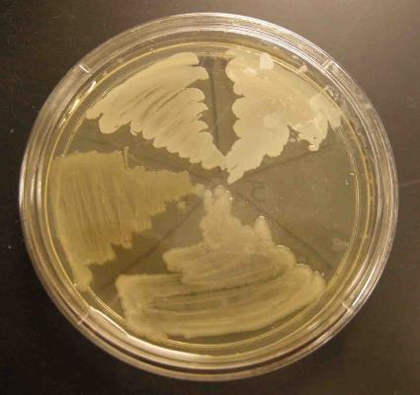
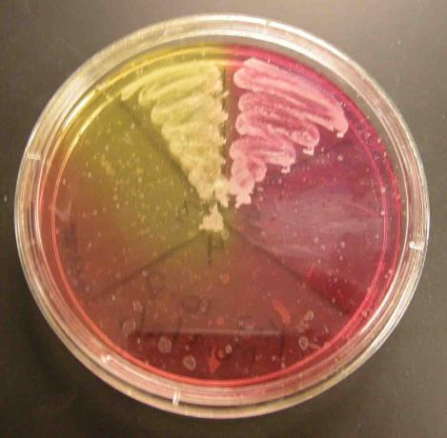
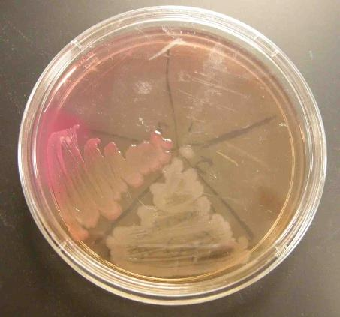
Inoculate Plates With Controls
You will be inoculating the four types of media we are using in this class (TSY, MAC, MSA, BAP) with four of our stock species of bacteria (E. coli, Salmonella pullorum, Staphylococcus epidermidis, Staphylococcus aureus).
Doing this will help you understand the properties of these media, and what the expected outcomes (growth, no growth, and differential color changes) look like.
Q: Why do we, in a fifth section of each plate, “inoculate” using a sterile loop?
From the Virtual Microbiology Classroom on ScienceProfOnline.com
Image: Arm plate, Source unknown

Slide 13
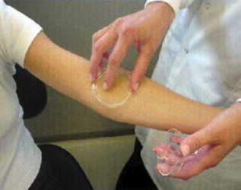
Normal Flora Samples
Arm Plate will demonstrate the microorganism inhabiting the surface of the skin.
Touch Plates will demonstrate the bacteria in the epidermis of our hands.
Throat Swab on Blood agar.
Nasal Swabs on TSY & MSA.
REMEMBER…
When placing one sample on two plates, inoculate the non-selective medium first!
Very gently transfer your sample to the plate. You want to avoid gouging the surface of the media.
From the Virtual Microbiology Classroom on ScienceProfOnline.com
Image: Arm plate, Source unknown

Slide 14
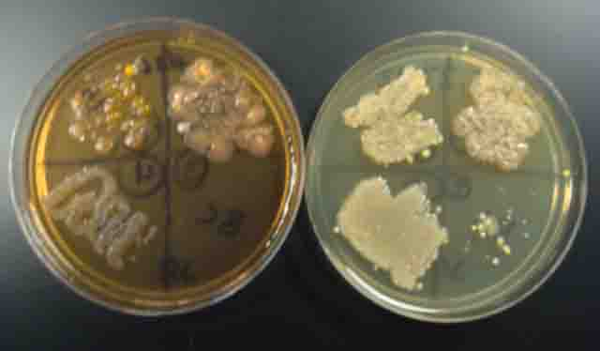
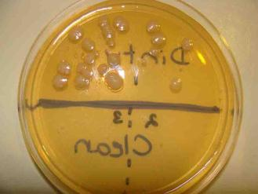
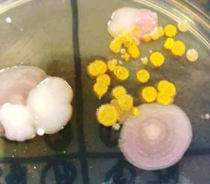
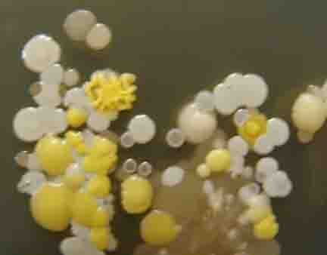
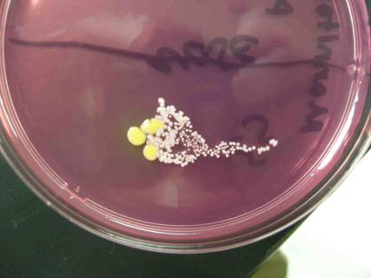
Microbial Colony Morphology
Images: Arm plate, TSY with sample from dish washer, MacConkey’s with variety of colonies, all by T. Port
From the Virtual Microbiology Classroom on ScienceProfOnline.com

Slide 15
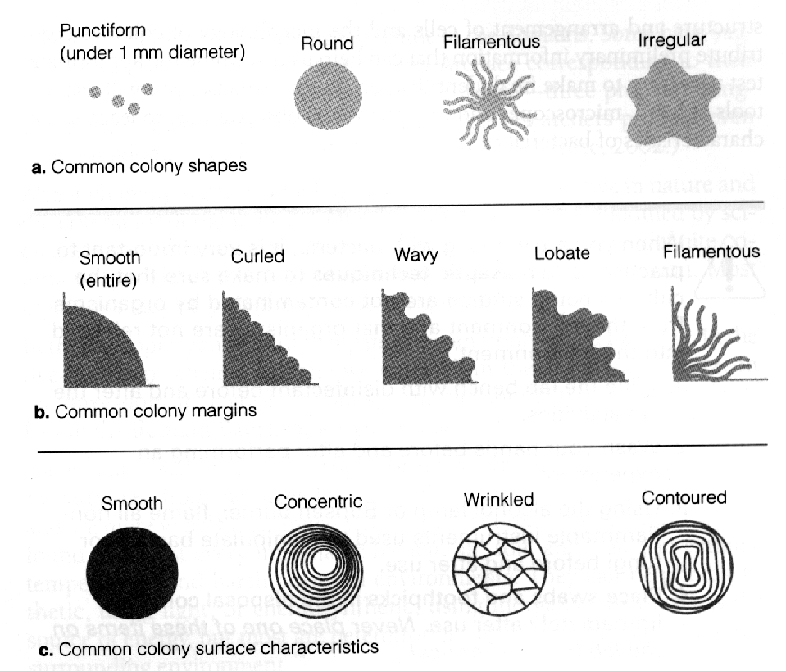
Microbial Colony Morphology

Slide 16
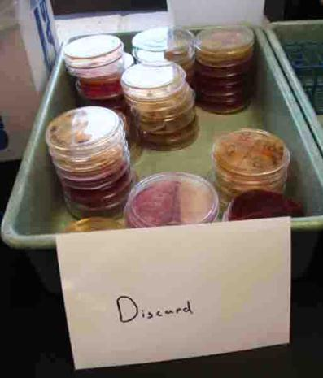
Discard Bin at Back of Lab
From the Virtual Microbiology Classroom on ScienceProfOnline.com

Slide 17
Confused?
Here are links to fun resources that further explain microbiology media & culture:
Media & Culture Laboratory Main Page on the Virtual Microbiology Classroom of Science Prof Online.
“Germs”, music by Weird Al Yankovic. Video by RevLucio.
Normal Flora webpage, by Douglas F. Fix. Interactive page where you can select an area of the body and learn which normal flora typically colonize that location.
How to Interpret: MacConkey’s (MAC), Mannitol Salt (MSA) and Blood Agar (BAP) videos from Science Prof Online.
How to Pour Bacterial Growth Media into Petri Dishes, video from Science Prof Online.
Bacterial growth video and narration, YouTube, Dizzo95..
Microbial Growth & Metabolism Main Page on the Virtual Microbiology Classroom of Science Prof Online.
E. coli population growth time lapse video.
Smart Links
(You must be in PPT slideshow view to click on links.)
From the Virtual Microbiology Classroom on ScienceProfOnline.com

Slide 18
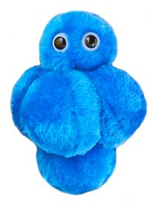
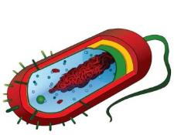
Are microbes intimidating you?
Do yourself a favor. Use the…
Virtual Microbiology Classroom (VMC) !
The VMC is full of resources to help you succeed, including:
practice test questions
review questions
study guides and learning objectives
You can access the VMC by going to the Science Prof Online website www.ScienceProfOnline.com
Images: Staph, Giant Microbes; Prokaryotic cell, Mariana Ruiz

