Slide 1

About Science Prof Online
PowerPoint Resources
Science Prof Online (SPO) is a free science education website that provides fully-developed Virtual Science Classrooms, science-related PowerPoints, articles and images. The site is designed to be a helpful resource for students, educators, and anyone interested in learning about science.
The SPO Virtual Classrooms offer many educational resources, including practice test questions, review questions, lecture PowerPoints, video tutorials, sample assignments and course syllabi. New materials are continually being developed, so check back frequently, or follow us on Facebook (Science Prof Online) or Twitter (ScienceProfSPO) for updates.
Many SPO PowerPoints are available in a variety of formats, such as fully editable PowerPoint files, as well as uneditable versions in smaller file sizes, such as PowerPoint Shows and Portable Document Format (.pdf), for ease of printing.
Images used on this resource, and on the SPO website are, wherever possible, credited and linked to their source. Any words underlined and appearing in blue are links that can be clicked on for more information. PowerPoints must be viewed in slide show mode to use the hyperlinks directly.
Several helpful links to fun and interactive learning tools are included throughout the PPT and on the Smart Links slide, near the end of each presentation. You must be in slide show mode to utilize hyperlinks and animations.
This digital resource is licensed under Creative Commons Attribution-ShareAlike 3.0:
http://creativecommons.org/licenses/by-sa/3.0/
Alicia Cepaitis, MS
Chief Creative Nerd
Science Prof Online
Online Education Resources, LLC
alicia@scienceprofonline.com
Tami Port, MS
Creator of Science Prof Online
Chief Executive Nerd
Science Prof Online
Online Education Resources, LLC
info@scienceprofonline.com
From the Virtual Biology Classroom on ScienceProfOnline.com
Image: Compound microscope objectives, T. Port
Notes:
Welcome to Science Prof Online PowerPoint Resources!
This PowerPoint Presentation comes from the Virtual Cell Biology Classroom of Science Prof Online, and, as such, is licensed under Creative Commons Attribution-ShareAlike 3.0.; meaning you can download, share and alter any of this presentation, but you can’t sell it or repackage and sell any part of it. Please credit Science Prof Online as the source of this presentation. Please abide by credited image copyrights. Thank you for using this resource.

Slide 2
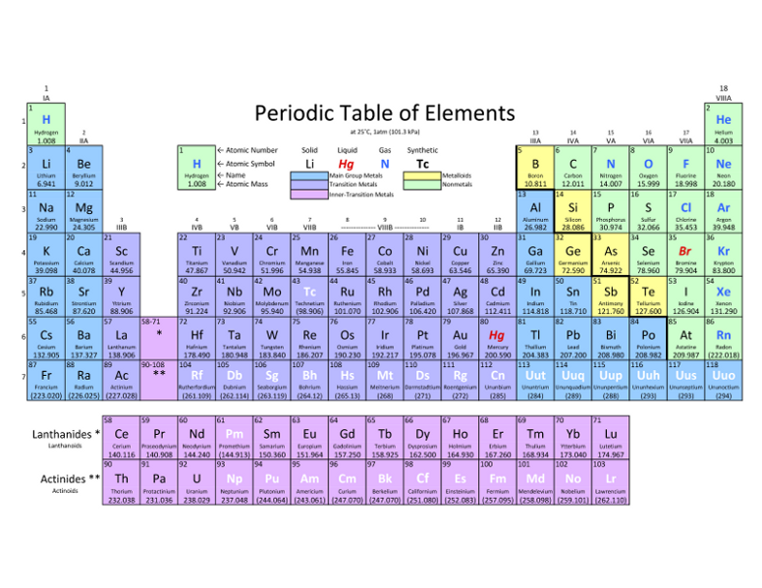
Chemistry
101
The Basics: Periodic Table, Bonds, pH & Molecules
WATCH THIS!
Amazing Chemical Reactions
From the Virtual Biology Classroom on ScienceProfOnline.com
Image: Periodic Table of Elements

Slide 3
Elements, Atoms & Chemical Symbols
Elements: Substances that can’t be broken down any further.
Atom: The smallest unit of an element.
Chemical Symbol:
Begins with one or two letters based on
elements name.
Q: What if there is more than one element that starts with the same letter?
Example: Carbon (C), Calcium (Ca), Chlorine (Cl)
WATCH THIS! Daniel Radcliff (Harry Potter) sings “The Element Song”!
Image: Periodic Table of Elements
From the Virtual Biology Classroom on ScienceProfOnline.com

Slide 4
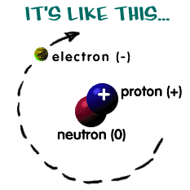
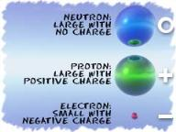
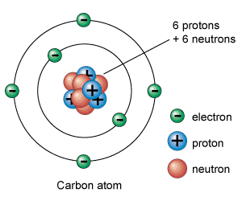
The Structure of an Atom
Here are some examples:
Atoms are the basis for everything in the universe.
Q: What are the three basic parts of an atom?
• ? = "+" positive charge.
Part of the atomic nucleus.
Repel each other.
• ? = neutral (a charge of zero).
Part of the atomic nucleus.
Separate protons, making an atom more stable.
• ? = "-" negative charge.
Orbit nucleus in different shells, or energy levels.
The thing that makes each element unique is the number of protons, since the number of neutrons and electrons can vary.
Q: If there is an equal number of electrons and protons in an atom, what is it’s charge?
NERDY SCIENCE JOKE: A neutron walks into a bar and asks “How much for a drink?”
Q: What does the bartender tell him?
Images: Structure of Atom, Chem4Kids Website; Carbon, Universe Today Website
From the Virtual Biology Classroom on ScienceProfOnline.com

Slide 5
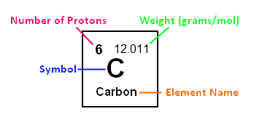
Protons & Neutrons:
Atomic Number, Mass Number & Atomic Mass
Atomic Number: The number of protons in the nucleus of an atom.
Q: What is the atomic number of carbon?
Atomic Mass: (aka atomic weight): The atomic mass of an element is rarely an even number. This happens because of the isotopes.
Many elements occur as isotopes. They vary in the # of neutrons they have.
When an atom has a different number of protons and neutrons, its nucleus becomes unstable.
Q: What is the atomic mass of carbon?
Mass Number: The number of protons, plus the number of neutrons.
Q: How do we know the mass number, if the number of neutrons in an element may vary? Lets look at out Lab Exercise
Atomic mass is calculated by figuring out the amounts of each type of atoms isotopes there are in the Universe.
Example: For carbon, there is a lot of C-12, some C-13, and some C-14 atoms.
When you average out all of the masses, you get a number that is a little bit higher than 12 (the weight of a C-12 atom). The average atomic mass for Carbon is actually 12.011.
Let’s listen to part of the Radiolab podcast episode “Elements” (starting at time 35:00) to learn more about the interesting new use of C-14.
From the Virtual Cell Biology Classroom on ScienceProfOnline.com

Slide 6
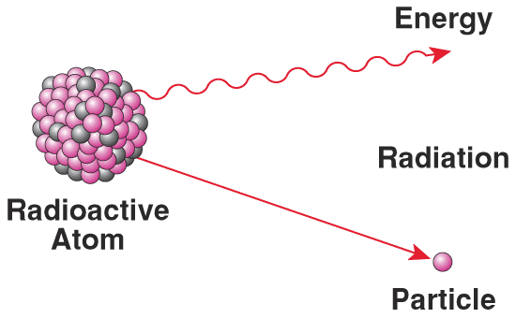
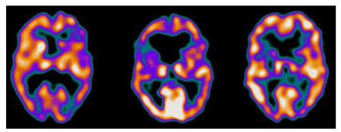
Isotopes & Radioactivity
• Isotope is radioactive if nucleus is unstable.
Most isotopes disintegrate spontaneously with the release
of energy by processes of nuclear or radioactive decay.
When the nucleus changes in structure, energy and/or subatomic particles are given off.
Other than radioactivity, isotopes of an element behave similarly: They can participate in molecule / chemical reactions that involve that element.
• When controlled, radioactive isotopes can be valuable medical tools. (Ex. Gamma camera can produce images of soft tissue when radiopharmaceuticals are injected into or ingested by patient.)
Schizophrenic female
Female with depression
Healthy female
From the Virtual Cell Biology Classroom on ScienceProfOnline.com

Slide 7
What about electrons?
In a neutral atom, there are the same number of protons (+) and electrons (-).
Electrons orbit around the atomic nucleus in shells.
The inner shell of an atom, closest to the nucleus, can have a maximum of two electrons.
The outermost shell is called the valence shell.
Eight (8) is the max number of valence electrons for a full valence shell.
Number of valence electrons governs an atom’s bonding behavior.
Atoms are much more stable, or less reactive, with a full valence shell.
By moving electrons, the two atoms become linked. This is known as chemical bonding.
See Rader’s Chem4Kids web page on the Periodic Table. Their explanations are extremely helpful!
Images: Carbon, Universe Today Website
From the Virtual Biology Classroom on ScienceProfOnline.com
Notes:
A: 8

Slide 8
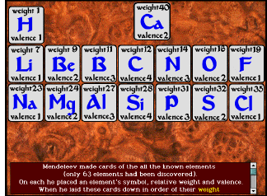
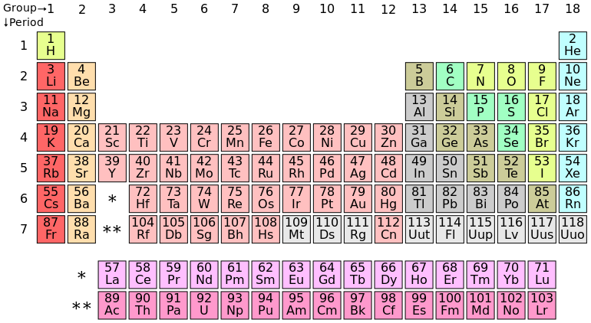
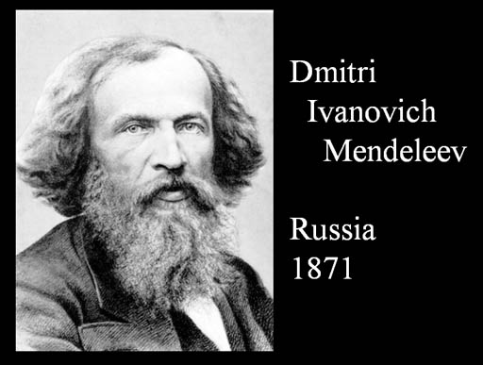
The Periodic Table
Dmitri Ivanovich Mendeleev
(1834 –1907)
Russian chemist and inventor.
Formulated Periodic Law.
Created his own version of the periodic table of elements, and used it to correct the properties of some already discovered elements and to predict the properties of eight elements that had not been discovered yet.
Listen to Radiolab podcast segment on Mendeleev and the periodic table from the episode
“Yellow Fluff and Other Curious Encounters”
(starting at 4:30 into the podcast).
Go to the SPO Virtual Biology Classroom to find a homework assignment based on this podcast.
Image: Periodic Table of Elements
From the Virtual Cell Biology Classroom on ScienceProfOnline.com

Slide 9
Electrons:
How can I determine the number of electron shells? Period !
Electrons in an atom are located in different shells or energy levels.
Each ROW of the periodic table is called a Period.
Period Rule 1: All of the elements in a Period have the same number of electron shells.
For example, every element in the top row (the first period) has one shell for its electrons. All elements in the second row (the second period) have two shells for their electrons.
Period Rule 2: As you move down the table, every row adds a shell, up to seven.
Period Rule 3: The innermost (closest to the nucleus) shell of all atoms (other than hydrogen) has two electrons.
Period Rule 4: The electrons in the outermost shell are called valence electrons.
Image: Periodic Table of Elements
From the Virtual Biology Classroom on ScienceProfOnline.com

Slide 10
Electrons:
How can I determine the number of outer shell electrons? Group!
Electrons in the outermost shell are called valence electrons.
Each COLUMN of the periodic table is called a Group.
Group Rule 1: All elements in the same Group (vertical column) have the same number of valence electrons.
Group Rule 2: As you move across the table, (ignoring columns 3 – 12, the transition elements) every row adds a valence electron, up to 8.
Key! If you know the number of shells and valence electrons, you can draw an electron shell diagram for any of the non-transitional elements.
From the Virtual Biology Classroom on ScienceProfOnline.com
Image: Periodic Table of Elements

Slide 11
Remind me why we care about these valence electrons…
Number of valence electrons governs an atom’s bonding behavior.
Eight (8) is the max number of valence electrons for a full valence shell.
Atoms are much more stable, or less reactive, with a full valence shell.
By moving electrons, the two atoms become linked. This is known as chemical bonding.
This stability can be achieved one of two ways:
- Ionic bond
- Covalent bond
See Rader’s Chem4Kids web page on the Periodic Table. Their explanations are extremely helpful!
Images: Carbon, Universe Today Website
From the Virtual Biology Classroom on ScienceProfOnline.com
Notes:
A: 8

Slide 12
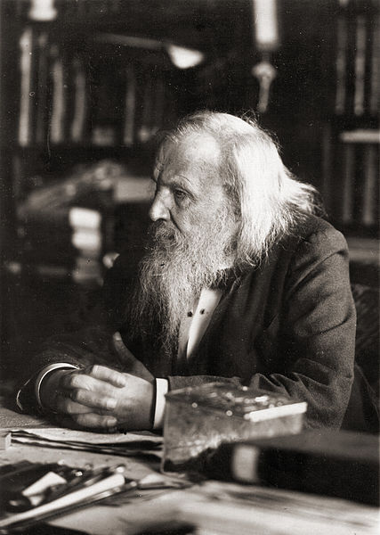
Let’s listen to “The Periodic Table: Rapping the Elements”
From the Virtual Cell Biology Classroom on ScienceProfOnline.com
Images: Periodic Table of Elements; Mendeleev, Wiki

Slide 13
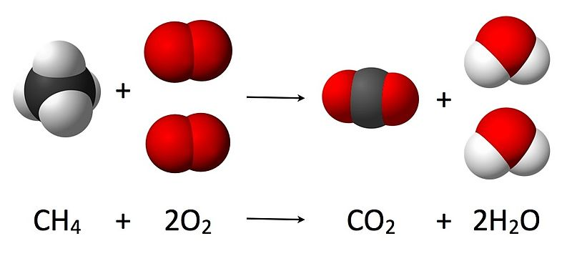
Chemical Bonds, Reactions
& Notation
Making Molecules & Compounds
From the Virtual Biology Classroom on ScienceProfOnline.com
Image: Combustion Reaction of Methane, Wiki

Slide 14
Chemical Shorthand
Chemical Symbol
Begins with one or two letters based on
elements name.
Q: What if there is more than one element that
starts with the same letter?
Example: Carbon (C), Calcium (Ca), Chlorine (Cl)
Chemical Formula
“Shorthand” for a compound.
Contains chemical symbols of the elements that make up the molecule.
Numerical subscripts represent number of atoms of each element in molecule.
Example: H₂0 = water; has two hydrogen atoms and one oxygen.
More than one molecule of same type…the group of letters is preceded by number.
Example 2H₂0 = two water molecules.
Image: Periodic Table of Elements
From the Virtual Biology Classroom on ScienceProfOnline.com

Slide 15
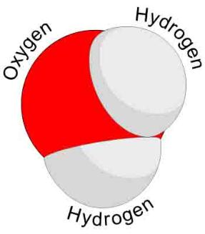
Elements, Atoms, Molecules & Compounds
Elements → Substances that can’t be broken
down any further.
Atom → The smallest unit of an element.
Two or more atoms joined together chemically:
Molecule
Molecule containing at least two different
Elements: Compound
Examples of molecules: Carbon dioxide (CO₂) and methane (CH₄) , molecular hydrogen (H₂), molecular oxygen (O₂) and molecular nitrogen (N₂).
Examples of compounds: Only molecules containing two or more elements, such as carbon dioxide (CO₂) and methane (CH₄).
Q: Explain why all compounds are molecules but not all molecules are compounds.
Image: Periodic Table of Elements; Water Molecule, Wiki
From the Virtual Biology Classroom on ScienceProfOnline.com

Slide 16
Chemical Bonding and Electron Valences
The electrons in an atom are located at different energy levels.
Electrons in the highest energy level are called valence electrons.
Number of valence electrons governs an atom’s bonding behavior.
Q: What is the max number of valence electrons for a full valence shell?
Atoms are much more stable, or less reactive, with a full valence shell.
By moving electrons, the two atoms become linked. This is known as chemical bonding.
This stability can be achieved one of two ways:
- Ionic bond
- Covalent bond
Watch Video:
Bill Nye
The Science Guy
on Chemical Reactions
Images: Carbon, Universe Today Website
From the Virtual Biology Classroom on ScienceProfOnline.com

Slide 17
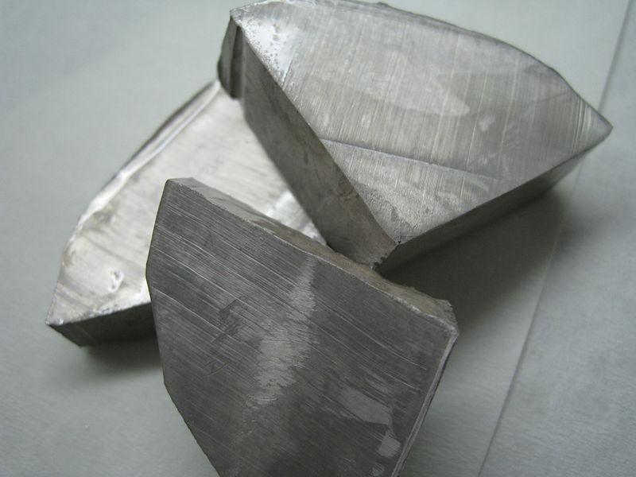
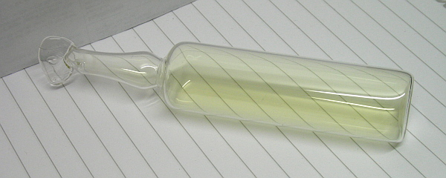
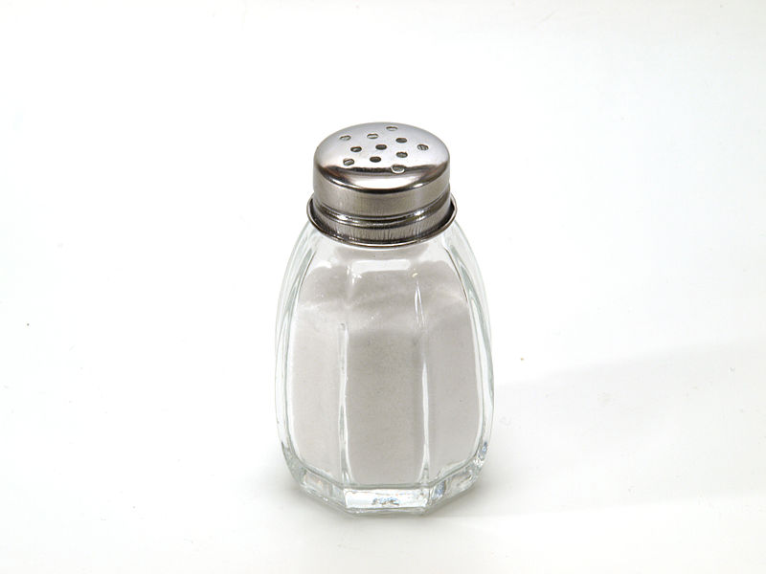
Compounds Have Their Own Properties
Compound has physical and chemical characteristics unique from the elements that make it up
Example: NaCl
Sodium Metal: Na
Chlorine Gas: Cl
Sodium Chloride: NaCl
Click here to watch this reaction in action!
From the Virtual Biology Classroom on ScienceProfOnline.com
Image: Sodium Metal, Chlorine gas, Sodium Chloride in shaker, Wiki

Slide 18
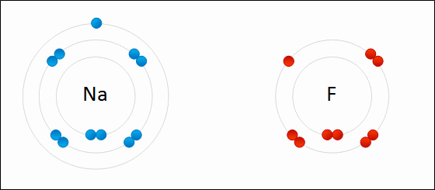
Types of
Chemical Bonds:
1. Ionic
2. Covalent
Image: Formation of ionic sodium fluoride, Wdcf
From the Virtual Biology Classroom on ScienceProfOnline.com

Slide 19
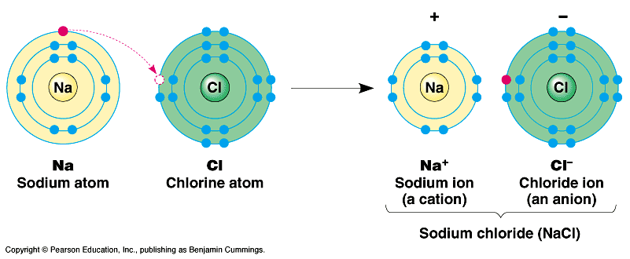
Ionic Bonds
Click here for Ionic Bonding Animations
Involves transfer of electrons between two atoms.
Found mainly … inorganic compounds.
Ion = an atom or group of atoms which have lost or gained one or more electrons, making them negatively or positively charged.
Q: What are positively charged ions (+) called?
Q: What are negatively charged ions (-) called?
From the Virtual Biology Classroom on ScienceProfOnline.com

Slide 20
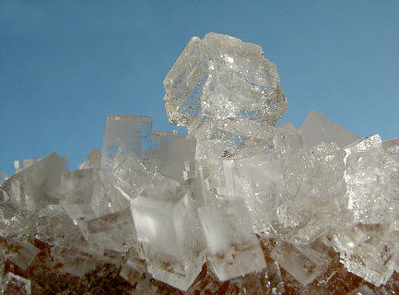
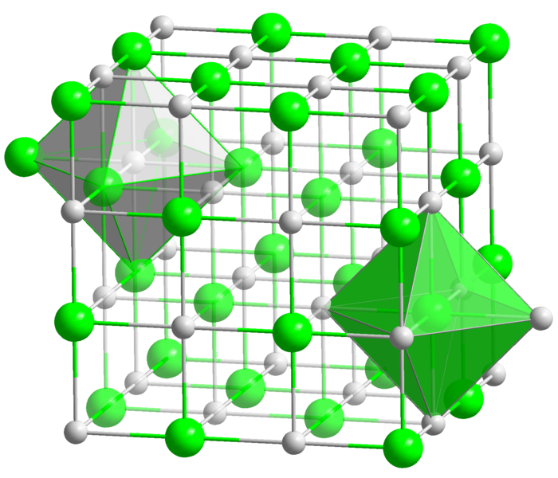
Ionic compounds are made of oppositely charged ions
Ionic Bonds are atoms held together by attraction between
a (+) and a (–) ion
Compound is neutral overall, but still charged on the inside.
Makes solid crystals.
Images: Halit crystal, Crystal structure of NaCl, Wiki
From the Virtual Biology Classroom on ScienceProfOnline.com

Slide 21
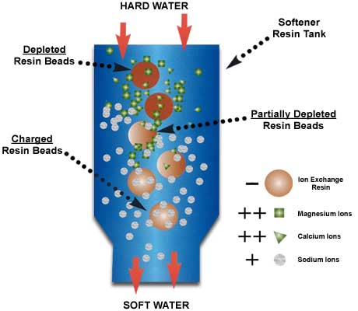
Everyday Science
Reactions Involving Ions
Remember… ion = an atom which has lost or gained one or more electrons, so it’s negatively or positively charged.
The Principle of
ion exchange
is a common water softening method.
From the Virtual Biology Classroom on ScienceProfOnline.com

Slide 22




Lets use a Branganalogy to help us Understand the Concept of Ion Exchange…
From the Virtual Biology Classroom on ScienceProfOnline.com
1. Brad Pitt is a negatively charged resin bead
2. Jennifer Anniston is a positively charged Sodium Ion
3. Angelina Jolie is a positively charged Calcium Ion
-
-
Na+
Now lets say that ‘positiveness’ equates with ‘drop-dead gorgeousness’
-
-
-
Ca++
-
-
Na+
-
Ca++
-
-
-
-
-
Negatively charged Brad is attracted to reasonably positive Jennifer.
-
Na+
-
Negatively charged Brad lets go of reasonably positive Jennifer in the presence of insanely positive Angelina.
-

Slide 23
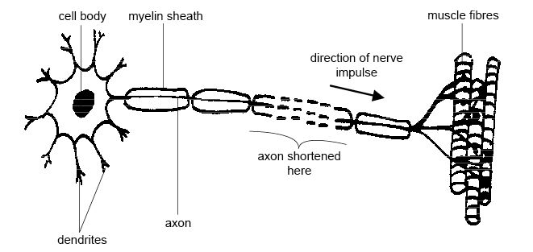
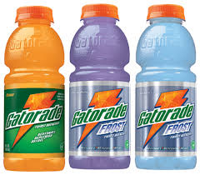
Importance of Ions/Electrolytes in the Body:
K⁺ ,Na⁺, Cl⁻
Carry electrical impulses in the nervous system
Maintain cellular function with the correct concentrations electrolytes
Watch This! “Brawndo” Video Clip
from movie Idiocracy.
Image: Motor neuron, Wiki
From the Virtual Biology Classroom on ScienceProfOnline.com

Slide 24
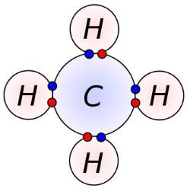
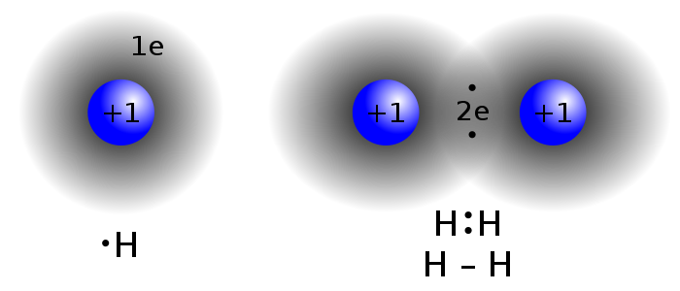
Types of Chemical Bonds:
1. Ionic
2.Covalent
Image: Covalent Bond H2; Methane Covalent Bonds, Dynablast, Wiki;
From the Virtual Biology Classroom on ScienceProfOnline.com

Slide 25
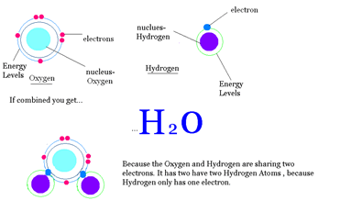
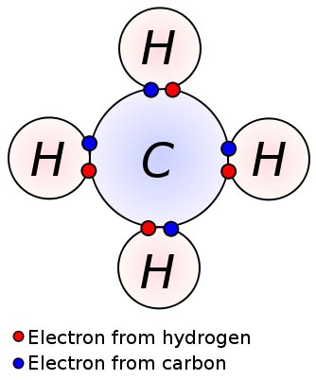
Covalent Bonds
Involves the sharing of a pair of electrons between atoms.
One covalent bond = 1 pair of shared electrons.
Covalent Compounds can make single (2 electrons), double (4 electrons) or even triple bonds (6 electrons) depending on the number of electrons they share.
Found mainly … organic compounds
Image: Covalent Bond H2; Methane Covalent Bonds, Dynablast, Wiki
From the Virtual Biology Classroom on ScienceProfOnline.com

Slide 26
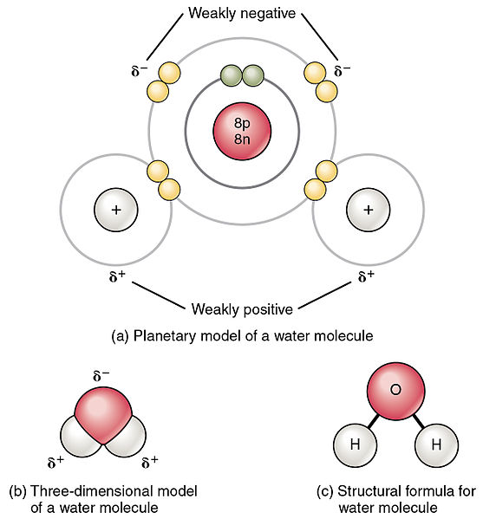
Polar vs. Non-Polar Covalent Bonds
Polar molecules unequally share electrons between atoms, so have a slight positive charge at one end and a slight negative charge at the other.
Non-polar molecules have electrons equally shared between their atoms.
Image: Polar water molecule, Non-polar methane molecule, Wiki
From the Virtual Biology Classroom on ScienceProfOnline.com

Slide 27
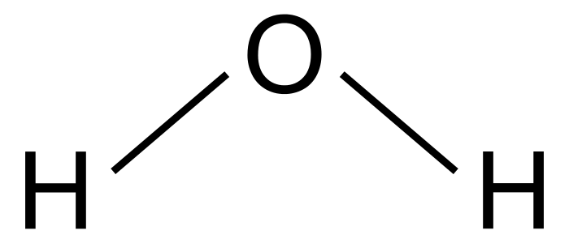
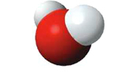
Water is a very common covalent compound. The lines between the O and H’s indicate a covalent bond
Click here to watch a video that compares
Ionic and Covalent Bonds!
Image: 2-D diagram of H20 molecule, 3-D diagram of Water Molecule, Wiki
From the Virtual Biology Classroom on ScienceProfOnline.com

Slide 28
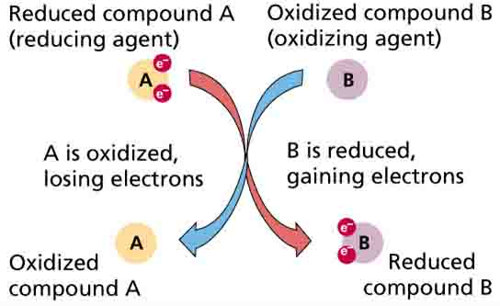
Oxidation - Reduction Reactions
Or Redox reaction = chemical reactions in which electrons are gained, lost (Q: What kind of bond?) or shared (Q: What kind of bond?) in a chemical reaction.
• oxidation: loss of electrons by a molecule, atom or ion.
• reduction: gain of electrons by a molecule, atom or ion.
From the Virtual Biology Classroom on ScienceProfOnline.com

Slide 29
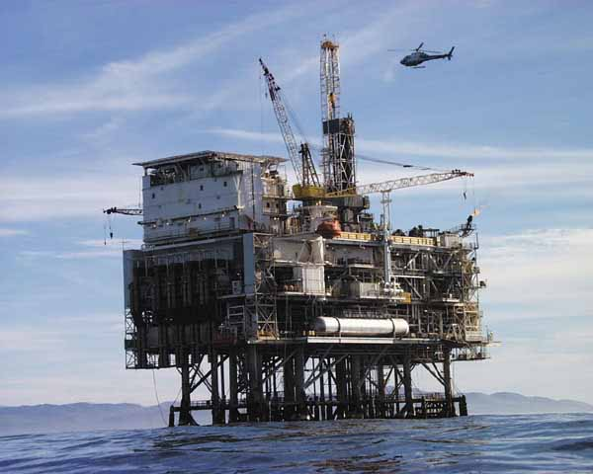
Oil Rig
Image: Oil Rig Platform, Nasa
From the Virtual Biology Classroom on ScienceProfOnline.com
Notes:
Oxidation Is Loss = OIL
Reduction Is Gain = RIG

Slide 30
Chemical Bonds hold molecules together, but can be broken during a chemical reaction
Reactants are the starting materials
Products are the end materials
From the Virtual Biology Classroom on ScienceProfOnline.com
Image: Combustion Reaction of Methane, Wiki

Slide 31
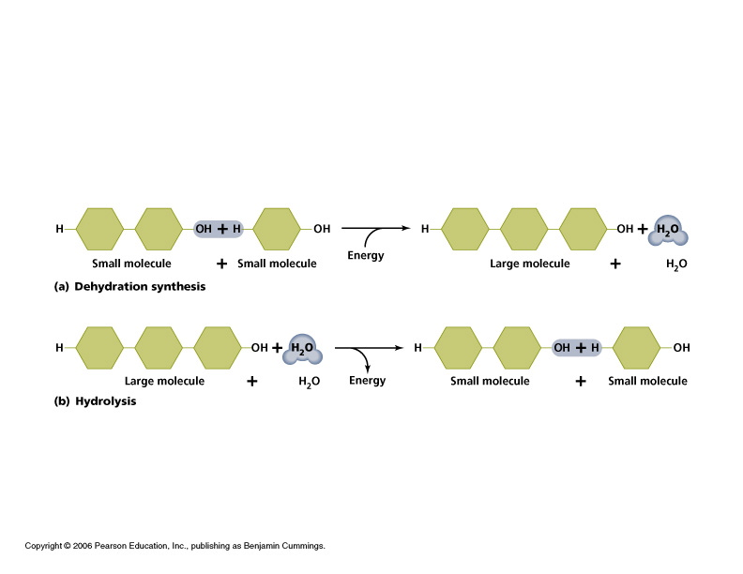
Simple Reactions Types
From the Virtual Biology Classroom on ScienceProfOnline.com

Slide 32
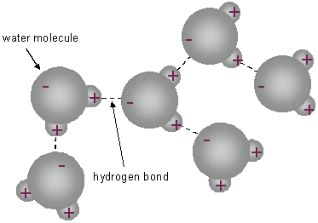
REVIEW!
Animated lessons on Chemical Bonding:
Ionic vs. Covalent Bonding
Chemical Structures & Bonding
Image: Methane Covalent Bonds, Dynablast; Formation of ionic sodium fluoride,
From the Virtual Cell Biology Classroom on ScienceProfOnline.com

Slide 33
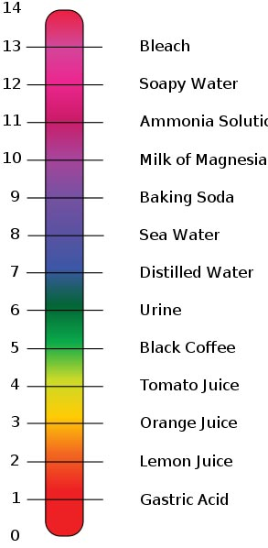
Acids, Bases & Buffers
Importance of
The pH Scale
in Biology
Images: pH scale, Edward Stevens, Wiki
From the Virtual Biology Classroom on ScienceProfOnline.com

Slide 34
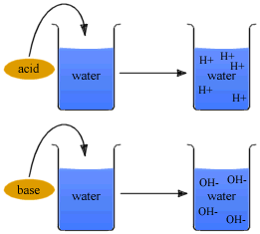
Ions: Acids & Bases
An acid is any ionic compound that releases hydrogen _____ (H⁺) in solution.
A base is any ionic compound that releases hydroxide _____ (⁻OH) in solution.
From the Virtual Biology Classroom on ScienceProfOnline.com
Notes:
cations
anions

Slide 35
Measurements of Acidity & Alkalinity (pH)
Acidity of a solution > measured by concentration of hydrogen ions (H+) vs. hydroxyl ions (OH-).
pH ranges: 0 (very acidic) to 14 (very basic).
pH scale is logarithmic.
Change in just one unit of scale = tenfold change in H+ concentration.
If concentration of H+ = OH - … neutral.
Images: pH scale, Edward Stevens, Wiki
From the Virtual Biology Classroom on ScienceProfOnline.com

Slide 36
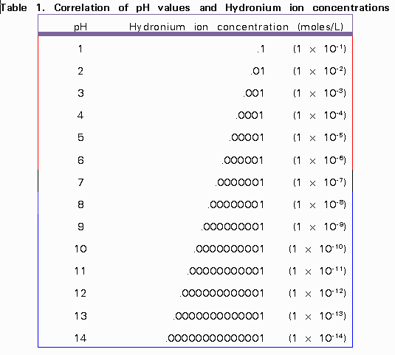
pH scale is logarithmic
Change in just one unit of scale
= tenfold change in H+ concentration.
Image: pH & hydronium ion concentration, UBC Wiki
From the Virtual Biology Classroom on ScienceProfOnline.com

Slide 37
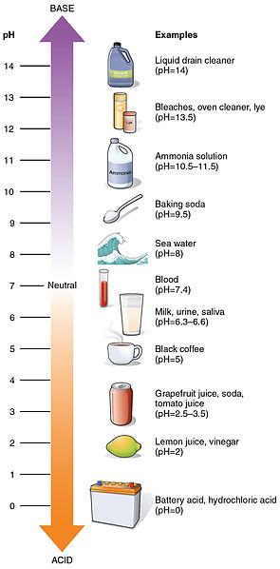
More Examples of pH from Daily Life
Images: pH scale, Wiki
From the Virtual Biology Classroom on ScienceProfOnline.com

Slide 38
Acid/Base Balance in Biology
pH balance is important to homeostasis of organisms.
Homeostasis = tendency of the body to maintain a balanced internal environment, even when faced with external changes. Such as the body's ability to maintain an internal temperature around 98.6 degrees F, whatever the temperature outside.
Examples:
Digestion needs acidic environment (pH 2-3)
Urine is slightly acidic
Blood must stay in neutral range near 7.35 to 7.45
Acids, Bases & You, and in-depth YouTube video.
Images: pH scale, Edward Stevens, Wiki
From the Virtual Biology Classroom on ScienceProfOnline.com

Slide 39
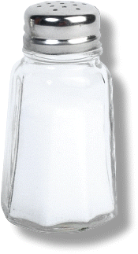
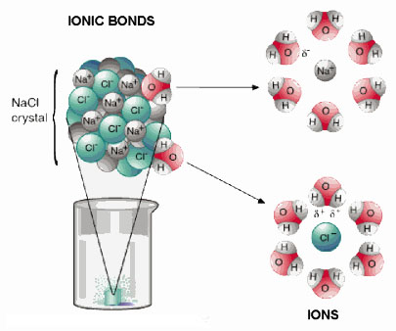
Ions & Salts
Compounds that dissociate in water and produce cations other than H+ and anions other than OH- are called salts.
The most familiar salt is sodium chloride, the principal component of common table salt.
Other examples of salts:
Baking soda (NaHCO3)
Epsom Salts (MgSO4)
From the Virtual Biology Classroom on ScienceProfOnline.com

Slide 40
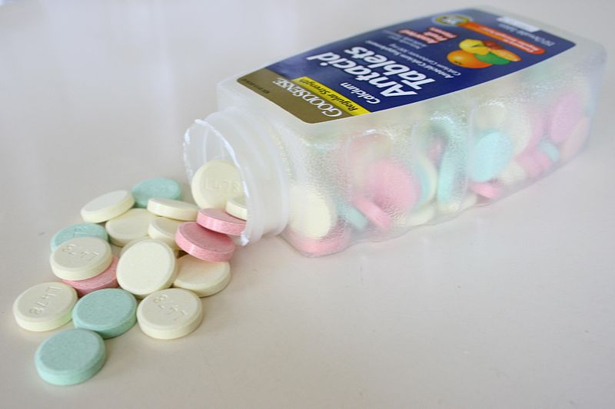
Salts: The Role of Buffers
Certain salts, called buffers, can
combine with excess hydrogen (H+) or
hydroxide (OH-) ions.
Produce substances less acidic or alkaline.
Act like a chemical sponge to soak up excess acid or base, keep pH constant.
- Buffers can be “used up”. Once used up, no longer help regulate pH.
- Buffers are vital to maintaining pH in organisms.
Example:
Antacids are buffers made of the salt calcium carbonate (CaCo3).
Images: Antacid Tablets, Wiki
From the Virtual Biology Classroom on ScienceProfOnline.com

Slide 41
REVIEW!
Interactive animated lessons on
pH: Acids & Bases
and
Buffers
Image: Methane Covalent Bonds, Dynablast; Formation of ionic sodium fluoride,
From the Virtual Biology Classroom on ScienceProfOnline.com

Slide 42
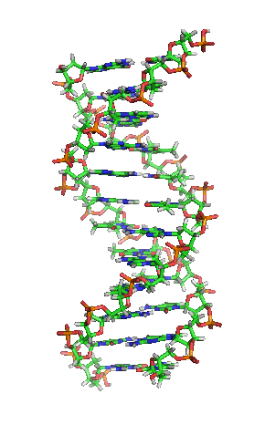
Organic Chemistry
From the Virtual Biology Classroom on ScienceProfOnline.com
Image: DNA, Richard Wheeler

Slide 43
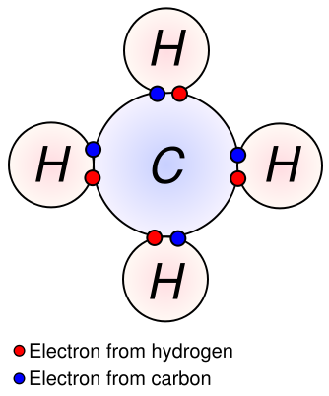
Inorganic vs Organic Molecules
?
?
Inorganic Molecules > Molecules that don’t have Carbon Hydrogen (C-H) bonds.
The major organic macromolecules (big molecules with carbon-hydrogen bonds) found in living things are:
1. carbohydrates
2. proteins
3. nucleic acids
4. lipids
From the Virtual Biology Classroom on ScienceProfOnline.com
Image: Methane Covalent Bonds, Dynablast, Wiki

Slide 44
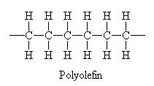
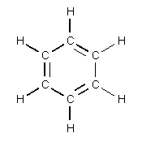
Carbon
Little Atom, Big Deal
The chemical basis of life. Abundant in all known life forms.
Essential to complex organic macromolecules, because each carbon atom can form ___ bonds (usually involving hydrogen , oxygen and/or nitrogen).
Able to form polymers (big organic molecules).
The atoms can bond with each other to form long chains.
Sometimes the ends of these chains join together to form a ring.
Double bonds form when atoms share two pairs of electrons (two covalent bonds).
From the Virtual Biology Classroom on ScienceProfOnline.com
Images: Carbon, Universe Today Website
Notes:
4

Slide 45
Study Table of Organic Macromolecules
(We will fill this in as we go through the rest of the lecture.)
Macromolecule (polymer) | Made of what type of monomer? | Is there another name for this polymer? | What are the main elements in this macromolecule? | Examples
1.
2.
3.
4.
From the Virtual Biology Classroom on ScienceProfOnline.com

Slide 46
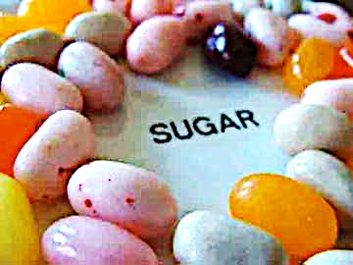

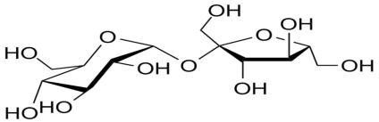
Organic Molecules
Carbohydrates
• “carbon” - hydrates”
• One carbon molecule to one water molecule (CH₂0)n.
• saccharide is a synonym for carbohydrate.
• The prefixes on the word “saccharide” relates to the size of the molecule (mono-, di-, tri- poly-).
BOOGERS!
You probably know that jelly beans are full of refined sugars…carbs. You may not know that boogers contain carbs as well. Boogers are dried-up mucus and dirty nose debris. Mucus is made mostly out of sugars and protein.
Images: Jelly beans, T. Port; Giraffe picking nose with tongue, Sucrose moleculee Wiki
From the Virtual Biology Classroom on ScienceProfOnline.com
Notes:
Saccharide

Slide 47
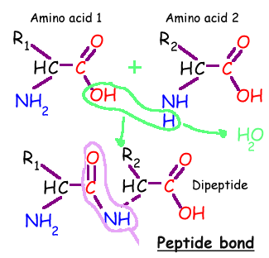
Organic Molecules - Proteins
Proteins are macromolecules, polymers composed of monomers called…
Amino acids contain a:
1. base amino group ( -NH₂)
2. acidic carboxyl group ( -COOH)
3. hydrogen atom
…all attached to same carbon atom (the α –carbon…alpha carbon).
4. Fourth bond attaches α-carbon to a side group (--R) that varies among different amino acids.
Side groups important … affects the way a proteins amino acids interact with one another, and how a protein interacts with other molecules.
Essential amino acids: Cannot be synthesized by the body. They must be ingested in the diet.
Arginine * Histidine * Methionine* Threonine * Valine * Isoleucine * Lysine * Phenylalanine *
Tryptophan * Leucine
From the Virtual Biology Classroom on ScienceProfOnline.com

Slide 48
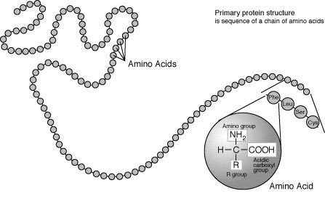
Organic Molecules – Proteins
Peptide Bonds
Link amino acids together in chains, like the beads on a necklace.
A dipeptide is 2 amino acids linked together.
A polypeptide, more than two.
From the Virtual Biology Classroom on ScienceProfOnline.com
Image: Protein Primary Structure, Wiki

Slide 49
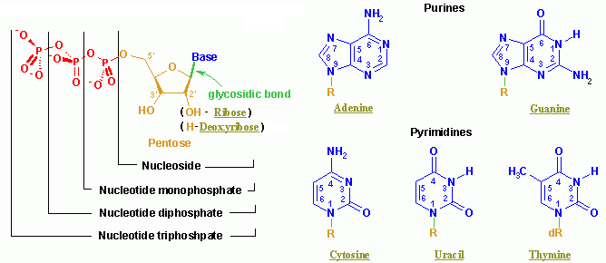
Organic Molecules – Nucleic Acids
Nucleic acids (both RNA and DNA) are macromolecules; polymers made up of monomers called nucleotides.
Nucleic acids deoxyribonucleic acid (DNA) and ribonucleic acid (RNA) = genetic material of cells.
Names derived from type of sugar contained within molecules = ribose
Nucleotides
Each monomer of nucleic acid is a nucleotide and consists of 3 portions:
- a sugar
- one or more phosphate
- one of five cyclic nitrogenous bases
+adenine, guanine (double-ringed purines)
+ cytosine, thiamine or uracil (single-ringed pyrimidines)
From the Virtual Biology Classroom on ScienceProfOnline.com
Image: Nucleotide Structure, Wikipedia

Slide 50

Organic Molecules – Nucleic Acids
Nucleic Acid Structure
Nucleotides linked by covalent bonds between sugar of one nucleotide and phosphate of next (sugar-phosphate backbone).
Nitrogenous bases extend from it like teeth of a comb.
From the Virtual Biology Classroom on ScienceProfOnline.com

Slide 51




Organic Molecules – Lipids
(Fats, Phospholipids, Waxes & Steroids)
Hydrophobic macromolecules…insoluble in water.
Not attracted to water because …
non-polar covalent bonds linking carbon & hydrogen aren’t attracted to the polar bonds of water.
From the Virtual Biology Classroom on ScienceProfOnline.com
Images: Cholesterol, Wiki; Phospholipid Structure, Bryan Derksen. Wiki Honeycomb, Wikii; Oil & Water, Kidipede

Slide 52


Organic Molecules – Lipids
(Fats, Phospholipids, Waxes & Steroids)
Fats
Fats and oils are made from two kinds of molecules:
• glycerol
(a type of alcohol)
• fatty acids
(triglycerides)
Images: Oil & Water, Kidipede
From the Virtual Biology Classroom on ScienceProfOnline.com

Slide 53

Organic Molecules – Lipids
(Fats, Phospholipids, Waxes & Steroids)
Phospholipids
• Phospholipids are a major component of all cell membranes.
Most phospholipids contain a diglyceride as the tail, and a phosphate group for head.
Hydrocarbon tails are hydrophobic, but phosphate heads are hydrophilic.
• So phospholipids are soluble in both water and oil.
• Tails from both layers facing inward and the heads facing outward = phospholipid bilayer.
From the Virtual Biology Classroom on ScienceProfOnline.com
Image: Cell Membrane, Wiki;

Slide 54




Organic Molecules – Lipids
(Fats, Phospholipids, Waxes & Steroids)
Waxes
• Do not have a hydrophilic head: so completely water insoluble.
Steroids
• The central core of a cholesterol molecule (4 fused rings) is shared by all steroids.
• Cholesterol is precursor to our sex hormones and Vitamin D.
• Our cell membranes contain cholesterol (in between the phospholipids) to help keep membrane “fluid” even when exposed to cooler temperatures.
From the Virtual Biology Classroom on ScienceProfOnline.com
Image: Lava Lamp, Wiki; Cholesterol molecule, Wiki; Phospholipids & Cholesterol, Cytochemistry.net

Slide 55


REVIEW!
Animated lessons on
Organic Macromolecules
From the Virtual Biology Classroom on ScienceProfOnline.com
Images: Cholesterol, Wiki; Chilesterol; Amino Acids & Peptide Bonds; DNA Molecule, National Science Foundation

Slide 56

Confused?
Here are some links to fun resources that further explain Chemistry:
Inorganic Chemistry Main Page on the Virtual Cell Biology Classroom of Science Prof Online.
“What Kind of Bonds AreThese?” song and slide show by Mark Rosengarten.
Ionic vs. Covalent Bonding animated science tutorial.
Chemical Structures & Bonding animated science tutorial.
“Meet the Elements” music video by They Might Be Giants.
Redox Reactions video lecture by Kahnacademy.
Chem4Kids website by Rader.
Acid & Bases, an Introduction by Vision Learning
Buffer System YouTube video.
Organic Chemistry Main Page on the Virtual Cell Biology Classroom of Science Prof Online.
Macromolecules interactive science tutorial.
DNA Structure Cell Biology Animation from John Kyrk.
(You must be in PPT slideshow view to click on links.)
Smart Links
Want to see me sing the Element Song?
Image: Daniel Radcliff by Joella Marano
From the Virtual Biology Classroom on ScienceProfOnline.com

