Slide 1

About Science Prof Online
PowerPoint Resources
Science Prof Online (SPO) is a free science education website that provides fully-developed Virtual Science Classrooms, science-related PowerPoints, articles and images. The site is designed to be a helpful resource for students, educators, and anyone interested in learning about science.
The SPO Virtual Classrooms offer many educational resources, including practice test questions, review questions, lecture PowerPoints, video tutorials, sample assignments and course syllabi. New materials are continually being developed, so check back frequently, or follow us on Facebook (Science Prof Online) or Twitter (ScienceProfSPO) for updates.
Many SPO PowerPoints are available in a variety of formats, such as fully editable PowerPoint files, as well as uneditable versions in smaller file sizes, such as PowerPoint Shows and Portable Document Format (.pdf), for ease of printing.
Images used on this resource, and on the SPO website are, wherever possible, credited and linked to their source. Any words underlined and appearing in blue are links that can be clicked on for more information. PowerPoints must be viewed in slide show mode to use the hyperlinks directly.
Several helpful links to fun and interactive learning tools are included throughout the PPT and on the Smart Links slide, near the end of each presentation. You must be in slide show mode to utilize hyperlinks and animations.
This digital resource is licensed under Creative Commons Attribution-ShareAlike 3.0:
http://creativecommons.org/licenses/by-sa/3.0/
Alicia Cepaitis, MS
Chief Creative Nerd
Science Prof Online
Online Education Resources, LLC
alicia@scienceprofonline.com
Tami Port, MS
Creator of Science Prof Online
Chief Executive Nerd
Science Prof Online
Online Education Resources, LLC
info@scienceprofonline.com
From the Virtual Biology Classroom on ScienceProfOnline.com
Image: Compound microscope objectives, T. Port
Notes:
Welcome to Science Prof Online PowerPoint Resources!
This PowerPoint Presentation comes from the Virtual Cell Biology Classroom of Science Prof Online, and, as such, is licensed under Creative Commons Attribution-ShareAlike 3.0.; meaning you can download, share and alter any of this presentation, but you can’t sell it or repackage and sell any part of it. Please credit Science Prof Online as the source of this presentation. Please abide by credited image copyrights. Thank you for using this resource.

Slide 2
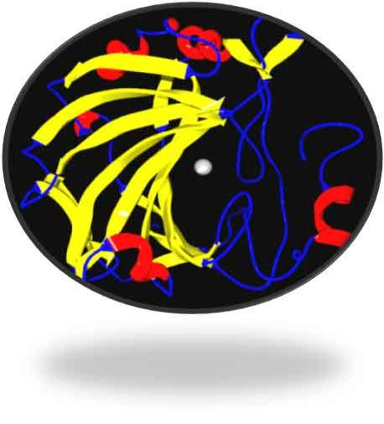
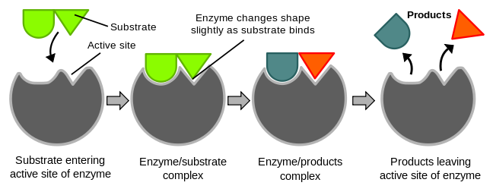
Enzymes
Images: Ribbon diagram of
enzyme with cofactor; Enzymatic reaction, Wiki
From the Virtual Biology Classroom on ScienceProfOnline.com

Slide 3
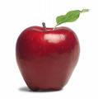
Apple Experiment
Come up and get an apple and a slice of lemon.
When you get back to your seat:
1. Take a big bite of your delicious apple.
2. Immediately squeeze lemon juice over the apple flesh that is now exposed from the bite.
3. IMPORTANT! Don’t get lemon juice all over the apple. Make sure that it is ONLY on the area that you just bit!
4. Set the lemon aside and wipe any lemon juice off of your hands with a napkin.
5. Take another bite from the opposite side of your apple.
6. Set your apple aside.
From the Virtual Biology Classroom on ScienceProfOnline.com

Slide 4
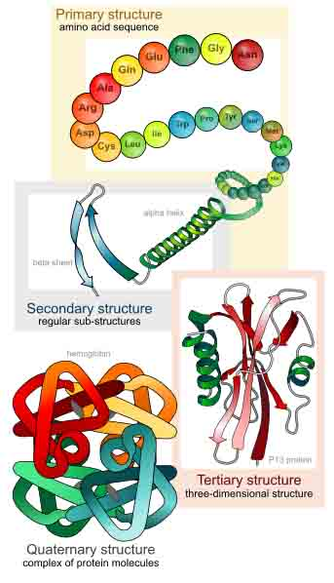
What are enzymes?
Enzymes
are
proteins.
Tertiary an d
quaternary
structure.
Q: What cellular organelle makes proteins?
From the Virtual Biology Classroom on ScienceProfOnline.com
Image: Levels of protein structure, M Ruiz

Slide 5
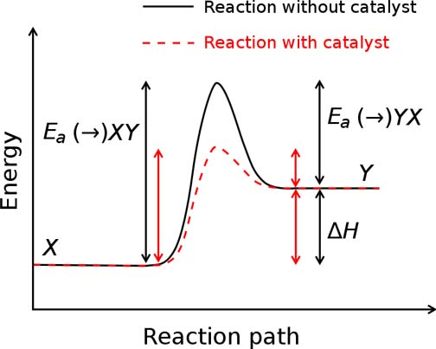
What do enzymes do?
Enzymes act as catalysts in cellular reactions.
Q: What does a catalyst do?
From the Virtual Biology Classroom on ScienceProfOnline.com
Images: Activation energy graph, Wiki
Notes:
catalysts

Slide 6
How do enzymes work?
Enzymes catalyze reactions by weakening chemical bonds, which lowers activation energy.
Video:
Activation Energy
From the Virtual Biology Classroom on ScienceProfOnline.com
Image: Activation energy graph, Wiki

Slide 7
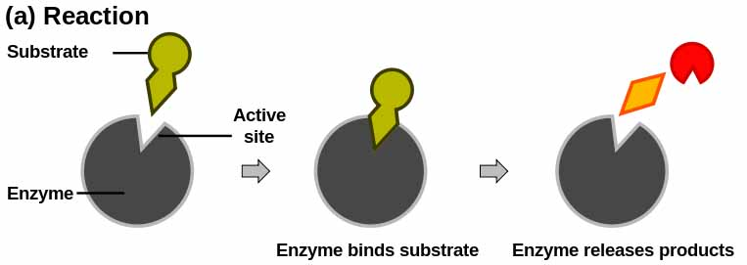
How do enzymes work?
Each enzyme has a unique 3-D shape, including a surface groove called an active site.
The enzyme works by binding a specific chemical reactant (substrate) to its active site, causing the substrate to become unstable and react.
The resulting product(s) is then released from the active site.
  Video: How Enzymes Work
From the Virtual Biology Classroom on ScienceProfOnline.com
Image: Enzymatic reaction, Jerry Crimson Manni

Slide 8
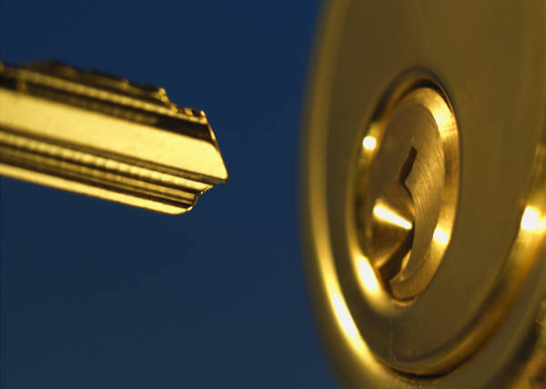
Enzymes…
are specific for what they will catalyze.
fit with substrate like a key and lock.
From the Virtual Biology Classroom on ScienceProfOnline.com

Slide 9
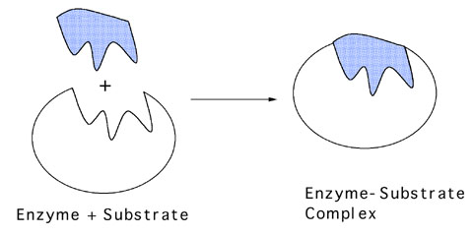
When an enzyme is interacting with it’s substrate, during the chemical reaction, together they are referred to as the …
From the Virtual Biology Classroom on ScienceProfOnline.com
Image: Enzyme –substrate complex, UC Davis

Slide 10
…are reusable.
They are not consumed (used up) in the reactions they catalyze.
May perform thousands of reactions per second.
Enzymes…
Video: Enzyme Hydrolysis of Sucrose
From the Virtual Biology Classroom on ScienceProfOnline.com

Slide 11

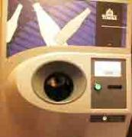
The more cans (substrate), the more $ (product).
The more recycling machines (enzymes), the faster the cans turn into $.
Enzymes are like tiny machines that catalyze reactions within living things.
$
$
$
$
$
$
$
From the Virtual Biology Classroom on ScienceProfOnline.com

Slide 12
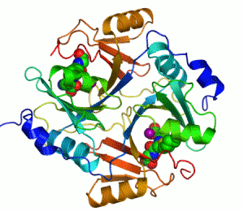
Enzymes…
Have names that usually end in -ase.
- Catalase
- Protease
- Lactase
From the Virtual Biology Classroom on ScienceProfOnline.com
Image: Animation of Enzyme, Wiki
Notes:
- ase

Slide 13
Formats for writing an enzymatic reaction.
( ________ )
_______ + ________ -----------> _________
( ________ )
__________ -----------> ________ ________
From the Virtual Biology Classroom on ScienceProfOnline.com
Notes:
Reactant, reactant, (enzyme) > product
Reactant, (enzyme) > product, product
One or more of the reactants in an enzymatic reaction is the substrate, the reactant(s) that specifically interacts with the enzyme.

Slide 14
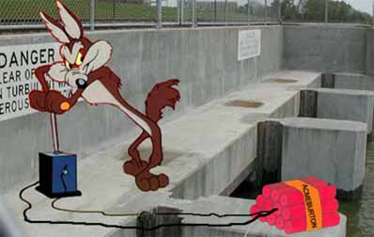
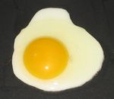

Q: How do you sabotage an enzyme?
• Denature it!
Alteration of a protein shape through some form of external stress
• Example, by applying heat, acidic or
alkaline environment
• Denatured enzyme can’t carry out its
cellular function .
Irreversible egg protein denaturation caused by high temperature (while cooking it).
Video: Denaturation in Food
From the Virtual Biology Classroom on ScienceProfOnline.com

Slide 15
Factors That Influence Enzyme Activity
Temperature
pH
Cofactors & Coenzymes
Inhibitors
From the Virtual Biology Classroom on ScienceProfOnline.com
Image: Animation of Enzyme, Wiki

Slide 16
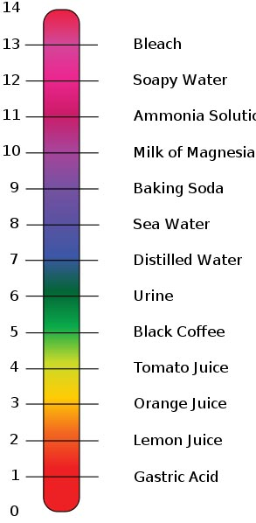
Temperature & pH
Think about what kind of cell or organism an enzyme may work in…
Temperatures far above the normal range denature enzymes. (This is why very high fevers are so dangerous. They can cook the body’s proteins.)
Most enzymes work best near neutral pH (6 to 8).
From the Virtual Biology Classroom on ScienceProfOnline.com
Images: pH scale, Edward Stevens, Wiki

Slide 17
Factors That Influence Enzyme Activity
Temperature
pH
Cofactors & Coenzymes
Inhibitors
From the Virtual Biology Classroom on ScienceProfOnline.com
Image: Animation of Enzyme, Wiki

Slide 18
Cofactors & Coenzymes
Non-protein substances (zinc, iron, copper, vitamins) are sometimes need for proper enzymatic activity.
• Coenzyme vs Cofactor: What’s the difference?
- Cofactor more general term. Includes inorganic and organic molecules.
- Coenzyme type of cofactor, But specifically organic molecules.
Image: Enzyme with Cofactor, Wiki. Ribbon-diagram showing carbonic anhydrase II. The grey sphere is the zinc cofactor in the active site.
From the Virtual Biology Classroom on ScienceProfOnline.com

Slide 19
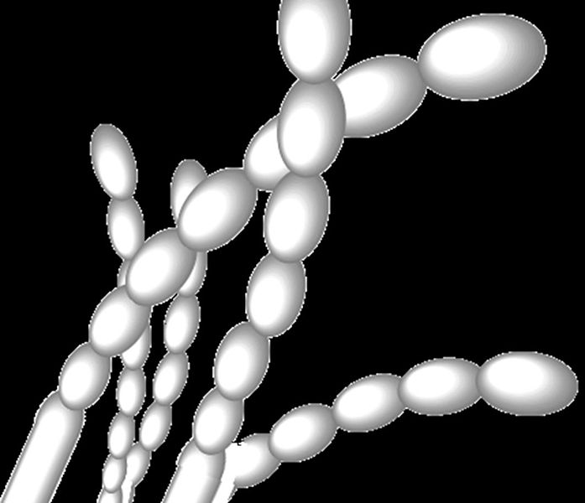
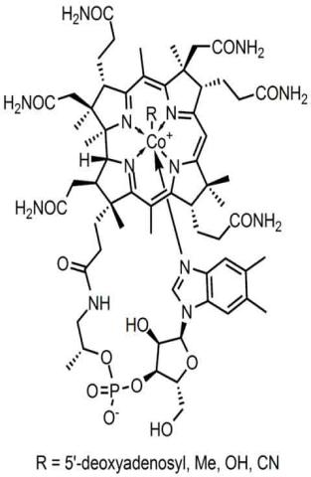
Coenzyme: Vitamin B12
Most vitamins are coenzymes essential in helping move atoms between molecules in the formation of carbohydrates, fats, and proteins.
Exclusively synthesized by bacteria.
Dietary sources include meat, eggs, dairy products and supplements.
Images: Streptomyces spores, Wiki; Vitamin B12 chemical structure, Wiki
From the Virtual Biology Classroom on ScienceProfOnline.com

Slide 20
Factors That Influence Enzyme Activity
Temperature
pH
Cofactors & Coenzymes
Inhibitors
From the Virtual Biology Classroom on ScienceProfOnline.com
Image: Animation of Enzyme, Wiki

Slide 21
Two Types of Enzyme Inhibitors
1. Competitive
inhibitor
Chemicals that resemble an enzyme’s normal substrate and compete with it for the active site.
Reversible depending on concentration of inhibitor and substrate.
EXAMPLE: The drug Antabuse is used to help alcoholics quit drinking. Antabuse inhibits aldehyde oxidase, resulting in the accumulation of acetaldehyde (say a-si-’tell-de-hide) during the metabolism of alcohol. Elevated acetaldehyde levels cause symptoms of nausea and vomiting.
From the Virtual Biology Classroom on ScienceProfOnline.com
Image: Competitive inhibition of enzyme, Jerry Crimson Mann

Slide 22
Two Types of Enzyme Inhibitors
2. Non-competitive inhibitor
Do not enter active site, but bind to another part of the enzyme, causing the enzyme & active site to change shape.
Usually reversible, depending on concentration of inhibitor & substrate.
Video
Feedback Inhibition of a Metabolic Pathway
EXAMPLE: You may know that compounds containing heavy metals such as lead, mercury, copper or silver are poisonous. This is because ions of these metals are non-competitive inhibitors for several enzymes.
From the Virtual Biology Classroom on ScienceProfOnline.com
Image: Pouring liquid mercury, Bionerd

Slide 23
Enzyme Inhibitors
Blocking an enzyme's activity can kill a pathogen or correct a metabolic imbalance.
Many medications are
enzyme inhibitors.
Enzyme inhibitors are also used as herbicides and pesticides.
EXAMPLE:
Another example of competitive inhibition is protease inhibitors.
They are a class of anti-retroviral drugs used to treat HIV.
The structure of the drug ritonavir (say ri-TAHN-a-veer) resembles the substrate of HIV protease, an enzyme required for HIV to be made.
From the Virtual Biology Classroom on ScienceProfOnline.com
Images: Prescription bottle, T. Port; Dead cockroach, Wiki

Slide 24
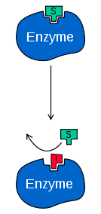
REVIEW!
Enzyme Inhibition:
1. Enzyme Inhibition I
2. Enzyme Inhibition II
3. Feedback Inhibition
of a Metabolic Pathway
Q: What type of inhibition is this?
Image: Enzyme Inhibitor, Wiki
From the Virtual Biology Classroom on ScienceProfOnline.com

Slide 25
Metabolism
The Transformation of Energy
Sum of all chemical reactions in a cell or organism.
Cells either get their energy either by photosynthesis or by eating stuff.
From the Virtual Biology Classroom on ScienceProfOnline.com
Image: Autotrophs & Heterotrophs, Mikael Häggström

Slide 26
Metabolic Pathways
Series of chemical reactions that regulate the concentration of substances within the organism.
Has order, like an assembly line.
Molecules are altered in a series of steps.
Use many smaller
steps rather than
one big step.
Enzymes are workers that control each station along the pathway.
May be turned on and off as needed.
  Video:
  Biochemical Pathways
From the Virtual Biology Classroom on ScienceProfOnline.com
Image: Metabolism Pathways, Wiki

Slide 27
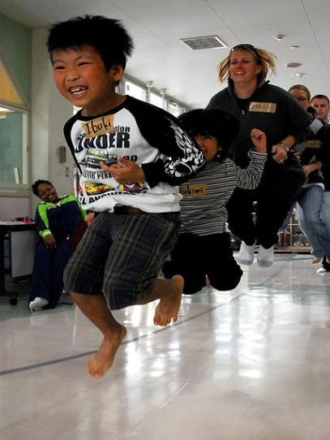
Why Are Enzymes So Important?
Why are we devoting one whole lecture topic to a protein molecule?
Nearly all chemical reactions in biological cells need enzymes to make the reaction occur fast enough to support life.
From the Virtual Biology Classroom on ScienceProfOnline.com
Image: Jumping rope, Meagan E. Klein

Slide 28
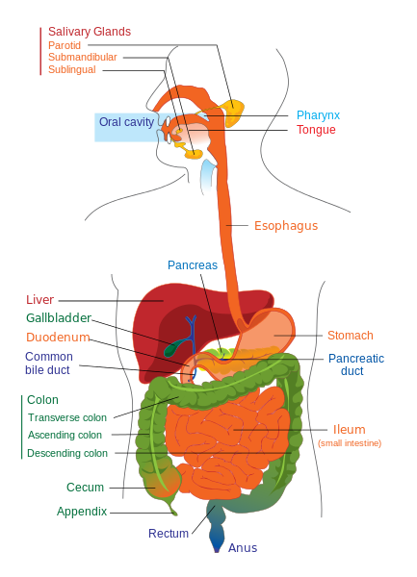
Digestion & Enzymes
Digesting one meal could take years without enzymes!
Examples of digestive enzymes: sucrase, lipase, amylase.
Videos:
1. Digestion of Molecules Animation
2. A Look At Digestive Enzymes In Our Body
3. Role of Enzymes in Digestion of Food
4. The Digestive System: Follow the Food!
From the Virtual Biology Classroom on ScienceProfOnline.com
Image: Digestive system diagram, Wiki

Slide 29
Study Table of Enzymes & Digestion
(We will fill this in as we go through lecture & lab.)
 | Enzymes involved? Which? | What’s happening? |  | Protein y/n | Carbs y/n | Fat y/n
mouth |  |  | digested?
 |  |  | absorbed?
esophagus |  |  | digested?
 |  |  | absorbed?
stomach |  |  | digested?
 |  |  | absorbed?
small intestines |  |  | digested?
 |  |  | absorbed?
large intestine |  |  | digested?
 |  |  | absorbed?
From the Virtual Biology Classroom on ScienceProfOnline.com

Slide 30
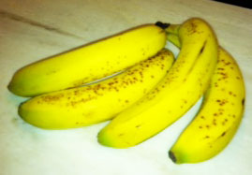
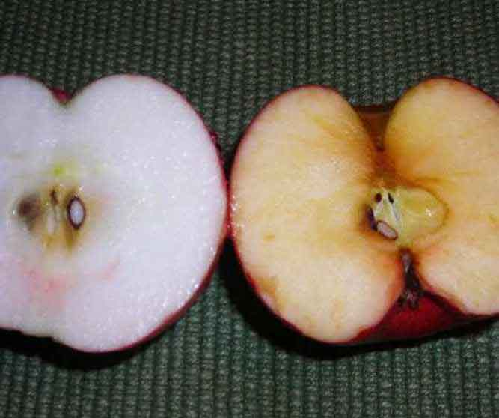
Meet the Enzyme: Catechol Oxidase
Catechol oxidase (also called catecholase) is present in most fruits and vegetables.
It is the enzyme that facilitates the browning of cut or bruised fruits and vegetables by catalyzing the following reaction.
Reaction:
catechol oxidase
catechol + O₂ ----------→ polyphenol
colorless substrate brown product
From the Virtual Biology Classroom on ScienceProfOnline.com
Image: Bananas & Apples, T. Port
Notes:
Catechol + oxygen (catecholase) > polyphenol

Slide 31
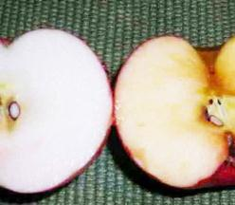
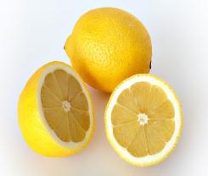
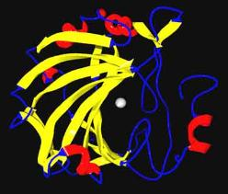
Meet the Enzyme: Catechol Oxidase
Reaction:
catechol oxidase
catechol + O₂ -----------→ polyphenol
colorless substrate brown product
We can slow this reaction by removing the enzyme’s cofactor:
Lemon juice and other acids are used to preserve color in fruit, particularly apples, by lowering the pH and removing the copper (cofactor) necessary for the enzyme to function.
Images: Apples, T. Port; Lemons, André Karwath; Enzyme with Cofactor, Wiki; pH scale, Edward Stevens, Wiki
From the Virtual Biology Classroom on ScienceProfOnline.com

Slide 32
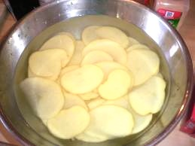
Meet the Enzyme: Catechol Oxidase
Reaction:
catechol oxidase
catechol + O₂ --------------→ polyphenol
colorless substrate brown product
We can also slow this reaction, without denaturing the enzme, by placing fruits & veggies under water.
Q: Why would doing this prevent browning?
From the Virtual Biology Classroom on ScienceProfOnline.com

Slide 33
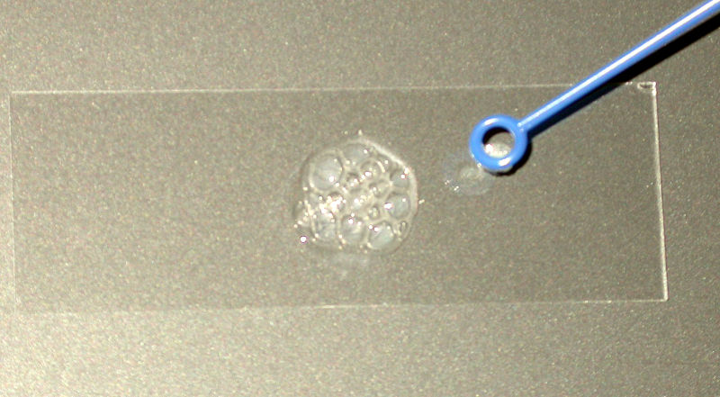
Meet the Enzyme:
Catalase
Bacterial sample added to a hydrogen peroxide..
What are the bubbles made of?
Reaction:
  catalase
2H₂O₂ ----------→ 2H₂0 + O₂
Catalase is an enzyme found in nearly all living things exposed to oxygen. This enzyme catalyzes the decomposition of hydrogen peroxide to water and oxygen, protecting the cell from oxidative damage.
Q: What do you think would happen if these potatoes were put into hydrogen peroxide, instead of water?
Images: Catalase test to determine if bacterial sample is aerobic, Wiki
From the Virtual Biology Classroom on ScienceProfOnline.com

Slide 34
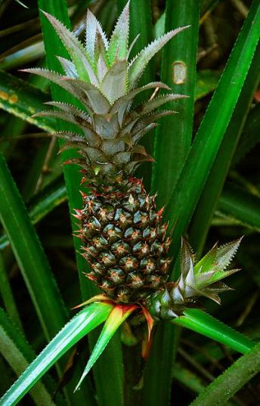
Meet the Enzyme: Bromelain
Pineapple contains enzyme bromelain, which can digest protein. (It is a protease.)
Jell-O® is made of gelatin, a processed version of a structural protein called collagen found in many animals, including humans.
Collagen = big, fibrous molecule makes skin, bones, and tendons both strong and elastic.
Gelatin you eat usually comes from the collagen found in cow, chicken or pig skin, bones and connective tissues. (Yummie!)
Examine 2 containers:
a. In one, canned pineapple was used to make Jell-O® .
b. The other, fresh pineapple was used.
Q: Why is one Jell-O solid and the other liquid?
From the Virtual Biology Classroom on ScienceProfOnline.com
Image: Pineapple, Whaldener Endo

Slide 35
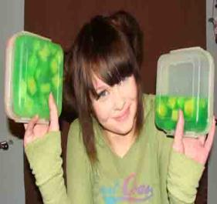
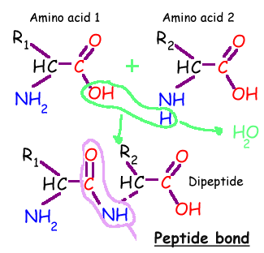

Meet the Enzyme: Bromelain
Bromelain is a protease enzyme that facilitates hydrolysis of protein.
Remember, hydrolysis cuts molecule by adding water…the reverse of the hydration synthesis pictured to the left.
Reaction:
bromelain
collagen protein + H₂0 --------------→ amino acids
substrate products
FYI: Bromelain is used as a meat tenderizer. Breaks down the collagen in meat. So what do you think could happen to your tongue when you eat fresh pineapple?
From the Virtual Biology Classroom on ScienceProfOnline.com
Notes:
protease

Slide 36
Confused?
Here are some links to fun resources that further explain enzymes:
Enzymes Main Page on the Virtual Cell Biology Classroom of Science Prof Online.
“How Enzymes Work” an animation from McGraw-Hill.
“The Role Enzymes Play in the Body” from Enzymedica. These guys are selling supplements. I don’t endorse the supplement, but their video is very instructive regarding enzymes and digestion.
Enzyme Substrate Interactions from Pearson Education.
“Enzymes and Digestion” from About.com.
“Bio Rad GTCA Song” musical advertisement for SsoFast™.
(You must be in PPT slideshow view to click on links.)
Smart Links
From the Virtual Biology Classroom on ScienceProfOnline.com

