Slide 1
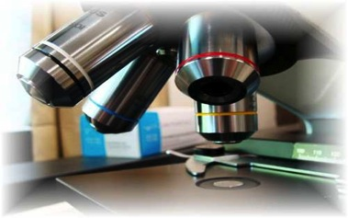
About Science Prof Online
PowerPoint Resources
Science Prof Online (SPO) is a free science education website that provides fully-developed Virtual Science Classrooms, science-related PowerPoints, articles and images. The site is designed to be a helpful resource for students, educators, and anyone interested in learning about science.
The SPO Virtual Classrooms offer many educational resources, including practice test questions, review questions, lecture PowerPoints, video tutorials, sample assignments and course syllabi. New materials are continually being developed, so check back frequently, or follow us on Facebook (Science Prof Online) or Twitter (ScienceProfSPO) for updates.
Many SPO PowerPoints are available in a variety of formats, such as fully editable PowerPoint files, as well as uneditable versions in smaller file sizes, such as PowerPoint Shows and Portable Document Format (.pdf), for ease of printing.
Images used on this resource, and on the SPO website are, wherever possible, credited and linked to their source. Any words underlined and appearing in blue are links that can be clicked on for more information. PowerPoints must be viewed in slide show mode to use the hyperlinks directly.
Several helpful links to fun and interactive learning tools are included throughout the PPT and on the Smart Links slide, near the end of each presentation. You must be in slide show mode to utilize hyperlinks and animations.
This digital resource is licensed under Creative Commons Attribution-ShareAlike 3.0:
http://creativecommons.org/licenses/by-sa/3.0/
Alicia Cepaitis, MS
Chief Creative Nerd
Science Prof Online
Online Education Resources, LLC
alicia@scienceprofonline.com
Tami Port, MS
Creator of Science Prof Online
Chief Executive Nerd
Science Prof Online
Online Education Resources, LLC
info@scienceprofonline.com
From the Virtual Biology Classroom on ScienceProfOnline.com
Image: Compound microscope objectives, T. Port
Notes:
Welcome to Science Prof Online PowerPoint Resources!
This PowerPoint Presentation comes from the Virtual Cell Biology Classroom of Science Prof Online, and, as such, is licensed under Creative Commons Attribution-ShareAlike 3.0.; meaning you can download, share and alter any of this presentation, but you can’t sell it or repackage and sell any part of it. Please credit Science Prof Online as the source of this presentation. Please abide by credited image copyrights. Thank you for using this resource.

Slide 2
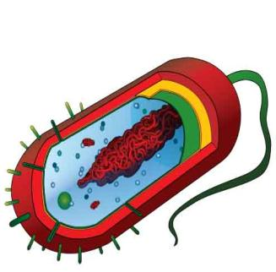
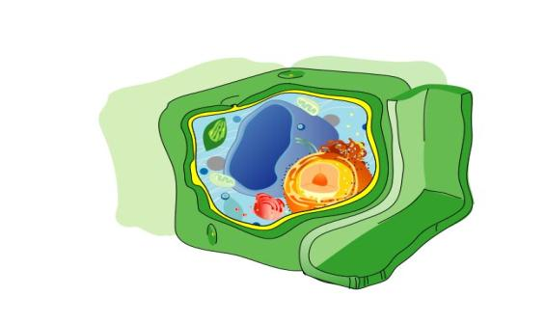
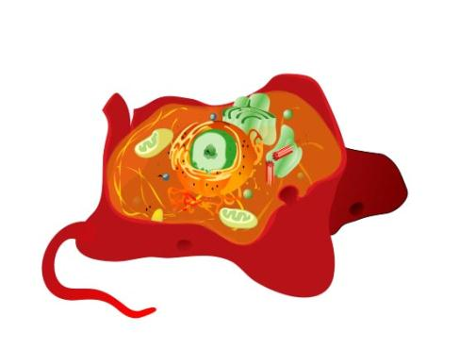
The Basics of
Biological Cells
Images: Prokaryotic cell, Animal cell & Plant cell, M. Ruiz, Objective lenses of microscope, T. Port
Images: M. Ruiz

Slide 3
Two Basic Types of Cells
Prokaryotic Cells
Eukaryotic Cells
Cells:
are the building blocks of life!
All living things are made of one or more cells.
only come from other cells.
are , really small. How small are they?
small because of surface to volume ratio
WATCH THIS!
Introduction to Cell Video
Images: Prokaryotic cell diagram & Eukaryotic cell diagram, M. Ruiz
From the Virtual Biology Classroom on ScienceProfOnline.com

Slide 4
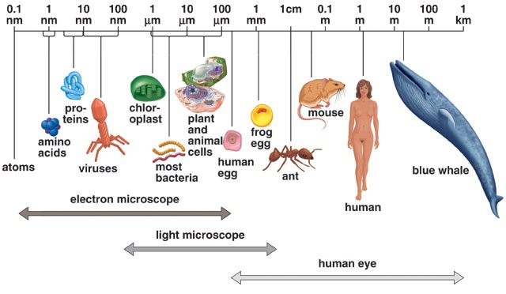
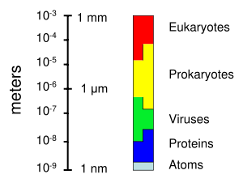
Size of Living Things
1 m = 100 cm = 1,000mm = 1,000,000 µm = 1,000,000,000nm
1mm = 1000 µm = 1000000nm
1 µm = 1000nm
Click link for an interactive
“Size of Microscopic Things”
animation on Cells Alive.
From the Virtual Biology Classroom on ScienceProfOnline.com

Slide 5
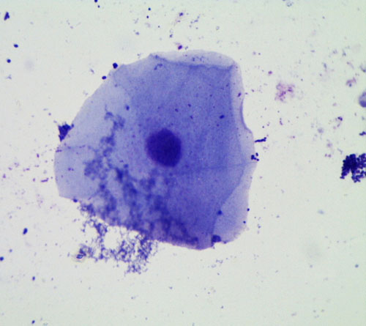
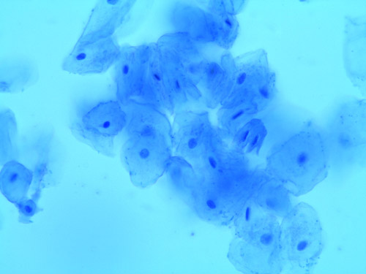
Parts Common to All Cells
Plasma membrane:
  boundary of the cell, controls what enters and leaves
Cytoplasm:
  fluid substance within the cell, contains dissolved solutes like ions and sugars
Genetic Info: DNA
  Provides instructions for how to build and run the cell
Images: Micrographs of human cheek cells at 400xTM and 100xTM, T. Port
From the Virtual Biology Classroom on ScienceProfOnline.com

Slide 6
Classification of Kingdoms of Eukaryotes
 | Bacteria | Protists | Fungi | Plants | Animals
Prokarytic or Eukaryotic?
Cell Organization (single or multicellular?)
Examples of Organisms
Distinguishing Characteristics
Other Details
Name three ways in which eukaryotes and prokaryotes differ:
From the Virtual Biology Classroom on ScienceProfOnline.com

Slide 7
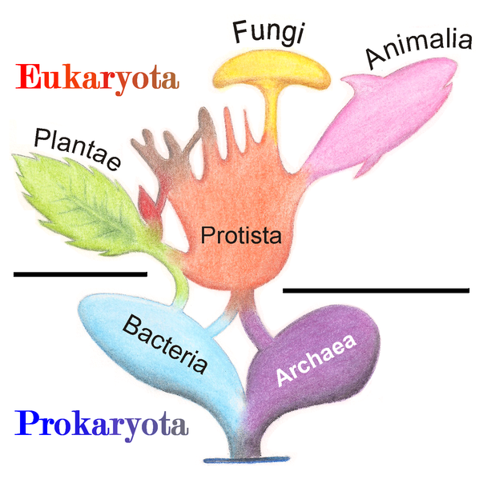
Old School 5 Kingdom classification of organisms
Eukaryotes
Prokaryotes
From the Virtual Biology Classroom on ScienceProfOnline.com
Image: Phylogenetic Tree, Wiki

Slide 8
Prokaryotic Cells
Prokaryotes
Single-celled.
Reproduce by binary fission (another copy by dividing).
No cell nucleus or any other membrane-bound organelles. DNA travels openly around the cell.
All bacteria are prokaryotes.
“Studio apartment” of cells. Everything is in one room.
Images: Prokaryotic Cell, M. Ruiz
From the Virtual Biology Classroom on ScienceProfOnline.com
Notes:
8

Slide 9
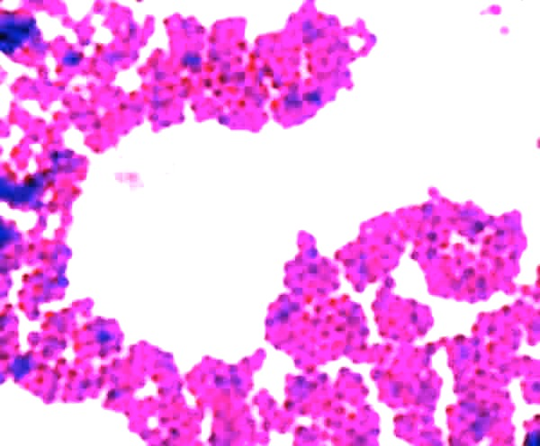
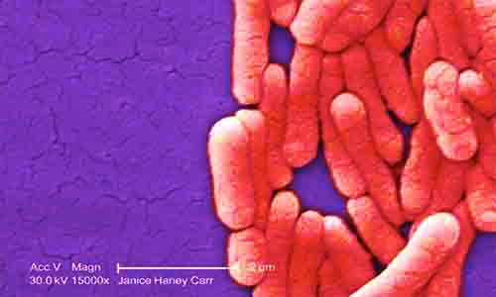
Bacteria
Prokaryotes
Unicellular microorganisms found in every habitat on Earth.
Most are heterotrophs, (including the ones that cause disease). Some are autotrophs.
Peptidoglycan cell walls.
Binary fission.
There are all varieties… pathogen, opportunist, harmless & beneficial.
Video: Time Lapse of Bacterial Growth
From the Virtual Biology Classroom on ScienceProfOnline.com
Image: Salmonella, Public Health Image Library,PHIL #10973
Notes:
Eubacteria

Slide 10
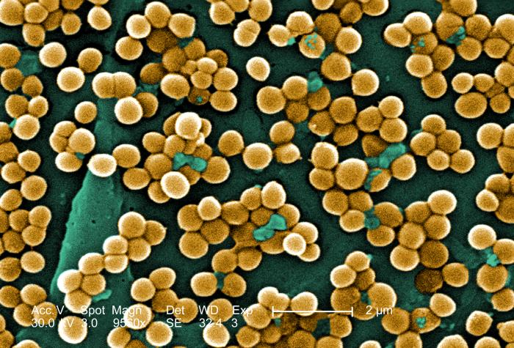
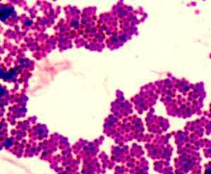
Bacteria: Staphylococcus
GRAM-POSITIVE
coccus-shaped
  Staphylococcus aureus (golden staph), most common cause of staph infections.
  Approximately 20–30% of general population “Staph carriers."
  S. aureus can cause illnesses ranging from minor skin infections to life-threatening diseases, such as meningitis, Toxic shock syndrome (TSS) & septicemia.
  MRSA = Methicillin-resistant Staphylococcus aureus
  One of the four most common causes of nosocomial infections, often causing postsurgical wound infections.
  S. epidermidis is normal flora which inhabits the skin of healthy humans.
Staphylococcus aureus,
Golden staph
(One of the reasons snot
gets yellow when you are sick.)
Stapylococcus epidermidis.
Images: S. aureus, Janice Haney Carr , PHIL #10046; Gram stain Staph, T. Port
From the Virtual Microbiology Classroom on ScienceProfOnline.com
Notes:
Staphylococcus

Slide 11
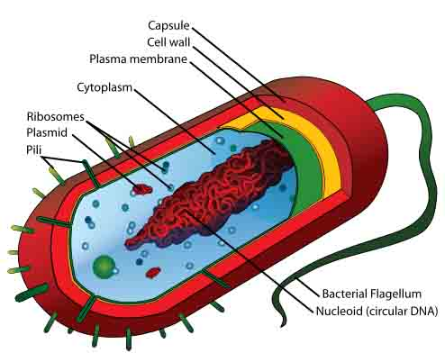
REVIEW!
Here’s an excellent interactive lesson on
Prokaryote Cell Structure
From the Virtual Biology Classroom on ScienceProfOnline.com
Images: Prokaryotic cell diagram, M. Ruiz

Slide 12

Eukaryotic Cells
Eu =“true”, karyon=“nucleus”
Genetic material contained in a nuclear membrane.
Membrane bound organelles.
Include animal, plant, fungi, algae cells as well as other microscopic eukaryotes.
Evolved from prokaryotic cells.
The “mansion” of cells, many different “rooms”.
From the Virtual Biology Classroom on ScienceProfOnline.com
Image: Eukaryotic Cell Diagram, M. Ruiz
Notes:
12

Slide 13
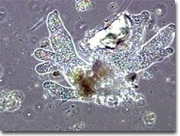
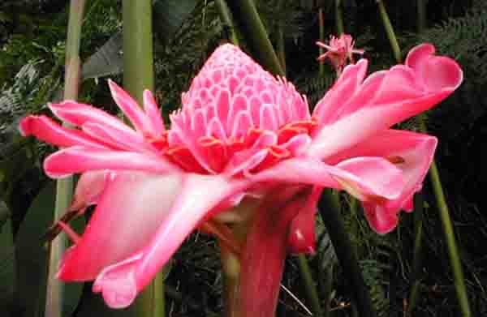
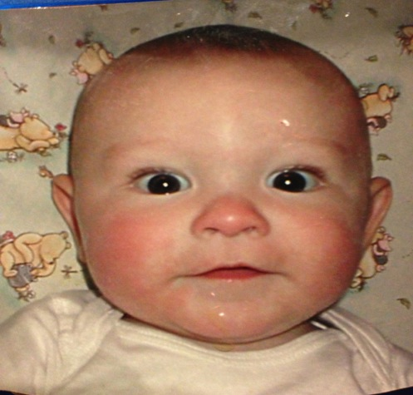
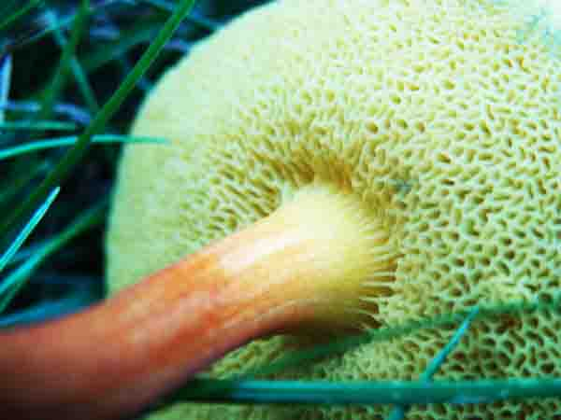
Eukaryotes
    1. Protists
    2. Plants
    3. Animals
    4. Fungi
Images: Photos by T. Port
From the Virtual Biology Classroom on ScienceProfOnline.com
Notes:
Eukaryota
Protozoans
Algae
Slime & Water Molds
Fungi
Helminths
vectors

Slide 14
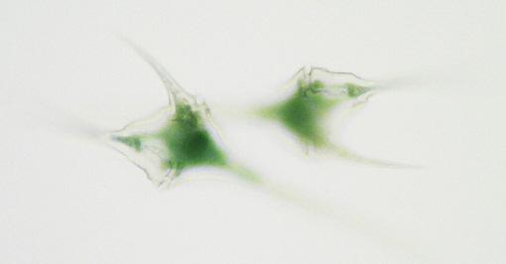

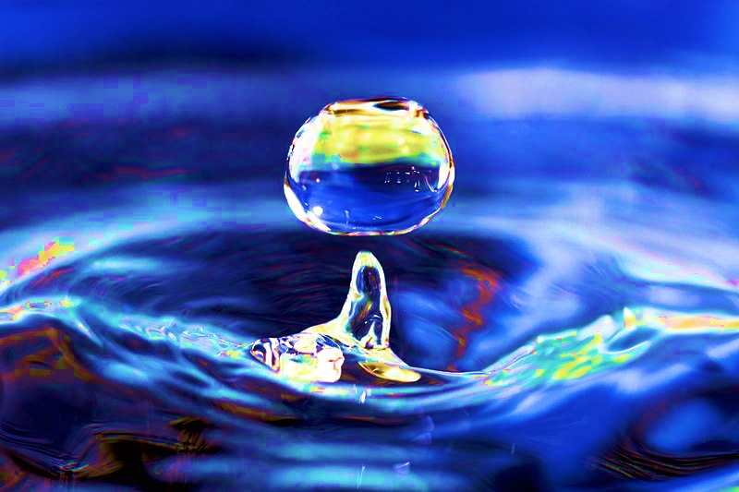
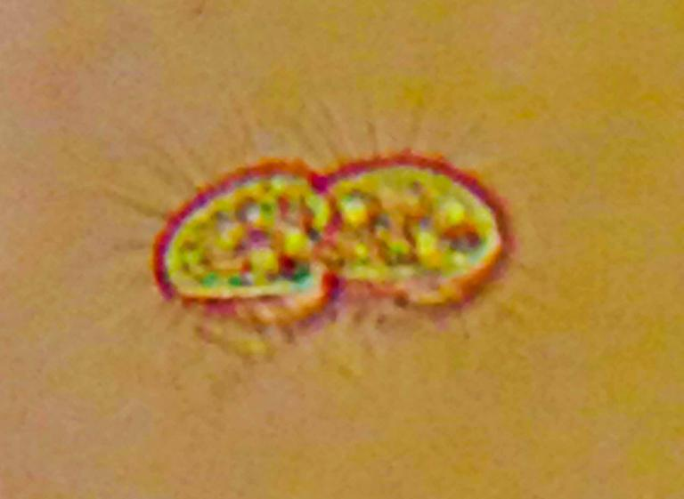
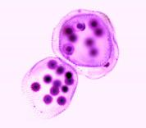
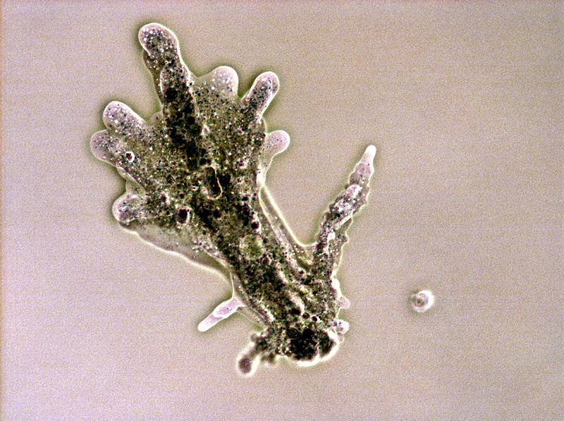
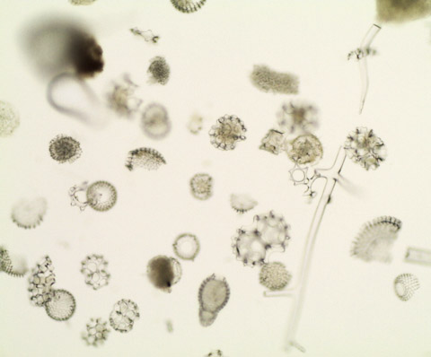
Protists
Eukaryotic
Unicellular
Need moist environment
Some more
plant like
(autotrophs).
Some more animal like (heterotrophs).
Life in a Drop of Water
Video: Life in a Drop of Water
Images: Clockwise from top: Ceratium, Tabellaria, Cyclidium, Volvox, and Diatoms, by T. Port; Amoebae, Wiki. Water drop, Wiki
From the Virtual Biology Classroom on ScienceProfOnline.com

Slide 15
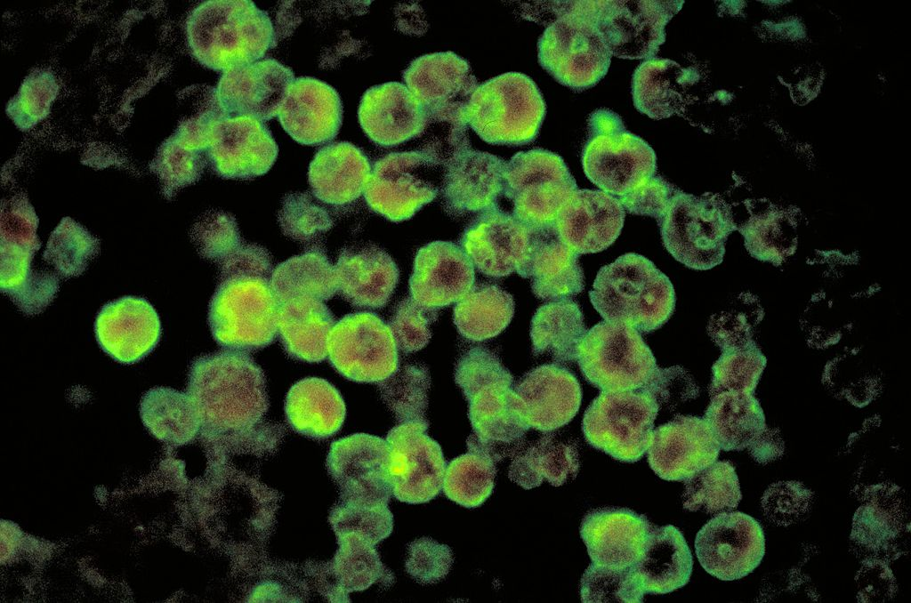
Amoebae: Naegleria fowleri
Pathogenic Protist
Meningoencephalitis caused by the amoeba
Naegleria fowleri (nuh-GLEER-ee-uh FOWL'-erh-eye),
a parasitic microorganism that feeds on brain tissue.
How Common is N. fowleri?
Infection very rare (34 US cases in past 10 years, but nearly always fatal.
Cases most often occur during the dry, hot summer months, when water is warm and at low levels.
How N. fowleri Attacks
Enters body through the nose; invades CNS by penetrating the olfactory mucosa and nasal tissues.
Early infections: necrosis (tissue death) and hemorrhaging in the olfactory bulbs.
Amoeba then climbs along nerve fibers through the floor of the cranium, into the brain.
Where Is Naegleria Found?
Worldwide distribution, typically found in warm fresh water, temperatures ranging from 77 – 95 F.
How to Reduce Your Risk
Infection usually follows water-related activities (swimming underwater, diving, or any water sport that results in water going up the nose).
Infection can only result from exposure to the amoeba’s environment, not from person-to-person contact.
Image: Naegleria folwleri, Wiki
From the Virtual Biology Classroom on ScienceProfOnline.com
Notes:
Protozoan

Slide 16
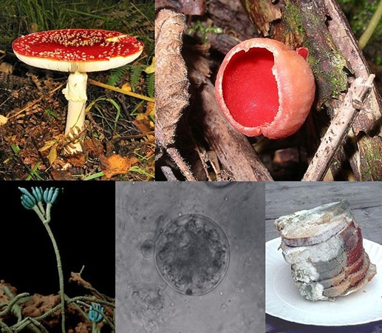
Fungi
Eukaryotic
Some unicellular. Some multicellular.
Heterotrophs that digest their food externally, secrete digestive enzymes and then absorb nutrient molecules into their cells.
Examples: yeasts, molds, and mushrooms.
Fungi are also used extensively by humans:
  yeasts responsible for fermentation of beer & bread
  mushroom farming is big industry
  produce some antibiotics
Fungi and bacteria are the primary decomposers of organic matter.
If you have ever had athlete's foot
or a yeast infection, you can blame a fungus.
Can be difficult to kill with antimicrobials. Remember, their cells are very much like ours.
Reproduce through tiny spores in the air.
You are more likely to get a fungal infection if you have a weakened immune system or take antibiotics.
Video:
Fungi - Death Becomes Them
from Crash Course Biology
From the Virtual Biology Classroom on ScienceProfOnline.com
Images: Fungi Collage, Borgqueen, Wiki, Creative Commons
Notes:
Fungi

Slide 17
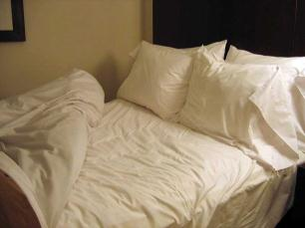
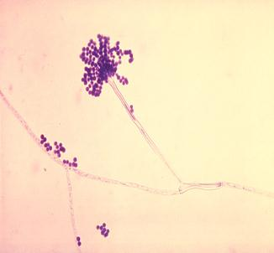
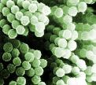
Opportunistic Fungal Pathogen
Aspergillus fumigatus
Can cause disease ________________.
Has become leading infectious cause of death in leukemia and bone marrow transplant patients.
Can result in:
- allergic reaction
- pulmonary mass
- systemic infection
- can also exacerbate asthma
Researchers dissected pillows (both feather and synthetic) and identified several thousand spores of fungus per gram of used pillow - more than a million spores per pillow.
Five things increase a persons risk of experiencing opportunistic mycoses:
  Invasive medical procedures
  Medical therapies that weaken the immune system
  Certain preexisting conditions / Immune compromised
  Specific lifestyle factors
Images: Bed with pillows, Liz Lawley; Aspergillus fumigatus , PHIL #300; A. fumigatus, Janice Carr, PHIL # 9998
From the Virtual Biology Classroom on ScienceProfOnline.com
Notes:
Aspergillus fumigatus
Aspergillosis

Slide 18
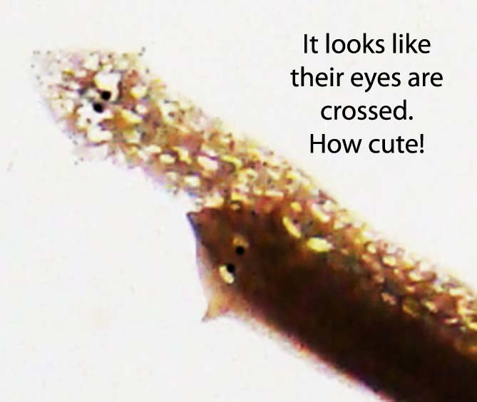
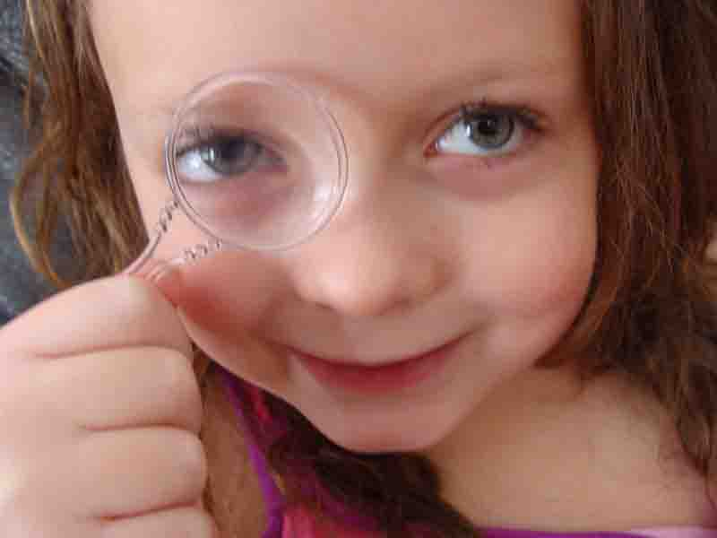

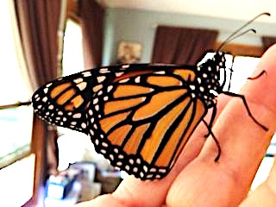
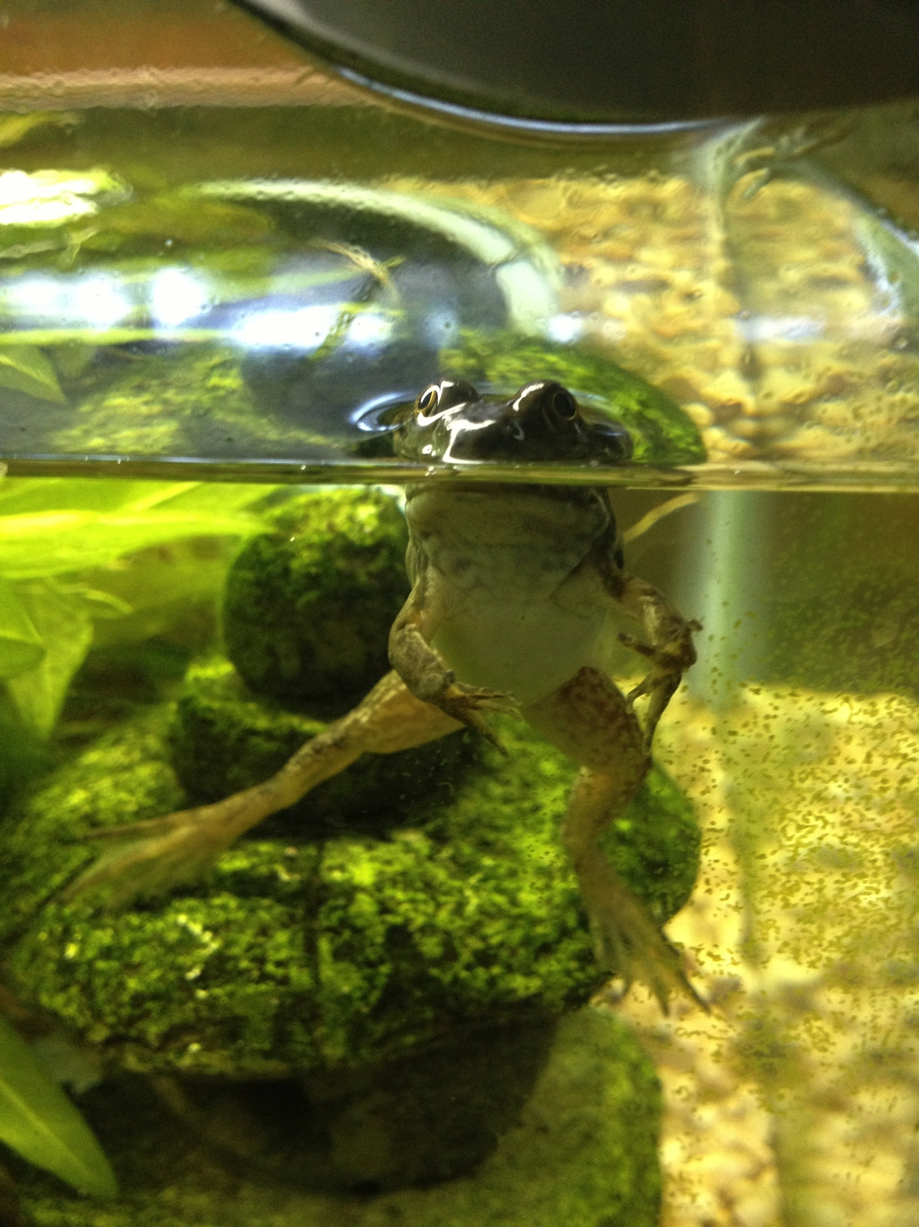
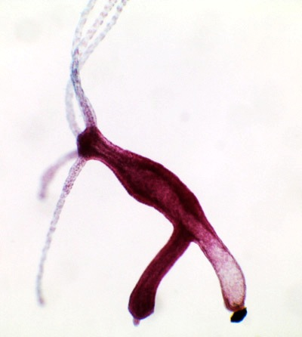
Animals
Eukaryotic
Multi-cellular
Heterotrophic
No cell wall.
Some reproduce asexually. Some reproduce sexually. Some can do both.
Most are motile (can move around)..
Video:
Eukaryopolis
The City of Animal Cells
from Crash Course Biology
From the Virtual Biology Classroom on ScienceProfOnline.com
All photos by T. Port

Slide 19
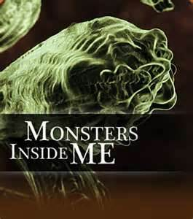
Animals: Parasitic Worms (Helminths)
Now lets watch the Monsters Inside Me Video Clip:
“Worm In My Butt”!
From the Virtual Biology Classroom on ScienceProfOnline.com
Animal Planet Show Monsters Inside Me

Slide 20
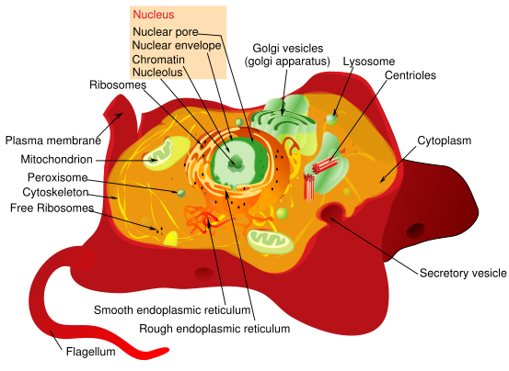
Animal Cell (Eukaryote)
From the Virtual Biology Classroom on ScienceProfOnline.com
Images: Animal cell diagram , M. Ruiz

Slide 21
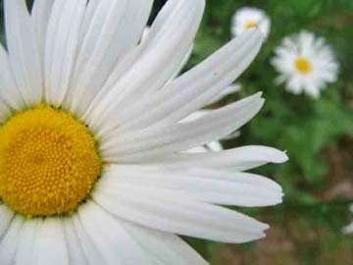
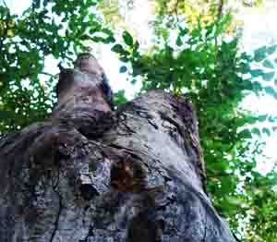
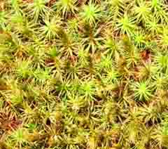
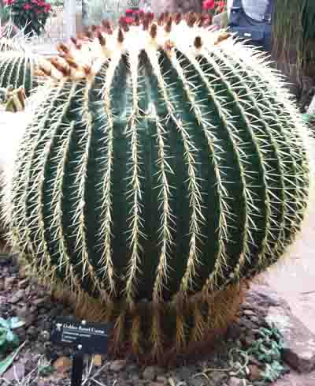
Plants
Eukaryotic
Multi-cellular
Autotrophic (photosynthesis)
Have cell wall.
Some reproduce asexually. Some reproduce sexually. Some can do both.
Video:
Pant Cells
from Crash Course Biology
From the Virtual Biology Classroom on ScienceProfOnline.com
All photos by T. Port
Notes:
Tool

Slide 22
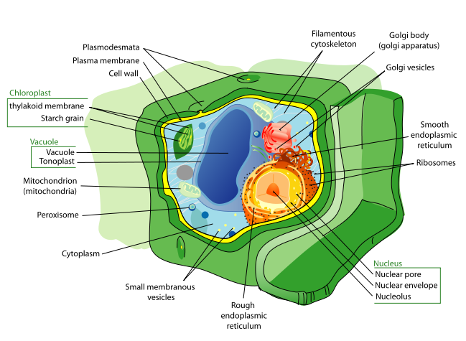
Plant Cell (Eukaryote)
From the Virtual Biology Classroom on ScienceProfOnline.com
Image: Plant cell diagram, M. Ruiz

Slide 23
REVIEW!
Here’s an excellent interactive lesson on
Eukaryotic Cell Structure.
From the Virtual Biology Classroom on ScienceProfOnline.com
Images: Prokaryotic cell diagram, M. Ruiz

Slide 24
Confused?
Here are some links to fun resources that further explain Cell Biology:
Eukaryotic Cells Main Page on the Virtual Cell Biology Classroom of Science Prof Online.
Prokaryotic & Eukaryotic: Two Types of Biological Cells, an article from SPO.
Eukaryotic Cell: Structures, Functions & Diagrams, an article from SPO.
“Cells” music video by They Might Be Giants.
Cells Alive interactive website.
“How big is a…” interactive diagram from Cells Alive website.
Cell Structure tutorials and quizzes from Interactive Concepts in Biochemistry.
Eukaryotic Cell Tour an Animated Science Tutorial.
“Germs”. Music by Weird Al Yankovic. Video by RevLucio.
“The Cell Song” lyrics by The Cell Squad, Freedom Middle School, Nashville, TN.
Endocytosis / Exocytosis animation and quiz from McGraw Hill.
Biology4Kids – Cell Biology Main Page by Raders.
(You must be in PPT slideshow view to click on links.)
Smart Links
From the Virtual Biology Classroom on ScienceProfOnline.com

