Slide 1

About Science Prof Online
PowerPoint Resources
Science Prof Online (SPO) is a free science education website that provides fully-developed Virtual Science Classrooms, science-related PowerPoints, articles and images. The site is designed to be a helpful resource for students, educators, and anyone interested in learning about science.
The SPO Virtual Classrooms offer many educational resources, including practice test questions, review questions, lecture PowerPoints, video tutorials, sample assignments and course syllabi. New materials are continually being developed, so check back frequently, or follow us on Facebook (Science Prof Online) or Twitter (ScienceProfSPO) for updates.
Many SPO PowerPoints are available in a variety of formats, such as fully editable PowerPoint files, as well as uneditable versions in smaller file sizes, such as PowerPoint Shows and Portable Document Format (.pdf), for ease of printing.
Images used on this resource, and on the SPO website are, wherever possible, credited and linked to their source. Any words underlined and appearing in blue are links that can be clicked on for more information. PowerPoints must be viewed in slide show mode to use the hyperlinks directly.
Several helpful links to fun and interactive learning tools are included throughout the PPT and on the Smart Links slide, near the end of each presentation. You must be in slide show mode to utilize hyperlinks and animations.
This digital resource is licensed under Creative Commons
Attribution-ShareAlike 3.0:http://creativecommons.org/licenses/by-sa/3.0/
Tami Port, MS
Creator of Science Prof Online
Chief Executive Nerd
Science Prof Online
Online Education Resources, LLC
info@scienceprofonline.com
Alicia Cepaitis, MS
Chief Creative Nerd
Science Prof Online
Online Education Resources, LLC
alicia@scienceprofonline.com
Image: Compound microscope objectives, T. Port
From the Virtual Cell Biology Classroom on ScienceProfOnline.com
Notes:
Welcome to Science Prof Online PowerPoint Resources!
This PowerPoint Presentation comes from the Virtual Cell Biology Classroom of Science Prof Online, and, as such, is licensed under Creative Commons Attribution-ShareAlike 3.0.; meaning you can download, share and alter any of this presentation, but you can’t sell it or repackage and sell any part of it. Please credit Science Prof Online as the source of this presentation. Please abide by credited image copyrights. Thank you for using this resource.

Slide 2
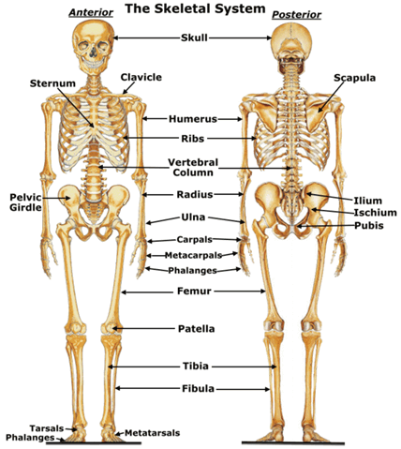
The Human Skeleton
Image: Skeletal system; Wikia; Red & Yellow Bone Marrow, Wiki
From the Virtual Anatomy and Physiology Classroom on ScienceProfOnline.com

Slide 3
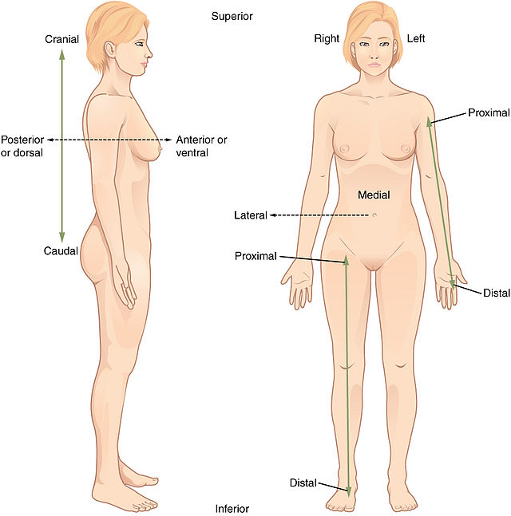
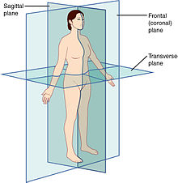
Anatomical Direction Terms and Body Planes
Images: Anatomical planes, Wiki; Anatomical Positions, Wiki

Slide 4
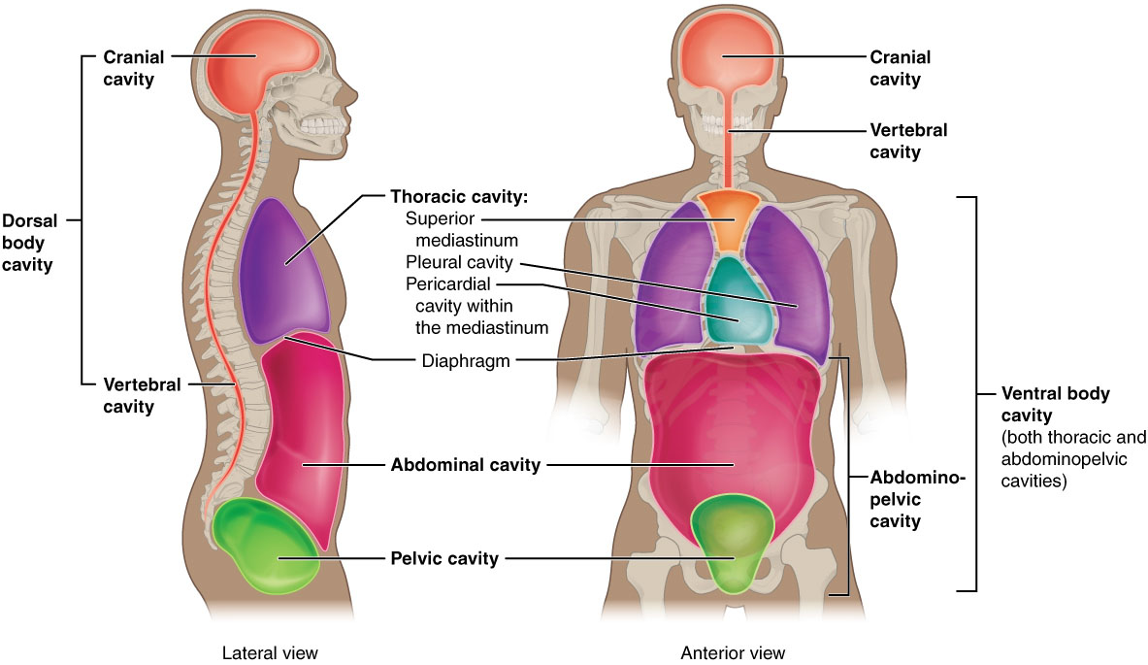
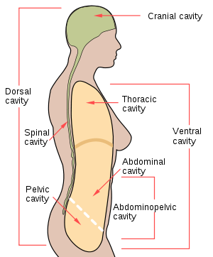
Human Body Cavities
Images: Body Cavities I, Wiki; Body Cavities II, Wiki

Slide 5
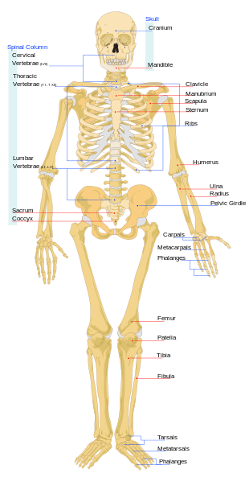
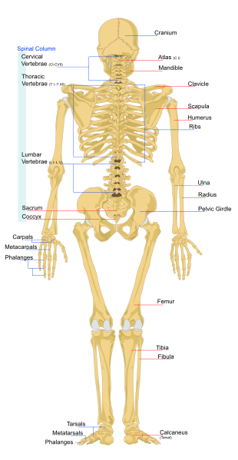
Human Skeleton Anterior & Posterior View
Video links:
Human Skeletal System
Them Not So Dry Bones
from Schoolhouse Rock
Human Skeletal System: It’s ALIVE!
from Crash Course Biology
Images: Human Skeleton front Wiki; Human Skeleton Back, Wiki

Slide 6
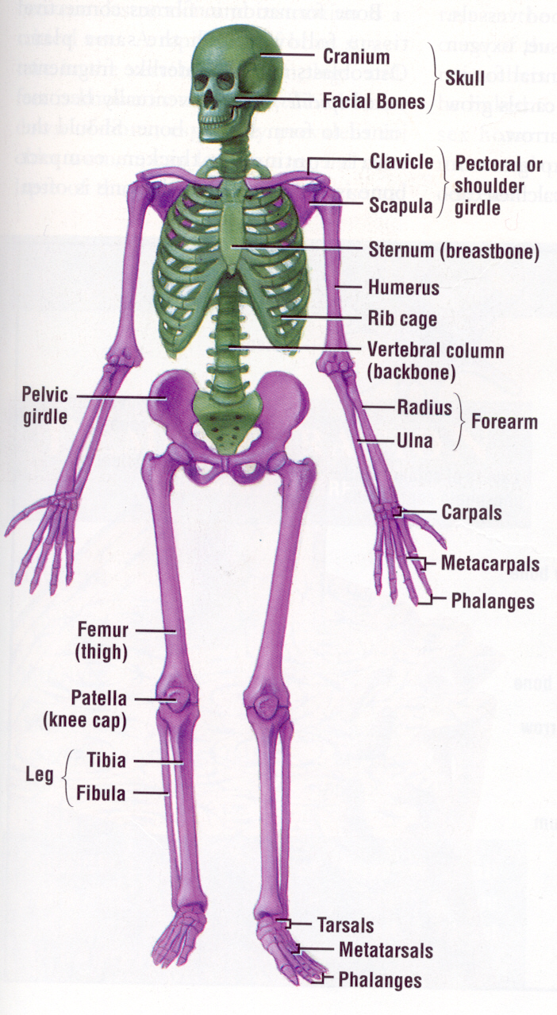
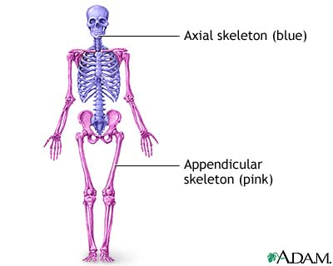
Axial & Appendicular Skeleton

Slide 7
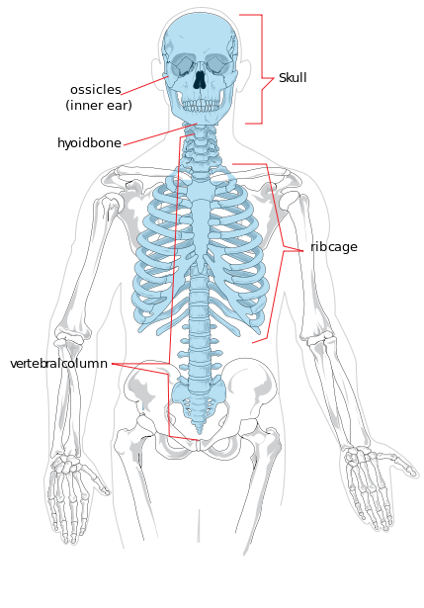
Axial Skeleton
Image: Axial Skeleton, Wiki

Slide 8
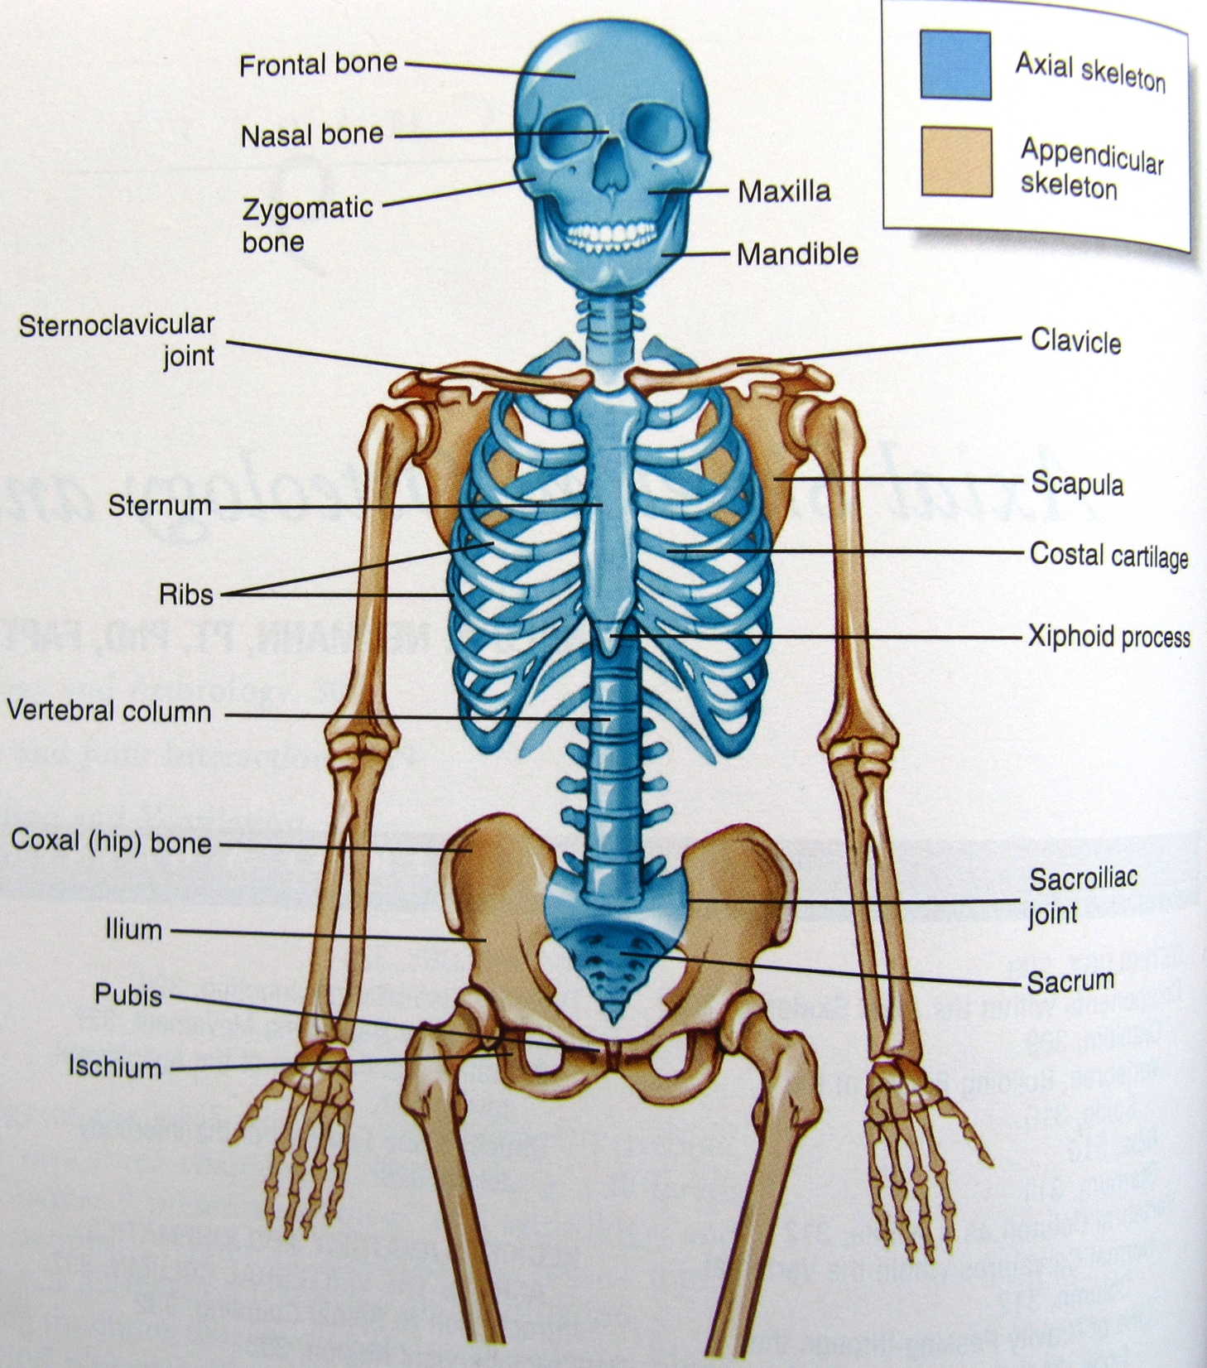
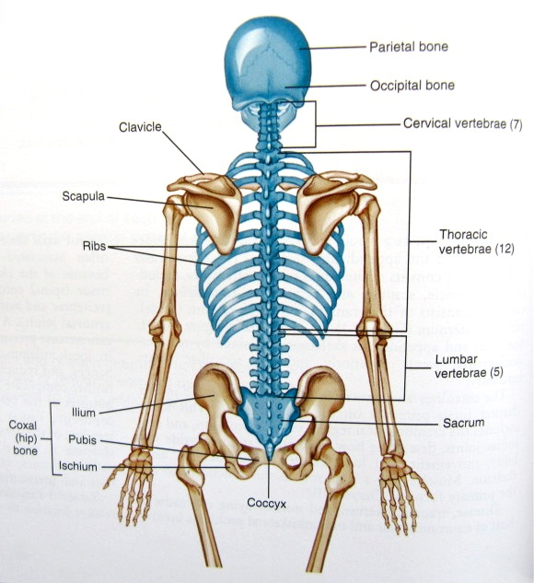
Axial Skeleton

Slide 9
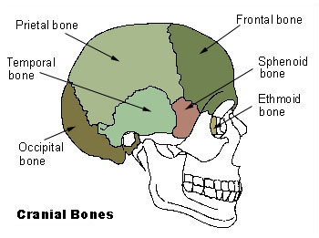
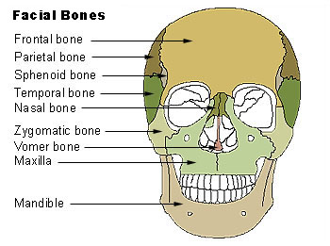
Axial Skeleton: Cranial & Facial Bones
Image: Cranial Bones, Facial Bones, Wiki

Slide 10
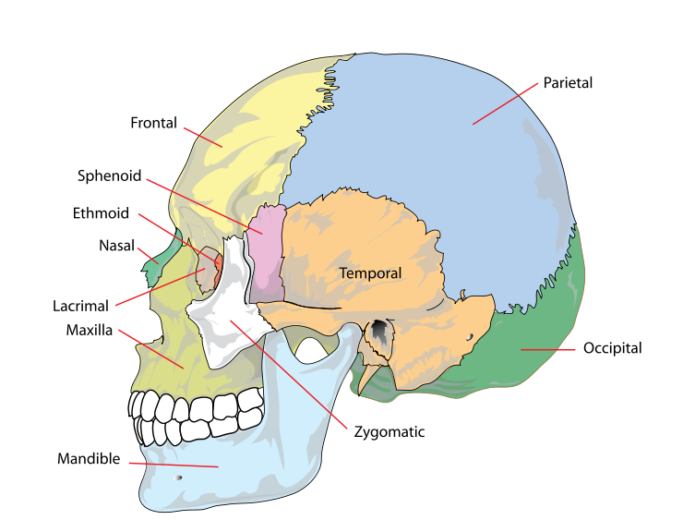
Axial Skeleton: Human Skull
Image: Human Skull, Wiki

Slide 11
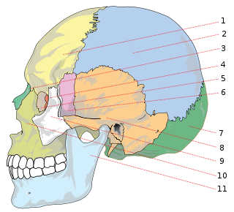
Axial Skeleton: Human Skull (Test your knowledge!)
Image: Human Skull, Wiki

Slide 12
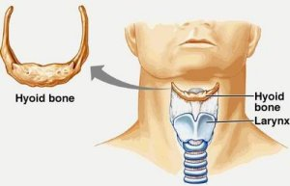
Axial Skeleton: Hyoid Bone
The hyoid is a horseshoe-shaped bone located in the anterior midline of the neck between the chin and the thyroid cartilage.
Its primary function is to anchor the tongue.
Unlike other bones, the hyoid is only distantly connected to other bones by muscles or ligaments.

Slide 13
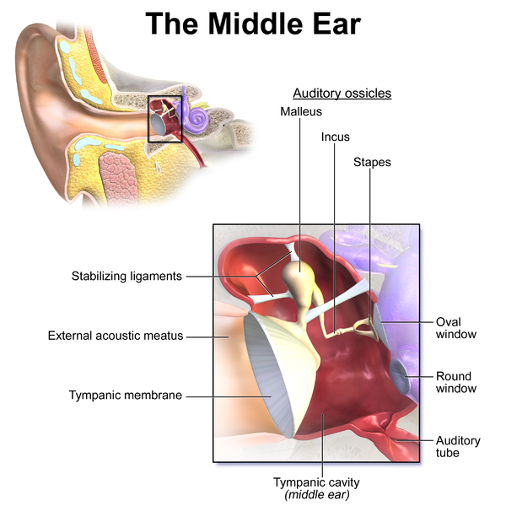
Axial Skeleton: Auditory Ossicles
The auditory ossicles are three bones in the middle ear that are among the smallest bones in the human body.
As sound waves vibrate the tympanic membrane (eardrum), the vibration moves the nearest ossicle, the malleus.
The malleus then transmits the vibrations, via the incus, to the stapes, and ultimately to the membrane of the oval window. The waves ultimately stimulate nerve impulses to the brain.
Image: Middle Ear, Wiki

Slide 14
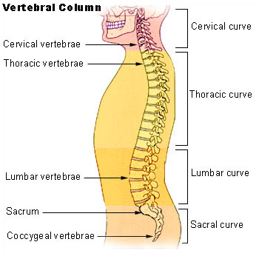
Axial Skeleton: Vertebral Column
Image: Vertebral Column, Wiki

Slide 15
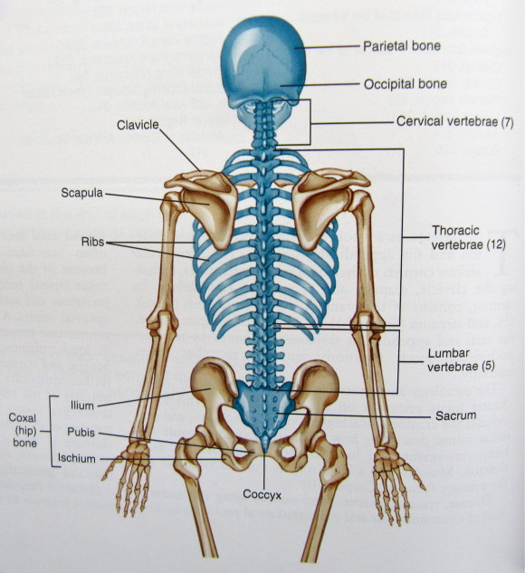
Axial Skeleton: Vertebral Column
Cervical:
Seven neck vertebrae,
C1-C7.
C1=atlas, C2=axis, C7=vertebra prominens (run your hands down the back of your neck the largest bump is due to the spinous process of C7!)
Thoracic:
Twelve thoracic vertebrae, articulate with the twelve pair of ribs.
Lumbar:
Largest vertebrae in lower back (lumbar region)
Sacrum: Five vertebrae that usually fuse during development.
Coccygeal: ‘tail bones’, 3-5 very small vertebrae

Slide 16
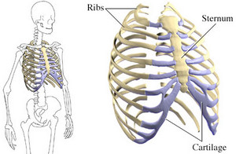
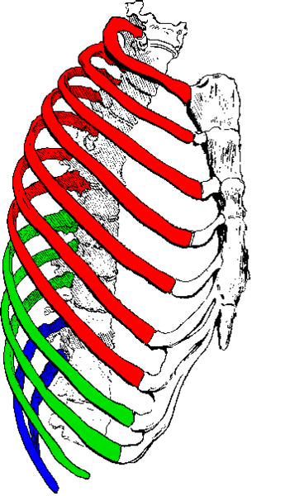
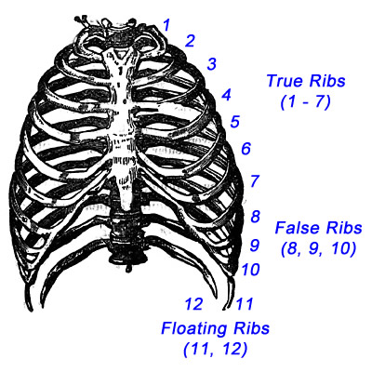
Axial Skeleton: Thoracic Cage (Rib Cage)
The rib cage is formed by the vertebral column, ribs, and sternum and encloses and protects the heart and lungs.
In humans, the rib cage, also known as the thoracic cage, is a structure made of boner and cartilage that surrounds the thoracic cavity and supports the pectoral girdle.
A typical human rib cage has24 ribs, the sternum (with xiphoid process), costal cartilages, and the 12 thoracic vertebrae.
Sternum
Xiphoid Process
Human Ribs:
- True (red)
- False (green)
- Floating (blue).
Image: Human ribs, Wiki

Slide 17
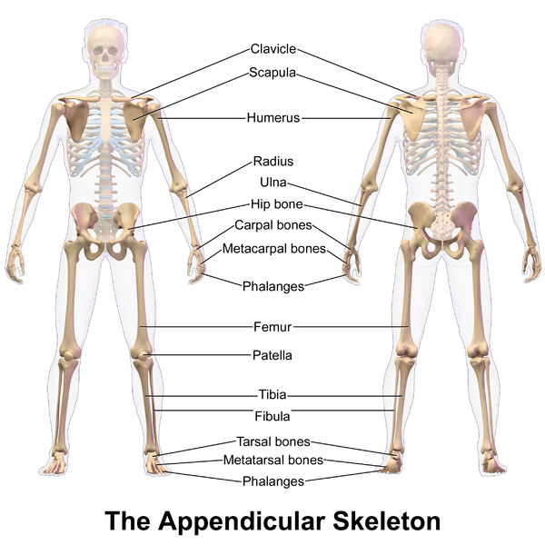
Appendicular Skeleton
Image: Appendicular Skeleton, Wiki

Slide 18
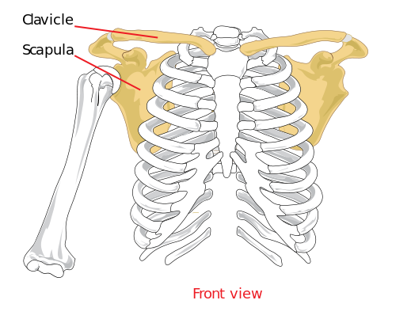
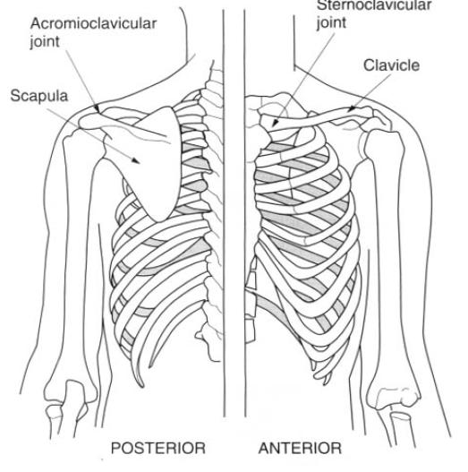
Upper Extremity: Pectoral Girdle
The pectoral girdle (a.k.a. shoulder girdle) is the set of bones connecting the upper limb to the axial skeleton on each side.
Image: Pectoral Girdle, Wiki

Slide 19
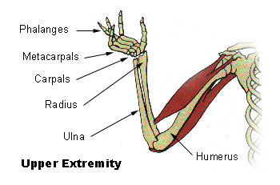
Upper Extremity: Arm – Brachial, Antebrachial, Carpal & Hand
Brachial Region
Antebrachial Region
Image: Upper extremity, Wiki

Slide 20
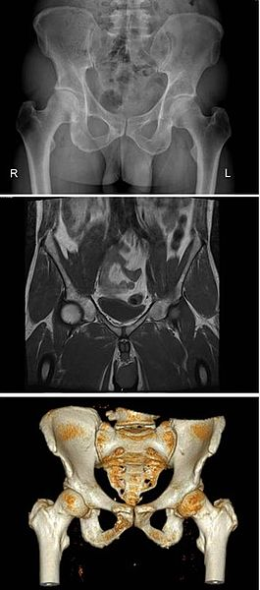
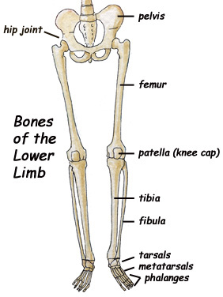
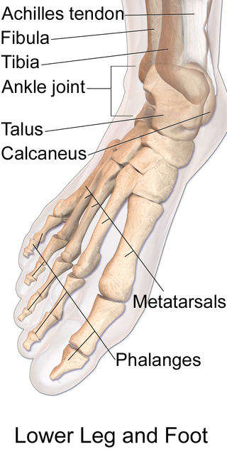
Lower Extremity: Pelvic Girdle, Leg & Foot
Human pelvis anterior, imaged by x-ray (top), magnetic resonance imaging (middle), and 3-dimensional computed tomography (bottom).
Image: Human Pelvis, Wiki; Anatomy of Human Foot, Wiki

Slide 21
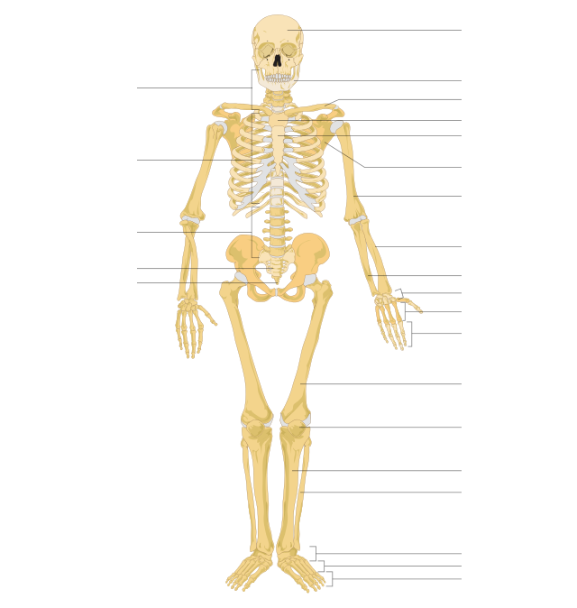
Label the Skeleton
Image: Human Skeleton, Wiki

Slide 22
Confused?
Here are some links to fun resources that further explain Human Organ Systems:
Anatomical Terms of Direction and Planes of Section from the Penguin Prof
Anatomical Planes and Spatial Relationships in the Human Body video from Interactive Biology.
Interactive Tutorial on Human Organs, from BBC Science: Human Body & Mind.
Human Anatomy Systems from InnerBody.com.
Human Body 101 video from National Geographic.
See the many other Organ System videos and animations linked on previous slides!
(You must be in PPT slideshow view to click on links.)
Smart Links
From the Virtual Cell Biology Classroom on ScienceProfOnline.com

