Slide 1

About Science Prof Online
PowerPoint Resources
Science Prof Online (SPO) is a free science education website that provides fully-developed Virtual Science Classrooms, science-related PowerPoints, articles and images. The site is designed to be a helpful resource for students, educators, and anyone interested in learning about science.
The SPO Virtual Classrooms offer many educational resources, including practice test questions, review questions, lecture PowerPoints, video tutorials, sample assignments and course syllabi. New materials are continually being developed, so check back frequently, or follow us on Facebook (Science Prof Online) or Twitter (ScienceProfSPO) for updates.
Many SPO PowerPoints are available in a variety of formats, such as fully editable PowerPoint files, as well as uneditable versions in smaller file sizes, such as PowerPoint Shows and Portable Document Format (.pdf), for ease of printing.
Images used on this resource, and on the SPO website are, wherever possible, credited and linked to their source. Any words underlined and appearing in blue are links that can be clicked on for more information. PowerPoints must be viewed in slide show mode to use the hyperlinks directly.
Several helpful links to fun and interactive learning tools are included throughout the PPT and on the Smart Links slide, near the end of each presentation. You must be in slide show mode to utilize hyperlinks and animations.
This digital resource is licensed under Creative Commons Attribution-ShareAlike 3.0:
http://creativecommons.org/licenses/by-sa/3.0/
Alicia Cepaitis, MS
Chief Creative Nerd
Science Prof Online
Online Education Resources, LLC
alicia@scienceprofonline.com
Tami Port, MS
Creator of Science Prof Online
Chief Executive Nerd
Science Prof Online
Online Education Resources, LLC
info@scienceprofonline.com
From the Virtual Biology Classroom on ScienceProfOnline.com
Image: Compound microscope objectives, T. Port
Notes:
Welcome to Science Prof Online PowerPoint Resources!
This PowerPoint Presentation comes from the Virtual Cell Biology Classroom of Science Prof Online, and, as such, is licensed under Creative Commons Attribution-ShareAlike 3.0.; meaning you can download, share and alter any of this presentation, but you can’t sell it or repackage and sell any part of it. Please credit Science Prof Online as the source of this presentation. Please abide by credited image copyrights. Thank you for using this resource.

Slide 2
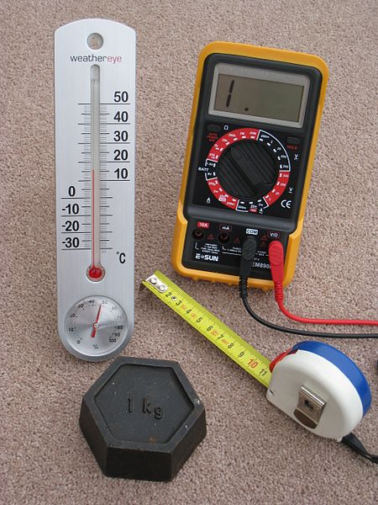
Metric Basics
From the Virtual Biology Classroom on ScienceProfOnline.com
Image: Four Metric Instruments, Wiki

Slide 3
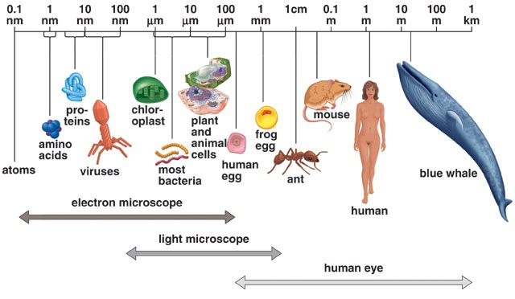
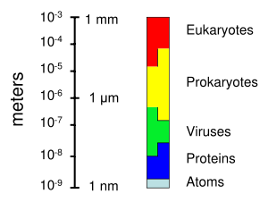
Size of Living Things
1 m = 100 cm = 1,000mm = 1,000,000 µm = 1,000,000,000nm
1mm = 1000 µm = 1000000nm
1 µm = 1000nm
Click link for an interactive
“Size of Microscopic Things”
animation on Cells Alive.
From the Virtual Biology Classroom on ScienceProfOnline.com

Slide 4
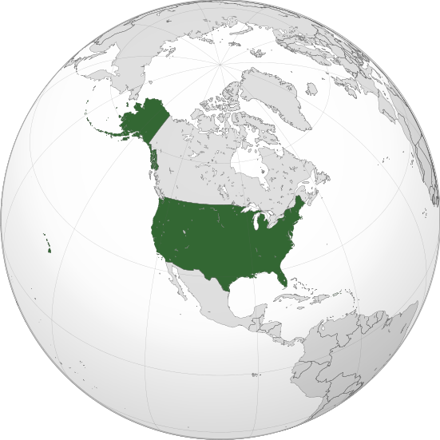
The Whole World Uses the Metric System … Except US
Have you ever been outside of the United States?
Almost every other country in the world uses the Metric System.
It can be confusing and frustrating for Americans when gasoline is sold in liters, temperature is in celsius, and distance is in kilometers.
You are familiar with some metric measurements…Name some.
From the Virtual Biology Classroom on ScienceProfOnline.com
Image: USA on globe, Wiki

Slide 5
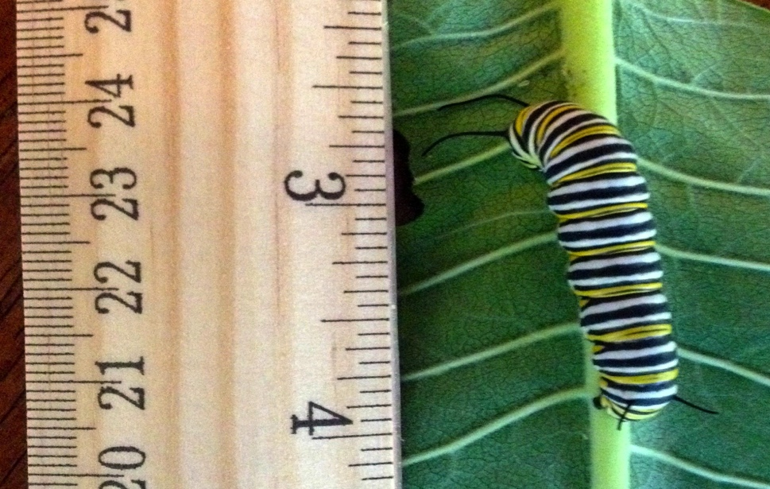
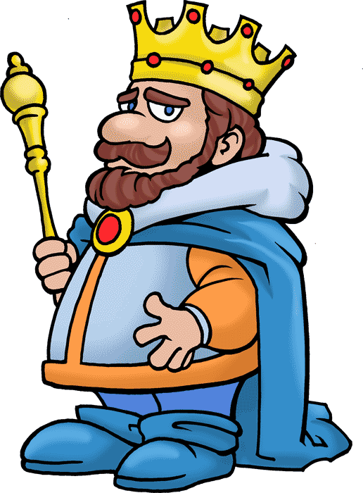
Science & The Metric System
Scientists once faced the same problem…
When different units of measurement were used in different countries, this led to confusion. (In 1999, NASA probe to Mars was lost because of a conversion error).
Watch This!
Bill Nye on the Metric System
Understanding the Metric System from Smith Math Academy
Metric Conversion Rap from The Metric Crew
So scientists agreed to use the metric system, which is much easier to convert.
For example …
Metric system: Based on units of ten. 1 meter = 100 centimeters, just like
one dollar = 100 cents.
English system: Based on a hodgepodge of numbers…
3ft in a yard, 12 inches in a foot, etc. (A yard was once based on
the length of the kings arm-span and foot based on the size of the
king’s foot, which changed wherever there was a new king!)
From the Virtual Biology Classroom on ScienceProfOnline.com
Image: This monarch caterpillar measures ` 4.5cm, T. Port

Slide 6
Important Measurements We Will Be Using in Lab
Take a look at “How the Metric System Works”, bottom of page 1, Metric Tutorial Part 1.
Measurement | Metric Base Unit | English Unit
Mass (weight) | gram (g) | Oz., Pound, Ton
Volume | liter (L) | Tsp., Pint, Gallon
Length | meter (m) | Inch, foot, yard
Temperature | degree Celcius (°C) | Fahrenheit (°F)
Density | g/mL = g/cc | lb/gallon
From the Virtual Biology Classroom on ScienceProfOnline.com

Slide 7
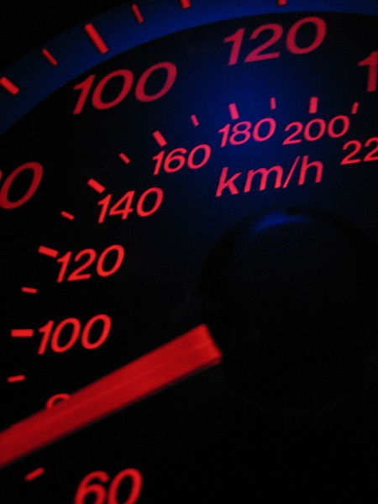
Metric Prefix Examples
Small amount example:
Milli- prefix used when measuring small amounts.
A milli- is one-thousandth of the original unit and is noted as a small letter m before the base unit.
Relationship between milli- and its base unit is always 1000 times. So, if you take 5 x 200mg tablets in medication = 1000 mg total = 1g!
Larger amount example:
Kilo- is 1000x larger than what you start with.
Adding the prefix kilo- always increases a base unit (such as m, g, L) by 1000 times so: 1 kilometer = 1000 meters, 1 kilograms = 1000 grams, 1 kiloliter = 1000 liters.
Check your understanding of the magnitude of these two prefixes by doing the problems near the bottom of page 2 of the Metric Tutorial Part 1.
From the Virtual Biology Classroom on ScienceProfOnline.com
Image: Speedometer sowing miles/h and km/h, Wiki

Slide 8
Metric Prefixes and Magnitude
PREFIX SYMBOL FACTOR
tera- T 1,000,000,000,000
(one million million, or a trillion)
giga- G 1,000,000,000
(one thousand million, or a billion)
mega- M 1,000,000 (one million)
kilo- K 1000
hecto- h 100
deca- D 10
(BASE UNIT) 1
deci- d 0.1 (one tenth, 1/10)
centi- c 0.01 (one hundredth, 1/100)
milli- m 0.001 (one thousandth, 1/1000, 10⁻³)
micro- μ 0.000001 (1/100,000 or 10⁻⁶)
nano n 0.000000001 (1/1,000,000,000, 10⁻⁹)
pico p 0.000000000001 (1,000,000,000,000, 10-12)
From the Virtual Biology Classroom on ScienceProfOnline.com

Slide 9
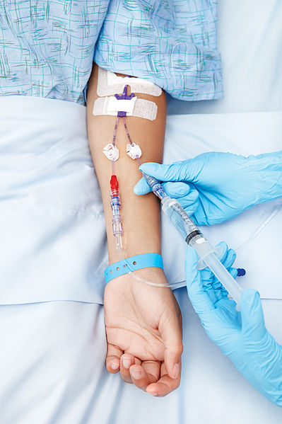
The Importance of Metric Conversions in Science and Medicine
Knowing how to convert amounts is essential in science, especially medicine.
Incorrect conversions of medication dosages can lead to “death by decimal”.
Although a doctor prescribes the medication amount and a pharmacist dispenses it, it’s the responsibility of everyone who handles or administers that medication to insure the safety of the patient.
First, let’s practice converting between metric prefixes, using the table below.
Then do Metric Conversion Practice on back page of Metric Tutorial Part 2.
Prefix | kilo- (K) | hecto- (h) | deca (D) | Base Unit (g, m L) | deci – (d) | centi- (c) | milli – (m)
Value | X 1000 | X 100 | X 10 | X 1 | X 0.1 (1/10) | X 0.01 (1/100) | X 0.001 (1/1000)
From the Virtual Biology Classroom on ScienceProfOnline.com
Image: Medication being dispensed intravenously, Wiki

Slide 10
Confused?
Here are some links to fun resources that further explain Metrics:
Smart Links
US Metric Association
Metric Measurement Millionaires Game
Worldwide Metric Conversion
Access to Flashcards and Games on Metrics
Quizzes and more Worksheets on Metrics
Metric Mania Conversion Practice Worksheet
Length Lab Worksheet
There are also many free apps that do metric conversions.
From the Virtual Biology Classroom on ScienceProfOnline.com

