Slide 1

About Science Prof Online
PowerPoint Resources
Science Prof Online (SPO) is a free science education website that provides fully-developed Virtual Science Classrooms, science-related PowerPoints, articles and images. The site is designed to be a helpful resource for students, educators, and anyone interested in learning about science.
The SPO Virtual Classrooms offer many educational resources, including practice test questions, review questions, lecture PowerPoints, video tutorials, sample assignments and course syllabi. New materials are continually being developed, so check back frequently, or follow us on Facebook (Science Prof Online) or Twitter (ScienceProfSPO) for updates.
Many SPO PowerPoints are available in a variety of formats, such as fully editable PowerPoint files, as well as uneditable versions in smaller file sizes, such as PowerPoint Shows and Portable Document Format (.pdf), for ease of printing.
Images used on this resource, and on the SPO website are, wherever possible, credited and linked to their source. Any words underlined and appearing in blue are links that can be clicked on for more information. PowerPoints must be viewed in slide show mode to use the hyperlinks directly.
Several helpful links to fun and interactive learning tools are included throughout the PPT and on the Smart Links slide, near the end of each presentation. You must be in slide show mode to utilize hyperlinks and animations.
This digital resource is licensed under Creative Commons Attribution-ShareAlike 3.0:
http://creativecommons.org/licenses/by-sa/3.0/
Alicia Cepaitis, MS
Chief Creative Nerd
Science Prof Online
Online Education Resources, LLC
alicia@scienceprofonline.com
Tami Port, MS
Creator of Science Prof Online
Chief Executive Nerd
Science Prof Online
Online Education Resources, LLC
info@scienceprofonline.com
From the Virtual Microbiology Classroom on ScienceProfOnline.com
Image: Compound microscope objectives, T. Port
Notes:
Welcome to Science Prof Online PowerPoint Resources!
This PowerPoint Presentation comes from the Virtual Cell Biology Classroom of Science Prof Online, and, as such, is licensed under Creative Commons Attribution-ShareAlike 3.0.; meaning you can download, share and alter any of this presentation, but you can’t sell it or repackage and sell any part of it. Please credit Science Prof Online as the source of this presentation. Please abide by credited image copyrights. Thank you for using this resource.

Slide 2
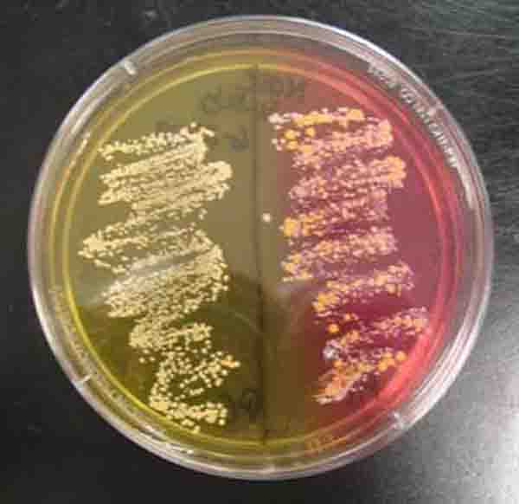
Chemistry
of
Microbiology
From the Virtual Microbiology Classroom on ScienceProfOnline.com
Image: Mannitol Salt Bacterial Growth Media, T. Port

Slide 3
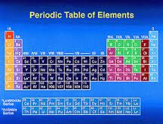
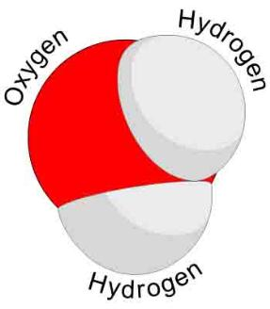
Elements, Atoms, Molecules & Compounds
Elements → Substances that can’t be broken
down any further.
Atom → The smallest unit of an element.
Two or more atoms joined together chemically:
Molecule
Molecule containing at least two different elements:
Compound
Examples of molecules: Carbon dioxide (CO₂) and methane (CH₄) , molecular hydrogen (H₂), molecular oxygen (O₂) and molecular nitrogen (N₂).
Examples of compounds: Only molecules containing two or more elements, such as carbon dioxide (CO₂) and methane (CH₄).
Q: Explain why all compounds are molecules but not all molecules are compounds.
Image: Periodic Table of Elements, NASA; Water Molecule, Wiki
From the Virtual Microbiology Classroom on ScienceProfOnline.com

Slide 4
Chemical Shorthand
Chemical Symbol
Begins with one or two letters based on
elements name.
Q: What if there is more than one element that
starts with the same letter?
Example: Carbon (C), Calcium (Ca), Chlorine (Cl)
Chemical Formula
“Shorthand” for a compound.
Contains chemical symbols of the elements that make up the molecule.
Numerical subscripts represent number of atoms of each element in molecule.
Example: H₂0 = water; has two hydrogen atoms and one oxygen.
More than one molecule of same type…the group of letters is preceded by number.
Example 2H₂0 = two water molecules.
Follow this link to see Daniel Radcliff (Harry Potter) sing “The Element Song”.
Image: Periodic Table of Elements, NASA
From the Virtual Microbiology Classroom on ScienceProfOnline.com

Slide 5
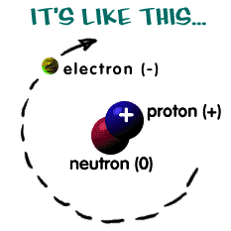
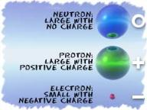
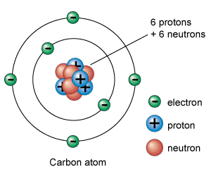
The Structure of an Atom
Here are some examples:
Atoms are the basis for everything in the universe.
Q: What are the three basic parts of an atom?
• ? = "-" negative charge
• ? = "+" positive charge
• ? = neutral (a charge of zero)
The thing that makes each element unique is the number of protons, since the number of neutrons and electrons can vary.
Protons and neutrons always in the center of atom (the nucleus).
Electrons are found whizzing around nucleus in areas called orbitals.
Q: If there is an equal number of electrons and protons in an atom, what is it’s charge?
NERDY SCIENCE JOKE: A neutron walks into a bar and asks “How much for a drink?”
Q: What does the bartender tell him?
Images: Structure of Atom, Chem4Kids Website; Carbon, Universe Today Website
From the Virtual Microbiology Classroom on ScienceProfOnline.com

Slide 6
Chemical Bonding and Electron Valences
The electrons in an atom are located at different energy levels.
Electrons in the highest energy level are called valence electrons.
Number of valence electrons governs an atom’s bonding behavior.
Q: What is the max number of valence electrons for a full valence shell?
Atoms are much more stable, or less reactive, with a full valence shell.
By moving electrons, the two atoms become linked. This is known as chemical bonding.
This stability can be achieved one of two ways:
- Ionic bond
- Covalent bond
Images: Carbon, Universe Today Website
From the Virtual Microbiology Classroom on ScienceProfOnline.com
Notes:
A: 8

Slide 7
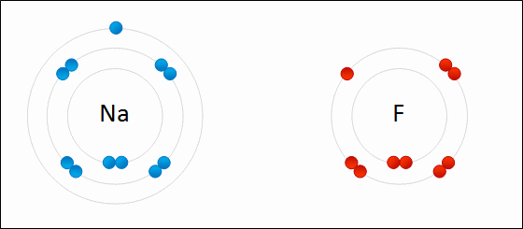
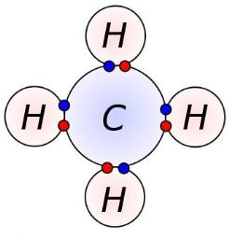
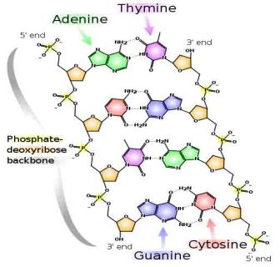
Three Main Types of Chemical Bonds:
1. Ionic
2. Covalent
3. Hydrogen
Image: Formation of ionic sodium fluoride, Wdcf; Methane Covalent Bonds, Dynablast, Wiki; DNA Chemical Structure, Madprime, Wiki
From the Virtual Microbiology Classroom on ScienceProfOnline.com

Slide 8
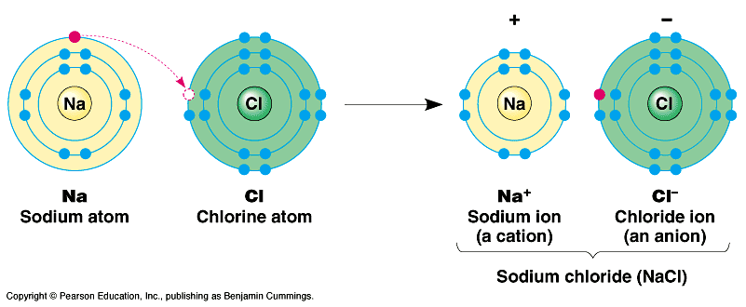
Ionic Bonds
Involves transfer of electrons between two atoms.
Found mainly … inorganic compounds.
Ion = an atom or group of atoms which have lost or gained one or more electrons, making them negatively or positively charged.
Q: What are positively charged ions (+) called?
Q: What are negatively charged ions (-) called?
Images: Sodium Chloride, University of Winnepeg
From the Virtual Microbiology Classroom on ScienceProfOnline.com

Slide 9
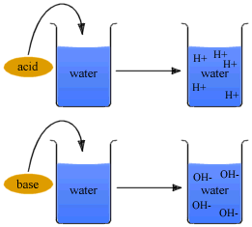
Ions: Acids & Bases
An acid is any ionic compound that releases hydrogen _____ (H⁺) in solution.
A base is any ionic compound that releases hydroxide _____ (⁻OH) in solution.
From the Virtual Microbiology Classroom on ScienceProfOnline.com
Notes:
cations
anions

Slide 10
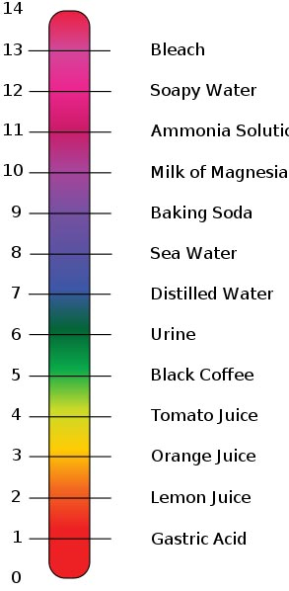
Measurements of Acidity & Alkalinity (pH)
Acidity of a solution > measured by concentration of hydrogen ions (H+).
pH ranges: 0 (very acidic) to 14 (very basic).
Change in just one unit of scale = tenfold change in H+ concentration.
If concentration of H+ = OH - … neutral.
Images: pH scale, Edward Stevens, Wiki
From the Virtual Microbiology Classroom on ScienceProfOnline.com

Slide 11
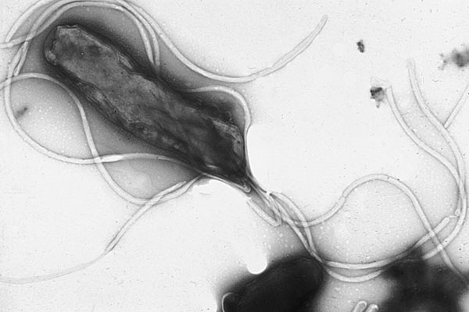
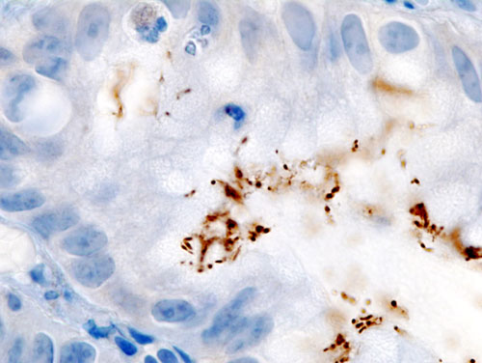
Meet the Microbe!
Multiple flagella allow H. pylori to penetrate the coating of the stomach epithelium.
Species: Helicobacter pylori
GRAM NEGATIVE
Microaerophilic, Acidophile
Helically shaped
Never normal flora
Robin Warran & Barry Marshall identified H. pylori in 1982, and discovered link between H. pylori and ulcers.
H. pylori virulence factors:
- Make proteins that inhibit acid production
- Flagella propel through stomach lining to epithelial cells
- Have adhesins
- Make enzymes to inhibit phagocytosis
What Is an Ulcer?
A sore or hole in lining of the stomach or duodenum (the first part of the small intestine).
Not caused by stress or eating spicy food, but these factors can make ulcers worse.
Incidence:
Many people have H. pylori infection, but most infected people, do not develop ulcers.
H. pylori produces enzyme urease, which breaks down urea (normally secreted into the stomach) to carbon dioxide and ammonia. The ammonia is converted to ammonium that neutralizes gastric acid.. The ammonia produced is toxic to the epithelial cells and damages them.
H. pylori from a gastric biopsy
Images: Helicobacter pylori, Yutaka Tsutsumi, M.D; Histopathology of H.pylori from a gastric biopsy, KGH
From the Virtual Microbiology Classroom on ScienceProfOnline.com

Slide 12
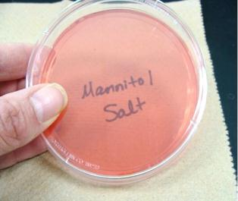
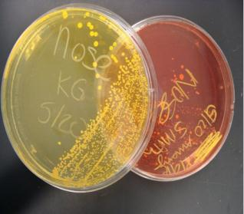
Mannitol Salt (MSA)
Mannitol Salt media is both selective & differential.
Selective because it has a high NaCl (7.5%) concentration, and few types of bacteria can grow on this hypertonic medium.
Members of genus Staphylococcus are
halophilic, and grow well on this media.
2. Differential because this medium contains a pH-sensitive dye to identify organisms that ferment mannitol (a sugar-alcohol). Organic acids wastes mannitol fermenters produce change the medium from red to yellow.
MSA works well for identifying pathogenic staphylococci, such as Staphylococcus aureus, which will ferment mannitol.
Most non-pathogenic staphylococci (Staphylococcus epidermidis) will not ferment mannitol.
Q: Regardless of the color of the plate, what do know about bacteria found growing on Mannitol Salt?
Q: If there is growth, what additional info can then be obtained about bacteria growing based on color of the medium.
Watch
VIDEO:
How to Interpret
Mannitol Salt Agar (MSA)
Images: Sterile Mannitol Salt Agar & Positive & negative differential reaction on Mannitol Salt Agar, T. Port
From the Virtual Microbiology Classroom on ScienceProfOnline.com

Slide 13
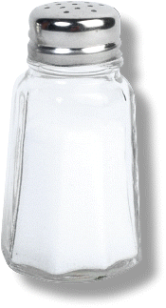
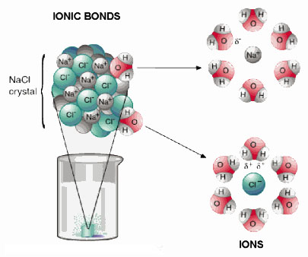
Ions & Salts
Compounds that dissociate in water and produce cations other than H+ and anions other than OH- are called salts.
The most familiar salt is sodium chloride, the principal component of common table salt.
Other examples of salts:
Baking soda (NaHCO3)
Epsom Salts (MgSO4)
From the Virtual Microbiology Classroom on ScienceProfOnline.com

Slide 14
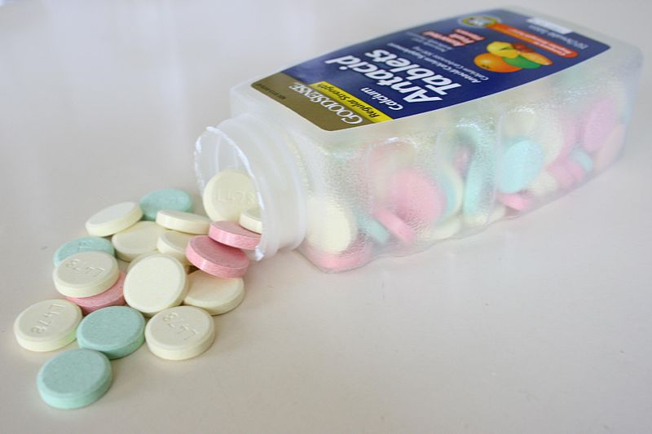
Salts: The Role of Buffers
Certain salts, called
buffers, can
combine with excess
hydrogen (H+) or
hydroxide (OH-) ions.
Produce substances less acidic or alkaline.
Example:
Antacids are buffers made of the salt calcium carbonate (CaCo3).
Images: Antacid Tablets, Wiki
From the Virtual Microbiology Classroom on ScienceProfOnline.com

Slide 15
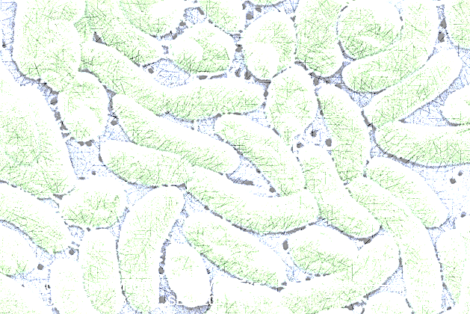
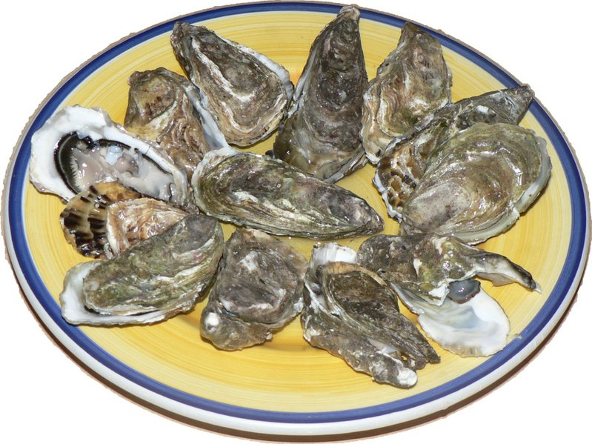
Antacids &
Food Poisoning
Acidic environment of stomach kills many bacteria before they can cause disease.
Researchers have found that antacids, in a simulated gastric environment, significantly increase survival rate of Vibrio vulnificus, leading cause of food-poisoning fatalities in US.
Images: Vibrio vulnificus, PHIL 7815, Antacid Tablets, Wiki Raw Oysters, David.Monniaux, Wiki
From the Virtual Microbiology Classroom on ScienceProfOnline.com

Slide 16
Three Main Types of Chemical Bonds:
1. Ionic
2. Covalent
3. Hydrogen
Image: Formation of ionic sodium fluoride, Wdcf; Methane Covalent Bonds, Dynablast, Wiki; DNA Chemical Structure, Madprime, Wiki
From the Virtual Microbiology Classroom on ScienceProfOnline.com

Slide 17
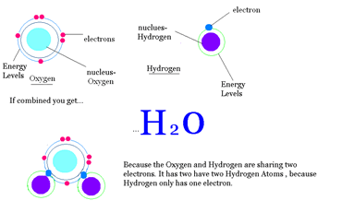
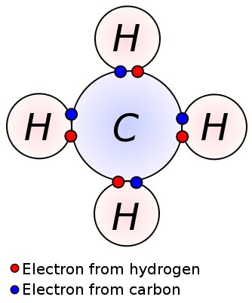
Covalent Bonds
Covalent Bonds: Involve the sharing of a pair of electrons between two atoms.
Found mainly … organic compounds
Image: Methane Covalent Bonds, Dynablast, Wiki
From the Virtual Microbiology Classroom on ScienceProfOnline.com

Slide 18
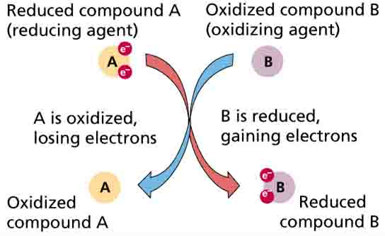
Oxidation - Reduction Reaction
Or Redox reaction = chemical reactions in which electrons are gained, lost (Q: What kind of bond?) or shared (Q: What kind of bond?) in a chemical reaction.
• oxidation: loss of electrons by a molecule, atom or ion.
• reduction: gain of electrons by a molecule, atom or ion.
From the Virtual Microbiology Classroom on ScienceProfOnline.com

Slide 19
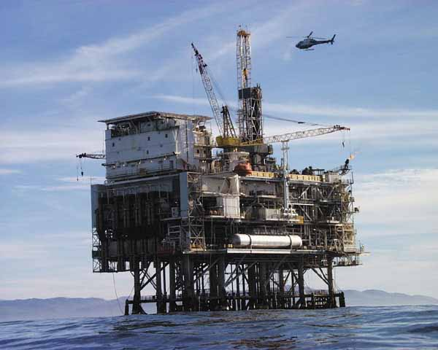
Oil Rig
Image: Oil Rig Platform, Nasa
From the Virtual Microbiology Classroom on ScienceProfOnline.com
Notes:
Oxidation Is Loss = OIL
Reduction Is Gain = RIG

Slide 20
Three Main Types of Chemical Bonds:
1. Ionic
2. Covalent
3. Hydrogen
Image: Formation of ionic sodium fluoride, Wdcf; Methane Covalent Bonds, Dynablast, Wiki; DNA Chemical Structure, Madprime, Wiki
From the Virtual Microbiology Classroom on ScienceProfOnline.com

Slide 21
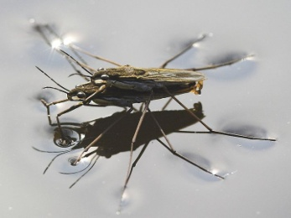
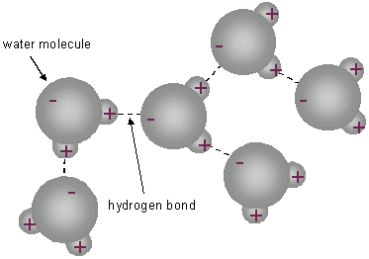
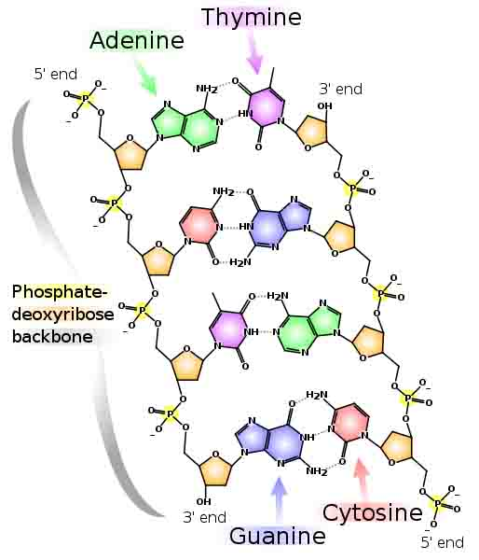
Hydrogen Bonds
Hydrogen Bonds: When an atom of hydrogen is attracted to another electronegative
atom in addition to the one it is covalently bonded to.
In some covalent bonds electrons are shared unequally by the hydrogen and the atom that the hydrogen is bound to. When the electrons in a covalent bond are not equally shared, the molecule is polar.
See the polar, covalent bonds of each individual water molecule below.
See the hydrogen bond attractions between the hydrogens and the oxygens of nearby, but separate water molecule below.
Found in water, proteins & DNA
Image: DNA Chemical Structure, Madprime, Wiki; Water Striders, Markus Gayda, Wiki
From the Virtual Microbiology Classroom on ScienceProfOnline.com

Slide 22
REVIEW!
Animated lessons on
Chemical Bonding
Image: Methane Covalent Bonds, Dynablast; Formation of ionic sodium fluoride,
From the Virtual Microbiology Classroom on ScienceProfOnline.com

Slide 23
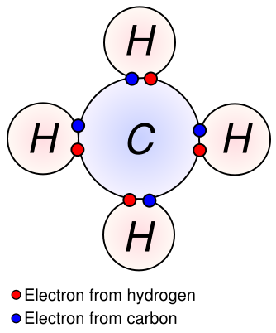
Inorganic vs Organic Molecules
?
?
Inorganic Molecules > Molecules that don’t have Carbon Hydrogen (C-H) bonds.
The major organic macromolecules (big molecules with carbon-hydrogen bonds) found in living things are:
1. Carbohydrates
2. Proteins
3. Nucleic Acids
4. Lipids
From the Virtual Microbiology Classroom on ScienceProfOnline.com
Image: Methane Covalent Bonds, Dynablast, Wiki

Slide 24
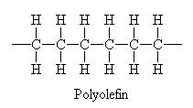
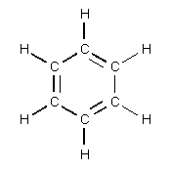
Carbon
Little Atom, Big Deal
The chemical basis of life. Abundant in all known life forms.
Essential to complex organic macromolecules, because each carbon atom can form 4 bonds (usually involving hydrogen, oxygen and/or nitrogen).
Able to form polymers (big organic molecules).
The atoms can bond with each other to form long chains.
Sometimes the ends of these chains join together to form a ring.
Double bonds form when atoms share two electrons (two covalent bonds).
From the Virtual Microbiology Classroom on ScienceProfOnline.com
Images: Carbon, Universe Today Website

Slide 25
Study Table of Organic Macromolecules
(We will fill this in as we go through the rest of the lecture.)
Macromolecule (polymer) | Made of what type of monomer? | Is there another name for this polymer? | Examples
1.
2.
3.
4.
From the Virtual Microbiology Classroom on ScienceProfOnline.com

Slide 26
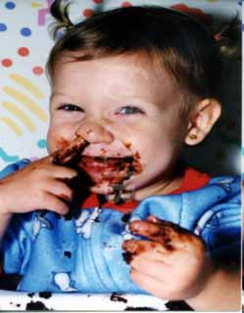
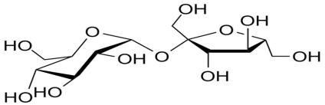
Organic Molecules - Carbohydrates
• “carbon - hydrates”
• One carbon molecule to one water molecule (CH₂0)n.
• saccharide is a synonym for carbohydrate.
• The prefixes on the word “saccharide” relates to the size of the molecule (mono-, di-, tri- poly-).
Boogers
Chocolate Cake
You probably know that chocolate cake is full of refined sugars…carbs. You may not know that boogers contain carbs as well. Boogers are dried-up mucus and dirty nose debris. Mucus is made mostly out of sugars and protein. Looks like this little punkin is double dipping. Bon appetite!
From the Virtual Microbiology Classroom on ScienceProfOnline.com
Image: Sucrose, Wiki

Slide 27
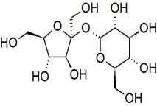
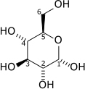
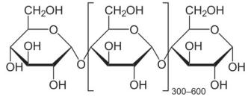
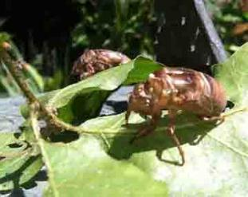
Organic Molecules - Carbohydrates
Monosaccharides
single sugars (one molecule)
simplest
*glucose, fructose
Disaccharides
double sugars
combination of two monosaccharides
* sucrose = glucose + fructose
* lactose = glucose + galactose
Polysaccharides
are macromolecules; polymers composed of several sugars
can be same monomer (many of same monosaccharide) or mixture of monomers
energy carbs: glycogen (animals) starch (plants)
structural carbs: chitin (animals), cellulose (plants)
From the Virtual Microbiology Classroom on ScienceProfOnline.com

Slide 28
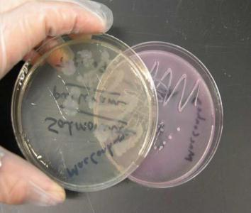
MacConkey's (MAC)
MacConkey’s media is both selective & differential.
Selective because it only grows Gram-negative
bacteria. Inhibits the growth of Gram-positive
bacteria.
Differential because neutral red (pH-sensitive
dye) and lactose (type of sugar) have been added
to media.
- Bacteria that use lactose (a disacchride) for food, produce acidic
metabolites that trigger the pH sensitive dye to turn pink.
- So lactose fermenting bacteria will grow in bright pink colonies while
non-lactose fermenters will be colorless and clear.
Q: Regardless of the color of the plate, what do know about bacteria found growing on MacConkey’s?
Q: If there is growth, what additional information is provided when the color of the bacteria is examined?
Enteric bacteria are the most frequently encountered bacteria isolated from many types of clinical specimens. They are most commonly lactose fermenters.
Watch
VIDEO:
How to Interpret MacConkey’s Agar (MAC)
Image: McConkey’s growing Salmonella on the left, and E. coli on the right, T. Port
From the Virtual Microbiology Classroom on ScienceProfOnline.com

Slide 29
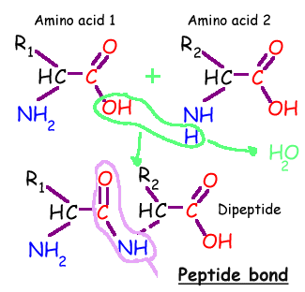
Organic Molecules - Proteins
Proteins are macromolecules, polymers composed of monomers called…
Amino acids contain a:
1. base amino group ( -NH₂)
2. acidic carboxyl group ( -COOH)
3. hydrogen atom
…all attached to same carbon atom (the α –carbon…alpha carbon).
4. Fourth bond attaches α-carbon to a side group (--R) that varies among different amino acids.
Side groups important … affects the way a proteins amino acids interact with one another, and how a protein interacts with other molecules.
Essential amino acids: Cannot be synthesized by the body. They must be ingested in the diet.
Arginine * Histidine * Methionine* Threonine * Valine * Isoleucine * Lysine * Phenylalanine *
Tryptophan * Leucine
From the Virtual Microbiology Classroom on ScienceProfOnline.com

Slide 30
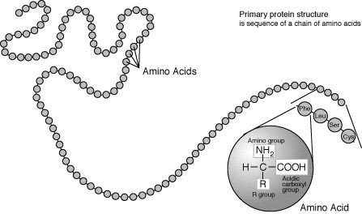
Organic Molecules – Proteins
Peptide Bonds
Link amino acids together in chains, like the beads on a necklace.
A dipeptide is 2 amino acids linked together.
A polypeptide, more than two.
From the Virtual Microbiology Classroom on ScienceProfOnline.com
Image: Protein Primary Structure, Wiki

Slide 31
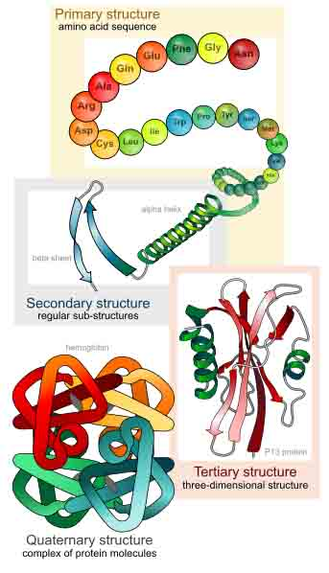
Protein Structure
From the Virtual Microbiology Classroom on ScienceProfOnline.com
Image: Levels of protein structure, M Ruiz

Slide 32

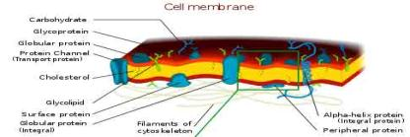
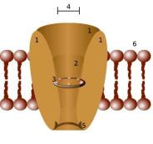
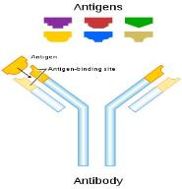
Organic Molecules - Proteins
Complex organic macromolecules fundamental to living cells.
Composed of one or more chains of amino acids.
Proteins perform many functions in cells, including:
1. Structural
• Components in cell walls, membranes,
and within cells themselves.
2. Enzymes
• Chemicals that speed up a chemical reaction.
• The catalysts in cells are called enzymes.
3. Regulation
• Some regulate cell function by stimulating or hindering either the action of other proteins or the expression of genes.
4. Transportation
• Some act as channels and “pumps” that move substances into or out of cells.
5. Defense
• Antibodies = proteins that defend your body against microorganisms
• Some bacteria produce proteins (bacteriocins) that kill other bacteria.
Images : Cell Membrane, Wiki; Channel Protein, Wiki; Antibody, Wiki
From the Virtual Microbiology Classroom on ScienceProfOnline.com

Slide 33
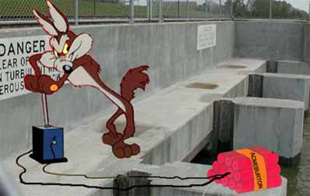

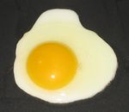
Q: How do you sabotage a protein?
• Alteration of a protein shape through some form of external stress
• Example, by applying heat, acidic or alkaline environment
• Denatured protein can’t carry out its cellular function .
Irreversible egg protein denaturation caused by high temperature (while cooking it).
From the Virtual Microbiology Classroom on ScienceProfOnline.com

Slide 34
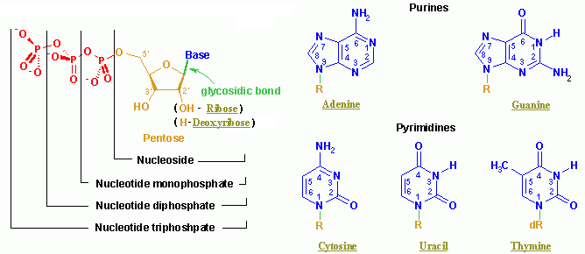
Organic Molecules – Nucleic Acids
Nucleic acids (both RNA and DNA) are macromolecules; polymers made up of monomers called nucleotides.
Nucleic acids deoxyribonucleic acid (DNA) and ribonucleic acid (RNA) = genetic material of cells.
Names derived from type of sugar contained within molecules = ribose
Nucleotides
Each monomer of nucleic acid is a nucleotide and consists of 3 portions:
- a sugar
- one or more phosphate
- one of five cyclic nitrogenous bases
+adenine, guanine (double-ringed purines)
+ cytosine, thiamine or uracil (single-ringed pyrimidines)
From the Virtual Microbiology Classroom on ScienceProfOnline.com
Image: Nucleotide Structure, Wikipedia

Slide 35
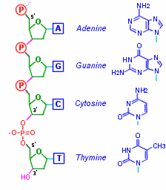
Organic Molecules – Nucleic Acids
Nucleic Acid Structure
Nucleotides linked by covalent bonds between sugar of one nucleotide and phosphate of next (sugar-phosphate backbone).
Nitrogenous bases extend from it like teeth of a comb.
From the Virtual Microbiology Classroom on ScienceProfOnline.com

Slide 36
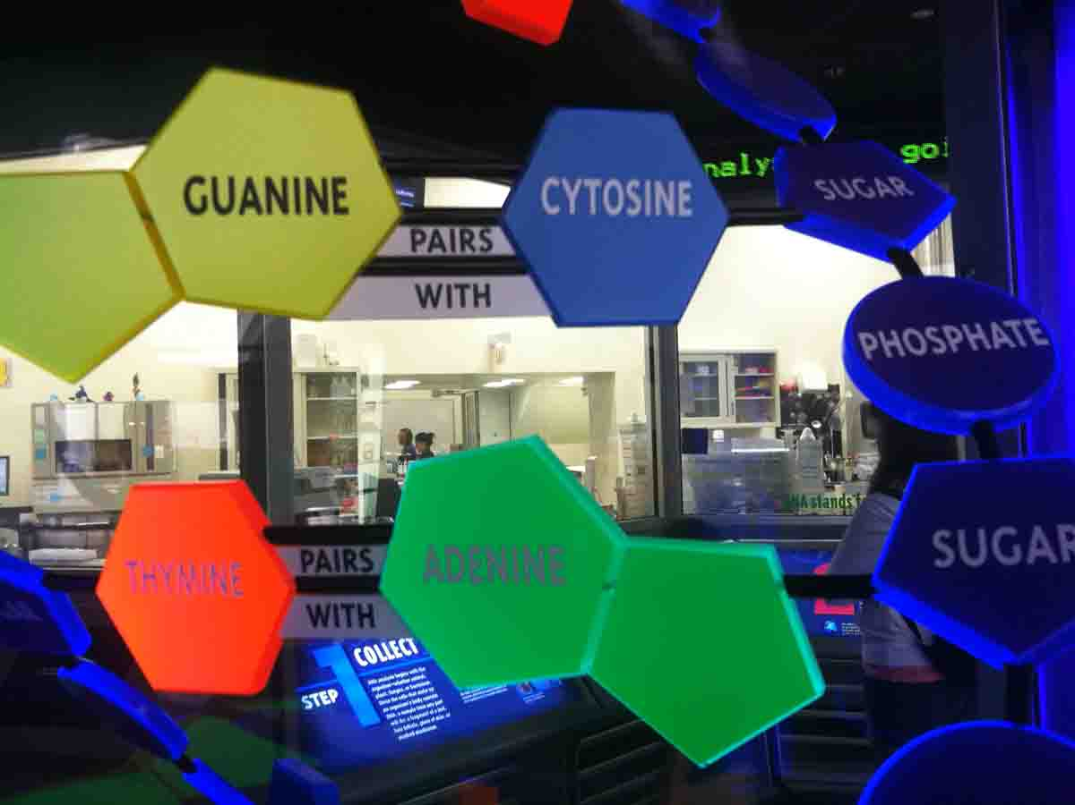
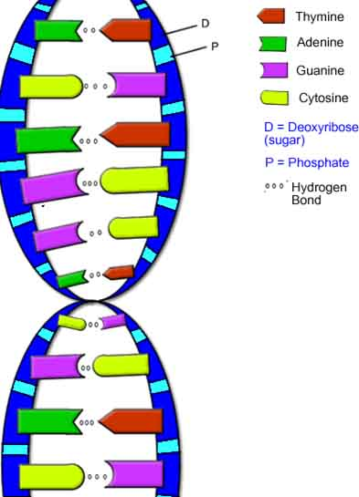
Nucleic Acids - DNA
DNA is a double stranded molecule, analogous to a ladder.
The “ladder” =
• two deoxyribose-phosphate chains form the “side rails”
• base pairs, linked by hydrogen bonds, form the “rungs”.
Purine Bases (double ring)
Adenine & Guanine
Pyrimidine Bases (single ring)
Cytosine & Thymine
Base Pairs (purine always pairs with pyrimidine):
Adenine + Thymine
Cytosine + Guanine
Hydrogen bonds attract the bases from one strand to the bases on the other strand and also twist the phosphate-sugar backbones into a helix.
<< Q: How do I remember this?
Images: Model of DNA Molecule, Field Museum, Chicago, T. Port DNA, Biology Corner Website
From the Virtual Microbiology Classroom on ScienceProfOnline.com

Slide 37

From the Virtual Microbiology Classroom on ScienceProfOnline.com
Image: DNA Molecule, National Science Foundation

Slide 38


ATP Production and Energy Storage
Q: This molecule has a sugar, a base and three phosphate groups. What kind of monomer is it?
Adenosine 5'-triphosphate
Multifunctional "molecular currency" of intracellular energy transfer.
Organisms release energy from nutrients; can be concentrated and stored in high-energy phosphate bonds of ATP.
Transports chemical energy within cells for metabolism.
Produced as energy source during photosynthesis and cellular respiration.
Consumed by many enzymes and a multitude of cellular processes
From the Virtual Microbiology Classroom on ScienceProfOnline.com
Image: ATP Molecule, NEUROtiker; ATP-ADP Cycle, CUNY
Notes:
A: Nucleotide

Slide 39




Organic Molecules – Lipids
(Fats, Phospholipids, Waxes & Steroids)
Hydrophobic macromolecules…insoluble in water.
Not attracted to water because …
non-polar covalent bonds linking carbon & hydrogen aren’t attracted to the polar bonds of water.
From the Virtual Microbiology Classroom on ScienceProfOnline.com
Images: Cholesterol, Wiki; Phospholipid Structure, Bryan Derksen. Wiki Honeycomb, Wikii; Oil & Water, Kidipede

Slide 40


Organic Molecules – Lipids
(Fats, Phospholipids, Waxes & Steroids)
Fats
Fats and oils are made from two kinds of molecules:
• glycerol
(a type of alcohol)
• fatty acids
(triglycerides)
Images: Oil & Water, Kidipede
From the Virtual Microbiology Classroom on ScienceProfOnline.com

Slide 41

Organic Molecules – Lipids
(Fats, Phospholipids, Waxes & Steroids)
Phospholipids
• Phospholipids are a major component of all cell membranes.
Most phospholipids contain a diglyceride as the tail, and a phosphate group for head.
Hydrocarbon tails are hydrophobic, but phosphate heads are hydrophilic.
• So phospholipids are soluble in both water and oil.
• Tails from both layers facing inward and the heads facing outward = phospholipid bilayer.
From the Virtual Microbiology Classroom on ScienceProfOnline.com
Image: Cell Membrane, Wiki;

Slide 42




Organic Molecules – Lipids
(Fats, Phospholipids, Waxes & Steroids)
Waxes
• Do not have a hydrophilic head: so completely water insoluble.
Steroids
• The central core of a cholesterol molecule (4 fused rings) is shared by all steroids.
• Cholesterol is precursor to our sex hormones and Vitamin D.
• Our cell membranes contain cholesterol (in between the phospholipids) to help keep membrane “fluid” even when exposed to cooler temperatures.
From the Virtual Microbiology Classroom on ScienceProfOnline.com
Image: Lava Lamp, Wiki; Cholesterol molecule, Wiki; Phospholipids & Cholesterol, Cytochemistry.net

Slide 43



Meet the Microbes: Mycobacterium
Mycobacteria colonies Eewwww, looks like ear wax.
GRAM-variable, obligate aerobe, bacillus-shaped
Q: Why are they considered “Gram variable”?
M. leprae and M. tuberculosis have plagued mankind for ages.
Thought that M. tuberculosis and M. leprae evolved from a soil bacterium that infected cows, then made jump to humans about the time of animal domestication, 10,000 years ago.
M. tuberculosis doubles population every 18-24 hours,
M. leprae doubles population about every 14 days.
Q: What might be the impact of generation
time on the course of the infectious
diseases these microbes cause?
Man with Leprosy
Acid-fast stain
The pink is our lab friend Mycobacterium
smegmatis
Images: TB Culture, Public Health Image Library (PHIL) #4428, Dr. George Kubica; 24 yo man from Norway, suffering from leprosy; Pierre Arents; Acid fast stain of Mycobacteria smegmatis & Staph, T. Port
From the Virtual Microbiology Classroom on ScienceProfOnline.com

Slide 44
REVIEW!
Animated lessons on
Organic Macromolecules
From the Virtual Microbiology Classroom on ScienceProfOnline.com
Images: Cholesterol, Wiki; Chilesterol; Amino Acids & Peptide Bonds; DNA Molecule, National Science Foundation

Slide 45

Confused?
Here are some links to fun resources that further explain
Inorganic Chemistry:
Inorganic Chemistry Main Page on the Virtual Cell Biology Classroom of Science Prof Online.
“She Blinded Me With Science” music video Thomas Dolby.
“What Kind of Bonds Are These?” song and slide show by Mark Rosengarten.
Chemical Bond Formation animated science tutorial.
“Meet the Elements” music video by They Might Be Giants.
Redox Reactions video lecture by Kahnacademy.
Chem4Kids website by Rader.
Neutron Dance …a so-bad-its-good ’80s music video by The Pointer Sisters.
(You must be in PPT slideshow view to click on links.)
Smart Links
Want to see me sing the Element Song?
Image: Daniel Radcliff by Joella Marano
From the Virtual Microbiology Classroom on ScienceProfOnline.com

Slide 46
Confused?
Here are some more links to fun resources that further explain Organic Chemistry:
Organic Chemistry Main Page on the Virtual Cell Biology Classroom of Science Prof Online.
“What Kind of Bonds Are These?” song and slide show by Mark Rosengarten
Macromolecules interactive science tutorial.
DNA Structure Cell Biology Animation from John Kyrk.
Build a DNA Molecule from University of Utah.
“Chemistry” a song by Kimya Dawson.
Redox Reactions video lecture by Kahnacademy
“Sugar, Sugar” song by The Archies.
Chem4Kids website by Rader.
“Better Living Through Chemistry” a song by Queens of the Stone Age.
“Chemistry” a song by Rush.
(You must be in PPT slideshow view to click on links.)
Smart Links
From the Virtual Microbiology Classroom on ScienceProfOnline.com

Slide 47


Are microbes intimidating you?
Do yourself a favor. Use the…
Virtual Microbiology Classroom (VMC) !
The VMC is full of resources to help you succeed, including:
practice test questions
review questions
study guides and learning objectives
You can access the VMC by going to the Science Prof Online website www.ScienceProfOnline.com
Images: Cholera, Vibrio cholerae, Giant Microbes; Prokaryotic cell, Mariana Ruiz

