Slide 1

About Science Prof Online
PowerPoint Resources
Science Prof Online (SPO) is a free science education website that provides fully-developed Virtual Science Classrooms, science-related PowerPoints, articles and images. The site is designed to be a helpful resource for students, educators, and anyone interested in learning about science.
The SPO Virtual Classrooms offer many educational resources, including practice test questions, review questions, lecture PowerPoints, video tutorials, sample assignments and course syllabi. New materials are continually being developed, so check back frequently, or follow us on Facebook (Science Prof Online) or Twitter (ScienceProfSPO) for updates.
Many SPO PowerPoints are available in a variety of formats, such as fully editable PowerPoint files (.ppt), as well as uneditable versions in smaller file sizes, such as PowerPoint Shows (.pps) and Portable Document Format (.pdf), for ease of printing. The font “Jokerman” is used frequently in titles. It has a microbiology feel to it. If you do not have this font, some titles may appear odd, oversized and off-center. Find free downloads of Jokerman by Googling “download jokerman font microsoft”.
Images used on this resource, and on the SPO website are, wherever possible, credited and linked to their source. Any words underlined and appearing in blue are links that can be clicked on for more information. PPT files must be viewed in slide show mode to use the hyperlinks directly.
Several helpful links to fun and interactive learning tools are included throughout the PPT and on the Smart Links slide, near the end of each presentation. You must be in slide show mode to utilize hyperlinks and animations.
This digital resource is licensed under Creative Commons Attribution-ShareAlike 3.0:
http://creativecommons.org/licenses/by-sa/3.0/
Alicia Cepaitis, MS
Chief Creative Nerd
Science Prof Online
Online Education Resources, LLC
alicia@scienceprofonline.com
Tami Port, MS
Creator of Science Prof Online
Chief Executive Nerd
Science Prof Online
Online Education Resources, LLC
info@scienceprofonline.com
From the Virtual Microbiology Classroom on ScienceProfOnline.com
Image: Compound microscope objectives, T. Port
Notes:
Welcome to Science Prof Online PowerPoint Resources!
This PowerPoint Presentation comes from the Virtual Cell Biology Classroom of Science Prof Online, and, as such, is licensed under Creative Commons Attribution-ShareAlike 3.0.; meaning you can download, share and alter any of this presentation, but you can’t sell it or repackage and sell any part of it. Please credit Science Prof Online as the source of this presentation. Please abide by credited image copyrights. Thank you for using this resource.

Slide 2
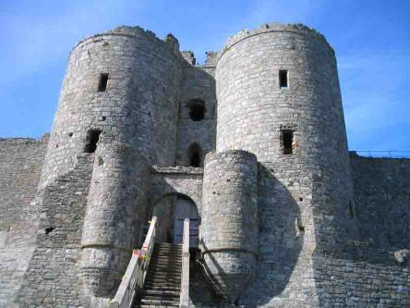

Immunology
Your skin
Your Skin
pathogen
pathogen
Your T-cell
Images:: Castle, S. Jervis,; Angelina Jolie as assassin in movie “Wanted”
From the Virtual Microbiology Classroom on ScienceProfOnline.com

Slide 3
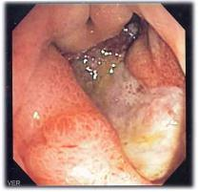
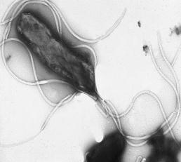
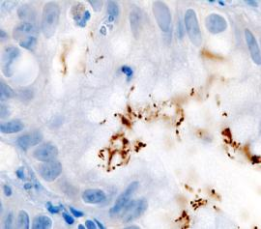
It Isn’t Easy Being a Pathogen
What a pathogen must do
in order to cause disease:
1. Gain access to the body.
2. - Attach to and/or enter cells of its host.
- Receptors on pathogen must fit, lock-and-key, with receptor sites on host cell.
3. Reproduce while avoiding host’s immune system long enough to produce harmful changes.
Multiple flagella allow H. pylori to penetrate the coating of the stomach epithelium.
H. pylori from a gastric biopsy
Images: Helicobacter pylori, Yutaka Tsutsumi, M.D; Deep gastric ulcer, Samir; Histopathology of H.pylori from a gastric biopsy, KGH
From the Virtual Microbiology Classroom on ScienceProfOnline.com

Slide 4
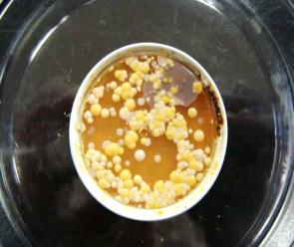
Normal Flora
Protect the body by competing with
potential pathogens.
This is called microbial antagonism.
Normal microbiota protect us by:
  Consuming nutrients that would otherwise be available to pathogens.
  Sometimes change the pH of the area they inhabit in ways that help them and hinder competing microbes.
  Presence stimulates certain parts of the second line of immune defense, helping the body defend itself from invaders.
  Normal flora of the intestines improve our overall health by producing several types of vitamins.
Image: Arm plate of normal flora, T. Port
From the Virtual Microbiology Classroom on ScienceProfOnline.com

Slide 5
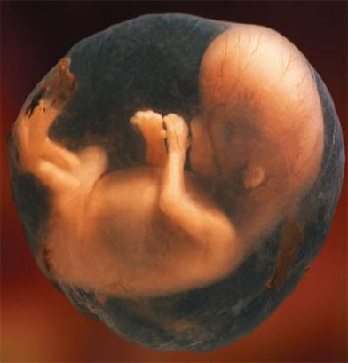
Innate Immunity
First two lines of immune defense considered together.
Q: Why do you think that they are called innate immunity?
Innate immunity is nonspecific, meaning that these lines of defense work against a wide range of pathogens.
Image: Fetus in amniotic sac, National Institutes of Health
From the Virtual Microbiology Classroom on ScienceProfOnline.com

Slide 6

First Line of Defense
Nonspecific
Structures, chemicals, processes that work to prevent pathogens entering the body.
Includes the skin and mucous membranes of the respiratory, digestive, urinary, and reproductive systems.
Your skin
First Line of Defense
Images: : Castle, S. Jervis
From the Virtual Microbiology Classroom on ScienceProfOnline.com

Slide 7
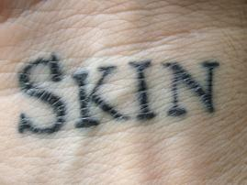
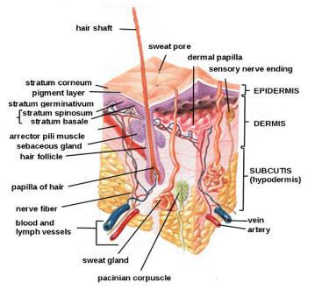
Skin – Physical Components of Defense
Two major layers:
  1. epidermis
    Outer layer composed of multiple layers of tightly packed cells
      Few pathogens can penetrate these layers
      Shedding of dead skin cells removes attached microorganisms
    Epidermal dendritic cells phagocytize pathogens.
      These cells extend out among other cells of the epidermis, forming a network to intercept invaders.
  2. dermis
    Contains protein fibers called collagen
      Give skin strength and pliability to resist abrasions that could introduce microorganisms
First Line of Defense
Image: “Skin” tattoo, Source unknown; Skin diagram, Daniel de Souza Telles
From the Virtual Microbiology Classroom on ScienceProfOnline.com

Slide 8
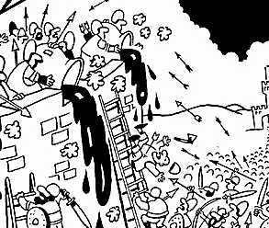
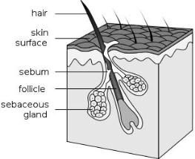
Skin – Chemical Components of Defense
perspiration secreted by sweat glands
  Salt- inhibits growth of pathogen by drawing water from their cells
  Antimicrobial peptides
  Lysozyme- destroys cell wall of bacteria
sebum secreted by sebaceous (oil) glands
  Helps keep skin pliable and less likely to break or tear
  Lowers pH of skin to a level inhibitory to many bacteria
First Line of Defense
Images: Cartoon of castle being defended, Source unknown; Hair follicle, Wiki
From the Virtual Microbiology Classroom on ScienceProfOnline.com

Slide 9
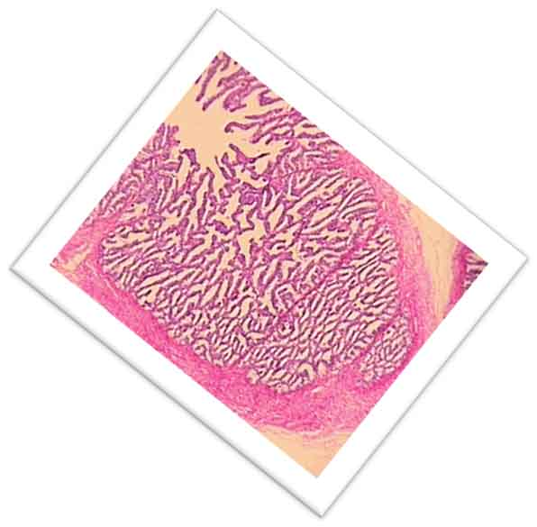
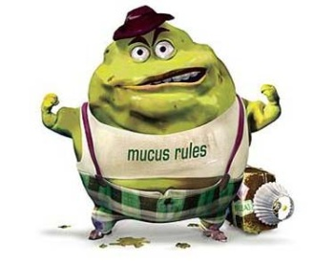
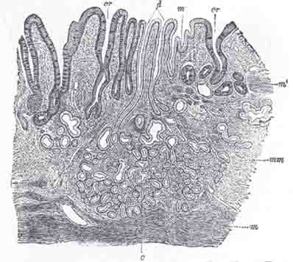
Mucous Membrane
Line all body cavities open to the outside environment.
Unlike surface epidermal cells, epithelial cells are living.
Epithelial cells packed tightly to prevent entry of pathogens, but often only one cell layer thick, so pathogens sometimes breech the barrier.
Continual shedding of cells carries attached microorganisms away
Besides producing mucus, mucous membranes also produce lysozyme and other antimicrobial peptides.
OMG U R Nasty > Every day you swallow and digest about 1 liter of mucus.
First Line of Defense
Images: Photo mucous membrane, Source unknown, Drawing of mucous membrane, Gray’s Anatomy
From the Virtual Microbiology Classroom on ScienceProfOnline.com

Slide 10
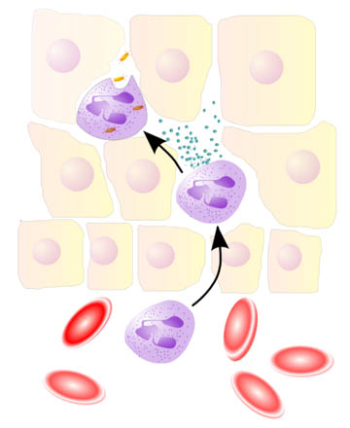
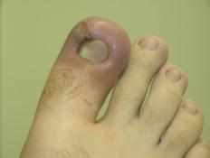
Second Line of Defense
Nonspecific
Operates when pathogens penetrate skin or mucous membranes.
Cells, antimicrobial chemicals, and processes, but no physical barriers.
Many of these components are contained or originate in the blood.
Second Line of Defense
Images: Neutrophil bacterial phagocytosis, Uwe Thormann; Ingrown toenail inflammation, Wiki
From the Virtual Microbiology Classroom on ScienceProfOnline.com

Slide 11
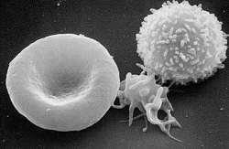
Formed Elements
Three types of formed elements:
  erythrocytes - red blood cell, carry oxygen & carbon dioxide in the blood.
  platelets - involved in blood clotting (also called thrombocytes).
  leukocytes - white blood cells; involved in defending the body against invaders.
    2 groups
      Granulocytes
      Agranulocytes
Second Line of Defense
Scanning electron micrograph of formed elements
RBC (left)
platelet (center)
leukocyte (right)
Image: Formed elements, NCI-Frederick
From the Virtual Microbiology Classroom on ScienceProfOnline.com

Slide 12
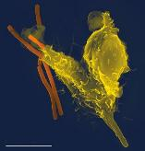
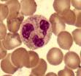



Leukocytes > Granulocytes
Category of white blood cells characterized by presence
of granules in their cytoplasm.
3 types:
    Neutrophils - Most abundant white blood cell. Predominant cells in pus, accounts for its whitish appearance. Respond quickly following tissue injury. Hallmark of acute inflammation.
    Basophils - Least common granulocyte. When activated, release histamine and other inflammatory chemicals.
    Eosinophils - Main effecter cells in allergic responses & asthma. Also fight helminth (worm) colonization.
Neutrophils and eosinophils can phagocytize pathogens.
Second Line of Defense
Image: Neutrophil engulfing Bacillus anthracis, Volker Brinkmann, Photos of granulocytes, Wiki; Drawing of granulocytes, US Gov
From the Virtual Microbiology Classroom on ScienceProfOnline.com

Slide 13
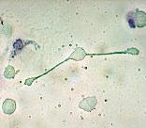
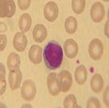
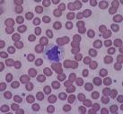
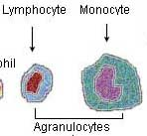
Leukocytes > Agranulocytes
2 types:
    Lymphocytes - most involved in specific immunity (3rd line of immune defense),
    Monocytes - leave the blood and mature into macrophages (phagocytic cells of the second line of defense).
Second Line of Defense
Image: Macrophage, Wiki; Lymphocyte, Nicolas Grandjean; Monocyte, Bobjgalindo
From the Virtual Microbiology Classroom on ScienceProfOnline.com

Slide 14

Components of the
Second Line of Defense
Leukocytes
  - Phagocytosis
    How phagocytes ingest and
    destroy foreign matter such as
    microorganisms or debris.
- Extracellular killing by leukocytes
Nonspecific chemical defenses
Inflammation
Fever
Second Line of Defense
Phagocytosis of a movie dude.
From the Virtual Microbiology Classroom on ScienceProfOnline.com

Slide 15
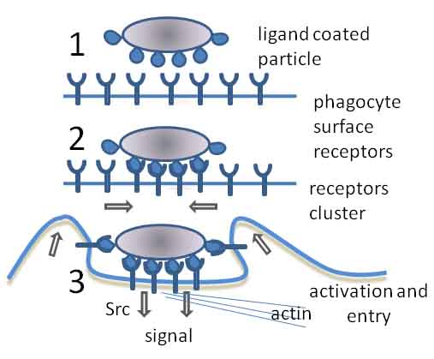
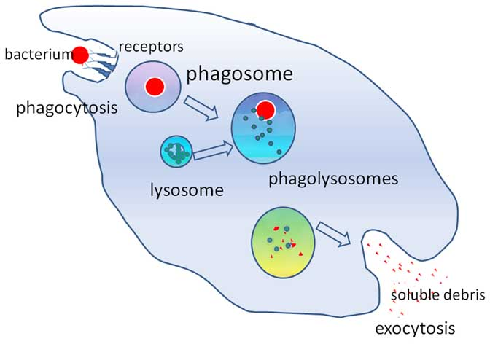
Leukocytes: Phagocytosis
Second Line of Defense
Let’s look at phagocytosis in action!
Image: Phagocytosis in three steps & Simple diagram of phagocytosis, Graham Colm
From the Virtual Microbiology Classroom on ScienceProfOnline.com

Slide 16
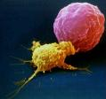
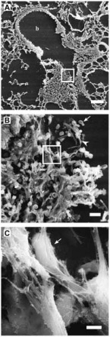
Leukocytes: Extracellular Killing
3 Cell Types That Kill Extracellularly:
  natural killer lymphocytes (NK cells)
    Secrete toxins onto surface of virally infected cells & tumors.
    Differentiate normal body cells because they have membrane proteins similar to the NK cells.
  eosinophils
    Mainly attack parasitic worms by attaching to their surface.
    Secrete toxins that weaken or kill worm.
    Elevated eosinophil levels, is often indicative of a helminth (parasitic worm) infection.
  neutrophils
    Can create the active ingredient in bleach to kill nearby microbes.
    Fibers called neutrophil extracellular traps (NETs) can ensnare and kill bacteria and fungi. Secrete antimicrobial proteins.
Second Line of Defense
Image: Natural killer cell (yellow) attacking a cancer cell (red),Dr. Rupert Handgretinger, University Hospital of Tübingen; Mouse lung cell NETS engulfing fungus PLoS.
From the Virtual Microbiology Classroom on ScienceProfOnline.com

Slide 17
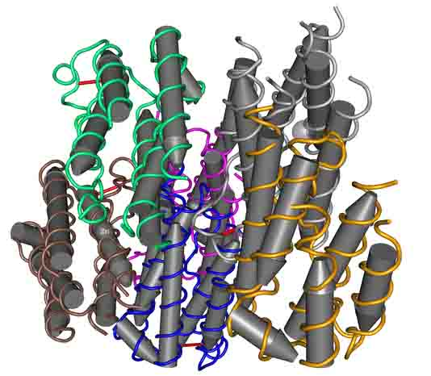
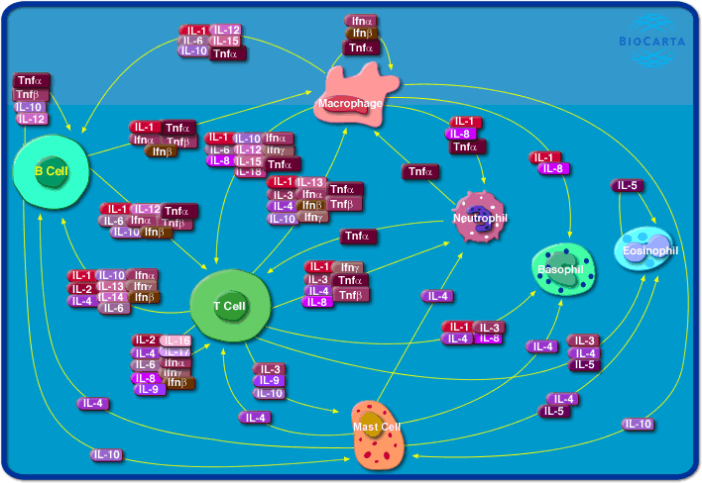
Components of the Second Line of Defense
Leukocytes
  Phagocytosis
  Extracellular killing by leukocytes
Nonspecific chemical defenses
- Lysozyme, Defensins & Cytokines (including
interferons and interleukins).
- Augment phagocytosis
  Some attack pathogens directly
  Some enhance features of
  nonspecific resistance
Inflammation
Fever
Second Line of Defense
Images: Interferon molecule, Nevit Dilman, Cytokine network, KUGI, Mouse Clone Database
From the Virtual Microbiology Classroom on ScienceProfOnline.com

Slide 18
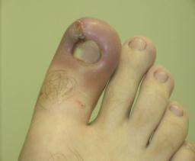
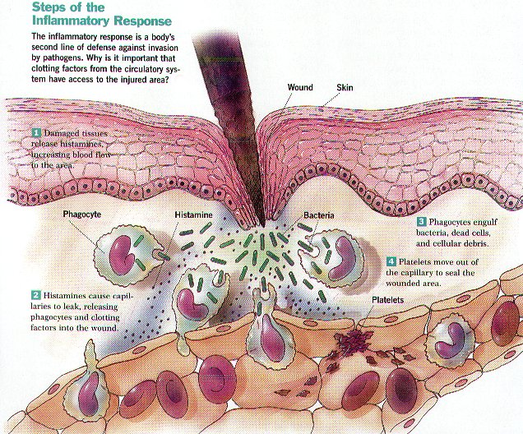
Components of the Second Line of Defense
Leukocytes
  Phagocytosis
  Extracellular killing by leukocytes
Nonspecific Chemical Defenses
- Ex. Lysozyme, Defensins & Cytokines
Inflammation
  Nonspecific response to tissue damage.
  Damages cells release histamines which increase vasodilation.
  - Heat, swelling, pain
Fever
Second Line of Defense
Images: Inflamed ingrown toenail, Menetekel
From the Virtual Microbiology Classroom on ScienceProfOnline.com

Slide 19

Components of the Second Line of Defense
Leukocytes
  Phagocytosis
  Extracellular killing by leukocytes
Nonspecific Chemical Defenses
- Ex. Lysozyme, Defensins & Cytokines
Inflammation
  Nonspecific response to tissue damage.
  Damages cells release histamines,
  which increase vasodilation.
  - Heat, swelling pain
Fever
Body temp
above normal range
of 36.5–37.5 °C (98–100 °F).
Results when chemicals called ________trigger the hypothalamus to increase body’s core temperature.
Various types of pyrogens
  Bacterial toxins
  Cytoplasm of bacteria released by lysis
  Antibody-antigen complexes
  Interleukin-I (IL-1 a cytokine)
Benefits
  Speed of immune system reaction increased
  Inhibits growth of some temp sensitive microorganisms
Second Line of Defense
Images: The sick girl, Michael Ancher
From the Virtual Microbiology Classroom on ScienceProfOnline.com

Slide 20

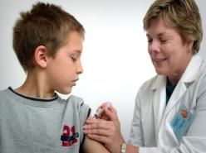
Third Line of Defense
Acquired
• The body’s ability to recognize and defend itself against distinct invaders.
  Is a “smart” system.
  Also called specific and adaptive immunity.
  “Memory” allows it to respond rapidly to additional encounters with a pathogen.
  - If nonspecific immune system has warriors, then acquired immunity has more sophisticated special agents and assassins.
Two types of specific immunity:
  Naturally acquired = immune response against antigens encountered in daily life.
  Artificially acquired = response to antigens introduced via vaccine.
  Q: How does the body recognize invaders?
Third Line of Defense
Images: Child getting immunized, PHIL #9423
From the Virtual Microbiology Classroom on ScienceProfOnline.com

Slide 21

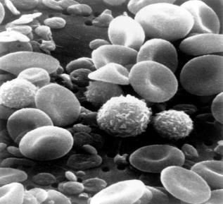
Antigens
Body does not direct immune
response against whole bacteria,
fungi, protozoa or viruses.
Foreign molecules trigger a specific immune response.
Include components of bacterial
cell walls, capsules, pili, and
flagella, as well as proteins of
viruses, fungi and protozoa.
Food and dust can also contain
antigenic particles.
Enter the body by various methods:
  Through breaks in skin & mucous membranes
  Direct injection, as with a bite or needle
  Through organ transplants and skin grafts
Antigens Are Like Name Tags Antigenic particles are often associated with a specific characteristic of an organism, so are detected as foreign when they get inside another organism that doesn’t have that characteristic.
Third Line of Defense
Hi! I’m Tami’s Cell
Hi! I’m Tami’s Cell
Can I see your I.D.?
Images: Blood cells, National Cancer Institute
From the Virtual Microbiology Classroom on ScienceProfOnline.com

Slide 22
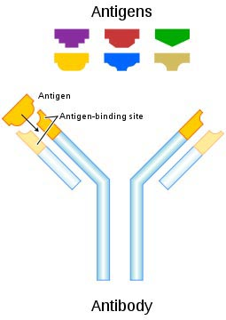
Antibodies
Also called immunoglobulins (Ig).
Proteinaceous molecules that bind antigens at the antigen-binding site.
Considered part of the humoral immune response since bodily fluids such as lymph and blood were once called humors.
Third Line of Defense
Images: Antibody, Fvasconcellos
From the Virtual Microbiology Classroom on ScienceProfOnline.com

Slide 23
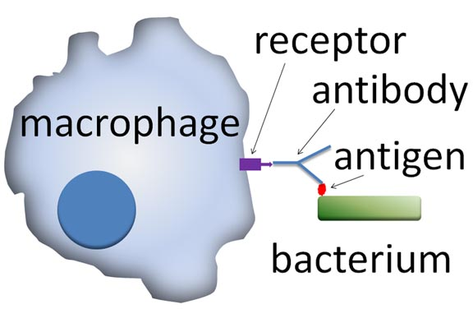
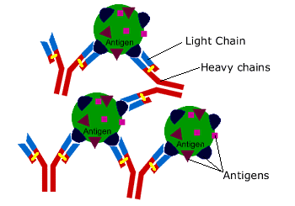
How Antibodies Work
Some act as opsonins, markers to identify antigens for phagocytes and stimulate phagoctosis.
Some work as antitoxins (i.e. they neutralize toxins for e.g. those causing diphtheria and tetanus).
Some attach to bacterial flagella making them less active and easier for phagocytes to engulf.
Some cause agglutination (clumping together) of bacteria making them less likely to spread
Third Line of Defense
Q: But where do antibodies come from?
Image: Antigen antibody complex, Dr. Sanderson Immunology Page; Opsonin, Graham Colm
From the Virtual Microbiology Classroom on ScienceProfOnline.com

Slide 24
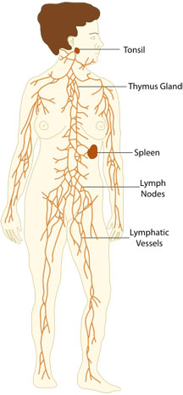
Lymphatic System
Screens tissues of the body for foreign antigens.
Composed of lymphatic vessels and lymphatic cells.
One-way system that conducts lymph from local tissues and returns it to the circulatory system.
  Lymph is a liquid with similar composition to blood plasma.
  Comes from fluid leaked from blood vessels into surrounding tissues.
Lymph nodes house white blood cells called lymphocytes that recognize and attack foreign antigens present in lymph.
Third Line of Defense
Image: Lymphatic system ; The Emirr
From the Virtual Microbiology Classroom on ScienceProfOnline.com

Slide 25

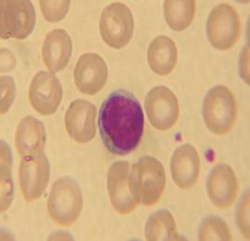
Lymphocytes
WBCs of specific immunity. Smallest
leukocytes. Have huge nucleus surrounded
by thin rim of cytoplasm.
Produced from blood stem cells in
the red bone marrow.
Two main types:
B cells mature in bone marrow, then concentrate in lymph nodes & spleen.
T cells mature in thymus.
B and T cells mature then circulate in the blood and lymph.
Circulation ensures they come into contact with pathogens and each other.
Third Line of Defense
Image: Lymphocyte SEM; Dr. Triche National Cancer Institute; Lymphocyte, Nicolas Grandjean
From the Virtual Microbiology Classroom on ScienceProfOnline.com

Slide 26
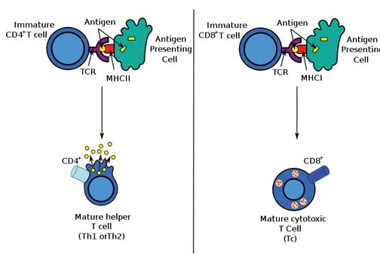
T Lymphocytes (T cells)
Produced in red bone marrow and mature in thymus.
Circulate in the lymph and blood and migrate to the lymph nodes (and other areas of the lymph system).
Part of the cellular immune response (aka cell-mediated immune response) because these cells act directly against various antigens
  Endogenous invaders (intracellular pathogens inside the body’s cells)
  Abnormal body cells such as cancer cells
Types
  cytotoxic or killer T cells (T_{C})
    Destroy compromised body cells
  helper T cells (T_{H})
    Activate B-cells
Third Line of Defense: Cell-mediated Immune Response
Image: Antigen presentation, Sjef
From the Virtual Microbiology Classroom on ScienceProfOnline.com

Slide 27
What Is an Antigen Presenting Cell?
Consider your WBCs a security force for your body and any non-self antigens as pictures of a bad guy.
The larger the force, the more likely one of the officers will run into a “bad guy” and help the body apprehend it.
Any WBC that can grab and present an antigen to another, is called an antigen presenting cell (APC).
Third Line of Defense
There are “professional” (WBC) APC cells, such as B cells, macrophages and dendritic cells.
There are also other cells in the body (non-WBCs) that are “non-professional” APC cells, such as fibroblasts (in skin), some epithelial and endothelial cells & glial cells (in brain).
Image: Antigen presentation, Sjef
From the Virtual Microbiology Classroom on ScienceProfOnline.com

Slide 28
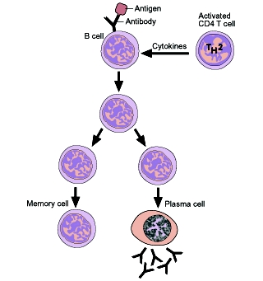
B Lymphocytes (B cells )
Activated B-lymphocytes produce either:
  Plasma cells make antibodies to a pathogen.
  Memory cells remember the same pathogen for faster antibody production in future infections.
Third Line of Defense: Humoral Immune Response
Image: B cell differentiation, Source unknown
From the Virtual Microbiology Classroom on ScienceProfOnline.com

Slide 29

REVIEW!
Animated lesson on
Humoral Immune Response
Image: Antigen antibody complex; Antibody, Fvasconcellos; B cell differentiation, Source unknown
From the Virtual Microbiology Classroom on ScienceProfOnline.com

Slide 30
Confused?
Here are links to fun resources that further explain
acquired immunity:
Immunology: Innate & Acquired Immunity Main Page on the Virtual Cell Biology Classroom of Science Prof Online.
Phagocytosis animation and quiz by McGraw-Hill.
Immune System “Who Wants to Be a Millionaire” game.
Immune System animation and quiz by McGraw-Hill.
“Fever”, song by Peggy Lee & “Assassin” song by John Mayer
Cellular Immune Response & Humoral Immune Response narrated animation and quiz from W. H. Freeman.
Immune System Defender, online game from the Nobel Prize website. Use your force of white blood cells to destroy invading bacteria, before they overpopulate and cause disease.
Immune System Game, a collection of online fun and educational games about immunology.
Smart Links
(You must be in PPT slideshow view to click on links.)
From the Virtual Microbiology Classroom on ScienceProfOnline.com

Slide 31
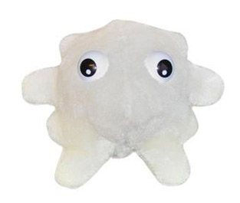
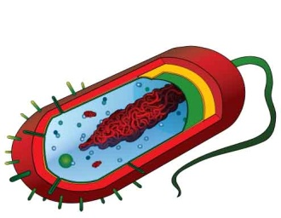
Are microbes intimidating you?
Do yourself a favor. Use the…
Virtual Microbiology Classroom (VMC) !
The VMC is full of resources to help you succeed, including:
practice test questions
review questions
study guides and learning objectives
You can access the VMC by going to the Science Prof Online website www.ScienceProfOnline.com
Images: White blood cell, Giant Microbes; Prokaryotic cell, Mariana Ruiz

