Slide 1

About Science Prof Online
PowerPoint Resources
Science Prof Online (SPO) is a free science education website that provides fully-developed Virtual Science Classrooms, science-related PowerPoints, articles and images. The site is designed to be a helpful resource for students, educators, and anyone interested in learning about science.
The SPO Virtual Classrooms offer many educational resources, including practice test questions, review questions, lecture PowerPoints, video tutorials, sample assignments and course syllabi. New materials are continually being developed, so check back frequently, or follow us on Facebook (Science Prof Online) or Twitter (ScienceProfSPO) for updates.
Many SPO PowerPoints are available in a variety of formats, such as fully editable PowerPoint files (.ppt), as well as uneditable versions in smaller file sizes, such as PowerPoint Shows (.pps) and Portable Document Format (.pdf), for ease of printing. The font “Jokerman” is used frequently in titles. It has a microbiology feel to it. If you do not have this font, some titles may appear odd, oversized and off-center. Find free downloads of Jokerman by Googling “download jokerman font microsoft”.
Images used on this resource, and on the SPO website are, wherever possible, credited and linked to their source. Any words underlined and appearing in blue are links that can be clicked on for more information. PPT files must be viewed in slide show mode to use the hyperlinks directly.
Several helpful links to fun and interactive learning tools are included throughout the PPT and on the Smart Links slide, near the end of each presentation. You must be in slide show mode to utilize hyperlinks and animations.
This digital resource is licensed under Creative Commons Attribution-ShareAlike 3.0:
http://creativecommons.org/licenses/by-sa/3.0/
Alicia Cepaitis, MS
Chief Creative Nerd
Science Prof Online
Online Education Resources, LLC
alicia@scienceprofonline.com
Tami Port, MS
Creator of Science Prof Online
Chief Executive Nerd
Science Prof Online
Online Education Resources, LLC
info@scienceprofonline.com
From the Virtual Microbiology Classroom on ScienceProfOnline.com
Image: Compound microscope objectives, T. Port
Notes:
Welcome to Science Prof Online PowerPoint Resources!
This PowerPoint Presentation comes from the Virtual Cell Biology Classroom of Science Prof Online, and, as such, is licensed under Creative Commons Attribution-ShareAlike 3.0.; meaning you can download, share and alter any of this presentation, but you can’t sell it or repackage and sell any part of it. Please credit Science Prof Online as the source of this presentation. Please abide by credited image copyrights. Thank you for using this resource.

Slide 2
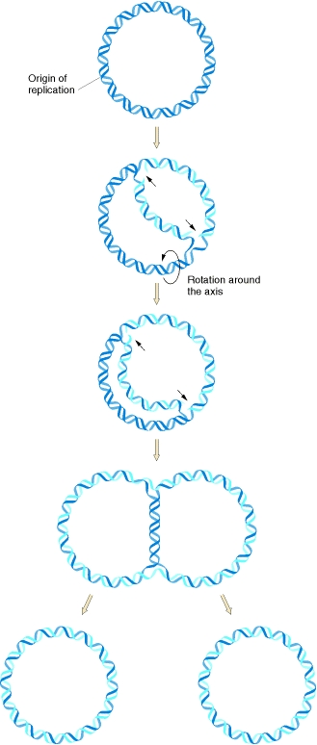
Microbial
Genetics
Image: Prokaryotic Replication, U.S. National Library of Medicine
From the Virtual Microbiology Classroom on ScienceProfOnline.com

Slide 3
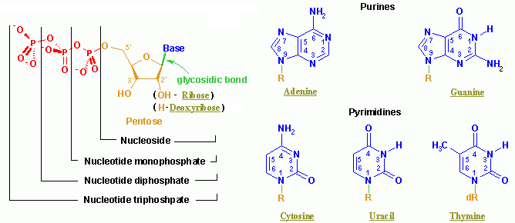
Nucleic Acids
Made of monomer building blocks called
nucleotides.
From the Virtual Microbiology Classroom on ScienceProfOnline.com
Image: Nucleotide Structure, Wikipedia

Slide 4
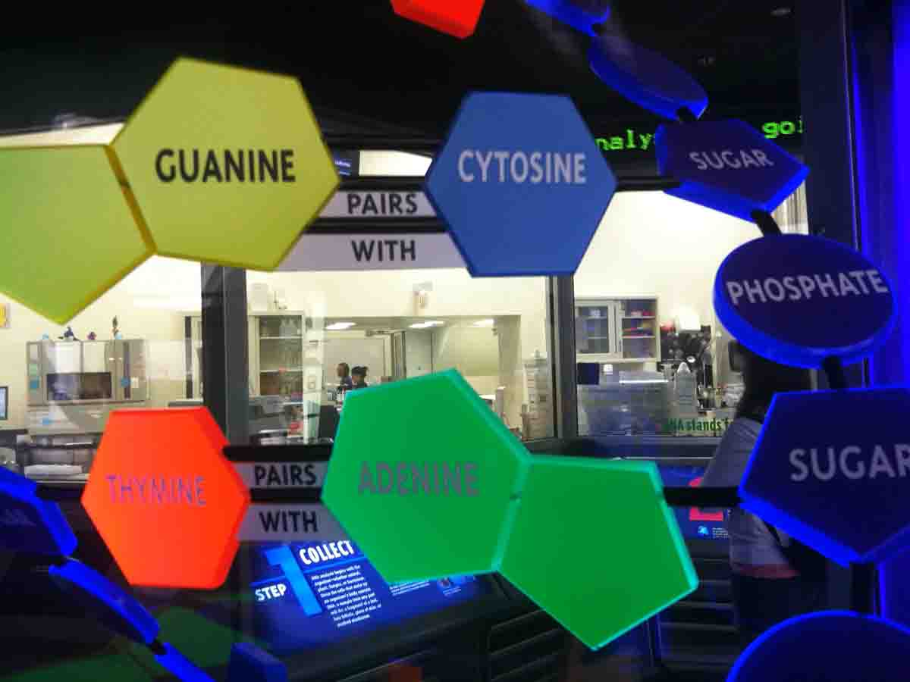
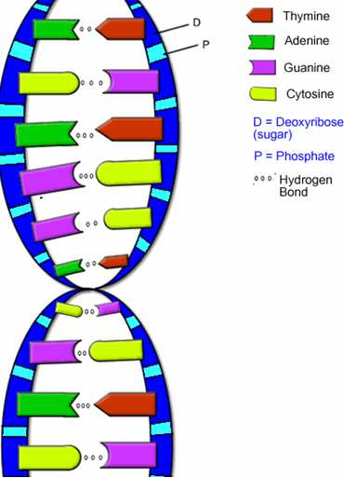
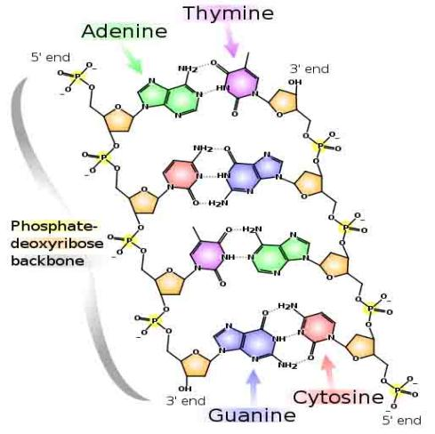
Nucleic Acids: DNA Structure
Images: Model of DNA Molecule, Field Museum, Chicago, T. Port; DNA Detail Diagram: Madprime; DNA & RNA Diagrams, BiologyCorner
From the Virtual Microbiology Classroom on ScienceProfOnline.com

Slide 5
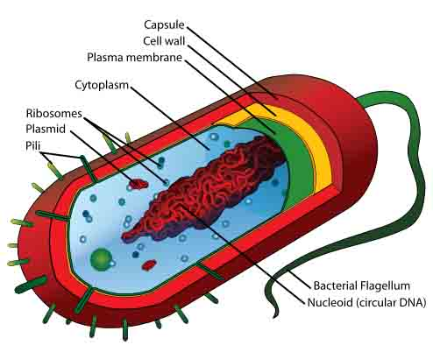
Prokaryote Genetics
Q: What is the specific name for the prokaryotes chromosome?
DNA floats freely within cytoplasm.
Prokaryotic DNA is packaged (coiled) differently than eukaryotic DNA. That is why some antibiotics can target prokaryotic nucleic acid while not hurting the DNA of our cells (selective toxicity).
Q: Prokaryotic DNA may be found in what other structure?
Image: Prokaryotic cell diagram: M. Ruiz, Bacterial conjugation, Adenosine
From the Virtual Microbiology Classroom on ScienceProfOnline.com

Slide 6
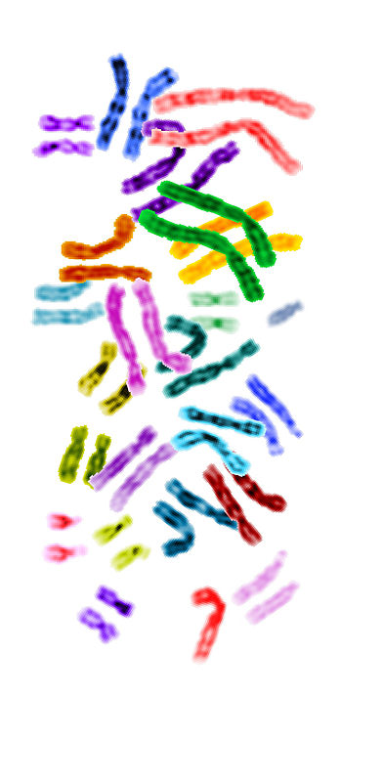
Eukaryote Genetics
Like prokaryotes, insofar as genome is also made of DNA.
May include several to many linear chromosomes within a membrane-bound nucleus.
  Q: How many chromosomes do humans have?
Two locations of eukaryotic DNA
  1. Nuclear DNA
  2. Extranuclear DNA
  Q: Where is the extranuclear DNA located in eukaryotic cells?
Image: Spectral karyotype, Jane Ades, NHGRI
From the Virtual Microbiology Classroom on ScienceProfOnline.com

Slide 7
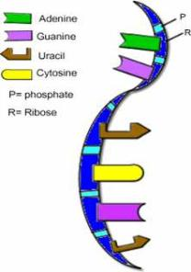

Genetic Material of Viruses
Show more variety in nature of their genomes than do cells.
Can be DNA or RNA; never both.
Primary way scientists categorize and classify viruses.
Can be dsDNA, ssDNA, dsRNA, ssRNA.
May be linear and composed of several segments or single and circular.
Much smaller than genomes of cells.
Images: DNA & RNA Diagrams, BiologyCorner
From the Virtual Microbiology Classroom on ScienceProfOnline.com

Slide 8
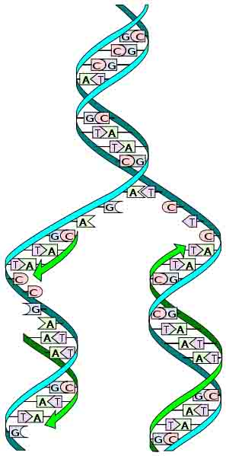
Copying DNA
Process of copying DNA is called replication.
Think “duplication”.
Happens in all types of cells, prokaryotes and eukaryotes.
Q: Why would a cell need to copy its DNA?
From the Virtual Microbiology Classroom on ScienceProfOnline.com
Image: Replication Diagram: Madprime
Notes:
Before a cell divides, it must first make a copy of its genetic material .
Replication

Slide 9
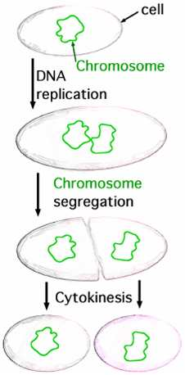
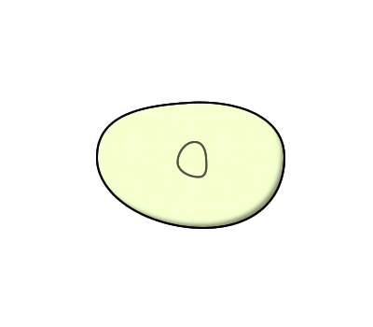
Prokaryote Genetics – Cell Division
After the genetic material is copied, the prokaryotic cell divides; a process called binary fission, in which two identical daughter cells arise from one parent cell.
Images: Binary Fission, JW Schmidt, Animation of binary fission, Brian Zablocky
From the Virtual Microbiology Classroom on ScienceProfOnline.com

Slide 10
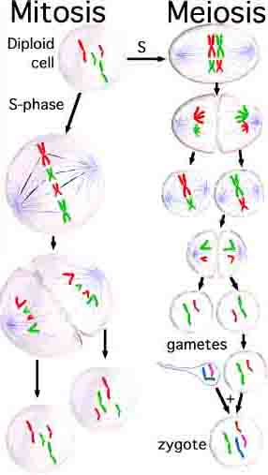
Eukaryote Genetics – Cell Division
From the Virtual Cell Biology Classroom on ScienceProfOnline.com
Image: Types of Cell Division, Saperaud Wiki

Slide 11
REVIEW!
Animated lesson
on
Cell Division
Images: Binary Fission, JW Schmidt, Types of Cell Division, Saperaud Wiki
From the Virtual Microbiology Classroom on ScienceProfOnline.com

Slide 12
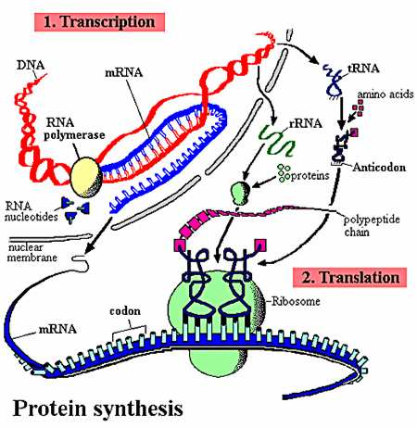
Nucleic Acid Function
Gene Expression:
Transcription & Translation
From the Virtual Microbiology Classroom on ScienceProfOnline.com

Slide 13

Nucleic Acids: RNA Structure
RNA is typically a single-stranded molecule.
Q: What base does RNA have that DNA doesn’t have?
Q: What base does DNA contain that RNA Doesn’t have?
From the Virtual Microbiology Classroom on ScienceProfOnline.com
Image: RNA, Biology Corner
Notes:
Uracil
Thymine

Slide 14
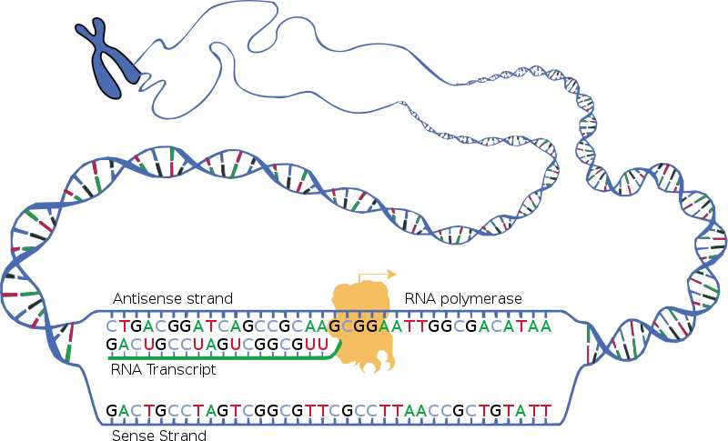
First thing to do in making a protein…
Make RNA, a process called transcription.
Process by which a DNA sequence is copied to produce a complementary RNA.
In other words, it is the transfer of genetic information from DNA into RNA.
Like replication, but we are making RNA.
Beginning of the process that ultimately leads to the translation of the genetic code (via mRNA) into a peptide or protein.
From the Virtual Microbiology Classroom on ScienceProfOnline.com
Image: Transcription, National Human Genome Research Institute.

Slide 15
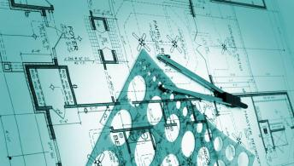
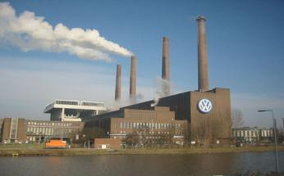
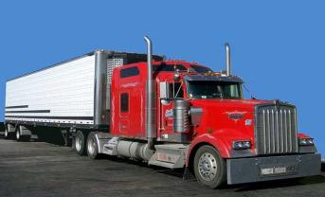
Types of RNA
Genetic information copied from DNA is transferred to 3 types of RNA:
messenger (mRNA) is like a
Copy of information in DNA that is brought to
the ribosome where the information is
translated into a protein.
ribosomal (rRNA) is like a
The protein factories of the cells.
transfer (tRNA) are like a
Brings the amino acid to the ribosome.
Images: Blueprint, clipart; Factory, Andreas Praefcke; Truck, PRA; Ribosome translating protein, Xvazquez.
From the Virtual Microbiology Classroom on ScienceProfOnline.com
Notes:
blueprint
factory
truck

Slide 16
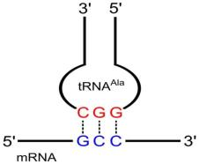
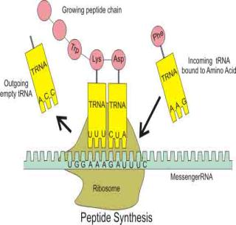
Next thing to do in making a protein…
Use the instructions delivered by RNA to make a protein molecule, a process called translation.
Ribosomes (Q: Which contain what type of RNA?) make proteins from the messages encoded in mRNA.
The genetic instructions for a
protein (polypeptide chain) are ‘written’
in the DNA as a series of
3-nucleotide ‘words’.
codon on mRNA
anti-codon on tRNA
‘U’ (uracil) replaces ‘T’ in RNA
This is the genetic code.
Q: Where does translation
occur in prokaryotes?
Q: Eukaryotes?
Anti-codon
Codon
Click here for animation of a ribosome building a protein.
Image: Codon-Anticodon pairing, Yikrazuul, Wiki; Peptide Synthesis Diagram: Boumphreyfr, Wiki; ; Ribosome translating protein, Xvazquez.
From the Virtual Microbiology Classroom on ScienceProfOnline.com
Notes:
Ribosomes
Codon
Anti-codon

Slide 17
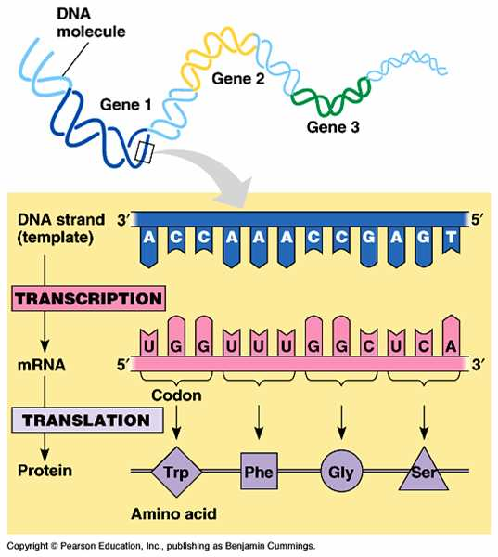
Gene Expression: Transcription & Translation Overview
REVIEW
Interactive animation that allows you to transcribe and translate
a gene!

Slide 18
Gene Expression in Microbes
Section of DNA (a gene) being transcribed & translated to produce a protein.
Genes can be turned on and off.
Understanding of how microbial genes are expressed (turned on and off) can help us control disease-causing bacteria.
From the Virtual Microbiology Classroom on ScienceProfOnline.com

Slide 19
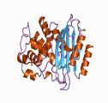
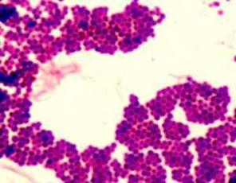
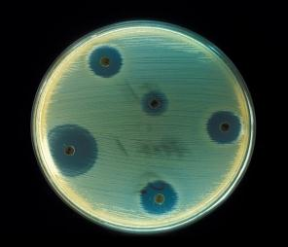
Using Gene Expression to Control Disease
Staphylococcus & Antibiotic Resistance
Many strains of Staphylococcus are now resistant to penicillin.
One bacterial protein that confers penicillin resistance is called beta-lactamase.
Beta-lactamase is an enzyme that cuts up and deactivates penicillin.
Gene for beta-lactamase only expressed (turned on) in the presence of penicillin.
When the bacteria is not exposed to penicillin, that gene is turned off and no beta-lactamase is made.
Understanding how beta-lactamase gene is turned on/off, can help us to design a drug to disable that gene’s expression (turn off the gene), making penicillin-resistant strains of Staph again vulnerable to penicillin.
Images: Gram stain of Staphylococcus, T.Port; Enzyme Beta-lactamase, J. Swaminathan & MSD staff, European Bioinformatics Institute; Staphylococcus aureus on antibiotic test plate, PHIL #2641
From the Virtual Microbiology Classroom on ScienceProfOnline.com

Slide 20
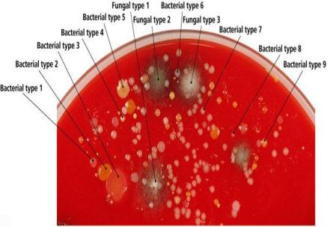
If binary fission creates clones…
Genetic Diversity in Prokaryotes
…then:
Q: Why isn’t there just one type of bacteria?
Q: How do bacteria change (for example develop resistance to antibiotics)?
From the Virtual Microbiology Classroom on ScienceProfOnline.com
Images: Binary Fission, JW Schmidt

Slide 21
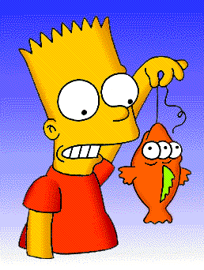
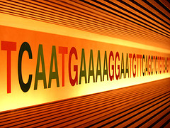
Replication Mistakes: Mutations of Genes
Change in the nucleotide base sequence of a genome; rare.
Almost always bad news, but...
Rarely leads to a protein having a novel property that improves ability of organism and its descendants to survive and reproduce.
Staph’s beta-lactamase gene is an example of a mutation that was advantageous.
From the Virtual Microbiology Classroom on ScienceProfOnline.com
Images: Blinky & Bart, Matt Groening

Slide 22
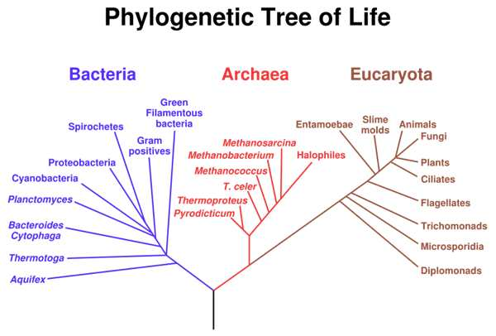
Increasing Genetic Diversity in Prokaryotes
Gene Transfer
Vertical gene transfer – organisms replicate their genomes and provide copies to descendants. Passing on genes to descendants.
Horizontal gene transfer – donor contributes part of genome to recipient that are not descendants; three types:
  Transformation
  Transduction
  Bacterial Conjugation
Images: Binary Fission, JW Schmidt, Phylogenetic Tree, Eric Gaba, NASA Astrobiology institute.
From the Virtual Microbiology Classroom on ScienceProfOnline.com

Slide 23
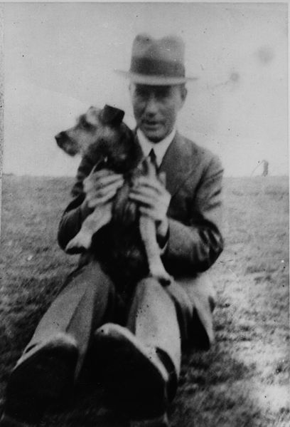
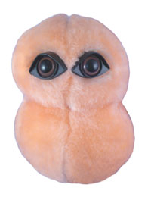
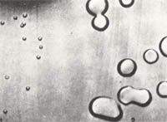
Increasing Genetic Diversity in Prokaryotes
Transformation
When a recipient cell takes up DNA from the environment (such as DNA released from a dead organism).
1928 Frederick Griffith discovered this process while trying to develop a vaccine for pneumonia caused by Streptococcus pneumoniae.
Griffith worked with two strains of Strep.
S Strain had a protective capsule & caused deadly pneumonia when injected into mice.
R strain were mutants that could not make the protective capsule and did not cause deadly disease (because the white blood cells of the mice could easily destroy R strain cells).
Images: Fredrick Griffith & Bobby, 1936, Coburn, Alvin F.; Pneumococcus, Giant Microbes; Rough (unencapsulated) and Smooth (encapsulated) Streptococcus pneumoniae, Wiki.
From the Virtual Microbiology Classroom on ScienceProfOnline.com

Slide 24
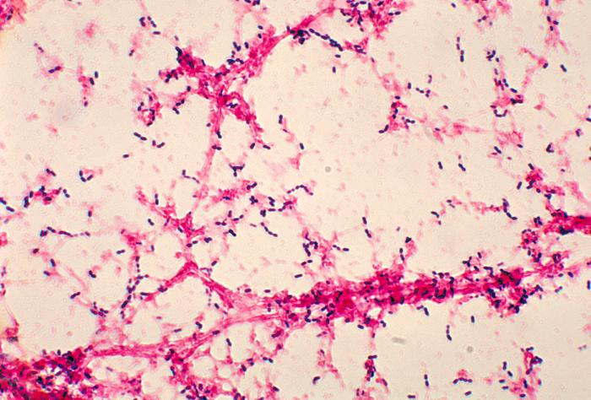
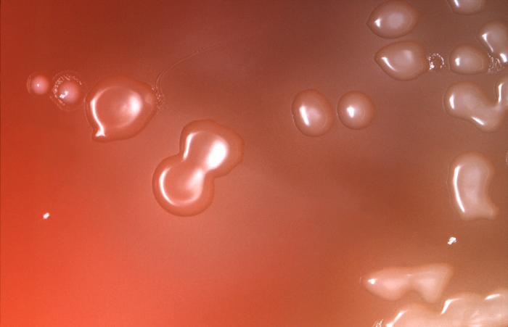
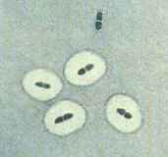
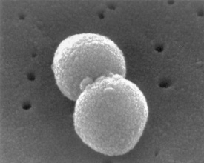
Meet the Microbe!
Streptococcus pneumoniae
Gram+ cocci that occur in pairs or chains.
Blood agar: alpha hemolytic under aerobic conditions and beta hemolytic under anaerobic conditions.
92 different strains, collectively called pneumococci, known to infect humans.
Unencapsulated strains: Those with no capsule/glycocalyx are normal microbiota of lungs, sinuses and middle ear of 75% of people. Don’t cause disease.
Encapsulated strains: Cells of virulent stains of S. pneumoniae are surrounded by a polysaccharide capsule which protects them from being digested by phagocytic white blood cells.
The virulent strain can cause:
- Pneumococcal pneumnia (causes 85% of pneumonia cases)
- Sinusitis and otitis media
- Bacteremia and Endocarditis
Note the “doughnut”-shape of Streptococcus pneumoniae bacterial colonies.
From the Virtual Microbiology Classroom on ScienceProfOnline.com
Images: S. pneumoniae, PHIL #10864, #2896, #2113, #263

Slide 25
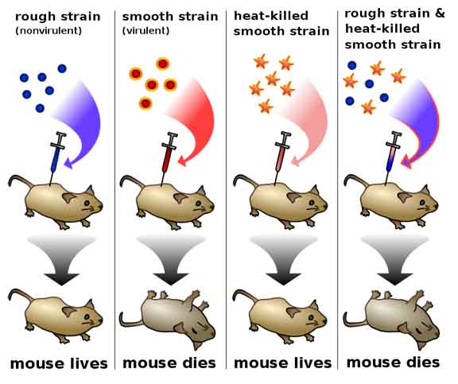
Transformation: Griffith’s Experiments
Increasing Genetic Diversity in Prokaryotes
From the Virtual Microbiology Classroom on ScienceProfOnline.com
Image: Griffith’s experiment, Madprime

Slide 26
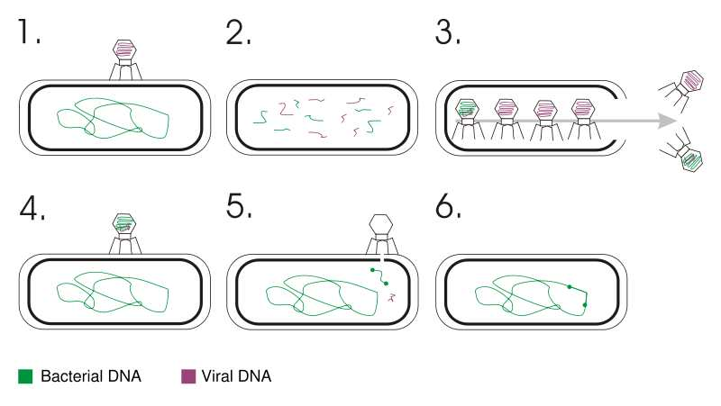
Increasing Genetic Diversity in Prokaryotes
Transduction
Transfer of DNA from one cell to another via a replicating virus (bacteriophage).
Can occur between prokaryotic cells or between eukaryotic cells. (The following is an example of transduction in bacterial cells by bacteriophage virus).
From the Virtual Microbiology Classroom on ScienceProfOnline.com
Image: Transduction, Geni

Slide 27
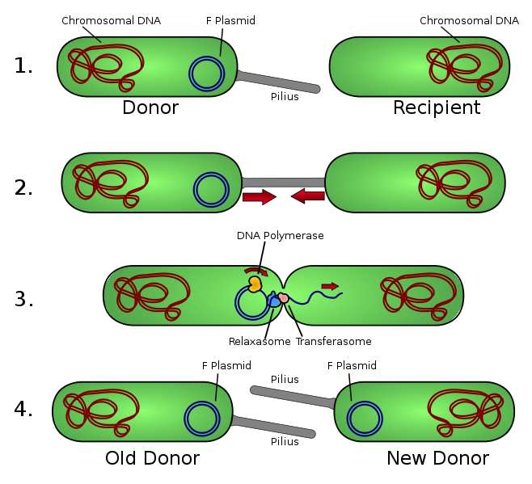
Increasing Genetic Diversity in Prokaryotes
Conjugation
From the Virtual Microbiology Classroom on ScienceProfOnline.com
Image: Bacterial conjugation by Adenosine

Slide 28
REVIEW!
Animated lesson on
Horizontal Gene Transfer
Images: Griffith’s experiment, Madprime; Transduction, Geni; Bacterial conjugation by Adenosine.
From the Virtual Microbiology Classroom on ScienceProfOnline.com

Slide 29
Confused?
Here are links to fun resources that further explain
microbial genetics.
Microbial Genetics Main Page on the Virtual Microbiology Classroom of Science Prof Online.
DNA Structure Cell Biology Animation from John Kyrk.
Build a DNA Molecule from University of Utah.
“Rockin’ Pneumonia & the Boogie Woogie Flu” song by John Rivers.
DNA Replication animation and review questions.
DNA Replication Process animated video by FreeScienceLectures.com.
DNA Replication step-through animation by John Kyrk.
DNA Transcription step-through animation by John Kyrk.
Transcribe & Translate a Gene, from University of Utah.
DNA Transcription and Protein Assembly animated movie by RedAndBrownPaperBag.
Transcription and Translation animated movie from PBS production “DNA: The Secret of Life.
“That Spells DNA” song by Jonathan Coulton.
“The Protein Synthesis Song” by MrsPurpleMonster18.
(You must be in PPT slideshow view to click on links.)
Smart Links
From the Virtual Microbiology Classroom on ScienceProfOnline.com

Slide 30
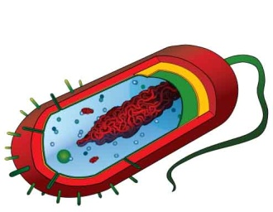
Are microbes intimidating you?
Do yourself a favor. Use the…
Virtual Microbiology Classroom (VMC) !
The VMC is full of resources to help you succeed, including:
practice test questions
review questions
study guides and learning objectives
You can access the Virtual Microbiology Classroom (VMC) on Science Prof Online website www.ScienceProfOnline.com
Images: Pneumococcus, Giant Microbes; Prokaryotic cell, Mariana Ruiz

