Slide 1

About Science Prof Online
PowerPoint Resources
Science Prof Online (SPO) is a free science education website that provides fully-developed Virtual Science Classrooms, science-related PowerPoints, articles and images. The site is designed to be a helpful resource for students, educators, and anyone interested in learning about science.
The SPO Virtual Classrooms offer many educational resources, including practice test questions, review questions, lecture PowerPoints, video tutorials, sample assignments and course syllabi. New materials are continually being developed, so check back frequently, or follow us on Facebook (Science Prof Online) or Twitter (ScienceProfSPO) for updates.
Many SPO PowerPoints are available in a variety of formats, such as fully editable PowerPoint files (.ppt), as well as uneditable versions in smaller file sizes, such as PowerPoint Shows (.pps) and Portable Document Format (.pdf), for ease of printing. The font “Jokerman” is used frequently in titles. It has a microbiology feel to it. If you do not have this font, some titles may appear odd, oversized and off-center. Find free downloads of Jokerman by Googling “download jokerman font microsoft”.
Images used on this resource, and on the SPO website are, wherever possible, credited and linked to their source. Any words underlined and appearing in blue are links that can be clicked on for more information. PPT files must be viewed in slide show mode to use the hyperlinks directly.
Several helpful links to fun and interactive learning tools are included throughout the PPT and on the Smart Links slide, near the end of each presentation. You must be in slide show mode to utilize hyperlinks and animations.
This digital resource is licensed under Creative Commons Attribution-ShareAlike 3.0:
http://creativecommons.org/licenses/by-sa/3.0/
Alicia Cepaitis, MS
Chief Creative Nerd
Science Prof Online
Online Education Resources, LLC
alicia@scienceprofonline.com
Tami Port, MS
Creator of Science Prof Online
Chief Executive Nerd
Science Prof Online
Online Education Resources, LLC
info@scienceprofonline.com
From the Virtual Microbiology Classroom on ScienceProfOnline.com
Image: Compound microscope objectives, T. Port
Notes:
Welcome to Science Prof Online PowerPoint Resources!
This PowerPoint Presentation comes from the Virtual Cell Biology Classroom of Science Prof Online, and, as such, is licensed under Creative Commons Attribution-ShareAlike 3.0.; meaning you can download, share and alter any of this presentation, but you can’t sell it or repackage and sell any part of it. Please credit Science Prof Online as the source of this presentation. Please abide by credited image copyrights. Thank you for using this resource.

Slide 2
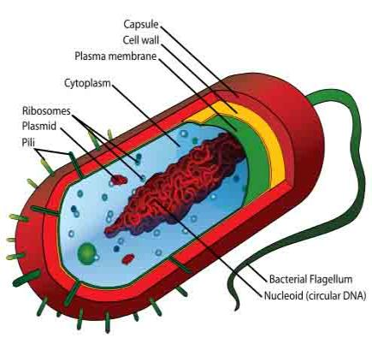
Prokaryotic Cell
Structure & Function
From the Virtual Microbiology Classroom on ScienceProfOnline.com
Image: Prokaryotic cell diagram: M. Ruiz

Slide 3

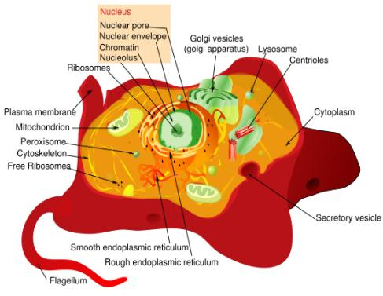
Two Basic Types of Cells
Prokaryotic Cell
Eukaryotic Cell
Images: Prokaryotic cell diagram & Eukaryotic cell diagram, M. Ruiz
From the Virtual Microbiology Classroom on ScienceProfOnline.com

Slide 4
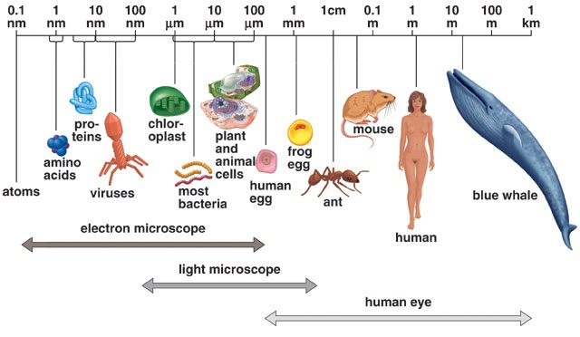
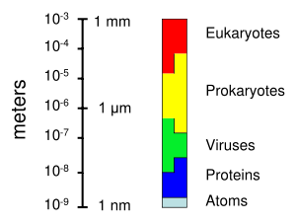
Size of Living Things
1 m = 100 cm = 1,000mm = 1,000,000 µm = 1,000,000,000nm
1mm = 1000 µm = 1000000nm
1 µm = 1000nm
Click link for an interactive Size of Microscopic Things” animation on Cells Alive.
From the Virtual Microbiology Classroom on ScienceProfOnline.com

Slide 5
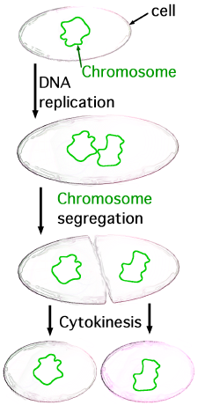
Prokaryotes
Binary Fission
Tell me about Prokaryotes…
Check out these quick animated lessons on
binary fission:
(Please watch both, as each provides different and useful information.)
Binary Fission Animation
from ClassZone
Binary Fission Animation
From McGraw-Hill
Images: Prokaryotic cell diagram, M. Ruiz, Binary fission, JW Schmidt
From the Virtual Microbiology Classroom on ScienceProfOnline.com
Notes:
Prokaryotes …
Reproduce by means of binary fission.
Do not have a cell nucleus or any other organelles with membranes. Plasma membrane their only membrane.
DNA travels openly around the cell.
All bacteria are prokaryotes.

Slide 6

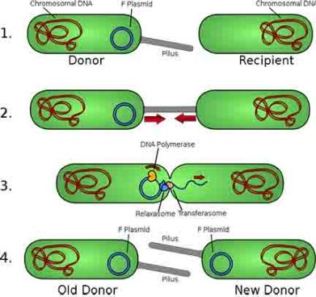
Prokaryote Genetics
Nucleoid
Region of cytoplasm where prokaryote’s genome (DNA) is located.
Usually a singular, circular chromosome.
Plasmid
Small extra piece of chromosome/genetic material.
5 - 100 genes
Not critical to everyday functions.
Can provide genetic information to promote:
- Antibiotic resistance
- Virulence factors
(molecules produced by pathogen that specifically influence host's function to allow the pathogen to thrive)
- Promote conjugation
(transfer of genetic material between bacteria through cell- to-cell contact)
Image: Prokaryotic Cell Diagram: M. Ruiz, Bacterial conjugation, Adenosine
From the Virtual Microbiology Classroom on ScienceProfOnline.com

Slide 7
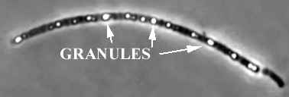
Prokaryotes
Cytoplasm
Also known as proto-plasm.
Gel-like matrix of water, enzymes, nutrients, wastes, and gases and
contains cell structures.
Location of growth, metabolism, and replication.
Granules
Bacteria’s way of storing nutrients.
Staining of some granules aids in identification.
Image: Prokaryotic cell diagram: M. Ruiz, Granules, Source Unknown
From the Virtual Microbiology Classroom on ScienceProfOnline.com

Slide 8
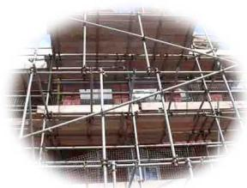
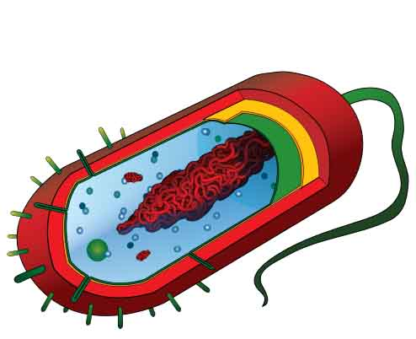
Prokaryotes
Cytoskeleton
Cellular "scaffolding" or "skeleton" within the cytoplasm.
Major advance in prokaryotic cell biology in the last decade has been discovery of the prokaryotic cytoskeleton.
Up until recently, thought to be a feature only of eukaryotic cells.
From the Virtual Microbiology Classroom on ScienceProfOnline.com
Image: Prokaryotic Cell: M. Ruiz

Slide 9
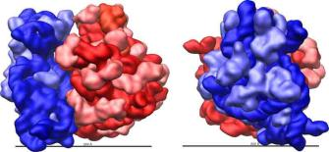
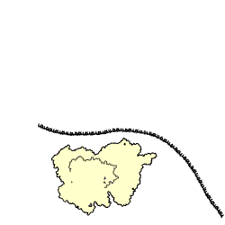
Prokaryotes
Ribosomes
Found within cytoplasm or attached to plasma membrane.
Made of protein & rRNA.
Composed of two subunits.
Cell may contain thousands .
Q: What do ribosomes do?
Q: What’s the relationship between the job that the ribosomes do and the genetic instructions (nucleic acids) of the cell?
Click here for animation of ribosome building a protein.
From the Virtual Microbiology Classroom on ScienceProfOnline.com
Animation: Ribosome translating protein,Xvazquez; Ribosome Structure, Vossman

Slide 10
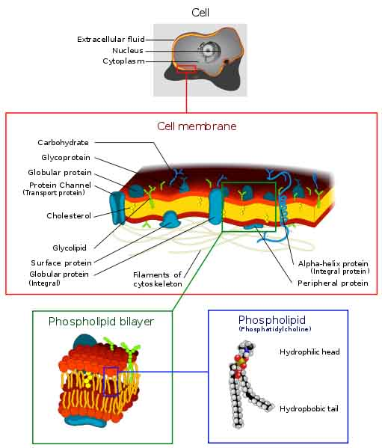
Prokaryotes
Plasma Membrane
Separates the cell from its environment.
Phospholipid molecules oriented so that hydrophilic water-loving heads directed outward and hydrophobic water-hating tails directed inward.
Proteins embedded in two layers of lipids (lipid bilayer).
Membrane is semi-permeable. Q: What does that mean?
From the Virtual Microbiology Classroom on ScienceProfOnline.com
Image: Cell Membrane diagram, Dhatfield
Notes:
Some materials can move across the membrane, others cannot.

Slide 11
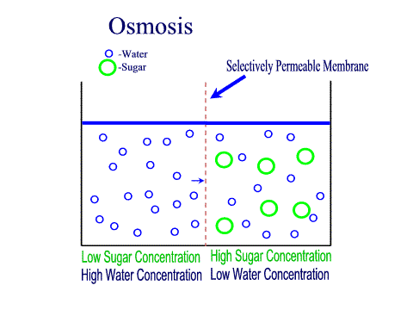
Prokaryotes – Plasma Membrane as a Barrier
Osmosis
Is the diffusion of water across a semi-permeable membrane.
Environment surrounding cells may contain amounts of dissolved substances (solutes) that are…
- equal to
- less than
- greater than
…those found within the cell.
Plasma membrane
CELL
Liquid environment outside the cell.
Liquid environment inside the cell.
From the Virtual Microbiology Classroom on ScienceProfOnline.com
Images: Osmosis animation; Osmosis with RBCs, M. Ruiz

Slide 12
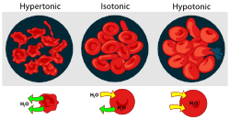
Prokaryotes – Plasma Membrane as a Barrier
Tonicity and Osmosis
isotonic: equal concentration of a solute
inside and outside of cell.
hypertonic: a higher concentration of solute.
hypotonic: a lower concentration of solute.
REVIEW!
How Osmosis Works animation
Diffusion, Osmosis & Active Transport Lecture Main Page of the
Virtual Cell Biology Classroom on the
Science Prof Online website
Water will always move toward a hypertonic environment!!
From the Virtual Microbiology Classroom on ScienceProfOnline.com
Images: Osmosis animation; Osmosis with RBCs, M. Ruiz

Slide 13

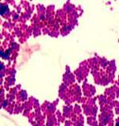
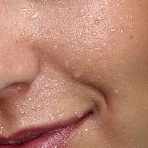
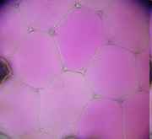
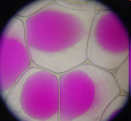

Cells & Water:
Osmotic Pressure
H₂O important reactant in many metabolic reactions.
Most cells die in absence of water.
Cell walls of bacteria and plants prevent them from exploding in a hypotonic environment, but most bacteria are vulnerable in hypertonic environments.
Many bacteria can be plasmolyzed by high concentrations of solutes.
You salty perspiration protects you from bacteria that cannot handle the high sodium chloride concentration.
The water moves out of the bacterium and it dies of ‘hyperosmostic shock’ (desiccation).
Q: Why can you keep honey on the cupboard for months, even years, without it spoiling?
Images: Water drop; Sweat on face of runner; Staphylococcus, T. Port; Cells, full of water versus plasmolyzed, Mnolf, Wiki
From the Virtual Microbiology Classroom on ScienceProfOnline.com

Slide 14
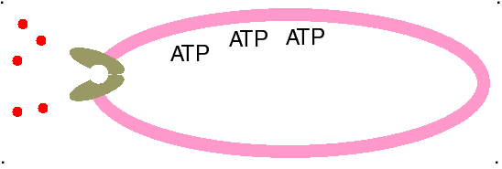
Plasma Membrane as a Barrier
ACTIVE TRANSPORT
How most molecules move across the plasma membrane.
Analogous to a pump moving water uphill.
Types of active transport are classified by type of energy used to drive molecules across membranes.
ATP Driven Active Transport
Energy from adenosine triphosphate (ATP) drives substances across the plasma membrane with the aid of carrier molecules.
From the Virtual Microbiology Classroom on ScienceProfOnline.com

Slide 15
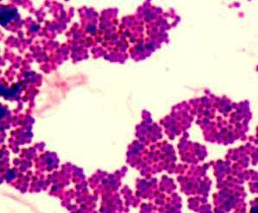
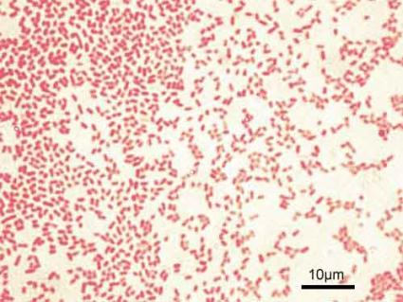
Prokaryotes - Cell Wall
From the peptidoglycan inwards all bacteria are very similar. Going further out, the bacterial world divides into two major classes (plus a couple of odd types). These are:
Gram-positive Gram-negative
Images: Staph, Gram Stain, SPO Microbiology Images, T. Port; E coli, Y tambe
From the Virtual Microbiology Classroom on ScienceProfOnline.com

Slide 16
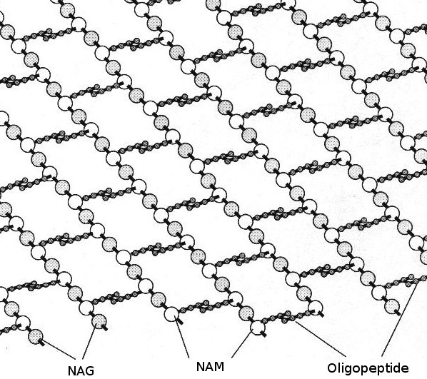
Bacterial Cell Wall
Peptidoglycan is a huge polymer of interlocking chains of alternating monomers.
Provides rigid support while freely permeable to solutes.
Backbone of peptidoglycan molecule composed of two amino sugar derivatives of glucose. The “glycan” part of peptidoglycan:
  - N-acetylglucosamine (NAG)
  - N-acetlymuramic acid (NAM)
NAG / NAM strands are
connected by interlocking
peptide bridges.
The “peptid” part
of peptidoglycan.
Image: Bonding structure peptidoglycan, Mouagip; Other Image Source Unknown
From the Virtual Microbiology Classroom on ScienceProfOnline.com

Slide 17
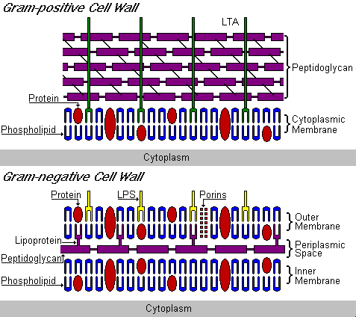
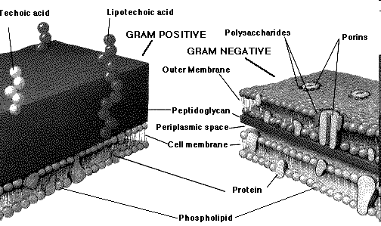
Prokaryotes - Cell Wall
Gram-Positive & Gram-Negative
From the Virtual Microbiology Classroom on ScienceProfOnline.com
Images: Sources Unknown
Notes:
Gram-positive
Peptidoglycan makes up as much as 90% of the thick, compact cell wall.
Gram-negative
More chemically complex and thinner.
Peptidoglycan only 5 – 20% of the cell wall.
Peptidoglycan not outermost layer, between the plasma membrane and the outer membrane.
Outer membrane is similar to the plasma membrane, but is less permeable and composed of lipopolysaccharides (LPS).
LPS is a harmful substance classified as an endotoxin,
The space between the cell wall and the plasma membrane is called the periplasm.

Slide 18
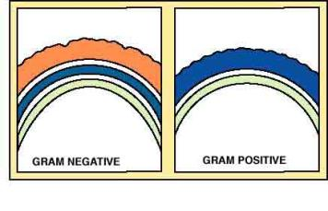
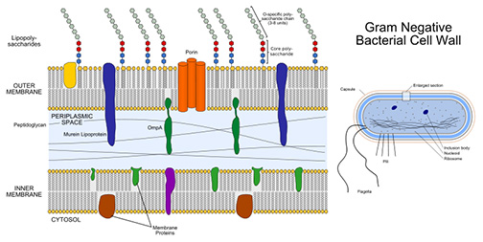
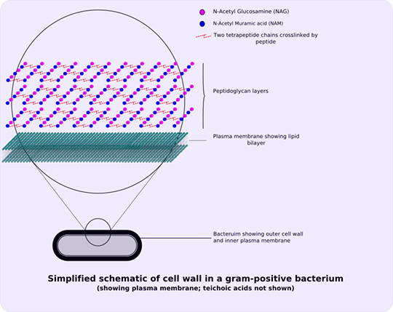
Prokaryotes - Cell Wall
Gram-Positive & Gram-Negative
FYI: The bacterial plasma membrane and cell wall together are called the
cell envelope.
Image: Gram-positive cell wall schematic, Wiki; Gram-negative cell wall schematic, Jeff Dahl
From the Virtual Microbiology Classroom on ScienceProfOnline.com

Slide 19
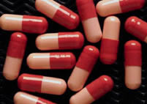
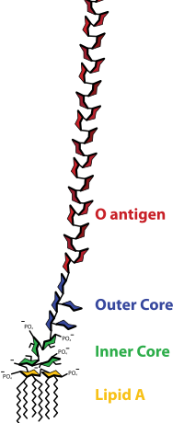
Q: Why are these differences in bacterial cell wall structure so important?
Image: Lipopolysaccharide, Wiki; Gram+ and Gram- cell wall diagram, source unknown; ; Gram-negative cell wall schematic, Jeff Dahl
From the Virtual Microbiology Classroom on ScienceProfOnline.com
Notes:
Gram-negative bacteria: fewer interpeptide bridges but have an outer membrane made of lipopolysaccharides (LPS), part of that molecule, Lipid-A, is a toxin.
Penicillins and cephalosporins interfere with linking of interpeptides, but can’t easily get to in gram- bacteria.
Cell walls without enough of these intact cross-links are structurally weak, and disintegrate when cells divide. This is how penicillins and cephalosporins work.
Since the eukaryotic cells of humans do not have cell walls, our cells are not damaged by these drugs.
Microorganisms that do not contain peptidoglycan are not susceptible to these drugs.

Slide 20
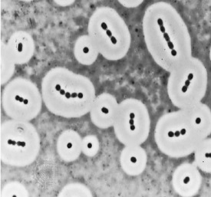
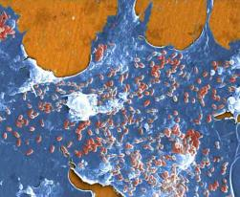
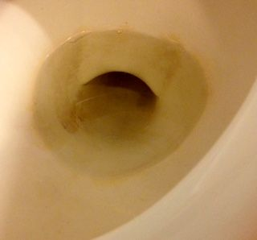
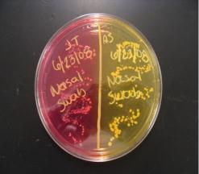
Prokaryotes - Glycocalyx
Some bacteria have an additional layer outside of the cell wall called the glycocalyx.
This additional layer can come in
one of two forms:
1. Slime Layer
  - Glycoproteins loosely associated with the cell wall.
- Slime layer causes bacteria to adhere to solid surfaces and helps prevent the cell from drying out.
- Streptococcus
The slime layer of Gram+ Streptococcus mutans allows it to accumulate on tooth enamel (yuck mouth and one of the causes of cavities).
Other bacteria in the mouth become trapped in the slime and form a biofilm & eventually a buildup of plaque.
Mannitol Salt
From the Virtual Microbiology Classroom on ScienceProfOnline.com
Images: Slime layer, Encyclopedia Britannica; Biofilm, PHIL # 11706; Dirty toilet, T. Port Sweat on face; Staphylococcus & Mannitol Salt agar, T. Port

Slide 21
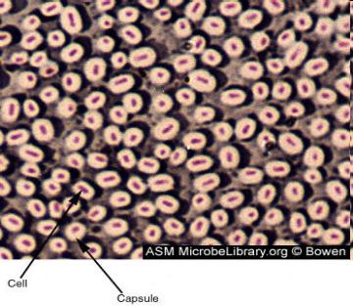

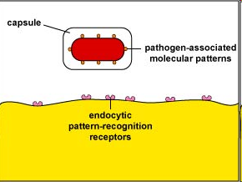
Prokaryotes - Glycocalyx
2. Capsule
Polysaccharides firmly attached to the cell wall.
Capsules adhere to solid surfaces and to nutrients in the environment.
Adhesive power of capsules is a major factor in the initiation of some bacterial diseases.
Capsule also protect bacteria from being phagocytized by cells of the hosts immune system.
From the Virtual Microbiology Classroom on ScienceProfOnline.com
Image: Prokaryotic Cell Diagram: M. Ruiz, Other Images Unknown Source
From the Virtual Microbiology Classroom on ScienceProfOnline.com

Slide 22
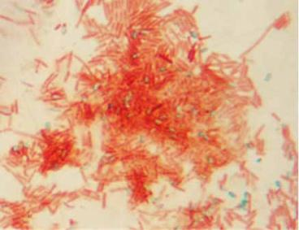
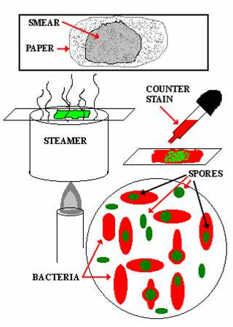
Prokaryotes - Endospores
Dormant, tough, non-reproductive structure produced by small number of bacteria.
Resistant to radiation, desiccation, lysozyme, temperature, starvation, and chemical disinfectants.
Endospores are commonly found in soil and water, where they may survive for very long periods of time.
Q: How and why do endospores form? Watch the animated lesson “Bacterial Spore Formation” to find out. Link also provides quiz questions to test your understanding of the material.
Q: What are the two endospore producing bacterial genera that were introduced in our History of Microbiology lecture?
An endospore stained bacterial smear of Bacillus subtilis showing endospores as green and vegetative cells as red.
From the Virtual Microbiology Classroom on ScienceProfOnline.com
Image: Bacillus subtilis, SPO Science Image Library, Endospore stain from Dr. Ronald E. Hurlbert, Microbiology 101 lab manual

Slide 23
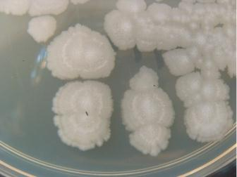
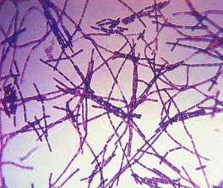
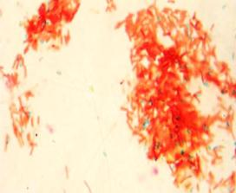
Bacterial Genus: __________
GRAM-POSITIVE
Obligate or facultative anaerobes,
endospore producers
bacillus-shaped
Q: Which two groups of bacteria produce endospores?
Common in soil. Only a few species cause disease in humans.
Extremely diverse group of bacteria, includes:
- causative agent of anthrax (Bacillus anthracis)
- species that synthesize important antibiotics, and enzymes for detergents.
Due to extreme tolerance to both heat and disinfectants, used to test heat sterilization techniques and chemical disinfectants.
This is our lab friend Bacillus subtilis.
Gram Stain
Endospore Stain
Images: Bacullus subtilis, T. Port: B. anthracis, Gram stained, CDC; Endospore stain, Tami Port
From the Virtual Microbiology Classroom on ScienceProfOnline.com
Notes:
Bacillus
endospores

Slide 24
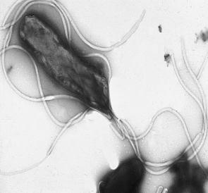
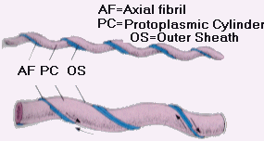
Prokaryotes – Surface Appendages
Some prokaryotes have distinct appendages that allow them to move about or adhere to solid surfaces.
Consist of delicate stands of proteins.
flagella: Long, thin extensions that allow some bacteria to move about freely in aqueous environments. (singular: flagellum)
axial filament (endoflagella): Wind around bacteria, causing movement in waves.
From the Virtual Microbiology Classroom on ScienceProfOnline.com
Images: Helicobacter pylori ; Axial filament, Source unknown

Slide 25
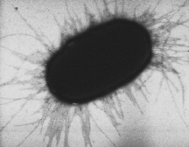
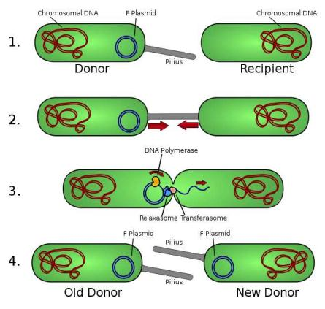
Prokaryotes – Surface Appendages
fimbriae: Most Gram-negative bacteria have these short, fine appendages surrounding the cell. Gram+ bacteria don’t have.
No role in motility. Help bacteria
adhere to solid surfaces. Major
factor in virulence.
(singular: fimbria)
pili:Tubes that are longer than fimbriae, usually shorter than flagella.
Use for movement, like grappling
hooks, and also use conjugation pili
to transfer plasmids. (singular = pilus)
From the Virtual Microbiology Classroom on ScienceProfOnline.com
Images: E. coli fimbriae, Manu Forero; Bacterial conjugation, Adenosine

Slide 26
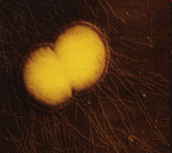
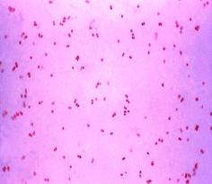
Meet the Microbe! Neisseria and its Fimbiriae
Gram- diplococci, resemble coffee beans when viewed microscopically.
Neisseria gonorrhoeae causes sexually transmitted disease gonorrhoeae.
Antibiotics applied to the eyes of neonates as a preventive measure against gonorrhoea.
One of the most communicable disease in the U.S.
125 cases per 100,000. Teens 15-19 yo 634 cases per 100,000. Young adults 20-25 460 per 100,000.
N. meningitidis most common causes of bacterial meningitis in young adults.
Q: What makes Neisseria so tough?
Lipopolysaccharide (LPS) of the cell wall of Neisseria acts as an endotoxin.
Polysaccharide capsule prevents host phagocytosis and aids in evasion of the host immune response.
Use fimbriae to attach onto host cells; avirulent without. Fimbriae have adhesion proteins (adhesins) on their tips that match, lock and key, with proteins on host epithelial cell surface.
Image: Neisseria photo, Textbook of Bacteriology, Gram stain of Neisseria gonorrhoeae, Souce PHIL #3798
From the Virtual Microbiology Classroom on ScienceProfOnline.com

Slide 27
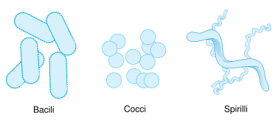
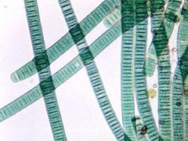
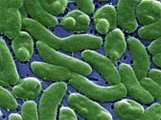
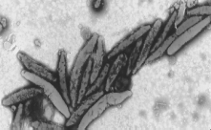
Prokaryotes – Cell Shapes
Most bacteria are classifies according to shape:
1. bacillus (pl. bacilli) = rod-shaped
2. coccus (pl. cocci … sounds like cox-eye) = spherical
3. spiral shaped
a. spirillum (pl. spirilla) = spiral with rigid cell wall, flagella
b. spirochete (pl. spirochetes) = spiral with flexible cell wall, axial filament
There are many more shapes beyond these basic ones. A few examples:
  Coccobacilli = elongated coccal form
  Filamentous = bacilli that occur in long threads
  Vibrios = short, slightly curved rods
  Fusiform = bacilli with tapered ends
Images: Basic bacterial shapes, Mariana Ruiz, Other examples of bacterial shapes, FDA, Gov.
From the Virtual Microbiology Classroom on ScienceProfOnline.com

Slide 28

Prokaryotes – Arrangements of Cells
Bacteria sometimes occur in groups, rather than singly.
bacilli divide along a single axis, seen in pairs or chains.
cocci divide on one or more planes, producing cells in:
- pairs (diplococci)
- chains (streptococci)
- packets (sarcinae)
- clusters (staphylococci).
Size, shape and arrangement of cells often first clues in identification of a bacterium.
Many “look-alikes”, so shape and arrangement not enough for id of genus and species.
From the Virtual Microbiology Classroom on ScienceProfOnline.com
Image: Bacterial shapes and cell arrangements, Mariana Ruiz Villarreal

Slide 29



Identify Each Type of
Cell Shape
&
Arrangement
A
B
C
D
Images: A. Staph; B. E. coli, T. Port; C. Bacillus anthracis, PHIL #2105; D. Streptococcus bacteria, PHIL #2110.
From the Virtual Microbiology Classroom on ScienceProfOnline.com

Slide 30
REVIEW!
Here’s an excellent interactive lesson on
Prokaryote Cell Structure
From the Virtual Microbiology Classroom on ScienceProfOnline.com
Images: Prokaryotic cell diagram, M. Ruiz

Slide 31
Confused?
Here are links to fun resources that further explain aerobic respiration:
Cell Structure: Prokaryotes Main Page on the Virtual Micrboiology Classroom of Science Prof Online.
Prokaryotic Cell: Structures, Functions & Diagrams, an article from SPO.
Prokaryotic & Eukaryotic: Two Types of Biological Cells, an article from SPO.
“Got the Time” music video by Anthrax.
Prokaryotic Cell interactive diagram from Cells Alive website.
“How big is a…” interactive diagram from Cells Alive website.
Cell Structure tutorials and quizzes from Interactive Concepts in Biochemistry.
How Osmosis Works, animation from McGraw-Hill.
“Germs”. Music by Weird Al Yankovic. Video by RevLucio.
Bacterial Pathogen Pronunciation Station, a webpage with links to audio files containing the pronunciation of the bacterial names, created by Neal R. Chamberlain, Ph.D.
Biology4Kids – Cell Biology Main Page by Raders.
(You must be in PPT slideshow view to click on links.)
Smart Links
From the Virtual Microbiology Classroom on ScienceProfOnline.com

Slide 32


Are microbes intimidating you?
Do yourself a favor. Use the…
Virtual Microbiology Classroom (VMC) !
The VMC is full of resources to help you succeed, including:
practice test questions
review questions
study guides and learning objectives
You can access the VMC by going to the Science Prof Online website www.ScienceProfOnline.com
Images: Clostridium difficile, Giant Microbes; Prokaryotic cell, Mariana Ruiz

