Slide 1

About Science Prof Online
PowerPoint Resources
Science Prof Online (SPO) is a free science education website that provides fully-developed Virtual Science Classrooms, science-related PowerPoints, articles and images. The site is designed to be a helpful resource for students, educators, and anyone interested in learning about science.
The SPO Virtual Classrooms offer many educational resources, including practice test questions, review questions, lecture PowerPoints, video tutorials, sample assignments and course syllabi. New materials are continually being developed, so check back frequently, or follow us on Facebook (Science Prof Online) or Twitter (ScienceProfSPO) for updates.
Many SPO PowerPoints are available in a variety of formats, such as fully editable PowerPoint files (.ppt), as well as uneditable versions in smaller file sizes, such as PowerPoint Shows (.pps) and Portable Document Format (.pdf), for ease of printing. The font “Jokerman” is used frequently in titles. It has a microbiology feel to it. If you do not have this font, some titles may appear odd, oversized and off-center. Find free downloads of Jokerman by Googling “download jokerman font microsoft”.
Images used on this resource, and on the SPO website are, wherever possible, credited and linked to their source. Any words underlined and appearing in blue are links that can be clicked on for more information. PPT files must be viewed in slide show mode to use the hyperlinks directly.
Several helpful links to fun and interactive learning tools are included throughout the PPT and on the Smart Links slide, near the end of each presentation. You must be in slide show mode to utilize hyperlinks and animations.
This digital resource is licensed under Creative Commons Attribution-ShareAlike 3.0:
http://creativecommons.org/licenses/by-sa/3.0/
Alicia Cepaitis, MS
Chief Creative Nerd
Science Prof Online
Online Education Resources, LLC
alicia@scienceprofonline.com
Tami Port, MS
Creator of Science Prof Online
Chief Executive Nerd
Science Prof Online
Online Education Resources, LLC
info@scienceprofonline.com
From the Virtual Microbiology Classroom on ScienceProfOnline.com
Image: Compound microscope objectives, T. Port
Notes:
Welcome to Science Prof Online PowerPoint Resources!
This PowerPoint Presentation comes from the Virtual Cell Biology Classroom of Science Prof Online, and, as such, is licensed under Creative Commons Attribution-ShareAlike 3.0.; meaning you can download, share and alter any of this presentation, but you can’t sell it or repackage and sell any part of it. Please credit Science Prof Online as the source of this presentation. Please abide by credited image copyrights. Thank you for using this resource.

Slide 2

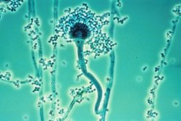
Meet the Microbes:
Eukaryotes
Aspergillus fumigatus
Image: Aspergillus fumigatus , CDC
From the Virtual Microbiology Classroom on ScienceProfOnline.com

Slide 3
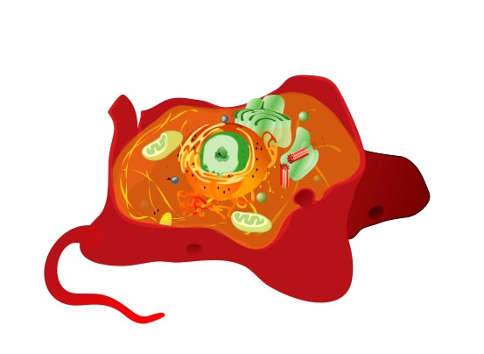
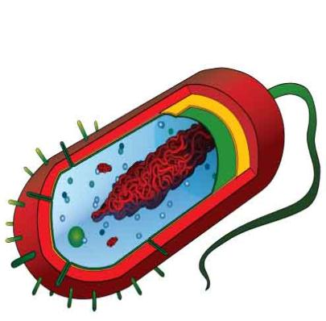
Q: What are the two basic types of cells?
Images: Prokaryotic Cell, Eukaryotic cell , M. Ruiz
From the Virtual Microbiology Classroom on ScienceProfOnline.com
Notes:
3
Prokaryotes
Eukaryotes

Slide 4
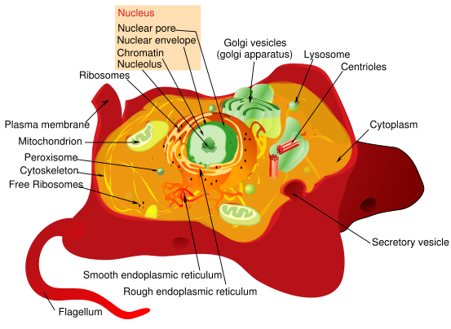
Eukaryotic Cells
Q: How are eukaryotic cells different from prokaryotic cells?
From the Virtual Microbiology Classroom on ScienceProfOnline.com
Image: Eukaryotic Cell Diagram, M. Ruiz
Notes:
4

Slide 5
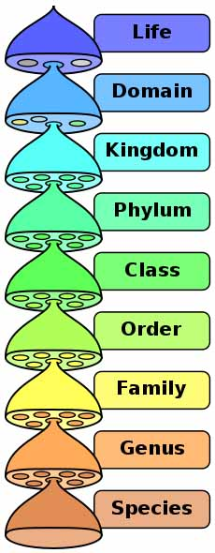
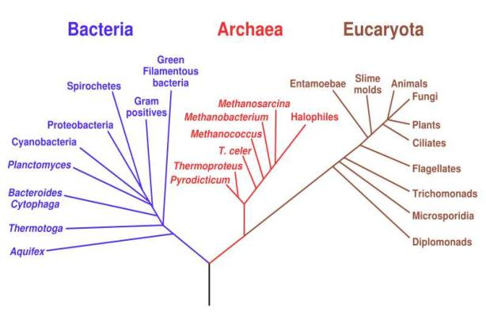
Classifying Living Things
Prokaryotes
Eukaryotes
Eubacteria
Archaea
Eukaryota
Image: Phylogenetic Tree, Eric Gaba, NASA Astrobiology institute; Biological classification diagram, Peter Halasz
From ScienceProfOnline.com, free science education website.

Slide 6
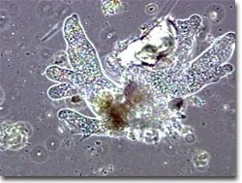
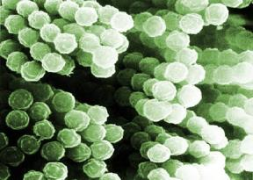
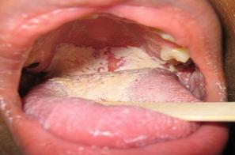
Domain: Eukaryota
Three major groups are of interest medical microbiologists as directly causing disease:
    1. Protozoans kingdom Protista
    (some can cause infectious disease)
    X Algae kingdom Protista
  (DO NOT cause infectious disease in humans, but some result in toxic fish & shellfish)
    X Slime & Water Molds kingdom Protista
  (DO NOT cause infectious disease in humans)
    2. Fungi kingdom Fungi
  (some can cause infectious disease)
    3. Helminths kingdom Animalia
  (worms that can cause infectious disease)
Some arachnids and insects, members of kingdom Animalia, are also associated with infectious disease,
as vectors.
Q: What do vectors do?
Images: Aspergillus fumigatus spores, Janice Carr, PHIL #9998; Oral candidiasis, D. Rosenbach, Wiki
From the Virtual Microbiology Classroom on ScienceProfOnline.com

Slide 7
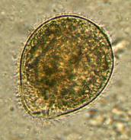
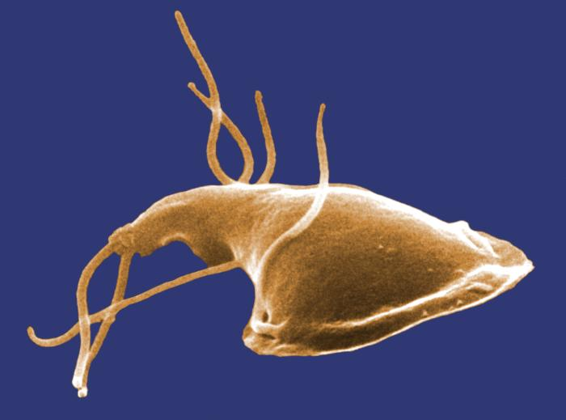
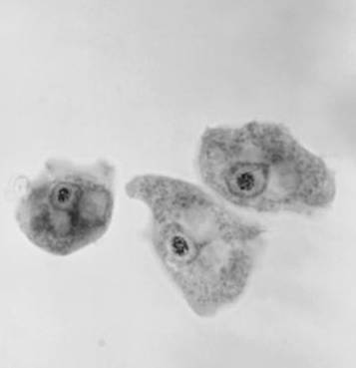
1. Protozoans
Protozoans are generally defined by four characteristics:
- Eukaryotic
- Single-celled (unicellular)
- No cell wall
- Motility (nearly all are able to move
due to cilia, flagella or pseudopodia)
Require moist environments.
Most are free-living and harmless. Very few are pathogens.
Motile feeding stage called trophozoite.
Many have hardy resting stage called cyst.
Image: Balantidium coli, Euthman; Giardia; Naegleria gruberi, PHIL #9863
From the Virtual Microbiology Classroom on ScienceProfOnline.com

Slide 8
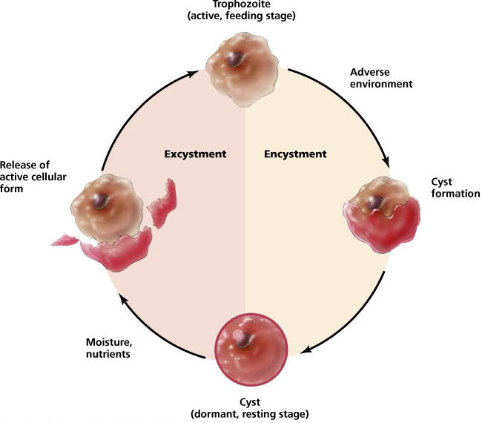
Protozoan Life Cycle
Q: What prokaryotic survival skill does this remind you of?
Image: Textbook, Microbiology, with Diseases by Taxonomy, R. Bauman.
From the Virtual Microbiology Classroom on ScienceProfOnline.com

Slide 9

Disease, Please: Dysentery
Inflammatory disorder of the intestine, especially the colon, that results in severe diarrhea containing mucus and/or blood in the feces.
Untreated, dysentery can be fatal due to massive dehydration.
Can be caused by bacteria, protozans or parasitic worms.
Image: Source Unknown
From the Virtual Microbiology Classroom on ScienceProfOnline.com

Slide 10

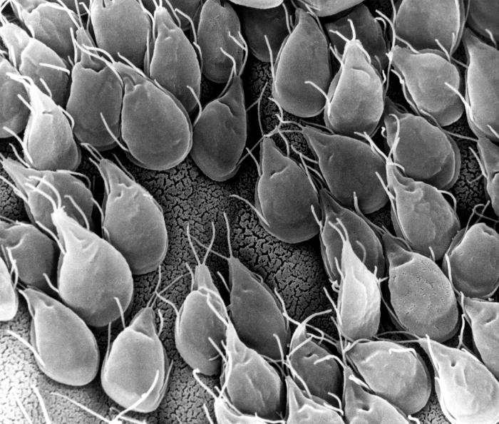
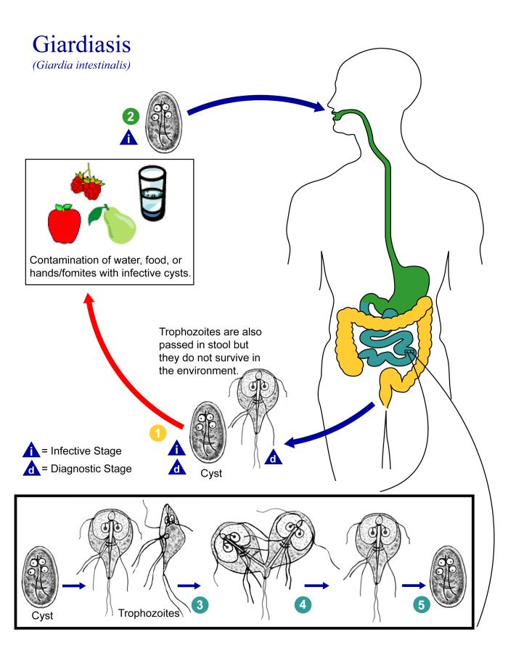

Protozoan Species: Giardia lamblia (aka G. intestinalis)
As a puppy, my dog Lulu was diagnosed with Giardia. The vet ordered an ELISA test on a stool sample. Unlike a routine flotation stool check that gets parasite eggs and cysts to float to the top of a solution, the ELISA test looks for a specific antigen (or protein) of the Giardia organism. Giardiasis is typically treated over several days with the drug Metronidazole.
Pathogenic species that feed off the intestinal lining.
Infection results from eating food / drinking water contaminated by the organism - usually from feces.
A large number generates inflammation, which causes nausea, stomach ache and diarrhea.
Chronic infection may result in malnourishment, blocking absorption
of food across
their intestinal
wall.
Images: Public Health Image Library, (PHIL) #11649; #11632 & #3394
From the Virtual Microbiology Classroom on ScienceProfOnline.com

Slide 11

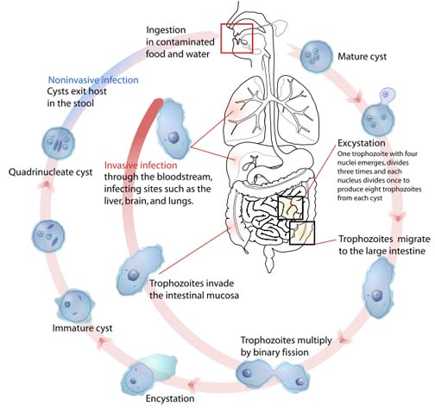

Protozoan Species: Entamoeba histolytica
(ENT-ah-MEE-bah HISS-tow-LIT-ick-ah)
• A type of amoebae.
• Eat and move by extending parts of their bodies to form pseudopods (SUE-dough-pods).
• Exists asymptomatically in 10% of world’s population.
• When disease develops, can be fatal (kills 100,000 annually).
• Feeds on the lining of the gut. Irritation created can lead to condition known as amoebic dysentery.
• Contracted by eating or drinking fecally contaminated food or water.
Image: E. histolytica spore, CDC; E. histolytica life cycle, Mariana Ruiz; E. histolytica trophozoite, CDC
From the Virtual Microbiology Classroom on ScienceProfOnline.com

Slide 12
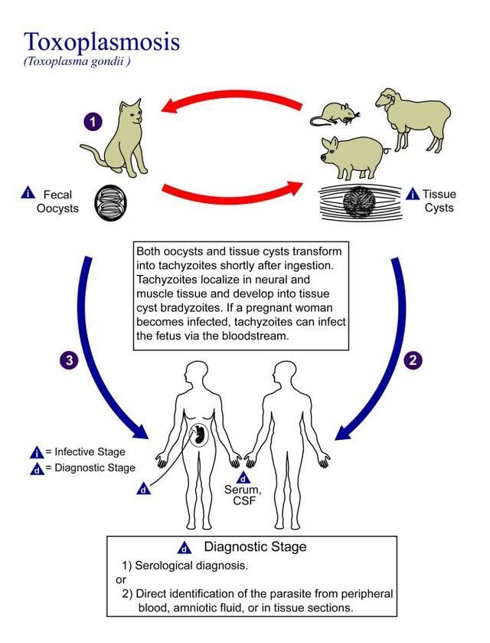
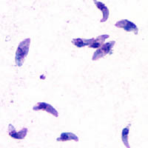
Disease, Please:
Toxoplasmosis
Caused by parasite
Toxoplasma gondii.
Can get from contaminated water, eating undercooked infected meat (especially pork, lamb & venison), or contact with cat feces that contain Toxoplasma.
1/3 of the global population and 60 million people in US may be infected, but few have symptoms.
Mild symptoms are flu-like.
Pregnant women and people with compromised immune systems could develop serious health problems.
Severe toxoplasmosis can damage the brain, eyes and other organs. Severe cases are more likely in individuals who have weak immune systems.
A leading cause of death attributed to foodborne illness in the United States.
Images: Toxoplasmosis life cycle, Wiki; Toxoplasma gondii, Wiki
From the Virtual Microbiology Classroom on ScienceProfOnline.com

Slide 13
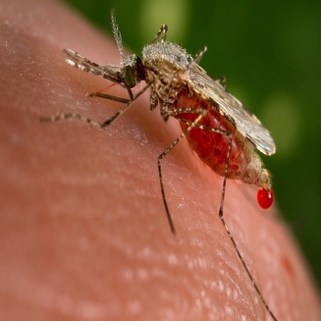
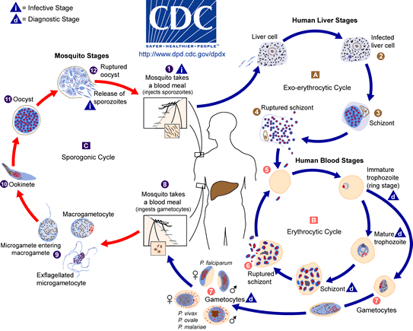
Disease,
Please:
Malaria
Life-threatening disease caused by Plasmodium protozoan parasites transmitted through the bites of infected mosquitoes.
Symptoms include fever, chills, and flu-like illness. Left untreated can cause coma and death if progresses to cerebral malaria.
~ 198 million cases of malaria in 2013.
In 2013, malaria caused an estimated 584 000 deaths, mostly among African children.
Increased malaria prevention and control measures are dramatically reducing the malaria burden in many places.
~ 1,500 cases diagnosed in US each year. Most are travelers and immigrants returning from countries where malaria commonly occurs (mainly sub-Saharan Africa and South Asia).
Travellers from malaria-free areas are very vulnerable to the disease.
Images: Anopheles mosquito, Wiki
From the Virtual Microbiology Classroom on ScienceProfOnline.com

Slide 14
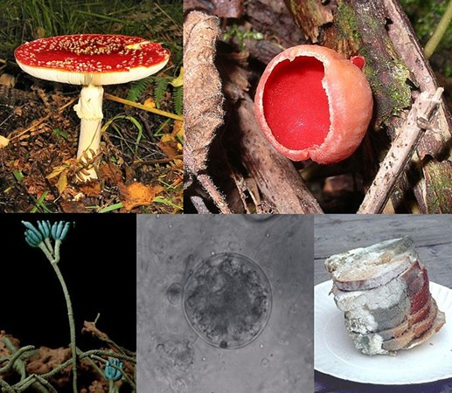
2. Fungi
Heterotrophic (consumers) digest their food externally, secrete digestive enzymes and then absorb nutrient molecules into their cells.
Examples: yeasts, molds, and mushrooms.
Often have important symbiotic relationships with other organisms, mainly plants. (Plants photosynthesize and provide carbon to the fungi in return for nutrients that fungi take up from the soil).
Fungi are also used extensively by humans:
  yeasts responsible for fermentation of beer & bread
  mushroom farming is big industry
  produce some antibiotics
~30% can cause disease in plants, animals & humans. Pathogenic fungi very resistant to antimicrobial drugs.
Fungi and bacteria are the primary decomposers of organic matter.
From the Virtual Microbiology Classroom on ScienceProfOnline.com
Images: Fungi Collage, Borgqueen, Wiki, Creative Commons

Slide 15
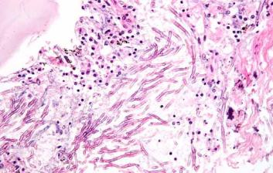
Fungal Infections
Also called mycoses (singular mycosis)
If you have ever had athlete's foot
or a yeast infection, you can blame a fungus.
A fungus is actually a primitive vegetable. Mushrooms, mold and mildew are examples.
Reproduce through tiny spores in the air. You can inhale the spores or they can land on you. As a result, fungal infections often start in the lungs or on the skin.
You are more likely to get a fungal infection if you have a weakened immune system or take antibiotics.
Fungi can be difficult to kill. For skin and nail infections medication applied directly to the infected area. Oral antifungal medicines available for serious infections.
From the Virtual Microbiology Classroom on ScienceProfOnline.com
Image: Pulmonary Aspergillosis, Nephron

Slide 16
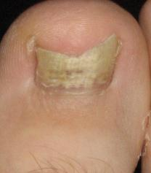
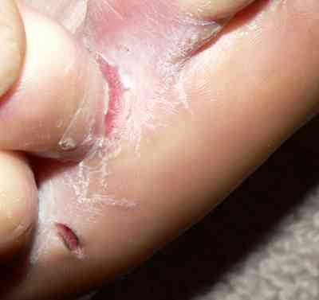
Fungal Infections: Types of Mycoses
Happen when fungi pass the resistance barriers of the body and establish infection.
Characterize mycoses by how widely / deeply infection has penetrated.
Superficial Mycoses: Most patients are not even aware that they have condition. Fungi only growing on dead skin, hair and nails. Fungus doesn’t secretes metabolites into body.
Cutaneous Mycoses: Fungi growing and secreting metabolites into the skin. Person is definitely aware of the infection. An example of this is Epidermophyton floccosum, one of the causes of athlete's foot.
Subcutaneous Mycoses: Fungus must be traumatically implanted into the body.
Systemic Mycoses: Fungi are inhaled into the lungs and subsequently are transported to other internal organs, usually through the bloodstream.
From the Virtual Microbiology Classroom on ScienceProfOnline.com
Images: Fungus Toe, Medguy; Athlete’s foot, Foloonb

Slide 17
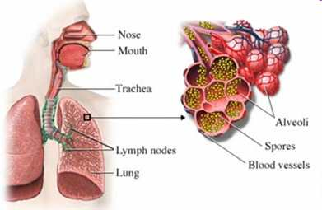
Epidemiology of Mycoses
Transmission and Prevalence of Fungal Infections
Fungi and their spores are found almost everywhere in the environment. You can’t avoid them.
It is your immune system that keeps you safe from fungal infection.
Mycoses are typically acquired via inhalation, trauma or ingestion.
Only very infrequently are they spread from person to person.
Still, epidemics of mycoses occur, but typically through mass exposure (like bird droppings in or near the ventilation system of a building).
Since usually not contagious, difficult to report incidence, other than epidemics or when they effect a specific population (such as AIDS patients).
From the Virtual Microbiology Classroom on ScienceProfOnline.com
Image: Source unknown

Slide 18
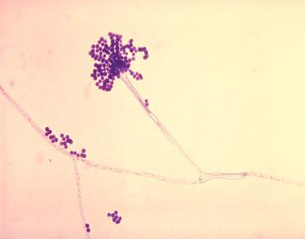
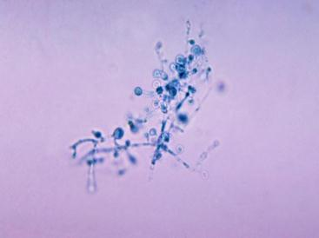
True Fungal Pathogens vs. Opportunistic Fungi
There are only four types of fungi that are considered true pathogens…
- Blastomyces dermatitidis
- Coccidioides immitis
- Historplamsa capsulatum
- Paracoccidioides brasiliensis
… the rest are considered opportunistic.
What’s the difference?
True pathogenic fungi have the ability to actively attack and invade tissues of healthy individuals. Have specific enzymes and proteins that help them survive and reproduce within the body.
Oppurtunistic fungi do not cause disease in healthy individuals, but can cause disease in those with weakened immune system.
Opportunist: Aspergillus
Pathogen: Blastomyces
Images: Aspergillus fumigatus , PHIL #300; Blastomyces, Public Health Image Library #3768
From the Virtual Microbiology Classroom on ScienceProfOnline.com

Slide 19

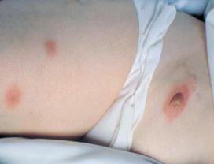
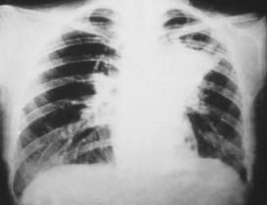
True Fungal Pathogen
Species: Blastomyces dermatitidis
(blast-o-MICE-ease dur-ma-TID-id-iss)
What Is Blastomycosis?
Caused by fungus found in soil in the eastern and central US.
Infection occurs by inhalation of spores. Once inhaled, fungus grows and may disseminate through blood to other organs.
Incubation period 30 to 100 days, although infection can be asymptomatic.
Pulmonary Blastidiomycosis
Resolves on its own in most people. In immune compromised can cause respiratory failure.
Disseminated Blastidiomycosis
If disseminates from lungs, can result in wart-like or recessed skin lesions (cutaneous blastidiomycosis) or damage to bones (osteoarticular blastidiomycosis).
AIDS patients are prone to develop meningitis from infection.
Images: Public Health Image Library (PHIL) #3768, #492 & #5801
From the Virtual Microbiology Classroom on ScienceProfOnline.com

Slide 20
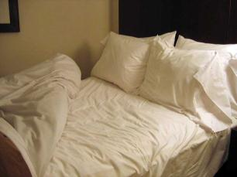

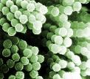
Opportunistic Fungal Pathogen
Species: Aspergillus fumigatus
Can cause disease aspergillosis.
Has become leading infectious cause of death in leukemia and bone marrow transplant patients.
Can result in:
- allergic reaction
- pulmonary mass
- systemic infection
- can also exacerbate asthma
Researchers dissected pillows (both feather and synthetic) and identified several thousand spores of fungus per gram of used pillow - more than a million spores per pillow.
Five things increase a persons risk of experiencing opportunistic mycoses:
  Invasive medical procedures
  Medical therapies that weaken the immune system
  Certain preexisting conditions / Immune compromised
  Specific lifestyle factors
Images: Bed with pillows, Liz Lawley; Aspergillus fumigatus , PHIL #300; A. fumigatus, Janice Carr, PHIL # 9998
From the Virtual Microbiology Classroom on ScienceProfOnline.com

Slide 21
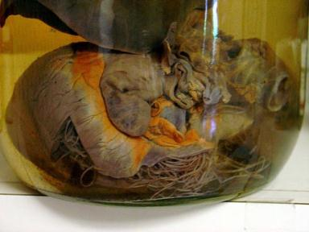
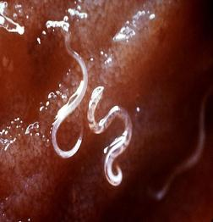
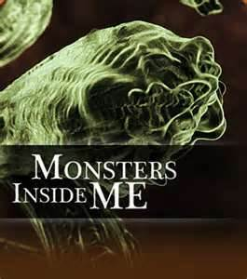
3. Helminths
Helminths are parasitic worms that live inside their host.
Examples: hook, whip, pin, heart and round worms
Belong to the Kingdom Animalia.
Live in and feed off living hosts.
Receive nourishment and protection while disrupting their hosts' nutrient absorption, causing weakness and disease.
Many types of helminths live in the digestive tract of their host. These are referred to as intestinal parasites.
Watch a video clip, called
Worm in My Butt, of a man describing his helminth infection.
Images: Heartworm in preserved heart of German Shepherd; Hookworms, PHIL #5705. Alternate “Worm In My Butt” video link.
From the Virtual Microbiology Classroom on ScienceProfOnline.com

Slide 22
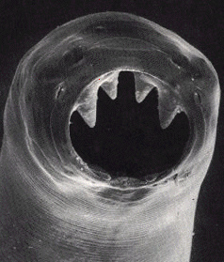
Ancylostoma duodenale
You are my host!
I am burrowing up through your feet, to your throat, where you’ll swallow me.
I live and grow, with my teeth hooked into the lining of your intestine!
From the Virtual Microbiology Classroom on ScienceProfOnline.com

Slide 23

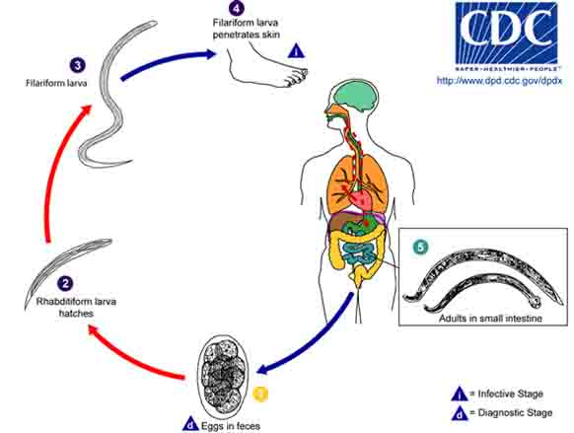
Helminth: Hookworms
Parasitic nematode worm (helminth) that lives in small intestine of host.
Helminths belong to Kingdom Animalia.
Two species commonly infect humans: Ancylostoma duodenale and Necator americanus.
Infect > 600 million worldwide.
Eggs in fecally-contaminated soil mature into larvae.
Larvae penetrate skin of foot (sometimes causing “ground itch”), ride the lymph system to the right side of heart, and pumped into lungs, are coughed up, and are then swallowed.
Enter digestive system, and mature into adult worms in small intestines.
Worms suck blood voraciously. Cause anemia, loss of iron & protein, and damage mucosa.
Images: Hookworms, PHIL #5705; Hookworm life cycle, CDC.
From the Virtual Microbiology Classroom on ScienceProfOnline.com

Slide 24
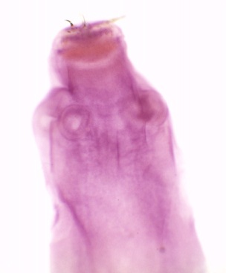
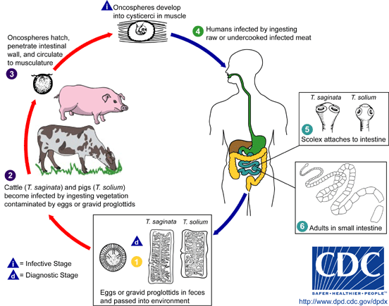
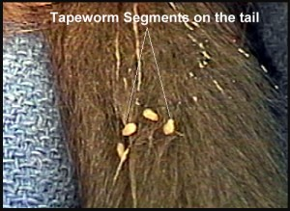
Helminth: Tapeworms
Parasitic nematode worm (helminth) that lives in small intestine of host.
Helminths belong to Kingdom Animalia.
Taeniasis is the infection of humans with adult tapeworm of Taenia saginata (beef)
or Taenia solium (pork).
People with taeniasis may not know they have an infection because symptoms usually mild or absent.
T. solium tapeworm infections can lead to cysticercosis, a disease that can cause seizures, so it is important seek treatment.
Can you get taeniasis from your dog or cat? Extremely unlikely. Dogs and cats get the flea tapeworm (Dipylidium caninum) as a result of swallowing a parasite-contaminated flea.
Images: Tapeworm scolex, T. Port; Tapeworm life cycle, CDC, Tapeworm segments on cat’s tail, Worms in Cats website.
From the Virtual Microbiology Classroom on ScienceProfOnline.com

Slide 25
Confused?
Here are some links to fun resources that further explain Cell Biology:
Eukaryotes: Meet the Microbes Main Page on the Virtual Cell Biology Classroom of Science Prof Online.
Play Pandemic 2 a video game of strategy, where you try to become a successful pandemic microbe and infect the world.
“Dysentery Gary”, a song by Blink182.
Cells Alive interactive 3-D cell.
Eukaryotic Cell Tour an Animated Science Tutorial.
Endoplasmic Reticulum & Golgi Apparatus animation and quiz.
Endomembrane System animation and quiz.
“Classification Rap” hilarious music video from 1989.
Endocytosis / Exocytosis animation from McGraw Hill.
Evolution of the Three Domains Animated Science Tutorial.
Smart Links
From the Virtual Microbiology Classroom on ScienceProfOnline.com

Slide 26
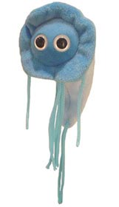

Are microbes intimidating you?
Do yourself a favor. Use the…
Virtual Microbiology Classroom (VMC) !
The VMC is full of resources to help you succeed, including:
Grr.
practice test questions
review questions
study guides and learning objectives
You can access the VMC by going to the Science Prof Online website www.ScienceProfOnline.com
Images: Giardia, Giant Microbes; Prokaryotic cell, Mariana Ruiz

