Slide 1

About Science Prof Online
PowerPoint Resources
Science Prof Online (SPO) is a free science education website that provides fully-developed Virtual Science Classrooms, science-related PowerPoints, articles and images. The site is designed to be a helpful resource for students, educators, and anyone interested in learning about science.
The SPO Virtual Classrooms offer many educational resources, including practice test questions, review questions, lecture PowerPoints, video tutorials, sample assignments and course syllabi. New materials are continually being developed, so check back frequently, or follow us on Facebook (Science Prof Online) or Twitter (ScienceProfSPO) for updates.
Many SPO PowerPoints are available in a variety of formats, such as fully editable PowerPoint files (.ppt), as well as uneditable versions in smaller file sizes, such as PowerPoint Shows (.pps) and Portable Document Format (.pdf), for ease of printing. The font “Jokerman” is used frequently in titles. It has a microbiology feel to it. If you do not have this font, some titles may appear odd, oversized and off-center. Find free downloads of Jokerman by Googling “download jokerman font microsoft”.
Images used on this resource, and on the SPO website are, wherever possible, credited and linked to their source. Any words underlined and appearing in blue are links that can be clicked on for more information. PPT files must be viewed in slide show mode to use the hyperlinks directly.
Several helpful links to fun and interactive learning tools are included throughout the PPT and on the Smart Links slide, near the end of each presentation. You must be in slide show mode to utilize hyperlinks and animations.
This digital resource is licensed under Creative Commons Attribution-ShareAlike 3.0:
http://creativecommons.org/licenses/by-sa/3.0/
Alicia Cepaitis, MS
Chief Creative Nerd
Science Prof Online
Online Education Resources, LLC
alicia@scienceprofonline.com
Tami Port, MS
Creator of Science Prof Online
Chief Executive Nerd
Science Prof Online
Online Education Resources, LLC
info@scienceprofonline.com
From the Virtual Microbiology Classroom on ScienceProfOnline.com
Image: Compound microscope objectives, T. Port
Notes:
Welcome to Science Prof Online PowerPoint Resources!
This PowerPoint Presentation comes from the Virtual Cell Biology Classroom of Science Prof Online, and, as such, is licensed under Creative Commons Attribution-ShareAlike 3.0.; meaning you can download, share and alter any of this presentation, but you can’t sell it or repackage and sell any part of it. Please credit Science Prof Online as the source of this presentation. Please abide by credited image copyrights. Thank you for using this resource.

Slide 2
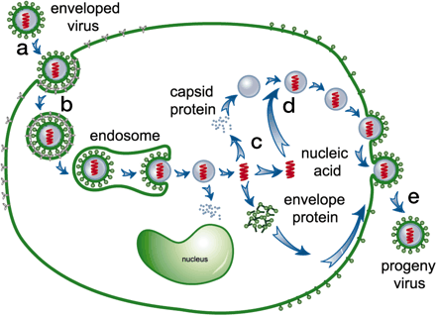
Virus Life Cycle
Image: Viral cycle of infection , National Academy of Sciences
From the Virtual Microbiology Classroom on ScienceProfOnline.com

Slide 3
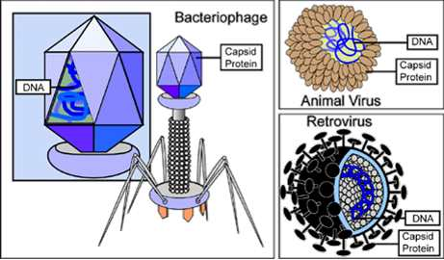
Bacteriophages (Phages) & Animal Viruses
The two categories of viruses that we are going to discuss in this class.
Image: Types of Viruses, National Institutes of Health
From the Virtual Microbiology Classroom on ScienceProfOnline.com

Slide 4
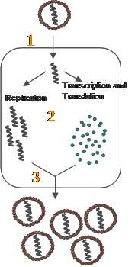
How Do Viruses Reproduce?
Four basic steps:
1. Recognize & attach to host cell.
2. Infect (get inside) host cell.
3. Force cell to manufacture viruses.
4. New viruses exit the host cell.
Image: Source unknown.
From the Virtual Microbiology Classroom on ScienceProfOnline.com

Slide 5
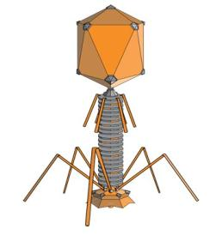
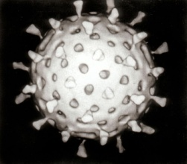
1. How does a virus recognize & attach to its host?
Most viruses infect only a certain type of host.
Specificity due to affinity of viral surface proteins to proteins on the surface of the host cell.
  bacteroiphages have proteins in their tail fibers (those extensions that look like legs) that are attracted to proteins on the surface of bacterial cells.
  animal viruses have proteins or glycoprotein spikes that correspond to glycoproteins on the surface of animal cells.
Viruses may also be so specific that they infect a particular cell type of the host organism. (HIV only attacks helper-T lymphocytes, a type of white blood cell, in humans.)
Images: Bacteriophage, Adenosine; Rotavirus, Animal Virus, Graham Colm;
From the Virtual Microbiology Classroom on ScienceProfOnline.com

Slide 6
How Do Viruses Reproduce?
Four basic steps:
1. Recognize & attach to host cell.
2. Infect (get inside) host cell.
3. Force cell to manufacture viruses.
4. New viruses exit the host cell.
Image: Source unknown.
From the Virtual Microbiology Classroom on ScienceProfOnline.com

Slide 7
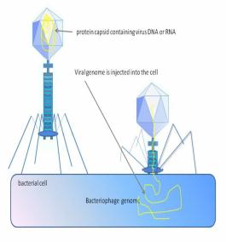
2. How does a virus infect its host?
Remember, a virus can exist outside of its host or
inside its host. So we need some more terms:
extracellular state
  Called virion (vie-ree-on)
  Protein coat (capsid) surrounding nucleic acid
  Some have phospholipid envelope
  Outermost layer provides protection and recognition sites for host cells
intracellular state
  Capsid removed
  Virus exists as nucleic acid (genetic material)
Image: Viral life cycle, National Academy of Sciences;
Bacteriophage injecting DNA into bacterial cell, Graham Colm.
From the Virtual Microbiology Classroom on ScienceProfOnline.com

Slide 8
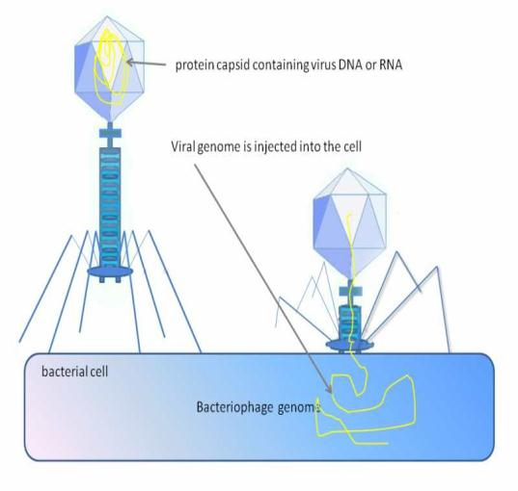
2a. How does a bacteriophage infect its host?
Image: Bacteriophage injecting DNA into bacterial cell, Graham Colm
From the Virtual Microbiology Classroom on ScienceProfOnline.com

Slide 9
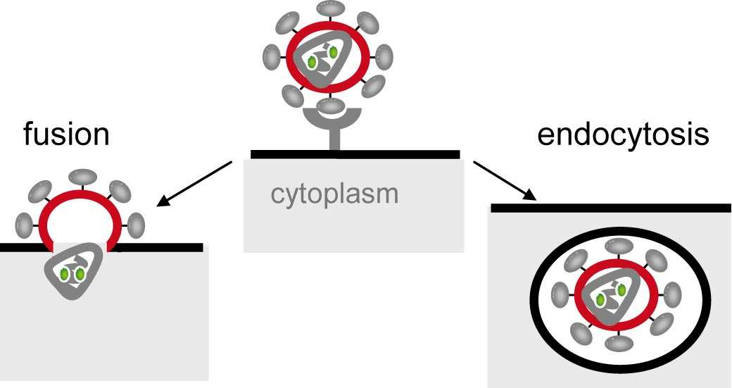
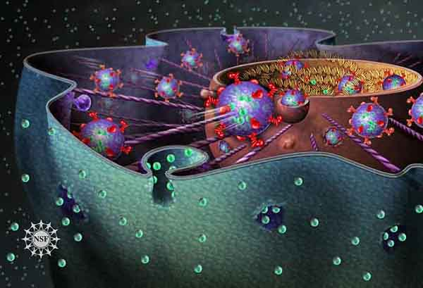
2b. How does an animal virus infect its host?
Entry of Viruses into Animal Cells – 3 Methods:
Direct penetration of naked virus
- Viral genome enters cell, while capsid remains on cell’s surface.
Like how phages enter bacteria.
Remember the endomembrane system of eukaryotes?
Endocytosis
    Membrane fusion
      - With membrane fusion and endocytosis, the capsid is removed once inside the host cell.
REVIEW!
Animation on endocytosis & exocytosis
Images: Virus Entry into Cell; Endocytosis & Exocytosis, NIGMS; Endocytosis & exocytosis, Nicolle Rager Fuller, NSF
From the Virtual Microbiology Classroom on ScienceProfOnline.com

Slide 10
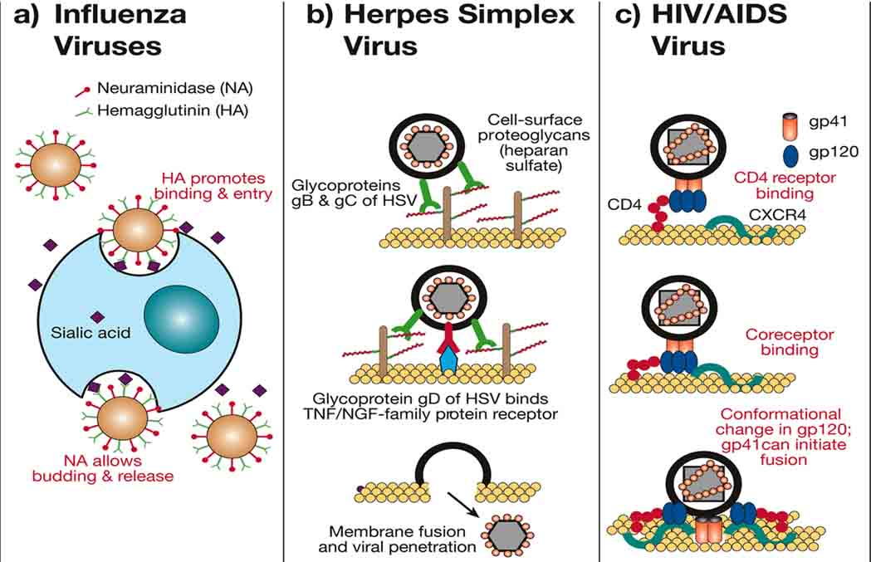
2b. How does an animal virus infect its host?
Examples of Animal Virus Entry
Image: Mechanisms of Viral entry into host cells, NCBI, US Gov.
From the Virtual Microbiology Classroom on ScienceProfOnline.com

Slide 11
How Do Viruses Reproduce?
Four basic steps:
1. Recognize & attach to host cell.
2. Infect (get inside) host cell.
3. Force cell to manufacture viruses.
4. New viruses exit the host cell.
Image: Source unknown.
From the Virtual Microbiology Classroom on ScienceProfOnline.com

Slide 12
3. How does the infecting virus trick the host into manufacturing more viruses?
Host cell reads viral genetic instructions and manufactures raw materials needed to build copies of new viruses.
The viral parts and pieces self-assemble.
Q: What process is required for host to make more genetic material for new DNA viruses?
Q: What processes are required for cell to produce viral proteins to function as capsids and envelope proteins for new viruses?
Image: Source unknown.
From the Virtual Microbiology Classroom on ScienceProfOnline.com

Slide 13
How Do Viruses Reproduce?
Four basic steps:
1. Recognize & attach to host cell.
2. Infect (get inside) host cell.
3. Force cell to manufacture viruses.
4. New viruses exit the host cell.
Image: Source unknown.
From the Virtual Microbiology Classroom on ScienceProfOnline.com

Slide 14
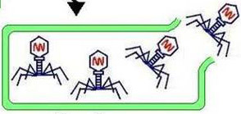
4a. How do new phages exit host bacterium?
  Most commonly released through cell lysis.
  Enzyme called endolysin, is coded for in the viral nucleic acid of lytic phages.
  Endolysin attacks and breaks down bacteria’s cell wall peptidoglycan.
  Infected bacterium is destroyed as a result.
Image: Bacteriophage Cell Lysis, Suly12
From the Virtual Microbiology Classroom on ScienceProfOnline.com

Slide 15
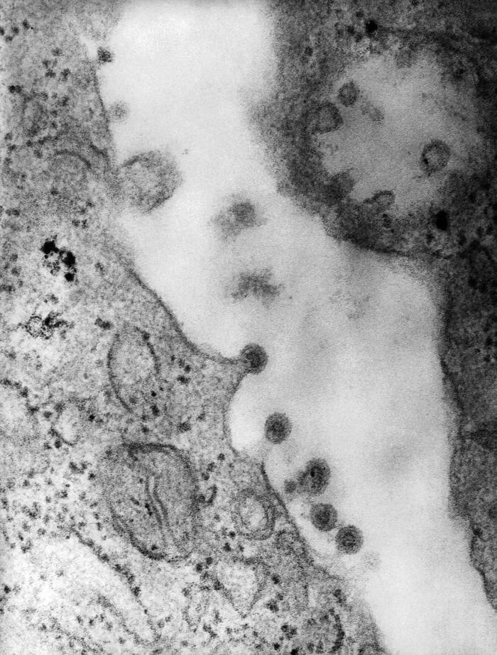
4b. How do new animal viruses exit host cell?
Depends whether or not they have
an envelope.
  Naked viruses
  After construction of capsid, naked viruses may be released from animal cell through exocytosis or may cause lysis and death of cell.
  Enveloped viruses
  Often released through a process called budding.
  Virus exits cell with part of cell’s plasma membrane.
Image: Viral life cycle, National Academy of Sciences; Rubella virions budding, PHIL # 10220
From the Virtual Microbiology Classroom on ScienceProfOnline.com
Notes:
envelope

Slide 16
Take a
look at:
“How A Virus Invades Your Body”
an animated video from NPR.
Image: Viral life cycle, National Academy of Sciences
From the Virtual Microbiology Classroom on ScienceProfOnline.com

Slide 17
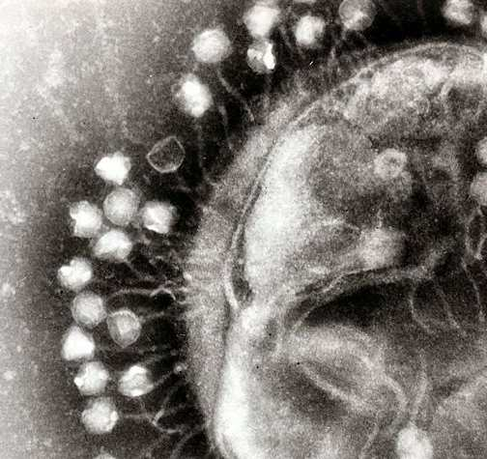
More about
Bacteriophages
Image: Bacteriophages attached to a bacterial cell, Graham Colm
From the Virtual Microbiology Classroom on ScienceProfOnline.com

Slide 18
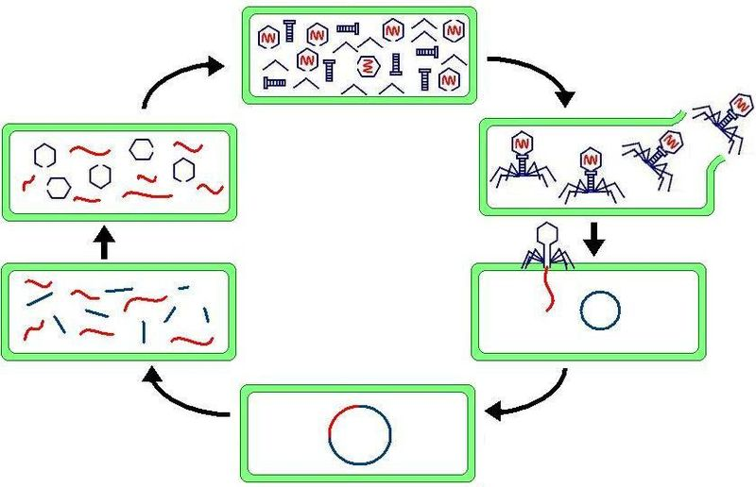
Phage Replication
The Lytic Cycle of Bacteriophages
REVIEW!
Steps in Replication of T4 Phage
an animated video and quiz from McGraw-Hill.
Image: Bacteriophage Lytic Replication, Suly12
From the Virtual Microbiology Classroom on ScienceProfOnline.com

Slide 19
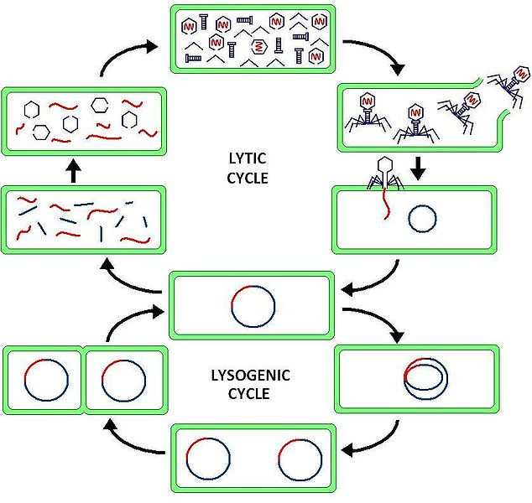
Phage Replication
The Lysogenic Cycle of Bacteriophages
REVIEW!
Animated lesson
and quiz on
Phage Replication Cycles
Image: Bacteriophage Lysogenic Replication, Suly12
From the Virtual Microbiology Classroom on ScienceProfOnline.com

Slide 20
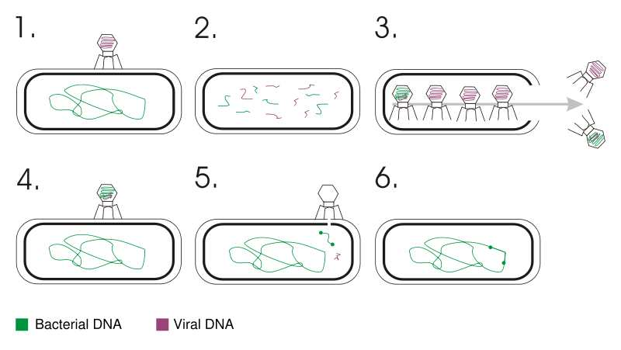
Q: What topic introduced bacteriophages earlier in the semester?
Transfer of DNA from one cell to another via a replicating virus (bacteriophage).
Can occur between prokaryotic cells or between eukaryotic cells. (The following is an example of transduction in bacterial cells by bacteriophage virus).
From the Virtual Microbiology Classroom on ScienceProfOnline.com
Image: Transduction, Geni
Notes:
Transduction

Slide 21
Confused?
Here are links to fun resources that further explain Microbiology:
Virus Life Cycle Main Page on the Virtual Microbiology Classroom of Science Prof Online.
How A Virus Invades Your Body animated video from NPR.
Steps in Replication of T4 Phage in E. coli animated video and quiz from McGraw-Hill.
Play Pandemic 2 a video game of strategy, where you try to become a successful pandemic microbe and infect the world. My 13-year old, pink-haired, daughter and I recommend this one to you.
“Quarantine” a scary movie about a new infectious disease.
Play Disease Defenders educational video game, Rice University.
“Virus” a song by Björk’s from Biophalia album with video of viruses infecting cell.
Giant Microbes, a company that sells adorable stuffed microbes.
(You must be in PPT slideshow view to click on links.)
Smart Links
From the Virtual Microbiology Classroom on ScienceProfOnline.com

Slide 22
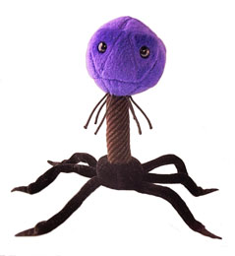
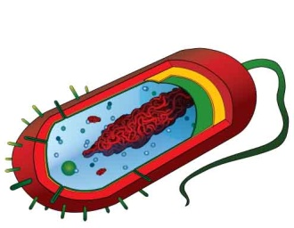
Are microbes intimidating you?
Do yourself a favor. Use the…
Virtual Microbiology Classroom (VMC) !
The VMC is full of resources to help you succeed, including:
practice test questions
review questions
study guides and learning objectives
You can access the VMC by going to the Science Prof Online website www.ScienceProfOnline.com
Images: Bacteriophage; Giant Microbes; Prokaryotic cell, Mariana Ruiz

