Slide 1

About Science Prof Online
PowerPoint Resources
Science Prof Online (SPO) is a free science education website that provides fully-developed Virtual Science Classrooms, science-related PowerPoints, articles and images. The site is designed to be a helpful resource for students, educators, and anyone interested in learning about science.
The SPO Virtual Classrooms offer many educational resources, including practice test questions, review questions, lecture PowerPoints, video tutorials, sample assignments and course syllabi. New materials are continually being developed, so check back frequently, or follow us on Facebook (Science Prof Online) or Twitter (ScienceProfSPO) for updates.
Many SPO PowerPoints are available in a variety of formats, such as fully editable PowerPoint files (.ppt), as well as uneditable versions in smaller file sizes, such as PowerPoint Shows (.pps) and Portable Document Format (.pdf), for ease of printing. The font “Jokerman” is used frequently in titles. It has a microbiology feel to it. If you do not have this font, some titles may appear odd, oversized and off-center. Find free downloads of Jokerman by Googling “download jokerman font microsoft”.
Images used on this resource, and on the SPO website are, wherever possible, credited and linked to their source. Any words underlined and appearing in blue are links that can be clicked on for more information. PPT files must be viewed in slide show mode to use the hyperlinks directly.
Several helpful links to fun and interactive learning tools are included throughout the PPT and on the Smart Links slide, near the end of each presentation. You must be in slide show mode to utilize hyperlinks and animations.
This digital resource is licensed under Creative Commons Attribution-ShareAlike 3.0:
http://creativecommons.org/licenses/by-sa/3.0/
Alicia Cepaitis, MS
Chief Creative Nerd
Science Prof Online
Online Education Resources, LLC
alicia@scienceprofonline.com
Tami Port, MS
Creator of Science Prof Online
Chief Executive Nerd
Science Prof Online
Online Education Resources, LLC
info@scienceprofonline.com
From the Virtual Microbiology Classroom on ScienceProfOnline.com
Image: Compound microscope objectives, T. Port
Notes:
Welcome to Science Prof Online PowerPoint Resources!
This PowerPoint Presentation comes from the Virtual Cell Biology Classroom of Science Prof Online, and, as such, is licensed under Creative Commons Attribution-ShareAlike 3.0.; meaning you can download, share and alter any of this presentation, but you can’t sell it or repackage and sell any part of it. Please credit Science Prof Online as the source of this presentation. Please abide by credited image copyrights. Thank you for using this resource.

Slide 2
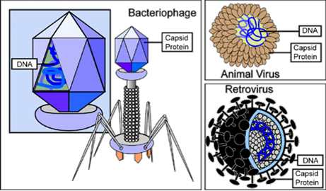
Virus
Structure
Image: Types of Viruses, National Institutes of Health
From the Virtual Microbiology Classroom on ScienceProfOnline.com

Slide 3
Cellular Organisms vs Acellular Particles
Eukaryotic Cell
1. Cellular microorganisms:
Prokaryotes
Domains: Archaea & Eubacteria
Eukaryotes
Domain: Eukaryota
2. Acellular infectious particles:
Viruses
So small can only be seen with an electron microscope.
Q: Are viruses the only type of acellular infectious particle?
Virus
Prokaryotic Cell
Eukaryotic Nucleus
1 ųm (1000 nm)
From the Virtual Microbiology Classroom on ScienceProfOnline.com

Slide 4

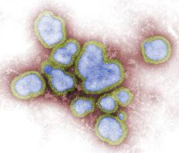
How Do Viruses Differ From Living Organisms?
Viruses are not living organisms because they are incapable of carrying out all life processes.
Viruses
  are not made of cells
  can not reproduce on their own
  do not grow or undergo division
  do not transform energy
  lack machinery for protein synthesis
Living Multicellular Organism: Kayla
Nonliving Acellular Infectious Agent:
H1N1 Influenza Virus
Images: Eukaryotic living organism named Kayla, T. Port; H1N1 Influenza Virus, Public Health Image Library (PHIL) #11702
From the Virtual Microbiology Classroom on ScienceProfOnline.com

Slide 5
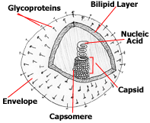
What Are Viruses Made Of?
Nucleic acid, proteins, and sometimes, lipids.
Need a quick chemistry review?
Here are animated lessons and quizzes on
Organic Macromolecules.
Nucleic acid surrounded by a protective protein coat, called a capsid.
An outer membranous layer, called an envelope, made of lipid and protein, surrounds the capsid in some viruses.
Image: Virus Structure, Drs. Foster & Smith PetEducation.com
From the Virtual Microbiology Classroom on ScienceProfOnline.com

Slide 6
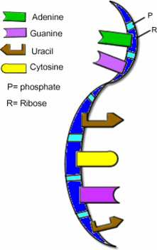
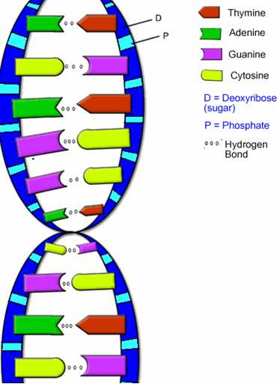
Genetic Material of Viruses
What Are Viruses Made Of?
Show more variety in nature of their genomes than do cells.
Like cells, viral genome is a nucleic acid.
Primary way scientists categorize and classify viruses.
Can be dsDNA, ssDNA, dsRNA, ssRNA.
May be linear and composed of several segments or single and circular.
Much smaller than genomes of cells.
Q: What is similar about the genetic materials of cells and viruses. What is different?
Images: DNA & RNA Diagrams, BiologyCorner
From the Virtual Microbiology Classroom on ScienceProfOnline.com

Slide 7
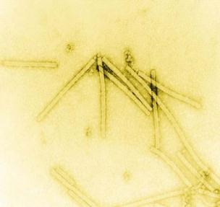
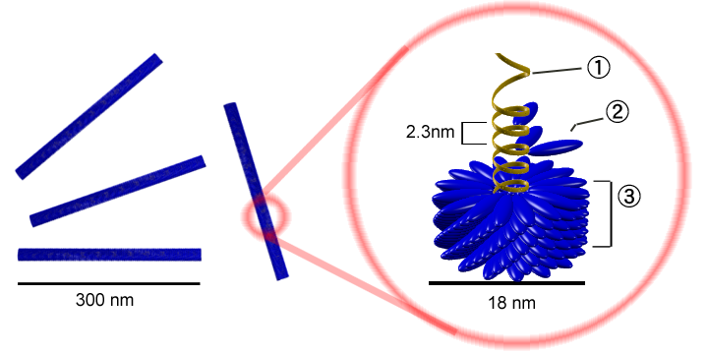
What Are Viruses Made Of?
The Viral Capsid
Protein coat provides protection for viral nucleic acid and means of attachment to host’s cells.
Composed of protein subunits called capsomeres.
Some capsids composed of single
type of capsomere; others
composed of multiple types.
______________
______________
______________
Image: Tobacco mosaic virus, US Gov; Tobacco Mosaic Virus Structure, Y tambe, Wiki
From the Virtual Microbiology Classroom on ScienceProfOnline.com
Notes:
nucleic acid
capsomere
capsid

Slide 8
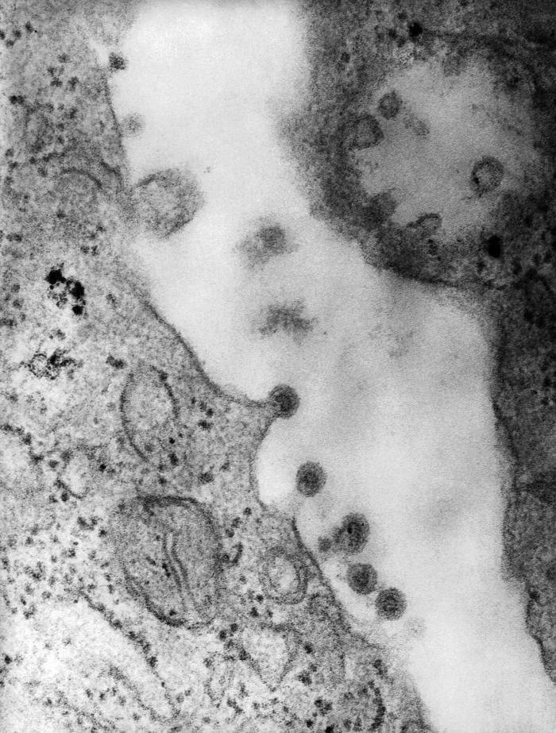
The Viral Envelope
What Are Viruses Made Of?
Acquired from host cell during viral release; envelope is portion of membrane system of host.
Q: If the viral envelope is taken from an infected cell’s plasma membrane, what macromolecule is the viral envelope primarily made of?
Also contains proteins and virally-coded glycoproteins (spikes).
Envelope’s proteins and glycoproteins often play role in host recognition.
If a virus doesn’t have an envelope, it is considered to be a naked virus.
Watch video: “Mechanism for Releasing Enveloped Viruses” from McGraw-Hill
Image: Virus Structure, Drs. Foster & Smith PetEducation.com; ; Rubella virions budding, PHIL # 10220
From the Virtual Microbiology Classroom on ScienceProfOnline.com

Slide 9
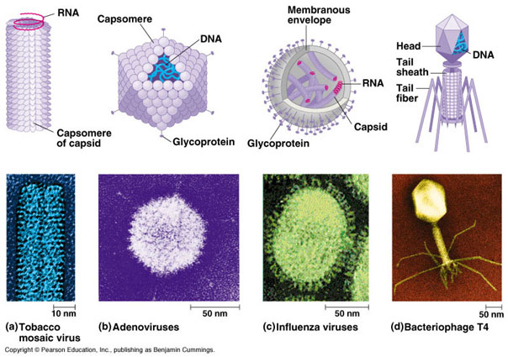
Helical
Polyhedral
Spherical
Bacteriophage

Slide 10
REVIEW!
Animated tutorial on
Viruses
NPR animated video “Flu Attack! How a Virus Invades Your Body”
From the Virtual Microbiology Classroom on ScienceProfOnline.com
Image: Virus Structure, Drs. Foster & Smith PetEducation.com

Slide 11
Confused?
Here are links to more fun resources that further explain Microbiology:
Virus Structure Main Page on the Virtual Microbiology Classroom of Science Prof Online.
Watch video “Mechanism for Releasing Enveloped Virus” from McGraw-Hill.
Play Pandemic 2 a video game of strategy, where you try to become a successful pandemic microbe and infect the world. My 13-year old, pink-haired, daughter and I recommend this one to you.
“Quarantine” a scary movie about a new infectious disease.
Play Disease Defenders educational video game, Rice University.
“Catch My Disease” song by Ben Lee.
Giant Microbes, a company that sells adorable stuffed microbes.
(You must be in PPT slideshow view to click on links.)
Smart Links
From the Virtual Microbiology Classroom on ScienceProfOnline.com

Slide 12
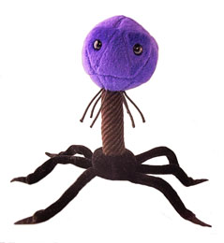
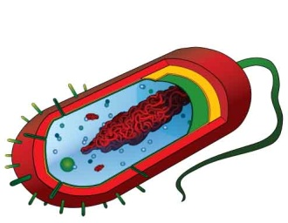
Are microbes intimidating you?
Do yourself a favor. Use the…
Virtual Microbiology Classroom (VMC) !
The VMC is full of resources to help you succeed, including:
practice test questions
review questions
study guides and learning objectives
You can access the VMC by going to the Science Prof Online website www.ScienceProfOnline.com
Images: Bacteriophage; Giant Microbes; Prokaryotic cell, Mariana Ruiz

